Slide 1
Canada Car Accident 1999 - 2014
Boris Korotkov
Chaewon Kim
Patricia Luo
Ryan He

Slide 2
Canada Car Accident 1999 - 2014
Overview
Analysis and Conclusions

Slide 3
Data Source
Canada, 1999 – 2014, CSV from Kaggle
Collision data: Date, Time, Severity, Road condition, Weather, etc.
Vehicle data: Type, Model year
Person data: Sex, Age, Position, Treatment, Safety device, etc.
C_YEAR | C_MNTH | C_WDAY | C_HOUR | C_SEV | C_VEHS | C_CONF | C_RCFG | C_WTHR | C_RSUR | C_RALN | C_TRAF | V_ID | V_TYPE | V_YEAR | P_ID | P_SEX | P_AGE | P_PSN | P_ISEV | P_SAFE | P_USER
1999 | 1 | 1 | 20 | 2 | 2 | 34 | UU | 1 | 5 | 3 | 3 | 1 | 6 | 1990 | 1 | M | 41 | 11 | 1 | UU | 1
About 6 million registered collisions
Most are number in string
Special values: e.g., not applicable, unknown

Slide 4
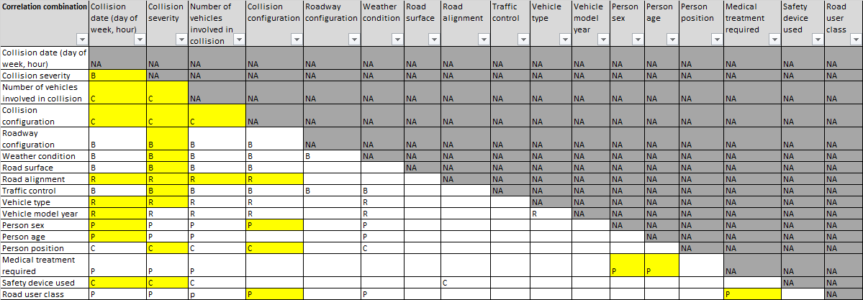
Data Loading & Preparation
Load data through pandas.read_csv, all cleanup/analysis in Python
Team analyzed all fields, each analysis covers relationship of two

Slide 5
Canada Car Accident 1999 - 2014
Overview
Analysis and Conclusions

Slide 6
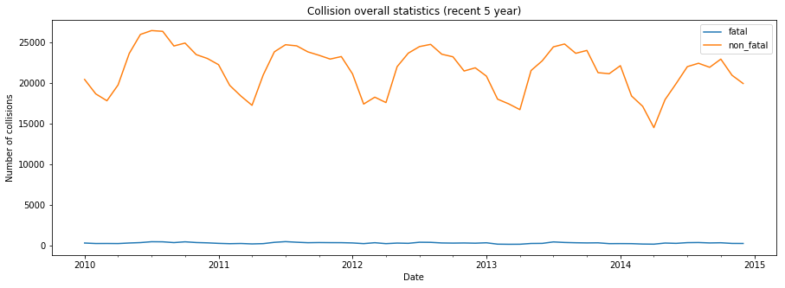
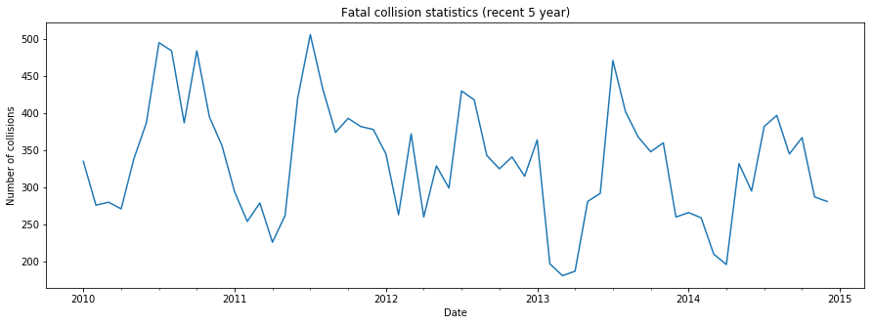
1. Fatal and Non-fatal Collision

Slide 7
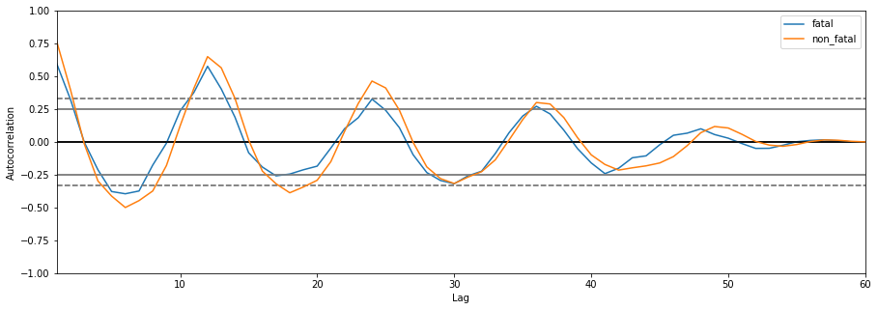
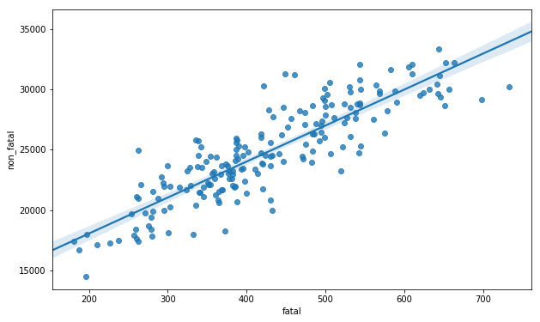
1. Fatal and Non-fatal Collision (cont’)
The autocorrelation of fatal and non-fatal collisions both follow similar pattern, which is a seasonal cycle of a year.
The distribution of fatal and non-fatal collisions are highly linear correlated.

Slide 8
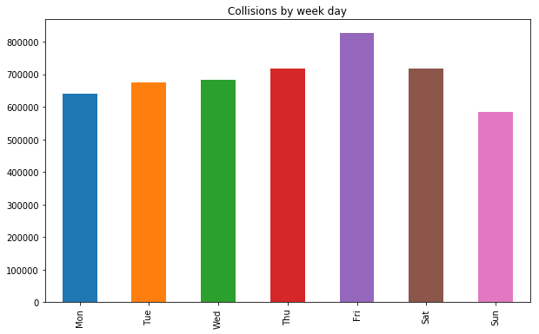
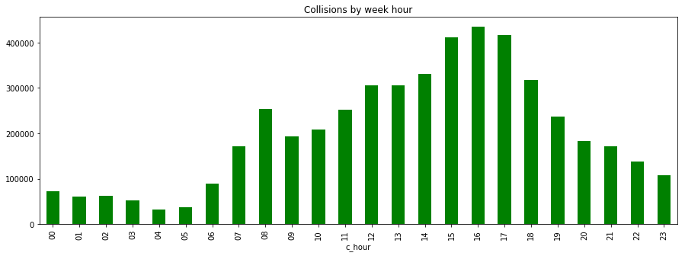
2. Collision Distribution by Week Day and Hour
Day Hour
Week Day

Slide 9
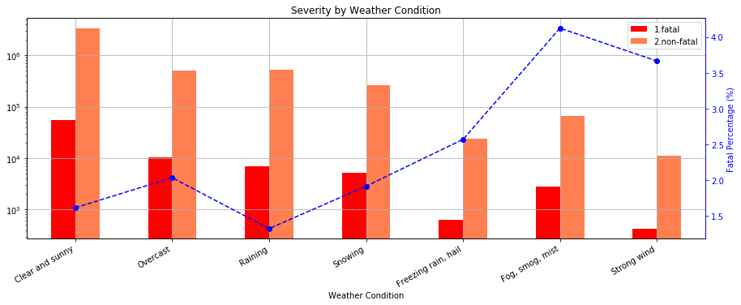
3. Weather and Collision Severity

Slide 10
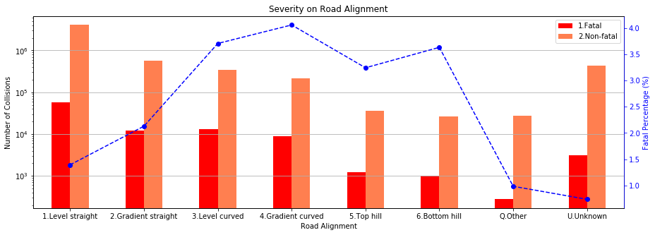
4. Road Alignment and Collision Severity

Slide 11
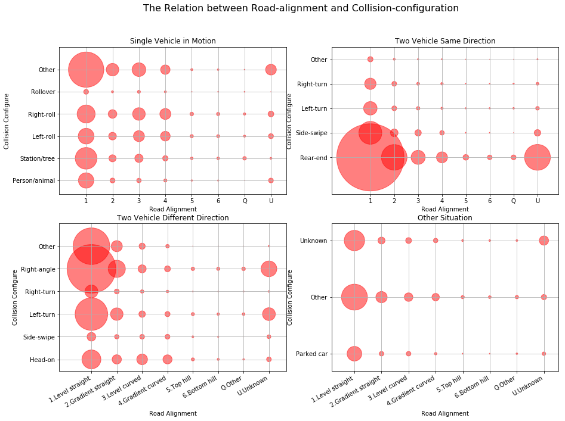
5. Road Alignment and Collision Configuration

Slide 12
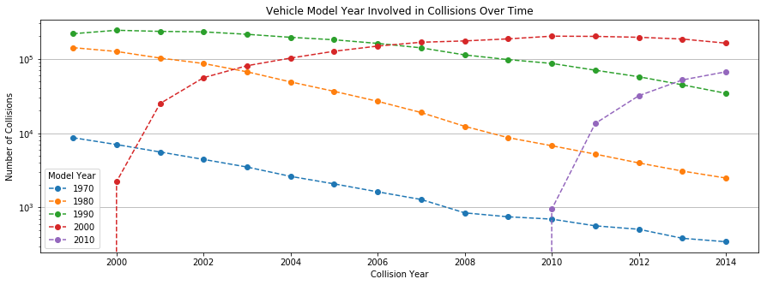
6. Vehicle Model Year Involved in Collision

Slide 13
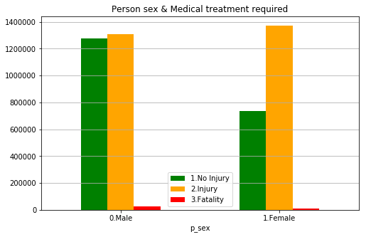
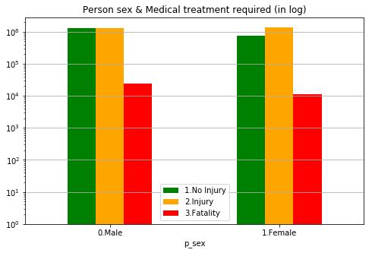
7. Person Sex

Slide 14
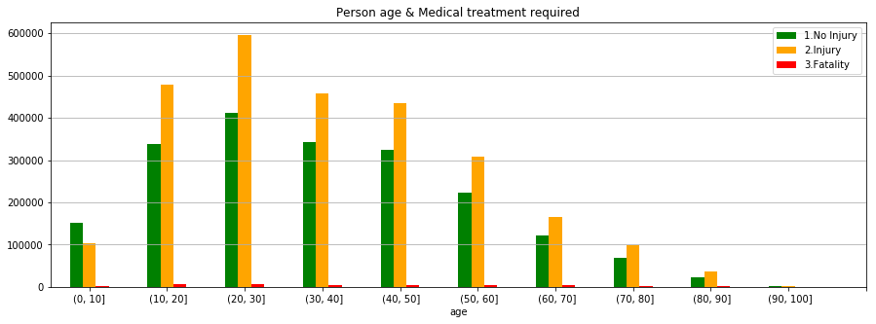
8. Person Age

Slide 15
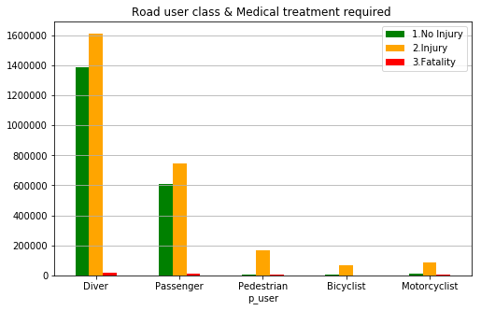
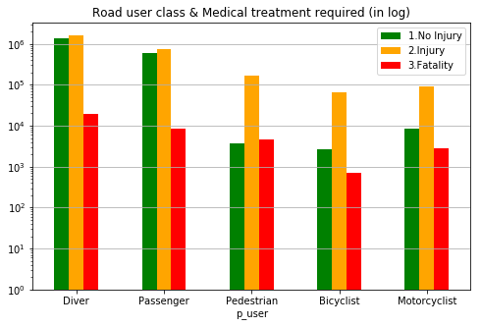
9. Road User Class

Slide 16
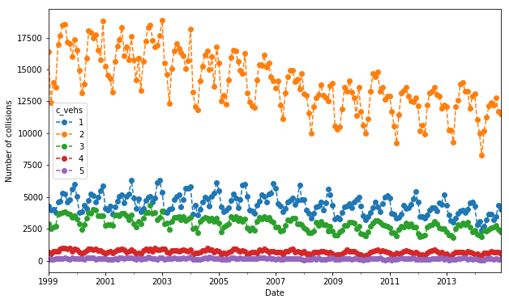
10. Number of Vehicles Involved in Collision

Slide 17
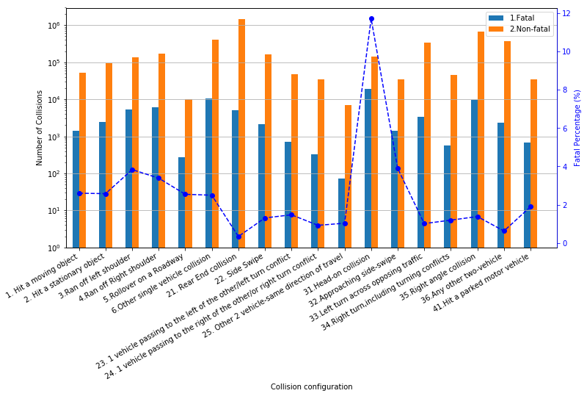
11. Collision Configuration and Severity

Slide 18
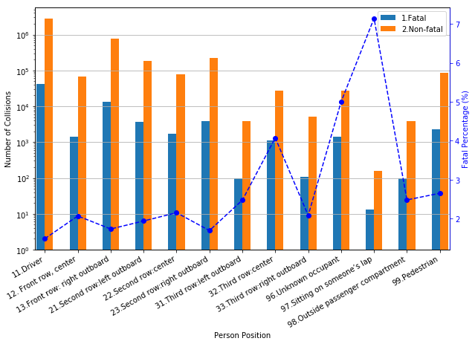
12. Person Position and Collision Severity

Slide 19

Canada Car Accident 1999 - 2014

Slide 20
Canada Car Accident 1999 - 2014
Thank You

