Slide 1
CS 106A, Lecture 13 Animation
reading:
Art & Science of Java, Ch. 9

Slide 2
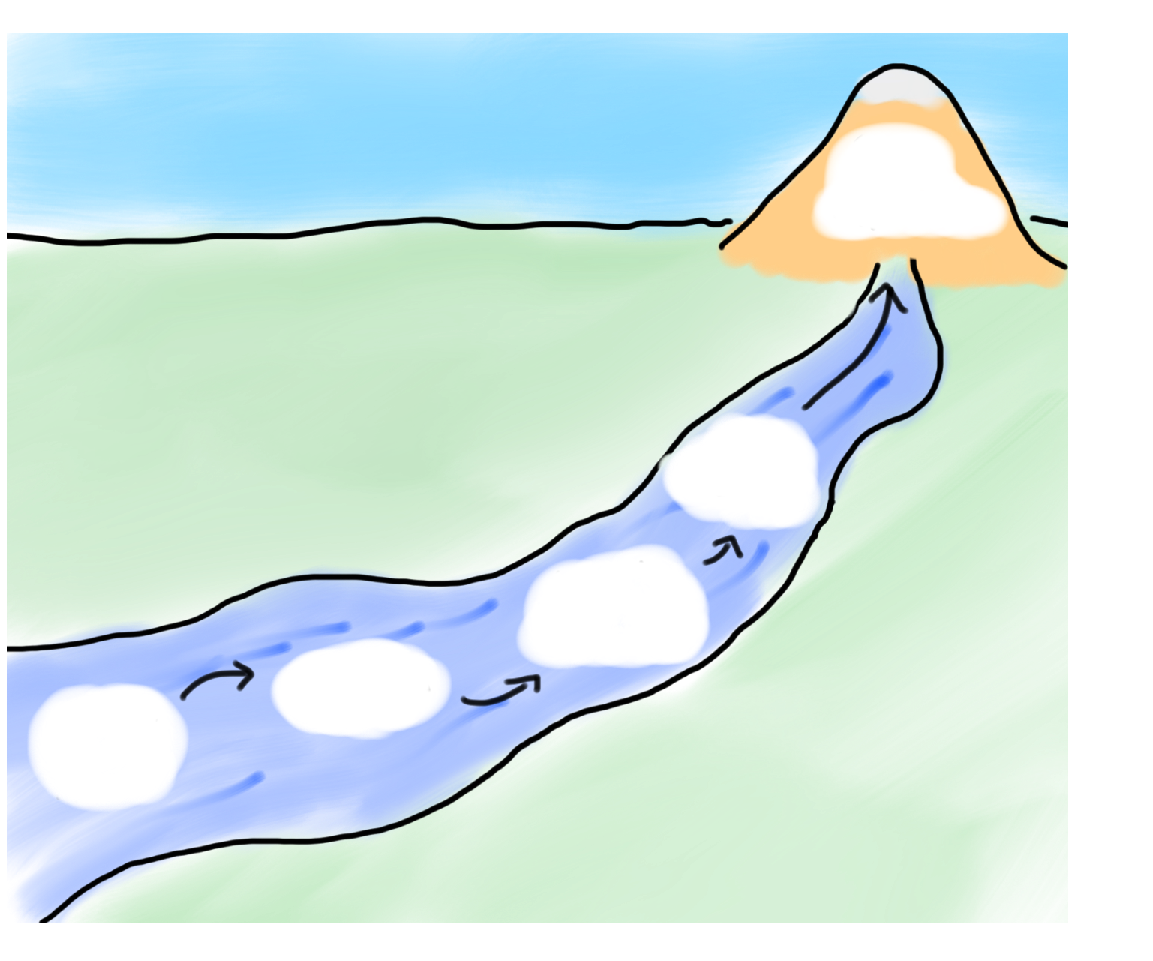
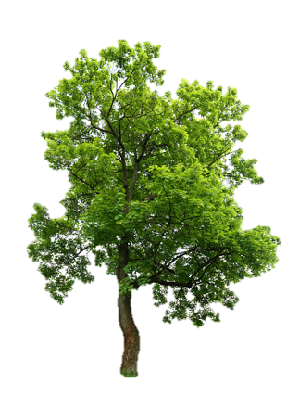
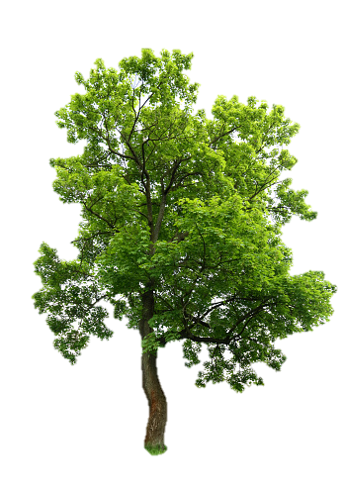

HW4:
Breakout
Memory
The River of Java
You are here
Events
Animation
Graphics
Programs

Slide 3
Plan For Today
Null
Animation
Practice: Animated Square
Practice: Kelp Forest

Slide 4
Plan For Today
Null
Animation
Practice: Animated Square
Practice: Kelp Forest

Slide 5
Null
Null is a special variable value that objects can have that means “nothing”. Primitives cannot be null.
If a method returns an object, it can return null to signify “nothing”. (just say return null;)
// may be a GObject, or null if nothing at (x, y)
GObject maybeAnObject = getElementAt(x, y);
Objects have the value null before being initialized.
Scanner myScanner; // initially null
Notes:
Different from the empty string

Slide 6
Null
You can check if something is null using == and !=
even though you usually compare Objects using .equals()
// may be a GObject, or null if nothing at (x, y)
GObject maybeAnObject = getElementAt(x, y);
if (maybeAnObject != null) {
// do something with maybeAnObject
} else {
// null – nothing at that location
}

Slide 7
Null
Calling methods on an object that is null will crash your program!
// may be a GObject, or null if nothing at (x, y)
GObject maybeAnObject = getElementAt(x, y);
if (maybeAnObject != null) {
int x = maybeAnObject.getX(); // OK
} else {
int x = maybeAnObject.getX(); // CRASH!
}
Notes:
Think about null like an “invalid mailing address” – if you try to send messages to it, your messages bounce because the address is invalid

Slide 8
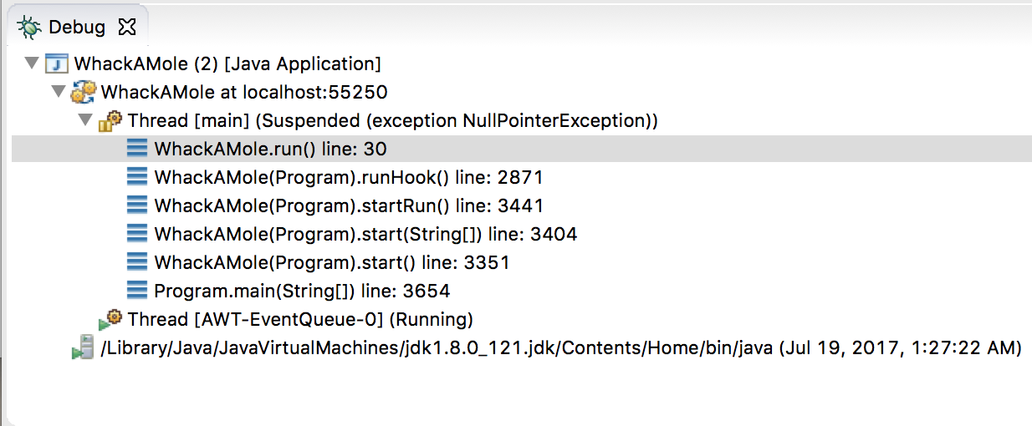
Null
Calling methods on an object that is null will crash your program! (throws a NullPointerException)

Slide 9
Plan For Today
Null
Animation
Practice: Animated Square
Practice: Kelp Forest

Slide 10
Simple animation
A Graphics program can be made to animate with a loop such as:
public void run() {
// create shapes here
while (condition) {
update the position of shapes;
pause(milliseconds);
}
}
The best number of ms to pause depends on the program.
most video games ~= 50 frames/sec = 25ms pause

Slide 11
Simple animation
Example:
public void run() {
GOval ball = new GOval(50, 50);
while (true) {
ball.move(1,1);
pause(10);
}
}
Can use setLocation or move for animation
setLocation takes an absolute position (x, y) as paremeters
move takes the change in position (dx, dy) as parameters

Slide 12
Graphical methods
These methods in graphical objects can be useful for animation:
The GraphicsProgram itself has these methods, too:
Method | Description
obj.getX() | the left x-coordinate of the shape
obj.getY() | the top y-coordinate of the shape
obj.getWidth() | number of pixels wide the shape is
obj.getHeight() | number of pixels tall the shape is
obj.move(dx, dy); | adjusts location by the given amount
obj.setLocation(x, y); | change the object's x/y position
obj.setSize(w, h); | change the object's width*height size
getWidth() | number of pixels wide the window is
getHeight() | number of pixels tall the window is
setCanvasSize(w, h) | change the canvas’s width*height size

Slide 13
Plan For Today
Null
Animation
Practice: Animated Square
Practice: Kelp Forest

Slide 14
Recap
Null
Animation
Practice: Animated Square
Practice: Kelp Forest
Next Time: Interactive Graphics Programs

