Slide 1
CS 106A, Lecture 20 ArrayLists and HashMaps
suggested reading:
Java Ch. 13.2

Slide 2
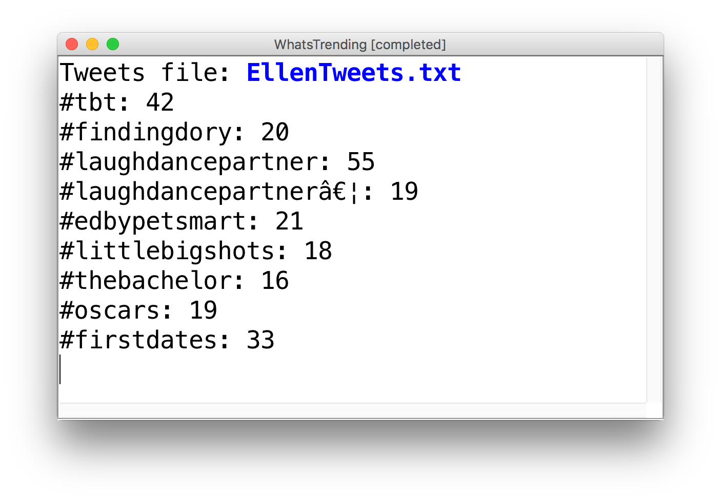
Learning Goals
Know how to store data in and retrieve data from a HashMap.

Slide 3
Plan for today
ArrayLists Recap and Reversible Writing
ArrayList Methods and Planner
Arrays vs. ArrayLists
HashMaps
Practice: Dictionary
HashMaps as Counters
Practice: What’s Trending
Recap

Slide 4
Plan for today
ArrayLists Recap and Reversible Writing
ArrayList Methods and Planner
Arrays vs. ArrayLists
HashMaps
Practice: Dictionary
HashMaps as Counters
Practice: What’s Trending
Recap

Slide 5
Our First ArrayList
// Create an (initially empty) list
ArrayList<String> list = new ArrayList<>();
// Add an element to the back
list.add("Hello"); // now size 1
list.add("there!"); // now size 2
// Access elements by index (starting at 0!)
println(list.get(0)); // prints "Hello"
println(list.get(1)); // prints "there!”
“Hello”
“Hello” | “there!”

Slide 6
Example: Reversible Writing
Let’s write a program that reverses a text file.
I am not a person who contributes
And I refuse to believe that
I will be useful
I will be useful
And I refuse to believe that
I am not a person who contributes
Notes:
Strategy was add each line of file to arraylist, then print in reverse order

Slide 7
Example: Reversible Writing
String filename = promptUserForFile("Filename: ", "res");
try {
Scanner s = new Scanner(new File(filename));
ArrayList<String> lines = new ArrayList<>();
// Read all lines and store in our ArrayList
while (scanner.hasNextLine()) { lines.add(scanner.nextLine());
}
// Output the lines from back to front
for (int i = lines.size() - 1; i >= 0; i--) {
println(lines.get(i));
}
} catch (IOException ex) {
println("Could not read file.");
}

Slide 8
Example: Reversible Writing
String filename = promptUserForFile("Filename: ", "res");
try {
Scanner s = new Scanner(new File(filename));
ArrayList<String> lines = new ArrayList<>();
// Read all lines and store in our ArrayList
while (scanner.hasNextLine()) { lines.add(scanner.nextLine());
}
// Output the lines from back to front
for (int i = lines.size() - 1; i >= 0; i--) {
println(lines.get(i));
}
} catch (IOException ex) {
println("Could not read file.");
}

Slide 9
Example: Reversible Writing
String filename = promptUserForFile("Filename: ", "res");
try {
Scanner s = new Scanner(new File(filename));
ArrayList<String> lines = new ArrayList<>();
// Read all lines and store in our ArrayList
while (scanner.hasNextLine()) { lines.add(scanner.nextLine());
}
// Output the lines from back to front
for (int i = lines.size() - 1; i >= 0; i--) {
println(lines.get(i));
}
} catch (IOException ex) {
println("Could not read file.");
}

Slide 10
Example: Reversible Writing
String filename = promptUserForFile("Filename: ", "res");
try {
Scanner s = new Scanner(new File(filename));
ArrayList<String> lines = new ArrayList<>();
// Read all lines and store in our ArrayList
while (scanner.hasNextLine()) { lines.add(scanner.nextLine());
}
// Output the lines from back to front
for (int i = lines.size() - 1; i >= 0; i--) {
println(lines.get(i));
}
} catch (IOException ex) {
println("Could not read file.");
}

Slide 11
Example: Reversible Writing
String filename = promptUserForFile("Filename: ", "res");
try {
Scanner s = new Scanner(new File(filename));
ArrayList<String> lines = new ArrayList<>();
// Read all lines and store in our ArrayList
while (scanner.hasNextLine()) { lines.add(scanner.nextLine());
}
// Output the lines from back to front
for (int i = lines.size() - 1; i >= 0; i--) {
println(lines.get(i));
}
} catch (IOException ex) {
println("Could not read file.");
}
Notes:
this is how we store file contents / avoid re-reading

Slide 12
Example: Reversible Writing
String filename = promptUserForFile("Filename: ", "res");
try {
Scanner s = new Scanner(new File(filename));
ArrayList<String> lines = new ArrayList<>();
// Read all lines and store in our ArrayList
while (scanner.hasNextLine()) { lines.add(scanner.nextLine());
}
// Output the lines from back to front
for (int i = lines.size() - 1; i >= 0; i--) {
println(lines.get(i));
}
} catch (IOException ex) {
println("Could not read file.");
}

Slide 13
Example: Reversible Writing
String filename = promptUserForFile("Filename: ", "res");
try {
Scanner s = new Scanner(new File(filename));
ArrayList<String> lines = new ArrayList<>();
// Read all lines and store in our ArrayList
while (scanner.hasNextLine()) { lines.add(scanner.nextLine());
}
// Output the lines from back to front
for (int i = lines.size() - 1; i >= 0; i--) {
println(lines.get(i));
}
} catch (IOException ex) {
println("Could not read file.");
}

Slide 14
Example: Reversible Writing
String filename = promptUserForFile("Filename: ", "res");
try {
Scanner s = new Scanner(new File(filename));
ArrayList<String> lines = new ArrayList<>();
// Read all lines and store in our ArrayList
while (scanner.hasNextLine()) { lines.add(scanner.nextLine());
}
// Output the lines from back to front
for (int i = lines.size() - 1; i >= 0; i--) {
println(lines.get(i));
}
} catch (IOException ex) {
println("Could not read file.");
}

Slide 15
Plan for today
ArrayLists Recap and Reversible Writing
ArrayList Methods and Planner
Arrays vs. ArrayLists
HashMaps
Practice: Dictionary
HashMaps as Counters
Practice: What’s Trending
Recap

Slide 16
ArrayList Methods
list.add(value); | appends value at end of list
list.add(index, value); | inserts given value just before the given index, shifting subsequent values to the right
list.clear(); | removes all elements of the list
list.get(index) | returns the value at given index
list.indexOf(value) | returns first index where given value is found in list (-1 if not found)
list.isEmpty() | returns true if the list contains no elements
list.remove(index); | removes/returns value at given index, shifting subsequent values to the left
list.remove(value); | removes the first occurrence of the value, if any
list.set(index, value); | replaces value at given index with given value
list.size() | returns the number of elements in the list
list.toString() | returns a string representation of the list such as "[3, 42, -7, 15]"
Notes:
Shifts elements if you add or remove!

Slide 17
Insert/remove
If you insert/remove in the front or middle of a list, elements shift to fit.
list.add(2, 42);
shift elements right to make room for the new element
list.remove(1);
shift elements left to cover the space left by the removed element
index | 0 | 1 | 2 | 3 | 4
value | 3 | 8 | 9 | 7 | 5
index | 0 | 1 | 2 | 3 | 4 | 5
value | 3 | 8 | 42 | 9 | 7 | 5
index | 0 | 1 | 2 | 3 | 4 | 5
value | 3 | 8 | 42 | 9 | 7 | 5
index | 0 | 1 | 2 | 3 | 4
value | 3 | 42 | 9 | 7 | 5
Notes:
9 7 5 are different indexes now!

Slide 18
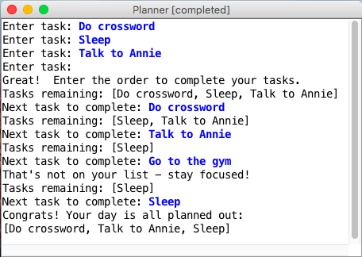
Example: Planner
Let’s write a program to help plan out our day
The program first prompts for things you want to do today
Then, it asks the user to re-input them in order of completion
Finally, it outputs the order the user has chosen for their tasks
Notes:
How can ArrayLists help us here? How would you go about solving this?
Think-pair-share until 11:40

Slide 19
Planner: Approach
Todos:
“Do crossword”

Slide 20
Planner: Approach
Todos:
“Do crossword” | “Sleep”

Slide 21
Planner: Approach
Todos:
“Do crossword” | “Sleep” | “Talk to Annie”

Slide 22
Planner: Approach
Todos:
“Do crossword” | “Sleep” | “Talk to Annie”
Order:
“Do crossword”

Slide 23
Planner: Approach
Todos:
“Sleep” | “Talk to Annie”
Order:
“Do crossword”

Slide 24
Planner: Approach
Todos:
“Sleep”
Order:
“Do crossword” | “Talk to Annie”

Slide 25
Planner: Approach
Todos:
DONE!
Order:
“Do crossword” | “Talk to Annie” | “Sleep”

Slide 26
Planner: Execution
To the code!
Notes:
Need to finish by 11:50

Slide 27
Plan for today
ArrayLists Recap and Reversible Writing
ArrayList Methods and Planner
Arrays vs. ArrayLists
HashMaps
Practice: Dictionary
HashMaps as Counters
Practice: What’s Trending
Recap

Slide 28
ArrayLists + Primitives = 💔
// Doesn’t compile ☹
ArrayList<int> list = new ArrayList<>();
Unlike arrays, ArrayLists can only store Objects!

Slide 29
ArrayLists + Primitives = 💔
Primitive | “Wrapper” Class
int | Integer
double | Double
boolean | Boolean
char | Character

Slide 30
ArrayLists + Wrappers = ❤️️
// Use wrapper classes when making an ArrayList
ArrayList<Integer> list = new ArrayList<>();
// Java converts Integer <-> int automatically!
int num = 123;
list.add(num);
int first = list.get(0); // 123
Conversion happens automatically!

Slide 31
Array vs. ArrayList
ArrayList
Array
ArrayList<Integer> list = new ArrayList<>();
list.add(1); // [1]
list.add(2); // [1, 2]
list.set(0, 3); // [3, 2]
int x = list.get(0); // 3
list.add(4); // [3, 2, 4]
list.contains(2); // true
int[] arr = new int[2]; // [0, 0]
arr[0] = 1; // [1, 0]
arr[1] = 2; // [1, 2]
arr[0] = 3; // [3, 2]
int x = arr[0]; // 3
[no equivalent]
Notes:
Let’s take a step back and compare arrays and arraylists

Slide 32
Array vs. ArrayList
Why do both of these exist in the language?
Arrays are Java's fundamental data storage
ArrayList is a library built on top of an array
When would you choose an array over an ArrayList?
When you need a fixed size that you know ahead of time
Simpler syntax for getting/setting
More efficient
Multi-dimensional arrays (e.g., images)
Histograms/tallying
Notes:
Finish by 11:55

Slide 33
Plan for today
ArrayLists Recap and Reversible Writing
ArrayList Methods and Planner
Arrays vs. ArrayLists
HashMaps
Practice: Dictionary
HashMaps as Counters
Practice: What’s Trending
Recap

Slide 34
Limitations of Lists
Can only look up by index (int), not by String, etc.
Cumbersome for preventing duplicate information
Slow for lookup
index | 0 | 1 | 2 | 3 | 4 | 5 | 6 | 7 | 8 | 9
value | 12 | 49 | -2 | 26 | 5 | 17 | -6 | 84 | 72 | 3

Slide 35
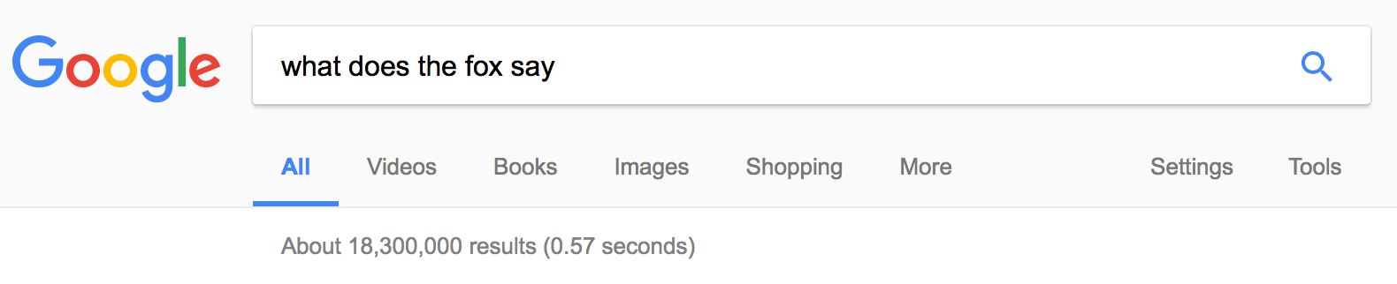
How Is Webpage Lookup So Fast?

Slide 36
Introducing… HashMaps!
A variable type that represents a collection of key-value pairs
You access values by key
Keys and values can be any type of Object
Resizable – can add and remove pairs
Has helpful methods for searching for keys

Slide 37
HashMap Examples
Phone book: name -> phone number
Search engine: URL -> webpage
Dictionary: word -> definition
Bank: account # -> balance
Social Network: name -> profile
Counter: text -> # occurrences
And many more…

Slide 38
Our First HashMap
import java.util.*;
HashMap<String, String> myHashMap = new HashMap<>();

Slide 39
Our First HashMap
HashMap<String, String> myHashMap = new HashMap<>();

Slide 40
Our First HashMap
Type of keys your HashMap will store.
HashMap<String, String> myHashMap = new HashMap<>();

Slide 41
Our First HashMap
Type of values your HashMap will store.
HashMap<String, String> myHashMap = new HashMap<>();

Slide 42
Our First HashMap
HashMap<String, String> myHashMap = new HashMap<>();

Slide 43
Our First HashMap
HashMap<String, String> myHashMap = new HashMap<>();

Slide 44
Our First HashMap
HashMap<String, String> myHashMap = new HashMap<>();

Slide 45
Our First HashMap - Put
// Create an (initially empty) HashMap
HashMap<String, String> map = new HashMap<>();
map.put("dog", "bark"); // Add a key-value pair
map.put("cat", "meow"); // Add another pair
map.put("seal", "ow ow"); // Add another pair
map.put("seal", "ow ow ow"); // Overwrites!
“ow
ow
ow”
“ow
ow”
Values:
“bark”
“meow”
Keys:
“dog”
“cat”
“seal”

Slide 46
Our First HashMap - Get
...
String s = map.get("dog"); // Get a value for a key
String s = map.get("cat"); // Get a value for a key
String s = map.get("fox"); // null
“ow
ow
ow”
Values:
“bark”
“meow”
Keys:
“dog”
“cat”
“seal”
Notes:
this is why keys and values have to be Objects--need to be able to return null

Slide 47
Our First HashMap - Remove
...
map.remove("dog"); // Remove pair from map
map.remove("seal"); // Remove pair from map
map.remove("fox"); // Does nothing if not in map
“ow
ow
ow”
“ow
ow”
Values:
“bark”
“meow”
Keys:
“dog”
“cat”
“seal”
Notes:
nothing happens if we remove and it wasn't there--this is nice (no error)

Slide 48
Review: HashMap Operations
m.put(key, value); Adds a key/value pair to the map.
m.put("Eric", "650-123-4567");
Replaces any previous value for that key.
m.get(key) Returns the value paired with the given key.
String phoneNum = m.get("Jenny"); // "867-5309"
Returns null if the key is not found.
m.remove(key); Removes the given key and its paired value.
m.remove("Annie");
Has no effect if the key is not in the map.
key value
"Jenny” → "867-5309"
"Mehran" → "123-4567"
"Marty" → "685-2181"
"Chris” → "947-2176"

Slide 49
Using HashMaps
A HashMap allows you to get from one half of a pair to the other.
Remembers one piece of information about every key.
Later, we can supply only the key and get back the related value:
Allows us to ask: What is Jenny’s phone number?
// key value
m.put("Jenny", "867-5309");
HashMap
m.get("Jenny")
HashMap
"867-5309"

Slide 50
Practice: Map Mystery
Q: What are the correct map contents after the following code?
HashMap<String, String> map = new HashMap<>();
map.put("K", "Schwarz");
map.put("C", "Lee");
map.put("M", "Sahami");
map.put("M", "Stepp");
map.remove("Stepp");
map.remove("K");
map.put("J", "Cain");
map.remove("C, Lee");
A. {C=Lee, J=Cain, M=Stepp, M=Sahami}
B. {C=Lee, J=Cain, M=Stepp}
C. {J=Cain M=Sahami, M=Stepp}
D. {J=Cain, K=Schwarz, M=Sahami}
E. other
Notes:
Should be here by 12:00. quick think
B

Slide 51
Practice: Map Mystery
Q: What are the correct map contents after the following code?
HashMap<String, String> map = new HashMap<>();
map.put("K", "Schwarz");
map.put("C", "Lee");
map.put("M", "Sahami");
map.put("M", "Stepp");
map.remove("Stepp");
map.remove("K");
map.put("J", "Cain");
map.remove("C, Lee");
Values:
“Schwarz”
“Sahami”
“Lee”
Keys:
“K”
“M”
“C”
Notes:
B

Slide 52
Practice: Map Mystery
Q: What are the correct map contents after the following code?
HashMap<String, String> map = new HashMap<>();
map.put("K", "Schwarz");
map.put("C", "Lee");
map.put("M", "Sahami");
map.put("M", "Stepp");
map.remove("Stepp");
map.remove("K");
map.put("J", "Cain");
map.remove("C, Lee");
Values:
“Schwarz”
“Stepp”
“Lee”
Keys:
“K”
“M”
“C”
Notes:
B

Slide 53
Practice: Map Mystery
Q: What are the correct map contents after the following code?
HashMap<String, String> map = new HashMap<>();
map.put("K", "Schwarz");
map.put("C", "Lee");
map.put("M", "Sahami");
map.put("M", "Stepp");
map.remove("Stepp");
map.remove("K");
map.put("J", "Cain");
map.remove("C, Lee");
Values:
“Schwarz”
“Stepp”
“Lee”
Keys:
“K”
“M”
“C”
Notes:
B

Slide 54
Practice: Map Mystery
Q: What are the correct map contents after the following code?
HashMap<String, String> map = new HashMap<>();
map.put("K", "Schwarz");
map.put("C", "Lee");
map.put("M", "Sahami");
map.put("M", "Stepp");
map.remove("Stepp");
map.remove("K");
map.put("J", "Cain");
map.remove("C, Lee");
Values:
“Stepp”
“Lee”
Keys:
“M”
“C”
Notes:
B

Slide 55
Practice: Map Mystery
Q: What are the correct map contents after the following code?
HashMap<String, String> map = new HashMap<>();
map.put("K", "Schwarz");
map.put("C", "Lee");
map.put("M", "Sahami");
map.put("M", "Stepp");
map.remove("Stepp");
map.remove("K");
map.put("J", "Cain");
map.remove("C, Lee");
Values:
“Cain”
“Stepp”
“Lee”
Keys:
“J”
“M”
“C”
Notes:
B

Slide 56
Practice: Map Mystery
Q: What are the correct map contents after the following code?
HashMap<String, String> map = new HashMap<>();
map.put("K", "Schwarz");
map.put("C", "Lee");
map.put("M", "Sahami");
map.put("M", "Stepp");
map.remove("Stepp");
map.remove("K");
map.put("J", "Cain");
map.remove("C, Lee");
Values:
“Cain”
“Stepp”
“Lee”
Keys:
“J”
“M”
“C”
Notes:
B

Slide 57
Plan for today
ArrayLists Recap and Reversible Writing
ArrayList Methods and Planner
Arrays vs. ArrayLists
HashMaps
Practice: Dictionary
HashMaps as Counters
Practice: What’s Trending
Recap

Slide 58
Exercise: Dictionary
Write a program to read a dictionary of words and definitions from a file, then prompt the user for words to look up.
Example data from the dictionary input file:
abate
to lessen; to subside
pernicious
harmful, injurious
How can a HashMap help us solve this problem?
Notes:
Live code, hopefully done by 12:10

Slide 59
Plan for today
ArrayLists Recap and Reversible Writing
ArrayList Methods and Planner
Arrays vs. ArrayLists
HashMaps
Practice: Dictionary
HashMaps as Counters
Practice: What’s Trending
Recap

Slide 60
Iterating Over HashMaps
...
for (String key : map.keySet()) {
String value = map.get(key);
// do something with key/value pair...
}
// Keys occur in an unpredictable order!
“ow
ow
ow”
Values:
“bark”
“meow”
Keys:
“dog”
“cat”
“seal”
Notes:
Loop over keys only!

Slide 61
Counting Exercise
Write a program to count the number of occurrences of each unique word in a large text file (e.g. Moby Dick ).
Allow the user to type a word and report how many times that word appeared in the book.
Report all words that appeared in the book at least 500 times.
How can a map help us solve this problem?
Think about scanning over a file containing this input data:
To be or not to be or to be a bee not two bees ...
^
Notes:
Think pair share 1 minute

Slide 62
Maps and Tallying
a map can be thought of as generalization of a tallying array
the "index" (key) doesn't have to be an int
count digits: 22092310907
// (R)epublican, (D)emocrat, (I)ndependent
count votes: "RDDDDDDRRRRRDDDDDDRDRRIRDRRIRDRRID"
index | 0 | 1 | 2 | 3 | 4 | 5 | 6 | 7 | 8 | 9
value | 3 | 1 | 3 | 0 | 0 | 0 | 0 | 1 | 0 | 2
key | "R" | "D" | "I"
value | 16 | 14 | 3
key value
"R" → 16
"D" → 14
"I" → 3
Notes:
have to initialize values unlike in array

Slide 63
Plan for today
ArrayLists Recap and Reversible Writing
ArrayList Methods and Planner
Arrays vs. ArrayLists
HashMaps
Practice: Dictionary
HashMaps as Counters
Practice: What’s Trending
Recap

Slide 64
Practice: What's Trending?
Social media can be used to monitor popular conversation topics.
Write a program to count the frequency of #hashtags in tweets:
Read saved tweets from a large text file.
Report hashtags that occur at least 15 times.
How can a map help us solve this problem?
Given these hashtags… We want to store...
#stanford
#summer
#california
#stanford
"#stanford" → 2
"#summer" → 1
"#california" → 1

Slide 65
Recap
ArrayLists are a variable type representing a list of items
Unlike arrays, ArrayLists have:
The ability to resize dynamically
Useful methods you can call on them
Unlike ArrayLists, arrays have:
The ability to store any type of item, not just Objects
HashMaps are a variable type representing a key-value pairs
Unlike arrays and ArrayLists, HashMaps:
Are not ordered
Store information associated with a key of any Object type
Next Time: defining our own variable types!
Notes:
Next time…

Slide 66
Overflow (extra) slides

Slide 67
Anagram exercise
Write a program to find all anagrams of a word the user types.
Type a word [Enter to quit]: scared
Anagrams of scared:
cadres cedars sacred scared
How can a map help us solve this problem?

Slide 68
Anagram observation
Every word has a sorted form where its letters are arranged into alphabetical order.
"fare" → "aefr"
"fear" → "aefr"
"swell" → "ellsw"
"wells" → "ellsw"
Notice that anagrams have the same sorted form as each other.
How is this helpful for solving the problem?
Suppose we were given a sortLetters method. How to use it?

Slide 69
Anagram solution
public String sortLetters(String s) { ... } // assume this exists
...
// build map of {sorted form => all words with that sorted form}
HashMap<String, String> anagrams = new
HashMap<String, String>();
try {
Scanner input = new Scanner(new File("dictionary.txt"));
while (true) {
String word = input.next();
String sorted = sortLetters(word); // "acders"
if (anagrams.containsKey(sorted)) {
String rest = anagrams.get(sorted);
anagrams.put(sorted, rest + " " + word); // append
} else {
anagrams.put(sorted, word); // new k/v pair
}
// {"acders" => "cadres caders sacred scared", ...}
}
} catch (FileNotFoundException fnfe) {
println("Error reading file: " + fnfe);
}

Slide 70
Anagram solution cont'd.
// prompt user for words and look up anagrams in map
String word = readLine("Type a word [Enter to quit]: ");
while (word.length() > 0) {
String sorted = sortLetters(word.toLowerCase());
if (anagrams.containsKey(sorted)) {
println("Anagrams of " + word + ":");
println(anagrams.get(sorted));
} else {
println("No anagrams for " + word + ".");
}
word = readLine("Type a word [Enter to quit]: ");
}

