Slide 1
CS 106A, Lecture 19 ArrayLists
suggested reading:
Java Ch. 11.8

Slide 2




Interactors
More Classes
We are here
Classes
HashMaps
ArrayLists
The River of Java

Slide 3
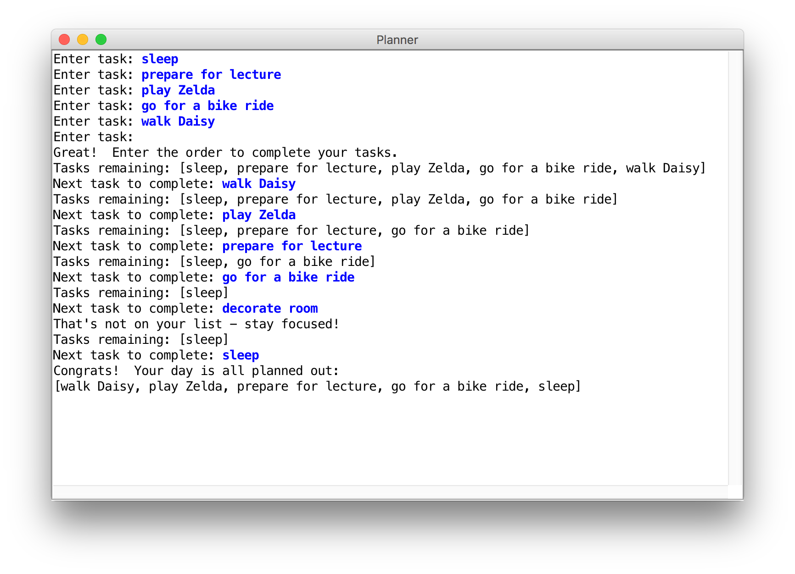
Learning Goals
Know how to store data in and retrieve data from an ArrayList.

Slide 4
Plan for today
Recap: Tic-Tac-Toe
ArrayLists
Example: reversible writing
Example: planner
ArrayLists vs. arrays
Recap

Slide 5
Plan for today
Recap: Tic-Tac-Toe
ArrayLists
Example: reversible writing
Example: planner
ArrayLists vs. arrays
Recap

Slide 6
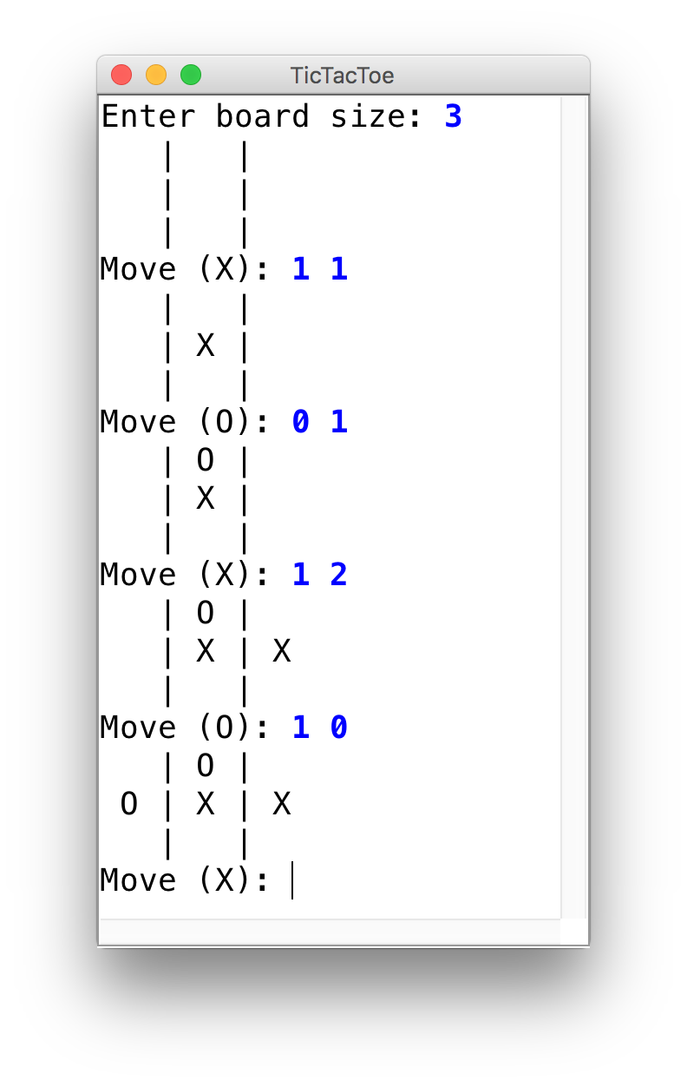
Tic-Tac-Toe
Let’s use 2D arrays to create a ConsoleProgram version of Tic-Tac-Toe.

Slide 7
Plan for today
Recap: Tic-Tac-Toe
ArrayLists
Example: reversible writing
Example: planner
ArrayLists vs. arrays
Recap

Slide 8
Limitations of Arrays
Size must be specified upon creation
Can’t add/remove/insert elements later
No built-in methods for searching, etc.
Can’t print arrays without Arrays.toString (or Arrays.deepToString)
index | 0 | 1 | 2 | 3 | 4 | 5 | 6 | 7 | 8 | 9
value | 12 | 49 | -2 | 26 | 5 | 17 | -6 | 84 | 72 | 3

Slide 9
Introducing… ArrayLists!
A variable type that represents a list of items.
You access individual items by index.
Store a single type of object (String, GRect, etc.)
Resizable – can add and remove elements
Has helpful methods for searching for items

Slide 10
Our First ArrayList
ArrayList<String> myArrayList = new ArrayList<>();

Slide 11
Our First ArrayList
import java.util.*;
ArrayList<String> myArrayList = new ArrayList<>();

Slide 12
Our First ArrayList
ArrayList<String> myArrayList = new ArrayList<>();

Slide 13
Our First ArrayList
ArrayList<String> myArrayList = new ArrayList<>();

Slide 14
Our First ArrayList
Type of items your ArrayList will store.
ArrayList<String> myArrayList = new ArrayList<>();
Notes:
Need to specify type like with arrays

Slide 15
Our First ArrayList
ArrayList<String> myArrayList = new ArrayList<>();

Slide 16
Our First ArrayList
ArrayList<String> myArrayList = new ArrayList<>();

Slide 17
Our First ArrayList
ArrayList<String> myArrayList = new ArrayList<>();

Slide 18
Our First ArrayList
// Create an (initially empty) list
ArrayList<String> list = new ArrayList<>();

Slide 19
Our First ArrayList
// Create an (initially empty) list
ArrayList<String> list = new ArrayList<>();
// Add an element to the back
list.add("Hello"); // now size 1
“Hello”

Slide 20
Our First ArrayList
// Create an (initially empty) list
ArrayList<String> list = new ArrayList<>();
// Add an element to the back
list.add("Hello"); // now size 1
list.add("there!"); // now size 2
“Hello”
“Hello” | “there!”

Slide 21
Our First ArrayList
// Add an element to the back
list.add("Hello"); // now size 1
list.add("there!"); // now size 2
// Access elements by index (starting at 0!)
println(list.get(0)); // prints "Hello"
println(list.get(1)); // prints "there!”
println(list); // prints ["Hello", "there!"]
“Hello”
“Hello” | “there!”

Slide 22
Our First ArrayList
// Add an element to the back
list.add("Hello"); // now size 1
list.add("there!"); // now size 2
// Access elements by index (starting at 0!)
for (int i = 0; i < list.size(); i++) {
println(list.get(i));
}
“Hello”
“Hello” | “there!”

Slide 23
Our First ArrayList
// Add an element to the back
list.add("Hello"); // now size 1
list.add("there!"); // now size 2
// Access elements by index (starting at 0!)
for (int i = 0; i < list.size(); i++) {
println(list.get(i));
}
“Hello”
“Hello” | “there!”
Notes:
Note here that we use .size() instead of length
Segue: there’s even a special type of for loop to iterate over items quickly

Slide 24
Our First ArrayList
// Add an element to the back
list.add("Hello"); // now size 1
list.add("there!"); // now size 2
// Access elements in order (also for arrays!)
for (String str : list) {
println(str);
}
“Hello”
“Hello” | “there!”

Slide 25
Iterating Over ArrayLists
// Access elements in order (also for arrays!)
for (String str : list) {
println(str);
}
// equivalent to
for (int i = 0; i < list.size(); i++) {
String str = list.get(i);
println(str);
}

Slide 26
Iterating Over ArrayLists
// Access elements in order (also for arrays!)
for (String str : list) {
println(str);
}
// equivalent to
for (int i = 0; i < list.size(); i++) {
String str = list.get(i);
println(str);
}

Slide 27
Bad Times with ArrayLists
// Create an (initially empty) list
ArrayList<String> list = new ArrayList<>();
// Wrong type – bad times! Won’t compile
GLabel label = new GLabel("Hello there!");
list.add(label);
// Invalid index! IndexOutOfBounds Exception
println(list.get(2));

Slide 28
Plan for today
Recap: Tic-Tac-Toe
ArrayLists
Example: reversible writing
Example: planner
ArrayLists vs. arrays
Recap

Slide 29
Example: Reversible Writing
Let’s write a program that reverses a text file.
I am not a person who contributes
And I refuse to believe that
I will be useful

Slide 30
Example: Reversible Writing
Let’s write a program that reverses a text file.
I am not a person who contributes
And I refuse to believe that
I will be useful
I will be useful
And I refuse to believe that
I am not a person who contributes
"I Have a Dream" by Antonia Lee, Sara Fung, Christy Fung, Rachel Lam
http://poets.spice.org.hk/index.php?option=com_content&view=article&id=45:my-family&catid=6:reverse-poem&Itemid=7
Notes:
Note – we don’t know (or need) how many lines there are! Limitation of arrays
How can an ArrayList help us here?
How would you go about this?

Slide 31
Example: Reversible Writing
Let’s write a program that reverses a text file.
“I am not a person who contributes”

Slide 32
Example: Reversible Writing
Let’s write a program that reverses a text file.
“I am not a person who contributes”
"And I refuse to believe that"

Slide 33
Example: Reversible Writing
Let’s write a program that reverses a text file.
“I am not a person who contributes”
"And I refuse to believe that"
“I will be useful”
Key idea: fill an ArrayList with each line in the file

Slide 34
Example: Reversible Writing
Let’s write a program that reverses a text file.
“I am not a person who contributes”
"And I refuse to believe that"
“I will be useful”

Slide 35
Example: Reversible Writing
Let’s write a program that reverses a text file.
“I am not a person who contributes”
"And I refuse to believe that"
“I will be useful”
Key idea: print the ArrayList items in reverse order
Notes:
Couldn’t do this with an array – we’d need to know # elements!

Slide 36
Example: Reversible Writing
String filename = promptUserForFile("Filename: ", "res");
try {
Scanner s = new Scanner(new File(filename));
ArrayList<String> lines = new ArrayList<>();
// Read all lines and store in our ArrayList
while (scanner.hasNextLine()) { lines.add(scanner.nextLine());
}
// Output the lines from back to front
for (int i = lines.size() - 1; i >= 0; i--) {
println(lines.get(i));
}
} catch (IOException ex) {
println("Could not read file.");
}

Slide 37
Example: Reversible Writing
String filename = promptUserForFile("Filename: ", "res");
try {
Scanner s = new Scanner(new File(filename));
ArrayList<String> lines = new ArrayList<>();
// Read all lines and store in our ArrayList
while (scanner.hasNextLine()) { lines.add(scanner.nextLine());
}
// Output the lines from back to front
for (int i = lines.size() - 1; i >= 0; i--) {
println(lines.get(i));
}
} catch (IOException ex) {
println("Could not read file.");
}

Slide 38
Example: Reversible Writing
String filename = promptUserForFile("Filename: ", "res");
try {
Scanner s = new Scanner(new File(filename));
ArrayList<String> lines = new ArrayList<>();
// Read all lines and store in our ArrayList
while (scanner.hasNextLine()) { lines.add(scanner.nextLine());
}
// Output the lines from back to front
for (int i = lines.size() - 1; i >= 0; i--) {
println(lines.get(i));
}
} catch (IOException ex) {
println("Could not read file.");
}

Slide 39
Example: Reversible Writing
String filename = promptUserForFile("Filename: ", "res");
try {
Scanner s = new Scanner(new File(filename));
ArrayList<String> lines = new ArrayList<>();
// Read all lines and store in our ArrayList
while (scanner.hasNextLine()) { lines.add(scanner.nextLine());
}
// Output the lines from back to front
for (int i = lines.size() - 1; i >= 0; i--) {
println(lines.get(i));
}
} catch (IOException ex) {
println("Could not read file.");
}

Slide 40
Example: Reversible Writing
String filename = promptUserForFile("Filename: ", "res");
try {
Scanner s = new Scanner(new File(filename));
ArrayList<String> lines = new ArrayList<>();
// Read all lines and store in our ArrayList
while (scanner.hasNextLine()) { lines.add(scanner.nextLine());
}
// Output the lines from back to front
for (int i = lines.size() - 1; i >= 0; i--) {
println(lines.get(i));
}
} catch (IOException ex) {
println("Could not read file.");
}

Slide 41
Example: Reversible Writing
String filename = promptUserForFile("Filename: ", "res");
try {
Scanner s = new Scanner(new File(filename));
ArrayList<String> lines = new ArrayList<>();
// Read all lines and store in our ArrayList
while (scanner.hasNextLine()) { lines.add(scanner.nextLine());
}
// Output the lines from back to front
for (int i = lines.size() - 1; i >= 0; i--) {
println(lines.get(i));
}
} catch (IOException ex) {
println("Could not read file.");
}

Slide 42
Example: Reversible Writing
String filename = promptUserForFile("Filename: ", "res");
try {
Scanner s = new Scanner(new File(filename));
ArrayList<String> lines = new ArrayList<>();
// Read all lines and store in our ArrayList
while (scanner.hasNextLine()) { lines.add(scanner.nextLine());
}
// Output the lines from back to front
for (int i = lines.size() - 1; i >= 0; i--) {
println(lines.get(i));
}
} catch (IOException ex) {
println("Could not read file.");
}

Slide 43
Example: Reversible Writing
String filename = promptUserForFile("Filename: ", "res");
try {
Scanner s = new Scanner(new File(filename));
ArrayList<String> lines = new ArrayList<>();
// Read all lines and store in our ArrayList
while (scanner.hasNextLine()) { lines.add(scanner.nextLine());
}
// Output the lines from back to front
for (int i = lines.size() - 1; i >= 0; i--) {
println(lines.get(i));
}
} catch (IOException ex) {
println("Could not read file.");
}

Slide 44
Plan for today
Recap: Tic-Tac-Toe
ArrayLists
Example: reversible writing
Example: planner
ArrayLists vs. arrays
Recap
Notes:
Before we get to that, there are some even cooler things ArrayLists let us do…

Slide 45
ArrayList Methods
list.add(value); | appends value at end of list
list.add(index, value); | inserts given value just before the given index, shifting subsequent values to the right
list.clear(); | removes all elements of the list
list.get(index) | returns the value at given index
list.indexOf(value) | returns first index where given value is found in list (-1 if not found)
list.isEmpty() | returns true if the list contains no elements
list.remove(index); | removes/returns value at given index, shifting subsequent values to the left
list.remove(value); | removes the first occurrence of the value, if any
list.set(index, value); | replaces value at given index with given value
list.size() | returns the number of elements in the list
list.toString() | returns a string representation of the list such as "[3, 42, -7, 15]"
Notes:
Shifts elements if you add or remove!

Slide 46
Insert/remove
If you insert/remove in the front or middle of a list, elements shift to fit.
list.add(2, 42);
shift elements right to make room for the new element
list.remove(1);
shift elements left to cover the space left by the removed element
index | 0 | 1 | 2 | 3 | 4
value | 3 | 8 | 9 | 7 | 5
index | 0 | 1 | 2 | 3 | 4 | 5
value | 3 | 8 | 42 | 9 | 7 | 5
index | 0 | 1 | 2 | 3 | 4 | 5
value | 3 | 8 | 42 | 9 | 7 | 5
index | 0 | 1 | 2 | 3 | 4
value | 3 | 42 | 9 | 7 | 5
Notes:
9 7 5 are different indexes now!

Slide 47
Example: Planner

Slide 48
Example: Planner
Let’s write a program to help plan out our day
The program first prompts for things you want to do today
Then, it asks the user to re-input them in order of completion
Finally, it outputs the order the user has chosen for their tasks
Notes:
How can ArrayLists help us here? How would you go about solving this?
Think-pair-share
Live coding

Slide 49
Planner: Approach
Todos:
“Walk Daisy”

Slide 50
Planner: Approach
Todos:
“Walk Daisy” | “Play Zelda”

Slide 51
Planner: Approach
Todos:
“Walk Daisy” | “Play Zelda” | “Lunch with Avi”

Slide 52
Planner: Approach
Todos:
“Walk Daisy” | “Play Zelda” | “Lunch with Avi”
Order:
“Walk Daisy”

Slide 53
Planner: Approach
Todos:
“Play Zelda” | “Lunch with Avi”
Order:
“Walk Daisy”

Slide 54
Planner: Approach
Todos:
“Play Zelda”
Order:
“Walk Daisy” | “Lunch with Avi”

Slide 55
Planner: Approach
Todos:
DONE!
Order:
“Walk Daisy” | “Lunch with Avi” | “Play Zelda”

Slide 56
Plan for today
Recap: Tic-Tac-Toe
ArrayLists
Example: reversible writing
Example: planner
ArrayLists vs. arrays
Recap
Notes:
So you might be thinking – ArrayLists are awesome! Why would you ever use arrays? There are some downsides…

Slide 57
ArrayLists + Primitives = 💔
// Doesn’t compile ☹
ArrayList<int> list = new ArrayList<>();
Unlike arrays, ArrayLists can only store objects!

Slide 58
ArrayLists + Primitives = 💔
Primitive | “Wrapper” Class
int | Integer
double | Double
boolean | Boolean
char | Character

Slide 59
ArrayLists + Wrappers = ❤️️
// Use wrapper classes when making an ArrayList
ArrayList<Integer> list = new ArrayList<>();
// Java converts Integer <-> int automatically!
int num = 123;
list.add(num);
int first = list.get(0); // 123
Conversion happens automatically!

Slide 60
Array vs. ArrayList
ArrayList
Array
ArrayList<Integer> list = new ArrayList<>();
list.add(1); // [1]
list.add(2); // [1, 2]
list.set(0, 3); // [3, 2]
int x = list.get(0); // 3
list.add(4); // [3, 2, 4]
list.contains(2); // true
int[] arr = new int[2]; // [0, 0]
arr[0] = 1; // [1, 0]
arr[1] = 2; // [1, 2]
arr[0] = 3; // [3, 2]
int x = arr[0]; // 3
[no equivalent]
Notes:
Let’s take a step back and compare arrays and arraylists

Slide 61
Array vs. ArrayList
Why do both of these exist in the language?
Arrays are Java's fundamental data storage
ArrayList is a library built on top of an array
When would you choose an array over an ArrayList?
When you need a fixed size that you know ahead of time
Simpler syntax for getting/setting
More efficient
Multi-dimensional arrays (e.g. images)
Histograms/tallying

Slide 62
Plan for today
Recap: Tic-Tac-Toe
ArrayLists
Example: reversible writing
Example: planner
ArrayLists vs. arrays
Recap

Slide 63
Recap
ArrayLists are a variable type representing a list of items
Unlike arrays, ArrayLists have:
The ability to resize dynamically
Useful methods you can call on them
Unlike ArrayLists, arrays have:
The ability to store any type of item, not just objects
Next Time: HashMaps
Notes:
Next time…

