Slide 1
CS 106A, Lecture 5 Booleans and Control Flow
suggested reading:
Java Ch. 3.4-4.6

Slide 2
Plan For Today
Announcements
Recap: Java, Variables and Expressions
Aside: Shorthand Operators + Constants
Revisiting Control Flow
If and While
For
Notes:
No helper hours tomorrow
Please submit if you haven’t already!
No Java features on HW1

Slide 3
Plan For Today
Announcements
Recap: Java, Variables and Expressions
Aside: Shorthand Operators + Constants
Revisiting Control Flow
If and While
For

Slide 4
Announcements
Everything canceled on Wednesday (7/4)
Lecture and LaIR are just not happening
Wednesday sections have been rescheduled
Go to your section leader’s if you can; otherwise, go to a different rescheduled section
Assignment 1 due Thursday at 11AM
Debugger tutorial up on website

Slide 5
Plan For Today
Announcements
Recap: Java, Variables and Expressions
Aside: Shorthand Operators + Constants
Revisiting Control Flow
If and While
For
Notes:
11:32AM

Slide 6
Java
Program
Karel Program
Console Program
Graphics Program
SuperKarel Program

Slide 7
Console I/O
println allows out to output text to the user via the console
Output is the “O” in “I/O”
We can also get input from the user via the console!
Use variables to store data collected via readInt, readDouble, etc.

Slide 8
Expressions
You can combine literals or variables together into expressions using binary operators:
+
Addition
*
Multiplication
–
Subtraction
Division
/
%
Remainder

Slide 9
Integer division, remainder
When we divide integers, the quotient is also an integer.
14 / 4 is 3, not 3.5 . (Java ALWAYS rounds down.)
3 4 52
4 ) 14 10 ) 45 27 ) 1425
12 40 135
2 5 75
54
21
More examples:
32 / 5 is 6 32 % 5 is 2
84 / 10 is 8 84 % 10 is 4
156 / 100 is 1 156 % 100 is 56
Dividing by 0 using /or % causes an error when your program runs.
/
%

Slide 10
Type Interactions
int and int results in an int
double and double results in a double
int and double results in a double
String and int results in a String
etc.
* The general rule is: operations always return the most expressive type
Notes:
MOST EXPRESSIVE TYPE –you can make an int into a string but not all strings into an int

Slide 11
Precedence
precedence: Order in which operators are evaluated.
Generally operators evaluate left-to-right. 1 - 2 - 3 is (1 - 2) - 3 which is -4
But * / % have a higher level of precedence than + - 1 + 3 * 4 is 13
6 + 8 / 2 * 3
6 + 4 * 3
6 + 12 is 18
Parentheses can alter order of evaluation, but spacing does not: (1 + 3) * 4 is 16 1+3 * 4-2 is 11
Notes:
If this doesn’t look familiar, remember to keep up with extra slides
Precedence also affects the *type* of the expression, since we evaluate two at a time

Slide 12
Practice
1 / 2 0
1.0 / 2 0.5
1 + 2 / 3 1
"abc" + (4 + 2) "abc6"
"abc" + 4 + 2 "abc42"
Notes:
0
0.5
2
“abc42”
“abc6”
If we want to store these expressions to use again later, we can put it in a variable

Slide 13
Variable Types
int – an integer number
double – a decimal number
char – a single character
boolean – true or false
Notes:
called primitive types

Slide 14
Making a new Variable
type
name
int myVariable;

Slide 15
Assignment
value
Existing variable name
myVariable = 2;

Slide 16
Declare / initialize
A variable can be declared/initialized in one statement.
This is probably the most commonly used declaration syntax.
Syntax:
type name = expression;
double tempF = 98.6;
int x = (12 / 2) + 3;
tempF | 98.6
x | 9

Slide 17
Plan For Today
Announcements
Recap: Variables and Expressions
Aside: Shorthand Operators + Constants
Revisiting Control Flow
If and While
For
Notes:
11:35AM

Slide 18
Shorthand Operators
Shorthand Equivalent longer version
variable += value; variable = variable + value;
variable -= value; variable = variable - value;
variable *= value; variable = variable * value;
variable /= value; variable = variable / value;
variable %= value; variable = variable % value;
variable++; variable = variable + 1;
variable--; variable = variable – 1;
x -= 3; // x = x - 3;
number *= 2; // number = number * 2;
x++; // x = x + 1;
Notes:
After x++; executes, the value of x has increased by one

Slide 19
Constants
constant: A variable that cannot be changed after it is initialized. Declared at the top of your class, outside of the run() method but inside public class Name. Can be used anywhere in that class.
Better style – can easily change their values in your code, and they are easier to read in your code.
Syntax:
private static final type name = value;
name is usually in ALL_UPPER_CASE
Examples:
private static final int DAYS_IN_WEEK = 7;
private static final double INTEREST_RATE = 3.5;

Slide 20
Receipt Program - Before
public class Receipt extends ConsoleProgram {
public void run() {
double subtotal = readDouble(”Meal cost? $”);
double tax = subtotal * 0.08;
double tip = subtotal * 0.20;
double total = subtotal + tax + tip;
println(“Tax : $” + tax);
println(“Tip: $” + tip);
println(“Total: $” + total);
}
}

Slide 21
Receipt Program – After
public class Receipt extends ConsoleProgram {
private static final double TAX_RATE = 0.08;
private static final double TIP_RATE = 0.2;
public void run() {
double subtotal = readDouble(”Meal cost? $”);
double tax = subtotal * TAX_RATE;
double tip = subtotal * TIP_RATE;
double total = subtotal + tax + tip;
println("Tax : $” + tax);
println("Tip: $” + tip);
println(”Total: $" + total);
}
}
Notes:
Better because it’s easy to see what those numbers represent, and they are easy to change
Why do I need constants? What if tax rate changes?

Slide 22
Plan For Today
Announcements
Recap: Variables and Expressions
Aside: Shorthand Operators + Constants
Revisiting Control Flow
If and While
For
Notes:
11:40AM

Slide 23
If/Else in Karel
if (condition) {
statement;
statement;
...
} else {
statement;
statement;
...
}
Runs the first group of statements if condition is true; otherwise, runs the second group of statements.

Slide 24
While Loops in Karel
while (condition) {
statement;
statement;
...
}
Repeats the statements in the body until condition is no longer true.
Each time, Karel executes all statements, and then checks the condition.
Notes:
We atlked about while, which uses these conditions, and also if/else, which uses these conditions

Slide 25
Conditions in Karel
while (frontIsClear()) {
body
}
if (beepersPresent()) {
body
}
Notes:
But what about Java? Good news is, it’s exactly the same! This is Java syntax. Now the question is what are the conditions?

Slide 26
Conditions in Java
while (condition) {
body
}
if (condition) {
body
}
The condition should be a “boolean” which is either true or false
Notes:
So what is a Boolean value?

Slide 27
Booleans
1 < 2
Notes:
This is a Boolean value, or technically an expression that evaluates to a Boolean value. Asking the question

Slide 28
Booleans
1 < 2
true
Notes:
How do we know that expression yielded a Boolean, when previously we said two ints joined by a binary operator yielded an int?

Slide 29
Relational Operators
Operator | Meaning | Example | Value
== | equals | 1 + 1 == 2 | true
!= | does not equal | 3.2 != 2.5 | true
< | less than | 10 < 5 | false
> | greater than | 10 > 5 | true
<= | less than or equal to | 126 <= 100 | false
>= | greater than or equal to | 5.0 >= 5.0 | true
* All have equal precedence

Slide 30
Relational Operators
Operator | Meaning | Example | Value
== | equals | 1 + 1 == 2 | true
!= | does not equal | 3.2 != 2.5 | true
< | less than | 10 < 5 | false
> | greater than | 10 > 5 | true
<= | less than or equal to | 126 <= 100 | false
>= | greater than or equal to | 5.0 >= 5.0 | true
* All have equal precedence
Notes:
Equals is weird because single equals is assignment!
Very common source of bugs
“not” in Java is exclamation point

Slide 31
Relational Operators
if (1 < 2) {
println("1 is less than 2!");
}
int num = readInt("Enter a number: ");
if (num == 0) { println("That number is 0!");
} else {
println("That number is not 0.");
}

Slide 32
Practice: Sentinel Loops
sentinel: A value that signals the end of user input.
sentinel loop: Repeats until a sentinel value is seen.
Example: Write a program that prompts the user for numbers until the user types -1, then output the sum of the numbers.
In this case, -1 is the sentinel value.
Type a number: 10
Type a number: 20
Type a number: 30
Type a number: -1
Sum is 60
Notes:
11:45AM
sentinel could not be valid user input
Think pair share (hint: fencepost)
code on paper or computer but don't spend too long pulling up Eclipse

Slide 33
Practice: Sentinel Loops
// fencepost problem!
// ask for number - post
// add number to sum - fence
int sum = 0;
int num = readInt("Enter a number: ");
while (num != -1) {
sum += num;
num = readInt("Enter a number: ");
}
println("Sum is " + sum);
Notes:
important: declaration happens outside of the loop

Slide 34
Practice: Sentinel Loops
// fencepost problem!
// ask for number - post
// add number to sum - fence
private static final int SENTINEL = -1;
int sum = 0;
int num = readInt("Enter a number: ");
while (num != SENTINEL) {
sum += num;
num = readInt("Enter a number: ");
}
println("Sum is " + sum);
(outside of run())

Slide 35
Practice: Sentinel Loops
// Solution #2: ”break” out of the loop
// ONLY appropriate to use in fencepost cases
int sum = 0;
while (true) {
int num = readInt("Enter a number: ");
if (num == -1) {
break; // immediately exits loop
}
sum += num;
}
println("Sum is " + sum);
Colin prefers this solution, but the debate of how to solve the “loop-and-a-half” problem has been raging for >50 years!
Notes:
Make sure someone asks about declaring num multiple times. I have a whole story to tell tomorrow
Break exits the closest loop it is in
If you go with this solution, don’t abuse break. Not allowed in Karel, don’t use when loop naturally works
You can have more complex conditions if you want…

Slide 36
Logical Operators
In order of precedence:
Operator | Description | Example | Result
! | not | !(2 == 3) | true
&& | and | (2 == 3) && (-1 < 5) | false
|| | or | (2 == 3) || (-1 < 5) | true
Cannot "chain" tests as in algebra; use && or || instead
// assume x is 15 // correct version
2 <= x <= 10 2 <= x && x <= 10
true <= 10 true && false
Error! false

Slide 37
Precedence Madness
Precedence: arithmetic > relational > logical
5 * 7 >= 3 + 5 * (7 – 1) && 7 <= 11
5 * 7 >= 3 + 5 * 6 && 7 <= 11
35 >= 3 + 30 && 7 <= 11
35 >= 33 && 7 <= 11
true && true
true
Notes:
You can store boolean expressions in variables too

Slide 38
Boolean Variables
// Store expressions that evaluate to true/false
boolean x = 1 < 2; // true
boolean y = 5.0 == 4.0; // false

Slide 39
Boolean Variables
// Store expressions that evaluate to true/false
boolean x = 1 < 2; // true
boolean y = 5.0 == 4.0; // false
// Directly set to true/false
boolean isFamilyVisiting = true;
boolean isRaining = false;

Slide 40
Boolean Variables
// Store expressions that evaluate to true/false
boolean x = 1 < 2; // true
boolean y = 5.0 == 4.0; // false
// Directly set to true/false
boolean isFamilyVisiting = true;
boolean isRaining = false;
// Ask the user a true/false (yes/no) question
boolean playAgain = readBoolean("Play again?”, "y", "n");
if (playAgain) {
...
Notes:
Note: does not store the whole expression – just the value.
Note – we don’t need to check if it’s equal to true

Slide 41
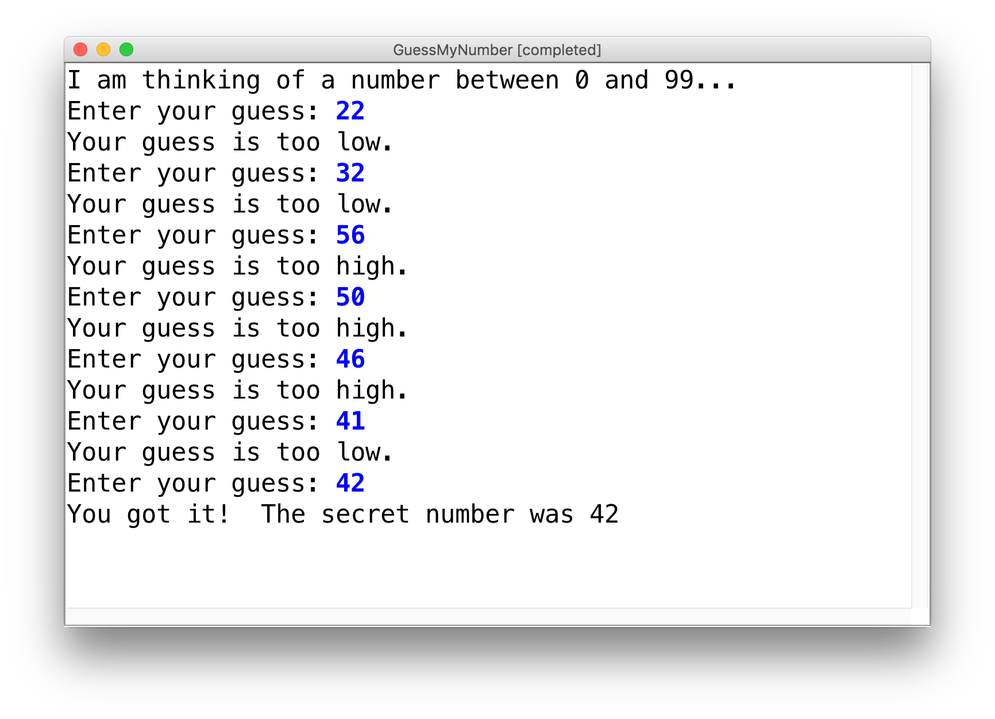
Practice: GuessMyNumber
Let’s write a program called GuessMyNumber that prompts the user for a number until they guess our secret number.
If a guess is incorrect, the program should provide a hint; specifically, whether the guess is too high or too low.
Notes:
11:55AMish, 12:00 is fine

Slide 42
Summary: Conditions
while (condition) {
body
}
if (condition) {
body
}
The condition should be a boolean which is either true or false

Slide 43
Plan For Today
Announcements
Recap: Variables and Expressions
Aside: Shorthand Operators + Constants
Revisiting Control Flow
If and While
For
Notes:
12:10PM

Slide 44
For Loops in Karel
for (int i = 0; i < max; i++) {
statement;
statement;
...
}
Repeats the statements in the body max times.

Slide 45
For Loops in Java
Repeats the loop if this condition passes
This code is run each time the code gets to the end of the ‘body’
This code is run once, just before the for loop starts
for (int i = 0; i < 3; i++) {
println("I love CS 106A!");
}

Slide 46
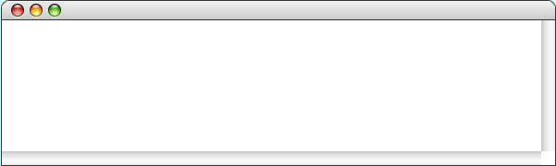
For Loops in Java
for (int i = 0; i < 3; i++) {
println("I love CS 106A!");
}
For Loop Redux

Slide 47
For Loops in Java
i
0
for (int i = 0; i < 3; i++) {
println("I love CS 106A!");
}
For Loop Redux

Slide 48
For Loops in Java
i
0
for (int i = 0; i < 3; i++) {
println("I love CS 106A!");
}
For Loop Redux

Slide 49
For Loops in Java
i
0
for (int i = 0; i < 3; i++) {
println("I love CS 106A!");
}
For Loop Redux
I love CS 106A!

Slide 50
For Loops in Java
i
0
for (int i = 0; i < 3; i++) {
println("I love CS 106A!");
}
For Loop Redux
I love CS 106A!

Slide 51
For Loops in Java
i
1
for (int i = 0; i < 3; i++) {
println("I love CS 106A!");
}
For Loop Redux
I love CS 106A!

Slide 52
For Loops in Java
i
1
for (int i = 0; i < 3; i++) {
println("I love CS 106A!");
}
For Loop Redux
I love CS 106A!

Slide 53
For Loops in Java
i
1
for (int i = 0; i < 3; i++) {
println("I love CS 106A!");
}
For Loop Redux
I love CS 106A!
I love CS 106A!

Slide 54
For Loops in Java
i
2
for (int i = 0; i < 3; i++) {
println("I love CS 106A!");
}
For Loop Redux
I love CS 106A!
I love CS 106A!

Slide 55
For Loops in Java
i
2
for (int i = 0; i < 3; i++) {
println("I love CS 106A!");
}
For Loop Redux
I love CS 106A!
I love CS 106A!

Slide 56
For Loops in Java
i
2
for (int i = 0; i < 3; i++) {
println("I love CS 106A!");
}
For Loop Redux
I love CS 106A!
I love CS 106A!
I love CS 106A!

Slide 57
For Loops in Java
i
3
for (int i = 0; i < 3; i++) {
println("I love CS 106A!");
}
For Loop Redux
I love CS 106A!
I love CS 106A!
I love CS 106A!

Slide 58
For Loops in Java
i
3
for (int i = 0; i < 3; i++) {
println("I love CS 106A!");
}
For Loop Redux
I love CS 106A!
I love CS 106A!
I love CS 106A!

Slide 59
For Loops in Java
for (int i = 0; i < 3; i++) {
println("I love CS 106A!");
}
For Loop Redux
I love CS 106A!
I love CS 106A!
I love CS 106A!

Slide 60
For Loops in Java
for (int i = 0; i < 3; i++) {
println("I love CS 106A!");
}
For Loop Redux
I love CS 106A!
I love CS 106A!
I love CS 106A!
Notes:
We start counting from 0, which is why you go until max without =
We can take advantage of the for loop variable!

Slide 61
Using the For Loop Variable
// prints the first 100 even numbers
for (int i = 0; i < 100; i++) {
println(i * 2);
}

Slide 62
Using the For Loop Variable
// Adds up the first 100 numbers
int sum = 0;
for (int i = 0; i < 100; i++) {
sum += i;
}
println("The sum is " + sum);

Slide 63
Using the For Loop Variable
// Launch countdown
for (int i = 10; i >= 1; i--) {
println(i);
}
println("Blast off!");
Output:
10
9
8
…
1
Blast off!

Slide 64
Recap
Announcements
Recap: Variables and Expressions
Aside: Shorthand Operators + Constants
Revisiting Control Flow
If and While
For
Next time: More control flow, methods in Java

Slide 65
[Extra] If/*Else If*/Else
if (condition1) {
...
} else if (condition2) { // NEW
...
} else {
...
}
Runs the first group of statements if condition1 is true; otherwise, runs the second group of statements if condition2 is true; otherwise, runs the third group of statements.
You can have multiple else if clauses together.

Slide 66
[Extra] If/*Else If*/Else
int num = readInt("Enter a number: ");
if (num > 0) {
println("Your number is positive");
} else if (num < 0) {
println("Your number is negative");
} else {
println("Your number is 0");
}
Notes:
No redundant conditions

