Slide 1
CS 106A, Lecture 24 Interactors and NameSurfer
suggested reading:
Java Ch. 10.5-10.6

Slide 2
Plan for today
Recap: Extending GCanvas
Interactors
JButton
JLabel
JTextField
Example: TipCalculator
NameSurfer

Slide 3
Plan for today
Recap: Extending GCanvas
Interactors
JButton
JLabel
JTextField
Example: TipCalculator
NameSurfer

Slide 4
Extending GCanvas
public class Graphics extends Program {
public void init() { // We can make our own GCanvas!
MyCanvas canvas = new MyCanvas();
add(canvas);
}
public void run() {
// Operate on this canvas
GObject obj = canvas.getElementAt(…);
}
}
Notes:
We CAN say canvas.getElementAt, but we want to decompose all our graphics code out into the MyCanvas file

Slide 5
Extending GCanvas
public class MyCanvas extends GCanvas {
public void addCenteredSquare(int size) {
GRect rect = new GRect(size, size);
int x = getWidth() / 2.0 –
rect.getWidth() / 2.0;
int y = getHeight() / 2.0 –
rect.getHeight() / 2.0;
add(rect, x, y);
}
}

Slide 6
Extending GCanvas
public class Graphics extends Program {
public void init() { // We can make our own GCanvas!
MyCanvas canvas = new MyCanvas();
add(canvas);
}
public void run() {
canvas.addCenteredSquare(20);
}
}

Slide 7
Common Bugs
When you are using a custom canvas, make sure to not call getWidth or getHeight on the canvas until it is shown onscreen!
public class MyProgram extends Program {
private MyCanvas canvas; public void init() {
// canvas not created yet!
canvas = new MyCanvas();
// canvas not added yet!
add(canvas);
// window not showing yet!
}
public void run() {
// good to go
}
}

Slide 8
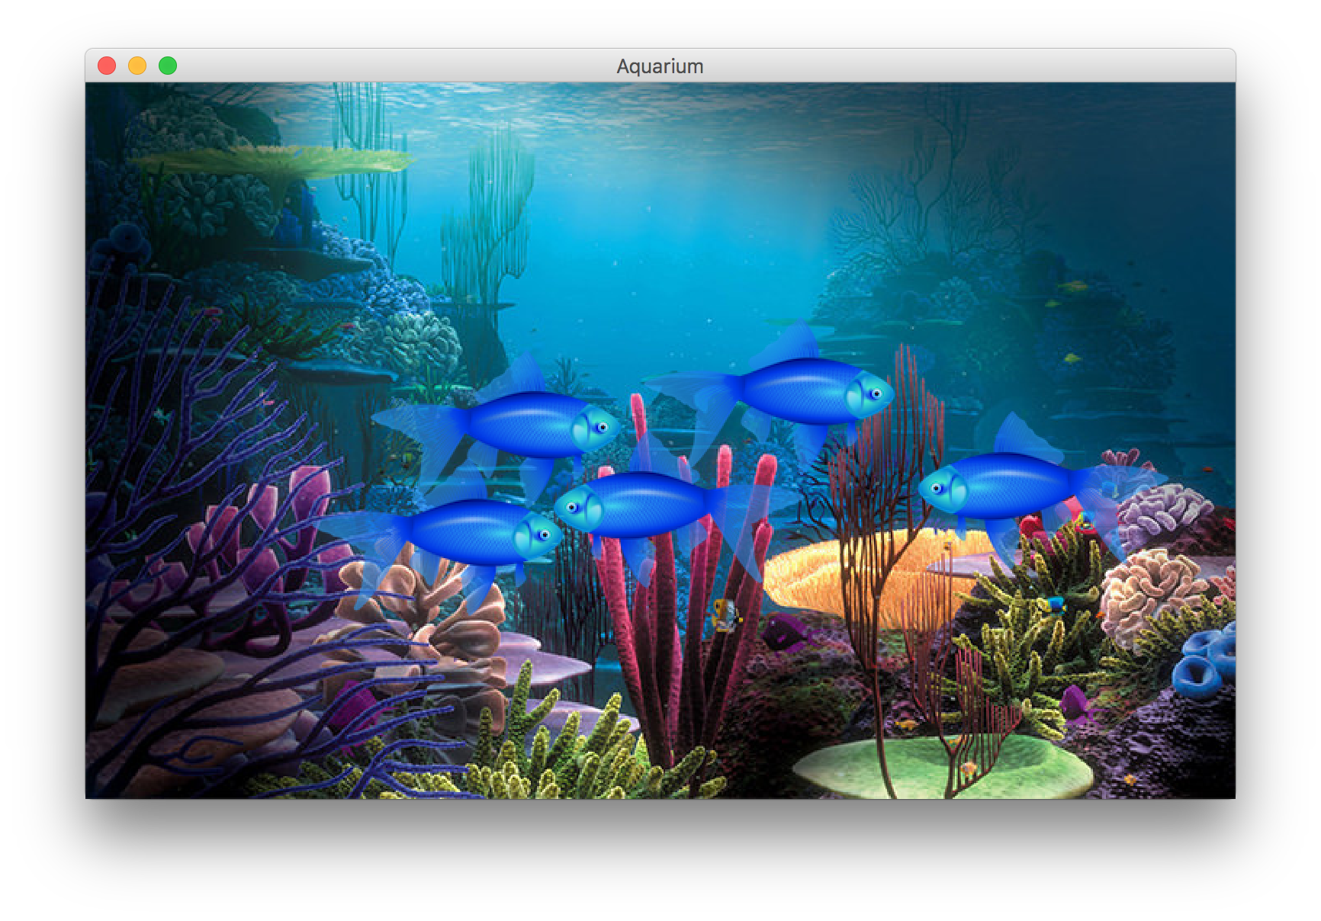
Example: Aquarium
We used classes to make a graphical program called Aquarium that simulates fish swimming around.

Slide 9
Aquarium.java
public class Aquarium extends Program {
private static final int NUM_FISH = 5;
private FishTank tank;
public void init() {
tank = new FishTank();
add(tank);
}
...

Slide 10
Aquarium.java
...
public void run() {
tank.initialize();
for (int i = 0; i < NUM_FISH; i++) {
tank.addFish();
}
while (true) {
tank.moveFish();
pause(30);
}
}
}

Slide 11
FishTank.java
public class FishTank extends GCanvas {
private ArrayList<Fish> fish;
public FishTank() {
fish = new ArrayList<>();
}
public void initialize() {
GImage background = new GImage("res/bkrnd.jpg");
background.setSize(getWidth(), getHeight());
add(background);
}
...

Slide 12
FishTank.java
...
public void addFish() {
Fish newFish = new Fish(getWidth(), getHeight());
fish.add(newFish);
add(newFish.getImage());
}
public void moveFish() {
for (Fish currentFish : fish) {
currentFish.swim(getWidth(), getHeight());
}
}
}

Slide 13
Plan for today
Recap: Extending GCanvas
Interactors
JButton
JLabel
JTextField
Example: TipCalculator
NameSurfer

Slide 14
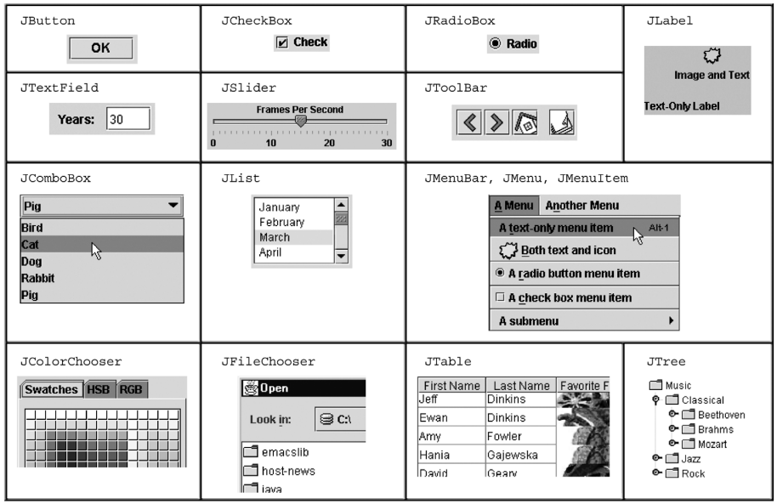
Interactors
Notes:
Going to focus on 3

Slide 15
Interactors
JComponent
JButton
JTextField
JLabel

Slide 16
Plan for today
Recap: Extending GCanvas
Interactors
JButton
JLabel
JTextField
Example: TipCalculator
NameSurfer

Slide 17
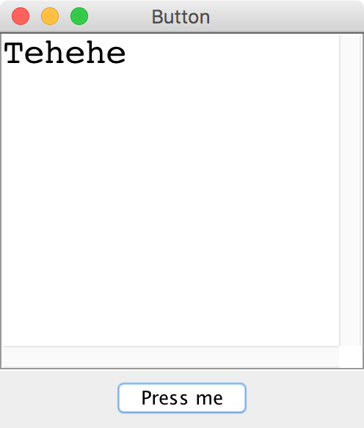
JButton

Slide 18
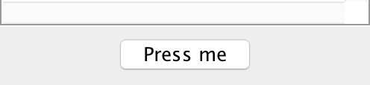
JButton
import java.awt.event.*;
import javax.swing.*;
JButton button = new JButton(“Press me”);
add(button, SOUTH);

Slide 19
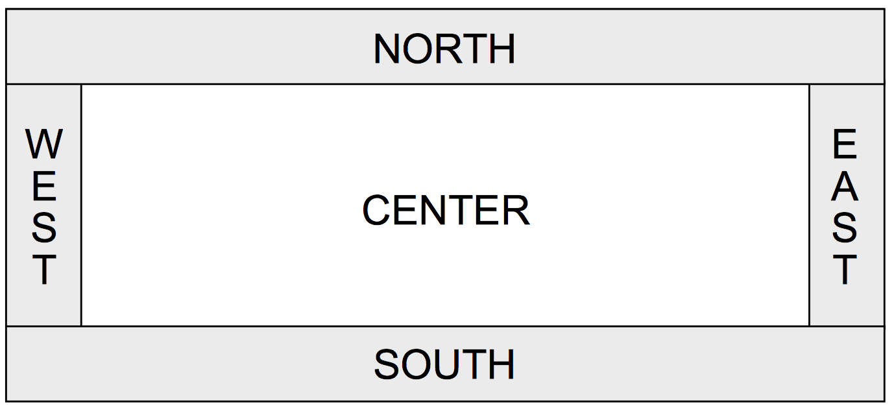
Window Regions
In graphics or console programs, the window is divided into five regions:
The CENTER region is typically where the action happens.
ConsoleProgram adds a console there
GraphicsProgram puts a GCanvas there
Other regions are visible only if you add an interactor to them using add(component, REGION);
Interactors are automatically centered within each region.

Slide 20
Responding To Button Clicks
To respond to events from interactors, we must do the following:
Call addActionListeners() at the end of init, once we are done adding buttons. This tells Java to let us know if any of the previous buttons were clicked.
Implement the public actionPerformed method. This method is called whenever a button is clicked.
Notes:
Only once all buttons are added!

Slide 21
JButton Example
public class Interactors extends ConsoleProgram {
public void init() { JButton yayButton = new JButton("Yay");
add(yayButton, SOUTH);
JButton nayButton = new JButton("Nay");
add(nayButton, SOUTH);
addActionListeners();
}
public void actionPerformed(ActionEvent event) {
... // ?
}
}

Slide 22
ActionEvent
The ActionEvent parameter contains useful event information.
Use getSource or getActionCommand to figure out what button or component was interacted with.
public void actionPerformed(ActionEvent event) {
String command = event.getActionCommand();
if (command.equals("Save File")) {
// user clicked the Save File button
...
}
}
Method | Description
e.getActionCommand() | a text description of the event (e.g. the text of the button clicked)
e.getSource() | the interactor that generated the event

Slide 23
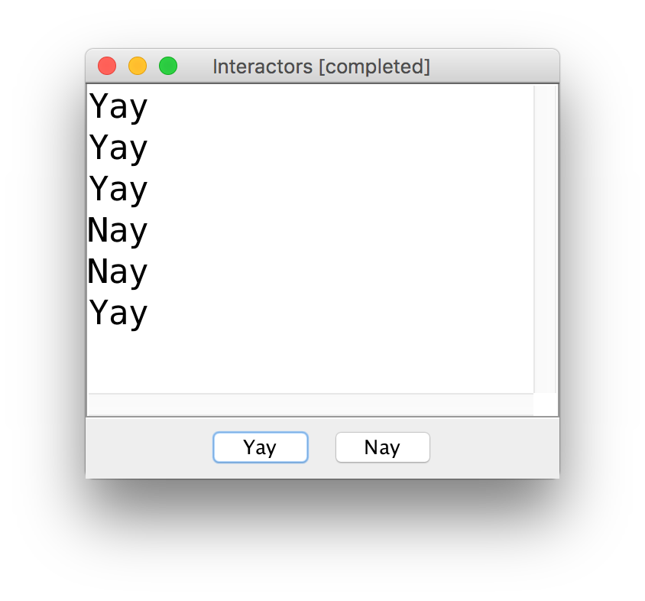
JButton Example

Slide 24
JButton Example
public class Interactors extends ConsoleProgram {
private JButton yayButton;
private JButton nayButton;
public void init() { yayButton = new JButton("Yay");
add(yayButton, SOUTH);
nayButton = new JButton("Nay");
add(nayButton, SOUTH);
addActionListeners();
}
public void actionPerformed(ActionEvent event) {
if (event.getSource() == yayButton) {
println("Yay");
} else if (event.getSource() == nayButton) {
println("Nay");
}
}
}

Slide 25
JButton Example #2
public class Interactors extends ConsoleProgram {
private JButton yayButton;
private JButton nayButton;
public void init() { JButton yayButton = new JButton("Yay");
add(yayButton, SOUTH);
JButton nayButton = new JButton("Nay");
add(nayButton, SOUTH);
addActionListeners();
}
public void actionPerformed(ActionEvent event) {
if (event.getActionCommand().equals("Yay")) {
println("Yay");
} else if (event.getActionCommand().equals("Nay")) {
println("Nay");
}
}
}

Slide 26
JButton Example #2
public class Interactors extends ConsoleProgram {
public void init() { JButton yayButton = new JButton("Yay");
add(yayButton, SOUTH);
JButton nayButton = new JButton("Nay");
add(nayButton, SOUTH);
addActionListeners();
}
public void actionPerformed(ActionEvent event) {
println(event.getActionCommand());
}
}
Notes:
Less hassle – no ivars!

Slide 27
Plan for today
Recap: Extending GCanvas
Interactors
JButton
JLabel
JTextField
Example: TipCalculator
NameSurfer

Slide 28
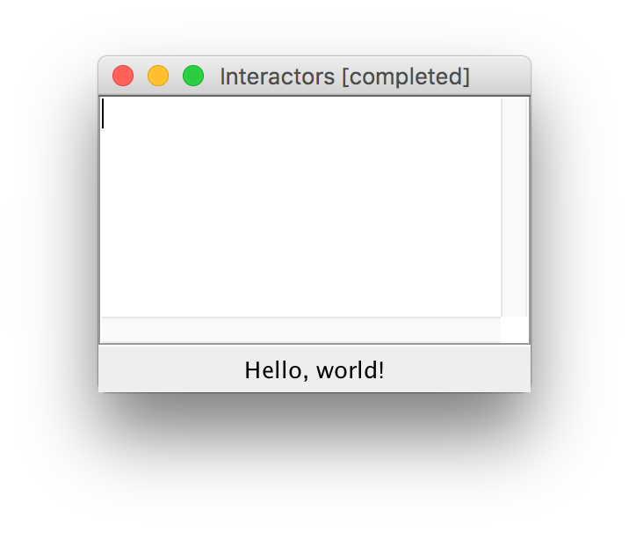
JLabel
JLabel label = new JLabel("Hello, world!");
add(label, SOUTH);

Slide 29
Plan for today
Recap: Extending GCanvas
Interactors
JButton
JLabel
JTextField
Example: TipCalculator
NameSurfer

Slide 30
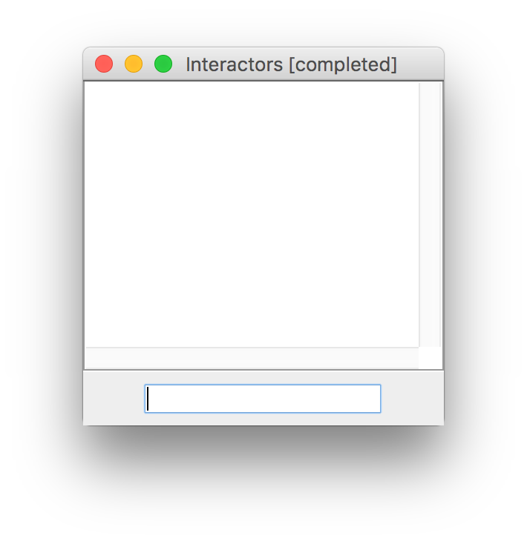
JTextField
JTextField field = new JTextField(10);
add(field, SOUTH);

Slide 31
JTextField
JTextField field = new JTextField(10);
add(field, SOUTH);
// Set the text in the text field
field.setText("Hello!");
// Get the text currently in the text field
String text = field.getText();

Slide 32
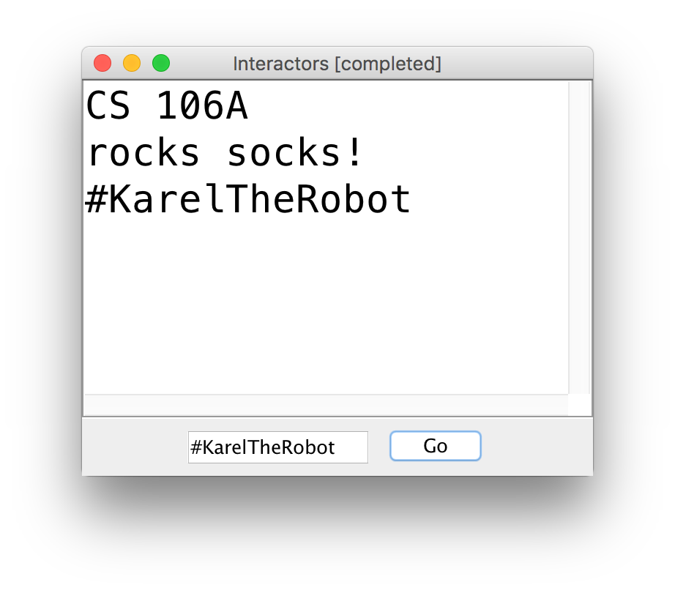
JTextField Example

Slide 33
JTextField Example
public class Interactors extends ConsoleProgram {
private JTextField textField;
public void init() {
textField = new JTextField(10);
add(textField, SOUTH); JButton goButton = new JButton("Go");
add(goButton, SOUTH);
addActionListeners();
}
public void actionPerformed(ActionEvent event) {
println(textField.getText());
}
}
Notes:
But what if we want to detect ENTER too?

Slide 34
Detecting ENTER Pressed
Detecting the ENTER key pressed in a JTextField requires extra work.
JTextField field = new JTextField(10);
// Tells Java to listen for ENTER on the text field
field.addActionListener(this);
// Sets the action command (like JButtons) to “Go”
field.setActionCommand("Go");
add(field, SOUTH);
Notes:
Not the default

Slide 35
Detecting ENTER Pressed
Detecting the ENTER key pressed in a JTextField requires extra work.
JTextField field = new JTextField(10);
field.addActionListener(this);
field.setActionCommand("Go");
add(field, SOUTH);
...
public void actionPerformed(ActionEvent event) {
if (event.getActionCommand().equals(“Go”)) {
...
}
}
Notes:
Can also check using e.getSource, but this is easier – why?

Slide 36
getActionCommand
Oftentimes, a text field has a “corresponding” button that takes action with the entered text. If we set the text field’s action command to be the same as its corresponding button, we can check for both a click and ENTER at once!

Slide 37
getActionCommand
public void init() {
JButton button = new JButton("Go");
add(button, SOUTH);
JTextField field = new JTextField(10);
field.addActionListener(this);
field.setActionCommand("Go");
add(field, SOUTH);
addActionListeners();
}
public void actionPerformed(ActionEvent event) {
if (event.getActionCommand().equals(“Go”)) {
...
}
}

Slide 38
getActionCommand
public void init() {
JButton button = new JButton("Go");
add(button, SOUTH);
JTextField field = new JTextField(10);
field.addActionListener(this);
field.setActionCommand("Go");
add(field, SOUTH);
addActionListeners();
}
public void actionPerformed(ActionEvent event) {
if (event.getActionCommand().equals(“Go”)) {
...
}
}

Slide 39
Plan for today
Recap: Extending GCanvas
Interactors
JButton
JLabel
JTextField
Example: TipCalculator
NameSurfer

Slide 40
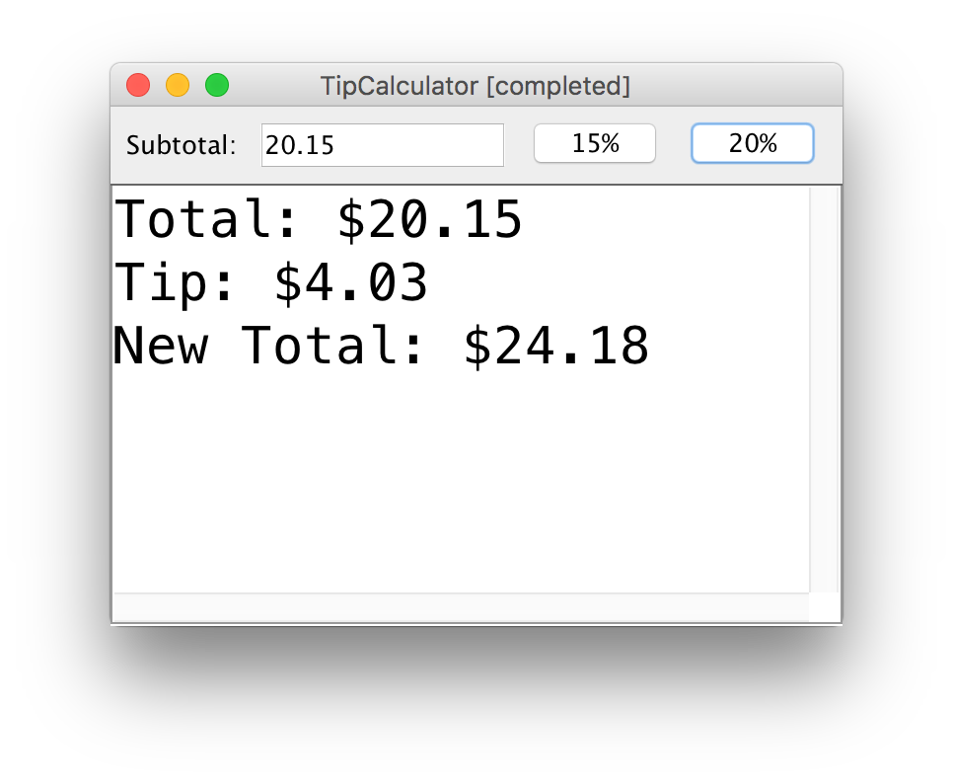
Practice: TipCalculator
Let’s write a program called TipCalculator that uses interactors to calculate the tip for a bill.

Slide 41
Practice: TipCalculator
Let’s write a program called TipCalculator that uses interactors to calculate the tip for a bill.
The program should calculate the appropriate tip depending on the button the user clicks on
The console should clear when a new tip is calculated (hint: use clearConsole()).
Convert a string into a double using Double.parseDouble(str);

Slide 42
Plan for today
Recap: Extending GCanvas
Interactors
JButton
JLabel
JTextField
Example: TipCalculator
NameSurfer

Slide 43
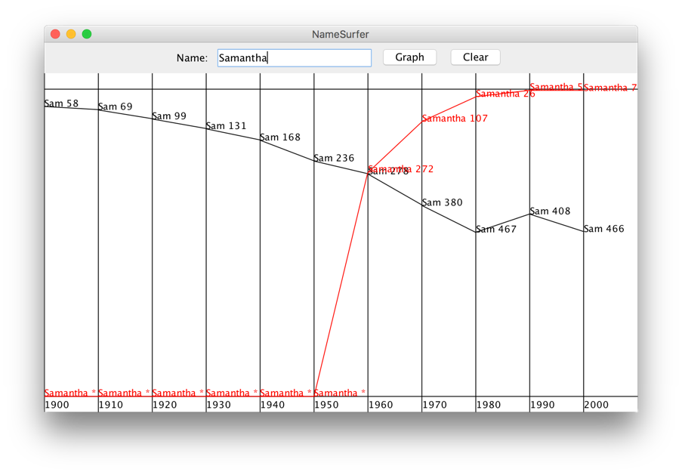
NameSurfer

Slide 44
NameSurfer Structure
NameSurfer.java – handles the interactors and overall program
NameSurferEntry – handles information about a single name and its ranks
NameSurferDatabase – handles information about all names and their ranks, and looks up info by name
NameSurferGraph – a GCanvas subclass that displays the name plots

Slide 45
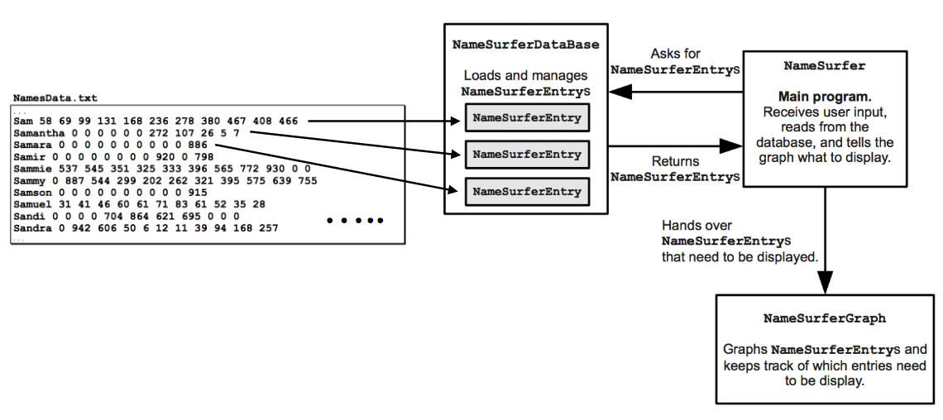
NameSurfer Structure

Slide 46
NameSurfer Structure
NameSurfer.java – handles the interactors and overall program
NameSurferEntry – handles information about a single name and its ranks
NameSurferDatabase – handles information about all names and their ranks, and looks up info by name
NameSurferGraph – a GCanvas subclass that displays the name plots
Notes:
Like Aquarium.java

Slide 47
NameSurfer Structure
NameSurfer.java – handles the interactors and overall program
NameSurferEntry – handles information about a single name and its ranks
NameSurferDatabase – handles information about all names and their ranks, and looks up info by name
NameSurferGraph – a GCanvas subclass that displays the name plots

Slide 48
NameSurferEntry
Responsible for storing the data about one name/line in the text file -> name and ranks. (Hint: use a Scanner!)
What instance variables does a NameSurferEntry need?
Implement the following methods:
public NameSurferEntry(String dataLine)
public String getName()
public int getRank(int decadesSince1900)
public String toString()

Slide 49
NameSurfer Structure
NameSurfer.java – handles the interactors and overall program
NameSurferEntry – handles information about a single name and its ranks
NameSurferDatabase – handles information about all names and their ranks, and looks up info by name
NameSurferGraph – a GCanvas subclass that displays the name plots

Slide 50
NameSurferDatabase
Responsible for reading in the text file and creating/storing NameSurferEntry objects.
Needs to be able to find entries given their name (case insensitive!). What data structure might be useful here?

Slide 51
NameSurferDatabase
// TODO: comment this file
import java.io.*;
import java.util.*;
public class NameSurferDatabase implements NameSurferConstants {
// TODO: comment this constructor
public NameSurferDatabase(String filename) {
// TODO: fill this in
}
// TODO: comment this method
public NameSurferEntry findEntry(String name) {
// TODO: implement this method
return null; // remove this line
}
}

Slide 52
NameSurfer Structure
NameSurfer.java – handles the interactors and overall program
NameSurferEntry – handles information about a single name and its ranks
NameSurferDatabase – handles information about all names and their ranks, and looks up info by name
NameSurferGraph – a GCanvas subclass that displays the name plots

Slide 53
NameSurferGraph
A subclass of GCanvas that handles all the graph drawing (similar to FishTank.java in our Aquarium program)
Different, cycling colors for each plot line
Ranks range from 1 to 1000, with rank 0 specially marked at the bottom
Tip: use the output comparison tool!

Slide 54
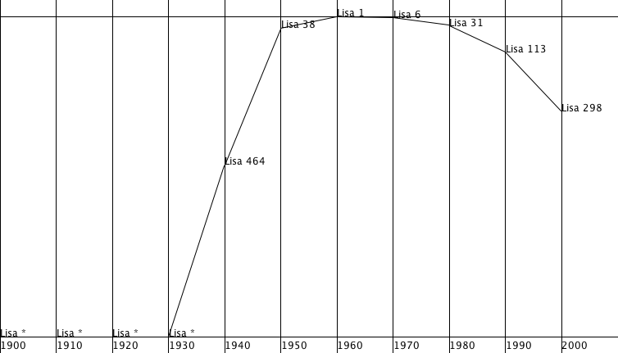
NameSurferGraph
Rank 1
Rank 1000
AND 0
Notes:
Fencepost!

Slide 55
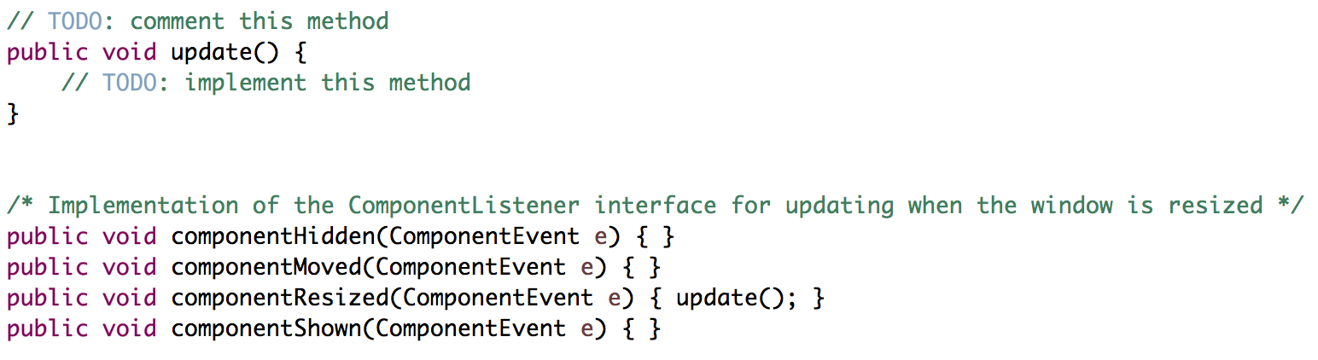
NameSurferGraph: Resizing

Slide 56
NameSurferGraph: Resizing
Every time the window resizes, update() is called.
Therefore, update() must clear and redraw the whole graph.
This means the graph must store the entries being graphed so it can redraw them whenever it needs to. What might be appropriate to help us store this?
Other required methods:
clear()
addEntry(NameSurferEntry entry)
These methods do NOT actually alter the graphics. You must call update() to do that, since update() must do all the drawing.

Slide 57
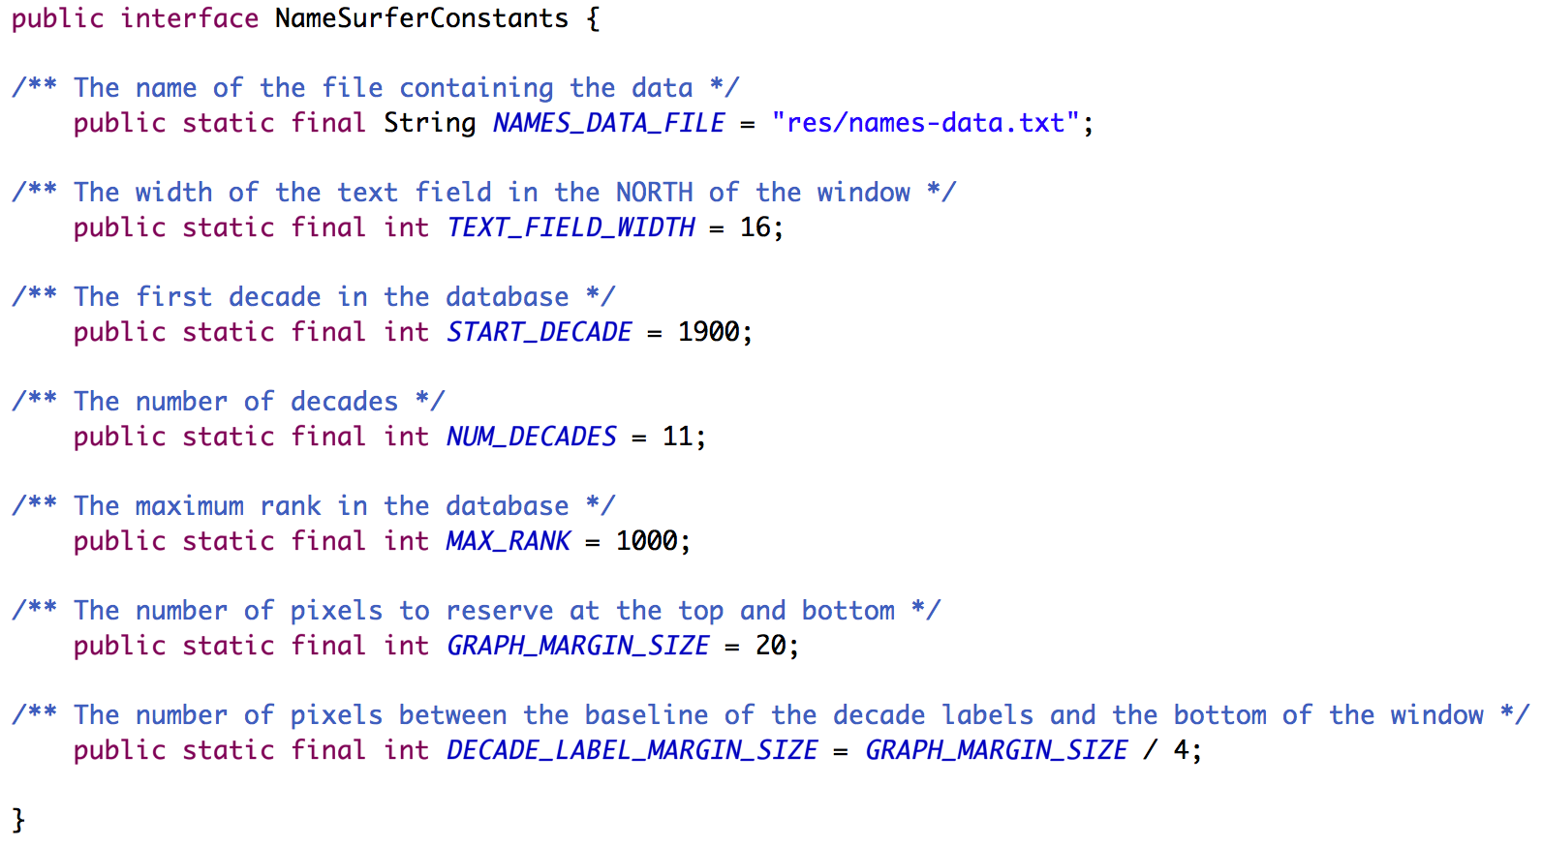
NameSurferConstants
Make sure to always use the provided constants! You may add more, but add them in other files, not this provided one.

Slide 58
Recap
Recap: Extending GCanvas
Interactors: JButton, JLabel, JTextField
Example: TipCalculator
NameSurfer
Next time: Life after CS 106A, Part 1

