Slide 1
CS 106A, Lecture 7 Parameters and Return
suggested reading:
Java Ch. 5.1-5.4

Slide 2
Plan For Today
Announcements
Recap: Scope
Parameters
Return

Slide 3
Announcements
Assignment 2 is out!
Due next Wednesday, 7/11
No partners
Use the output comparison tool
YEAH (Your Early Assignment Help) hours
Friday 7/6, 1:30PM-2:20PM in Gates B01

Slide 4
Plan For Today
Announcements
Recap: Scope
Parameters
Return

Slide 5
Methods in Java
We can define new methods in Java just like in Karel:
private void name() {
statement;
statement;
...
}
For example:
private void printGreeting() {
println("Hello world!");
println("I hope you have a great day.");
}
Notes:
Use to factor out duplicated code

Slide 6
Methods in Java
public void run() {
int x = 2;
printX();
}
private void printX() {
// ERROR! "Undefined variable x"
println("X has the value " + x);
}
Notes:
But….methods can’t share variables! Why? SCOPE

Slide 7

By Chris Piech

Slide 8
Variable Scope
The scope of a variable refers to the section of code where a variable can be accessed.
Scope starts where the variable is declared.
Scope ends at the termination of the code block in which the variable was declared.
A code block is a chunk of code between { } braces
Notes:
Applies to methods and control flow

Slide 9
Variable Scope
Variables have a lifetime (called scope):
public void run() {
… some code
if (condition) {
int w = 4;
… some code
}
… some other code
}
w is created here
w’s scope
w goes away here (at the end of its code block)

Slide 10
Variable Scope
You cannot have two variables with the same name in the same scope.
for (int i = 1; i <= 100; i++) {
int i = 2; // ERROR
print("/");
}

Slide 11
Variable Scope
You can have two variables with the same name in separate scopes.
public void run() {
for (int i = 0; i < 5; i++) { // i ok here
int w = 2; // w ok here
}
for (int i = 0; i < 2; i++) { // i ok here
int w = 3; // w ok here
}
}

Slide 12
Variable Scope
You can have two variables with the same name in separate scopes.
public void run() {
int num = 5;
cow();
println(num); // prints 5
}
private void cow() {
int num = 10;
println(num); // prints 10
}

Slide 13
Plan For Today
Announcements
Recap: Scope
Parameters
Return

Slide 14
Parameters
Parameters let you provide a method some information when you are calling it.
Notes:
Calling just means executing it

Slide 15


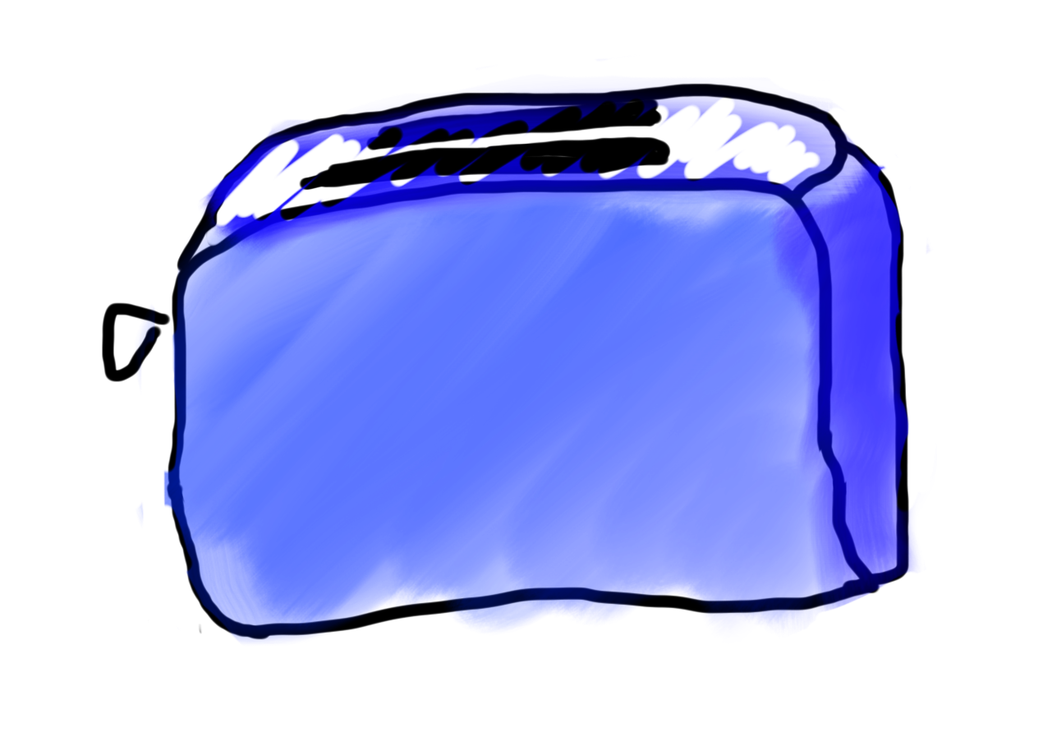
Methods = Toasters
parameter

Slide 16
Example: readInt
readInt(”Your guess? ");

Slide 17
Example: readInt
readInt(”Your guess? ");
We call readInt
We give readInt some information in parentheses (the text to print to the user)
Notes:
So far, we’ve only seen methods that take one String parameter

Slide 18
Declaring a parameter
Stating that a method requires a parameter in order to run
private void name(type name) {
statements;
}
Example:
private void password(int code) {
println("The password is: " + code);
}
When password is called, the caller must specify the integer code to print.

Slide 19
Example: printGreeting
printGreeting(5);
(Prints a greeting a certain number of times)

Slide 20
Wouldn’t it be nice if…
We give printGreeting some information (the number of greetings to print)
We call printGreeting
printGreeting(5);
Notes:
Just like println or readInt, we have a method and give it some information
How do we define a command, or method, like this?

Slide 21
Methods with Parameters
Tells Java this method needs one int in order to execute.
private void printGreeting(int times) {
// use ‘times’ to print the greeting
}
Notes:
basically declare a variable that you want to pass in

Slide 22
Passing a parameter
Calling a method and specifying values for its parameters
methodName(expression);
Example:
public void run() {
password(42);
password(12345);
}
Output:
The password is 42
The password is 12345
Illegal to call without passing an int for that parameter.
password(); // Error
password(3.7); // Error
Notes:
We just talked about how to declare, now let’s talk about how to use
Int parameter was a contract

Slide 23
Methods with Parameters
printGreeting(5);
private void printGreeting(int times) {
// use ‘times’ to print the greeting
}
Notes:
how is this information useful?

Slide 24
Methods with Parameters
printGreeting(5);
private void printGreeting(int times) {
for (int i = 0; i < times; i++) {
println("Hello world!");
}
}
Notes:
Where do we call this printGreeting method?

Slide 25
Methods with Parameters
public void run() {
int repeats = 5;
printGreeting(repeats);
}
private void printGreeting(int times) {
for (int i = 0; i < times; i++) {
println("Hello world!");
}
}
Notes:
Let's see step by step how this works

Slide 26
Methods with Parameters
public void run() {
int repeats = 5;
printGreeting(repeats);
}
private void printGreeting(int times) {
for (int i = 0; i < times; i++) {
println("Hello world!");
}
}

Slide 27
Methods with Parameters
public void run() {
int repeats = 5;
printGreeting(repeats);
}
private void printGreeting(int times) {
for (int i = 0; i < times; i++) {
println("Hello world!");
}
}
run

Slide 28
Methods with Parameters
public void run() {
int repeats = 5;
printGreeting(repeats);
}
private void printGreeting(int times) {
for (int i = 0; i < times; i++) {
println("Hello world!");
}
}
run

Slide 29
Methods with Parameters
public void run() {
int repeats = 5;
printGreeting(repeats);
}
private void printGreeting(int times) {
for (int i = 0; i < times; i++) {
println("Hello world!");
}
}
run
run
repeats
5

Slide 30
Methods with Parameters
public void run() {
int repeats = 5;
printGreeting(repeats);
}
private void printGreeting(int times) {
for (int i = 0; i < times; i++) {
println("Hello world!");
}
}
run
repeats
5

Slide 31
Methods with Parameters
public void run() {
int repeats = 5;
printGreeting(repeats);
}
private void printGreeting(int times) {
for (int i = 0; i < times; i++) {
println("Hello world!");
}
}
run
repeats
5

Slide 32
Methods with Parameters
public void run() {
int repeats = 5;
printGreeting(repeats);
}
private void printGreeting(int times) {
for (int i = 0; i < times; i++) {
println("Hello world!");
}
}
printGreeting
run
repeats
5

Slide 33
Methods with Parameters
public void run() {
int repeats = 5;
printGreeting(repeats);
}
private void printGreeting(int times) {
for (int i = 0; i < times; i++) {
println("Hello world!");
}
}
printGreeting
times
run
repeats
5
5

Slide 34
Methods with Parameters
public void run() {
int times = 5;
printGreeting(times);
}
private void printGreeting(int times) {
for (int i = 0; i < times; i++) {
println("Hello world!");
}
}

Slide 35
Methods with Parameters
public void run() {
int times = 5;
printGreeting(times);
}
private void printGreeting(int times) {
for (int i = 0; i < times; i++) {
println("Hello world!");
}
}
run

Slide 36
Methods with Parameters
public void run() {
int times = 5;
printGreeting(times);
}
private void printGreeting(int times) {
for (int i = 0; i < times; i++) {
println("Hello world!");
}
}
run
times
5

Slide 37
Methods with Parameters
public void run() {
int times = 5;
printGreeting(times);
}
private void printGreeting(int times) {
for (int i = 0; i < times; i++) {
println("Hello world!");
}
}
run
times
5

Slide 38
Methods with Parameters
public void run() {
int times = 5;
printGreeting(times);
}
private void printGreeting(int times) {
for (int i = 0; i < times; i++) {
println("Hello world!");
}
}
run
times
5

Slide 39
Methods with Parameters
public void run() {
int times = 5;
printGreeting(times);
}
private void printGreeting(int times) {
for (int i = 0; i < times; i++) {
println("Hello world!");
}
}
printGreeting
run
times
5

Slide 40
Methods with Parameters
public void run() {
int times = 5;
printGreeting(times);
}
private void printGreeting(int times) {
for (int i = 0; i < times; i++) {
println("Hello world!");
}
}
printGreeting
times
run
times
5
5

Slide 41
Parameters are Copies
// NOTE: This program is buggy!!
public void run() {
int x = 3;
addFive(x);
// prints "x = 3"!
println("x = " + x);
}
private void addFive(int x) {
x += 5;
}
run
x
3

Slide 42
Parameters are Copies
// NOTE: This program is buggy!!
public void run() {
int x = 3;
addFive(x);
// prints "x = 3"!
println("x = " + x);
}
private void addFive(int x) {
x += 5;
}
run
x
addFive
x
3
3

Slide 43
Parameters are Copies
// NOTE: This program is buggy!!
public void run() {
int x = 3;
addFive(x);
// prints "x = 3"!
println("x = " + x);
}
private void addFive(int x) {
x += 5;
}
run
x
addFive
x
3
8

Slide 44
Parameters are Copies
// NOTE: This program is buggy!!
public void run() {
int x = 3;
addFive(x);
// prints "x = 3"!
println("x = " + x);
}
private void addFive(int x) {
x += 5;
}
run
x
3
Notes:
We’ll see later today how to fix this

Slide 45
Multiple parameters
A method can accept multiple parameters separated by commas: ,
When calling it, you must pass values for each parameter.
Declaration:
private void name(type name, ..., type name) {
statements;
}
Call:
name(value, value, ..., value);

Slide 46
Drawing boxes
Let’s write a program that uses methods and parameters to print the following boxes:
**********
* *
* *
**********
*******
* *
* *
* *
* *
*******
The code to draw each box will be very similar.
Would variables help? Would constants help?
Notes:
What command would be nice to have?

Slide 47
drawBox
drawBox(10, 4);

Slide 48
drawBox
private void drawBox(int width, int height) {
// use width and height variables
// to draw a box
}

Slide 49
drawBox
We give drawBox some information (the size of the box we want)
We call drawBox
drawBox(10, 4);

Slide 50
Parameters
parameter: A value passed to a method by its caller.
Write a method drawBox to draw a box of any size.
When declaring the method, we will state that it requires the caller to tell it the width and height of the box.
When calling the method, we will specify the width and height to use.
**********
* *
* *
**********
10, 4
run
drawBox
7, 5
drawBox
*******
* *
* *
* *
*******

Slide 51
drawBox
private void drawBox(int width, int height) {
// use width and height variables
// to draw a box
}

Slide 52
drawBox
**********
* *
* *
**********
private void drawBox(int width, int height) { drawLine(width); for (int line = 0; line < height - 2; line++) { boxSide(width);
}
drawLine(width);
}

Slide 53
drawBox
**********
* *
* *
**********
private void drawBox(int width, int height) { drawLine(width); for (int line = 0; line < height - 2; line++) { boxSide(width);
}
drawLine(width);
}

Slide 54
drawBox
**********
* *
* *
**********
private void drawBox(int width, int height) { drawLine(width); for (int line = 0; line < height - 2; line++) { boxSide(width);
}
drawLine(width);
}

Slide 55
drawBox
**********
* *
* *
**********
private void drawBox(int width, int height) { drawLine(width); for (int line = 0; line < height - 2; line++) { boxSide(width);
}
drawLine(width);
}

Slide 56
drawBox
**********
* *
* *
**********
private void drawBox(int width, int height) { drawLine(width); for (int line = 0; line < height - 2; line++) { boxSide(width);
}
drawLine(width);
}

Slide 57
line
**********
private void drawLine(int width) { for (int i = 0; i < width; i++) { print("*");
}
println();
}

Slide 58
boxSide
* *
private void boxSide(int width) {
print("*");
for (int i = 0; i < width - 2; i++) {
print(" ");
}
println("*");
}

Slide 59
boxSide
**********
* *
* *
**********
*******
* *
* *
* *
* *
*******
public void run() {
drawBox(10, 4);
drawBox(7, 6);
}

Slide 60
Plan For Today
Announcements
Recap: Scope
Parameters
Return

Slide 61
Return
Return values let you give back some information when a method is finished.
Notes:
When a method finishes it “returns” back to the caller

Slide 62
Methods = Toasters
parameter

Slide 63
Methods = Toasters
parameter

Slide 64
Methods = Toasters

Slide 65

Methods = Toasters

Slide 66

Methods = Toasters
return

Slide 67
Example: readInt
int x = readInt(”Your guess? ");
Notes:
We’ve already seen return values!

Slide 68
Example: readInt
int x = readInt(”Your guess? ");
We call readInt
We give readInt some information (the text to print to the user)

Slide 69
Example: readInt
int x = readInt(”Your guess? ");
When finished, readInt gives us information back (the user’s number) and we put it in x.
Notes:
When we set a variable equal to a method, this tells Java to save the return value in that variable

Slide 70
Example: readInt
int x = readInt(”Your guess? ");
When we set a variable equal to a method, this tells Java to save the return value of the method in that variable.
Notes:
When we set a variable equal to a method, this tells Java to save the return value in that variable

Slide 71
Example: metersToCm
double cm = metersToCm(5);
(Returns the given number of m as cm)

Slide 72
Example: metersToCm
We give metersToCm some information (the number of meters)
We call metersToCm
double cm = metersToCm(5);
Notes:
How do we define a command, or method, like this?
Finally time to learn about what is inside parentheses…

Slide 73
Example: metersToCm
When metersToCm finishes, it returns the number of cm, and we put that in this variable.
double cm = metersToCm(5);
Notes:
How do we define a command, or method, like this?
Finally time to learn about what is inside parentheses…

Slide 74
Methods and Return
Tells Java this method needs one double in order to execute.
private double metersToCm(double meters) {
...
}
Notes:
We’re being sloppy—there should be a .0

Slide 75
Methods and Return
Tells Java that, when this method finishes, it will return a double. (Void meant returns nothing)
private double metersToCm(double meters) {
...
}
Notes:
Void meant returns nothing!

Slide 76
Methods and Return
Tells Java that, when this method finishes, it will return a double.
private double metersToCm(double meters) {
return 100 * meters;
}
Notes:
Void meant returns nothing!

Slide 77
Methods and Return
public void run() {
double meters = readDouble("#meters? ”);
double cm = metersToCm(meters);
println(cm + " centimeters.");
}
private double metersToCm(double meters) {
return 100 * meters;
}

Slide 78
Methods and Return
public void run() {
double meters = readDouble("#meters? ”);
double cm = metersToCm(meters);
println(cm + " centimeters.");
}
private double metersToCm(double meters) {
return 100 * meters;
}
run
meters
?

Slide 79
Methods and Return
public void run() {
double meters = readDouble("#meters? ”);
double cm = metersToCm(meters);
println(cm + " centimeters.");
}
private double metersToCm(double meters) {
return 100 * meters;
}
run
meters
5

Slide 80
Methods and Return
public void run() {
double meters = readDouble("#meters? ”);
double cm = metersToCm(meters);
println(cm + " centimeters.");
}
private double metersToCm(double meters) {
return 100 * meters;
}
run
meters
metersToCm
meters
5
?

Slide 81
Methods and Return
public void run() {
double meters = readDouble("#meters? ”);
double cm = metersToCm(meters);
println(cm + " centimeters.");
}
private double metersToCm(double meters) {
return 100 * meters;
}
run
meters
metersToCm
meters
5
5

Slide 82
Methods and Return
public void run() {
double meters = readDouble("#meters? ”); double cm = metersToCm(meters);
println(cm + " centimeters.");
}
private double metersToCm(double meters) {
return 100 * meters;
}
500
run
meters
metersToCm
meters
5
5

Slide 83
Methods and Return
public void run() {
double meters = readDouble("#meters? ”); double cm = metersToCm(meters);
println(cm + " centimeters.");
}
private double metersToCm(double meters) {
return 100 * meters;
}
500
run
cm meters
metersToCm
meters
500
5
5
Notes:
If you just call metersToCm but don’t save it, it won’t put the 500 anywhere!

Slide 84
Methods and Return
public void run() {
double meters = readDouble("#meters? ”); double cm = metersToCm(meters);
println(cm + " centimeters.");
}
private double metersToCm(double meters) {
return 100 * meters;
}
run
cm meters
500
5

Slide 85
Methods and Return
public void run() {
double meters = readDouble("#meters? ”);
println(metersToCm(meters) + "cm.");
}
private double metersToCm(double meters) {
return 100 * meters;
}
If a method returns something, you can use it directly in an expression!
Notes:
Can also use the method directly as a value

Slide 86
Parameters vs. Return
return: To send out a value as the result of a method.
Parameters send information in from the caller to the method.
Return values send information out from a method to its caller.
A call to the method can be used as part of an expression.
Q: Why return? Why not just println the result value?
-42
Math.abs(-42)
42
run
2.71
3
Math.round(2.71)

Slide 87
Methods
visibility type nameOfMethod(parameters) {
statements
}
visibility: usually private or public
type: type returned by method (e.g., int , double, etc.)
Can be void to indicate that nothing is returned
parameters: information passed into method

Slide 88
Returning Booleans
private boolean isEven(int number) {
}

Slide 89
Returning Booleans
private boolean isEven(int number) {
if (number % 2 == 0) {
return true;
else {
return false;
}
}

Slide 90
Returning Booleans
private boolean isEven(int number) {
if (number % 2 == 0) {
return true;
else {
return false;
}
}
public void run() { int num = readInt("? ");
if (isEven(num)) {
println("Even!");
} else {
println("Odd!");
}
}
Notes:
Can also use the method directly as a value

Slide 91
Returning Booleans
private boolean isEven(int number) {
return number % 2 == 0;
}
public void run() { int num = readInt("? ");
if (isEven(num)) {
println("Even!");
} else {
println("Odd!");
}
}
Notes:
Rather than if condition return true else return false, just return the condition!

Slide 92
Return
Return ends a method’s execution.
private int multiplyByTwo(int num) {
return num * 2;
println("Hello world?"); // not executed!
}
Notes:
Want to walk through in depth example

Slide 93
Return
private int max(int num1, int num2) {
if (num1 >= num2) {
return num1;
}
return num2; // here only if num1 < num2
}
Return ends a method’s execution.
public void run() {
println(max(2,3));
}
Notes:
Want to walk through in depth example

Slide 94
Revisiting a Bug
// NOTE: This program is buggy!!
public void run() {
int x = 3;
addFive(x);
// prints "x = 3"!
println("x = " + x);
}
private void addFive(int x) {
x += 5;
}

Slide 95
Fixed!
// NOTE: This program is feeling just fine
public void run() {
int x = 3;
x = addFive(x);
// prints "x = 5"!
println("x = " + x);
}
private int addFive(int x) {
x += 5;
return x;
}

Slide 96
Recap
Announcements
Recap: Scope
Parameters
Return
Next time: Strings (new variable type!)

