Slide 1
CS 106A, Lecture 22 More Classes
suggested reading:
Java Ch. 6

Slide 2
Plan for today
Announcements
Review: Classes
toString
this
Practice: Employee
Inheritance
Preview: Extending GCanvas
Recap

Slide 3
Learning Goals
Know how to define our own variable types
Know how to define variable types that inherit from other types
Be able to write programs consisting of multiple classes

Slide 4
Plan for today
Announcements
Review: Classes
toString
this
Practice: Employee
Inheritance
Preview: Extending GCanvas
Recap

Slide 5
Announcements
Assignment 5 due/Assignment 6 out Monday
Reminder: the 106A website’s “Schedule” page has lots of neat stuff for each lecture!
Slides and suggested reading sections
Starter code and polished solutions for live-coded programs
CodeStepByStep practice problems
Midterm regrade requests can be made on Gradescope until 1PM on Monday

Slide 6
Plan for today
Announcements
Review: Classes
toString
this
Practice: Employee
Inheritance
Preview: Extending GCanvas
Recap

Slide 7
What Is A Class?
A class defines a new variable type.

Slide 8


Classes Are Like Blueprints
iPod blueprint (class)
state: current song volume battery life
behavior: power on/off change station/song change volume choose random song
constructs
iPod (variable) #1
state: song = "1,000,000 Miles" volume = 17 battery life = 2.5 hrs
behavior: power on/off change station/song change volume choose random song
iPod (variable) #2
state: song = "Letting You" volume = 9 battery life = 3.41 hrs
behavior: power on/off change station/song change volume choose random song
iPod (variable) #3
state: song = "Discipline" volume = 24 battery life = 1.8 hrs
behavior: power on/off change station/song change volume choose random song

Slide 9
Creating A New Class
What information is inside this new variable type?
These are its instance variables.
How do you create a variable of this type?
This is the constructor.
What can this new variable type do?
These are its public methods.

Slide 10
Example: BankAccount
Let’s see the code!

Slide 11
Plan for today
Announcements
Review: Classes
toString
this
Practice: Employee
Inheritance
Preview: Extending GCanvas
Recap

Slide 12
Printing Variables
By default, Java doesn't know how to print objects.
BankAccount ba1 = new BankAccount("Marty", 1.25);
println("ba1 is " + ba1); // ba1 is BankAccount@9e8c34
// better, but cumbersome to write
println("ba1 is " + ba1.getName() + " with $"
+ ba1.getBalance()); // ba1 is Marty with $1.25
// desired behavior
println("ba1 is " + ba1); // ba1 is Marty with $1.25

Slide 13
The toString Method
A special method in a class that tells Java how to convert an object
into a string.
BankAccount ba1 = new BankAccount("Marty", 1.25);
println("ba1 is " + ba1);
// the above code is really calling the following:
println("ba1 is " + ba1.toString());
Every class has a toString, even if it isn't in your code.
Default: class's name @ object's memory address (base 16)
BankAccount@9e8c34

Slide 14
The toString Method
public String toString() {
code that returns a String
representing this object;
}
Method name, return, and parameters must match exactly.
Example:
// Returns a String representing this account.
public String toString() {
return name + " has $" + balance;
}

Slide 15
Plan for today
Announcements
Review: Classes
toString
this
Practice: Employee
Inheritance
Preview: Extending GCanvas
Recap

Slide 16
The “this” Keyword
this: Refers to the object on which a method is currently being called
BankAccount ba1 = new BankAccount();
ba1.deposit(5);
// in BankAccount.java
public void deposit(double amount) {
// for code above, “this” -> ba1
...
}

Slide 17
Using “this”
Sometimes we want to name parameters the same as instance variables.
public class BankAccount {
private double balance;
private String name;
...
public void setName(String newName) {
name = newName;
}
}
Here, the parameter to setName is named newName to be distinct from the object's field name .

Slide 18
Using “this”
public class BankAccount {
private double balance;
private String name;
...
public void setName(String name) {
name = name;
}
}

Slide 19
Using “this”
We can use “this” to specify which one is the instance variable
and which one is the local variable.
public class BankAccount {
private double balance;
private String name;
...
public void setName(String name) {
this.name = name;
}
}

Slide 20
Plan for today
Announcements
Review: Classes
toString
this
Practice: Employee
Inheritance
Preview: Extending GCanvas
Recap

Slide 21
Practice: Employee
Let’s define a new variable type called Employee that represents a single Employee.
What information would an Employee store?
What could an Employee do?
How would you create a new Employee variable?

Slide 22
Plan for today
Announcements
Review: Classes
toString
this
Practice: Employee
Inheritance
Preview: Extending GCanvas
Recap

Slide 23
Inheritance
Inheritance lets us relate our variable types to one another.

Slide 24
Inheritance
Variable types can seem to “inherit” from one other. We don’t want to have to duplicate code for each one!
Employee
Programmer
Karel Programmer

Slide 25
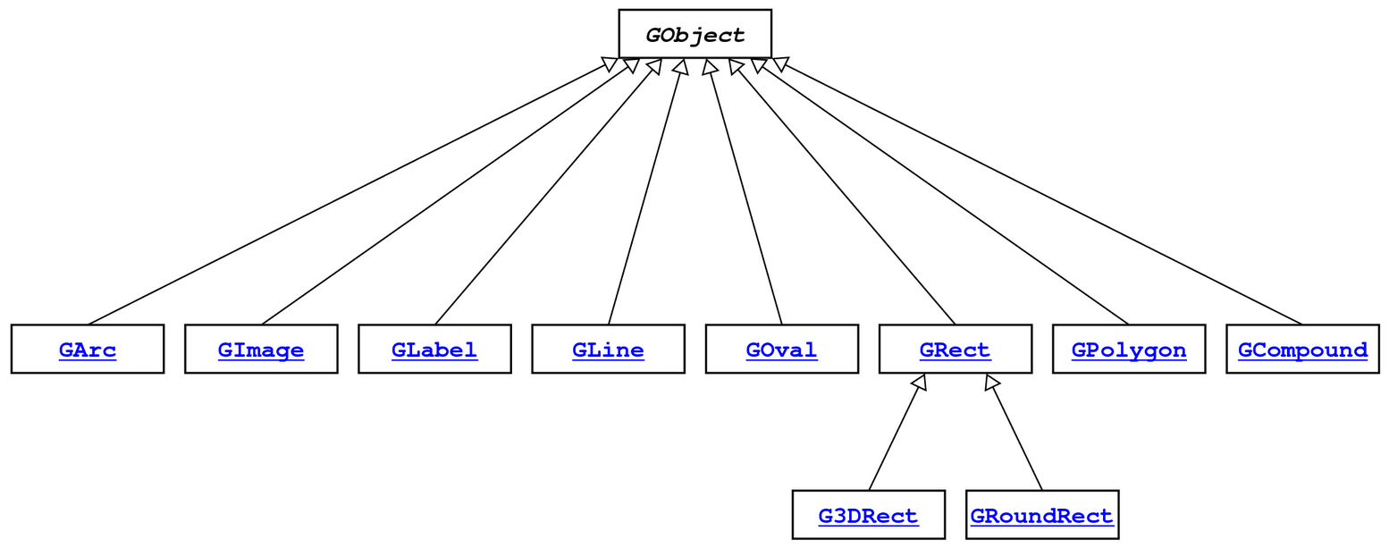
Example: GObjects
The Stanford library uses an inheritance hierarchy of graphical objects based on a common superclass named GObject.

Slide 26
Example: GObjects
GObject defines the state and behavior common to all shapes:
contains(x, y)
getColor(), setColor(color)
getHeight(), getWidth(), getLocation(), setLocation(x, y)
getX(), getY(), setX(x), setY(y), move(dx, dy)
setVisible(visible), sendForward(), sendBackward()
toString()
The subclasses add state and behavior unique to them:
GLabel GLine GPolygon
get/setFont get/setStartPoint addEdge
get/setLabel get/setEndPoint addVertex
get/setFillColor
... ... ..

Slide 27
Using Inheritance
public class Name extends Superclass {
Example:
public class Programmer extends Employee {
...
}
By extending Employee, this tells Java that Programmer can do everything an Employee can do, plus more.
Programmer automatically inherits all of the code from Employee!
The superclass is Employee, the subclass is Programmer.

Slide 28
Example: Programmer
public class Programmer extends Employee {
private int timeCoding;
...
public void code() { timeCoding += 10;
}
}
...
Programmer annie = new Programmer(“Annie”);
annie.code(); // from Programmer
annie.promote(); // from Employee!
Notes:
If you add functionality to Employee it adds everywhere

Slide 29
Example: KarelProgrammer
public class KarelProgrammer extends Programmer {
private int numBeepersPicked;
...
public void pickBeepers() { numBeepersPicked += 2;
}
}
...
KarelProgrammer colin = new KarelProgrammer(“Colin”);
colin.pickBeepers(); // from KarelProgrammer
colin.code(); // from Programmer!
colin.promote(); // From Employee!

Slide 30
Advanced: Overriding
public class KarelProgrammer extends Programmer {
...
@Override
public boolean promote() { salary *= 3;
return true;
}
}
...
KarelProgrammer colin = new KarelProgrammer(“Colin”);
colin.promote(); // From KarelProgrammer, not Employee!

Slide 31
Advanced: Overriding
public class Clicker extends GraphicsProgram {
...
@Override
public void mouseClicked(MouseEvent e) { // do some stuff
}
}

Slide 32
Plan for today
Announcements
Review: Classes
toString
this
Practice: Employee
Inheritance
Preview: Extending GCanvas
Recap

Slide 33
GCanvas
A GCanvas is the canvas area that displays all graphical objects in a GraphicsProgram.
When you create a GraphicsProgram, it automatically creates a GCanvas for itself, puts it on the screen, and uses it to add all graphical shapes.
GCanvas is the one that contains methods like:
getElementAt
add
remove
getWidth
getHeight
…

Slide 34
GCanvas
public class Graphics extends GraphicsProgram {
public void run() { // A GCanvas has been created for us! GRect rect = new GRect(50, 50);
add(rect); // adds to the GCanvas!
...
// Checks our GCanvas for elements!
GObject obj = getElementAt(25, 25);
}
}

Slide 35
Extending GCanvas
public class Graphics extends Program {
public void run() { // We have to make our own GCanvas now
MyCanvas canvas = new MyCanvas();
add(canvas);
// Can’t do this anymore, because we are
// not using GraphicsProgram’s provided
// canvas
// GObject obj = getElementAt(…);
}
}
Notes:
We CAN say canvas.getElementAt, but we want to decompose all our graphics code out into the MyCanvas file

Slide 36
Extending GCanvas
public class Graphics extends Program {
public void run() { // We have to make our own GCanvas now
MyCanvas canvas = new MyCanvas();
add(canvas);
// Operate on this canvas
GObject obj = canvas.getElementAt(…);
}
}
Notes:
We CAN say canvas.getElementAt, but we want to decompose all our graphics code out into the MyCanvas file

Slide 37
Extending GCanvas
public class MyCanvas extends GCanvas {
public void addCenteredSquare(int size) {
GRect rect = new GRect(size, size);
int x = getWidth() / 2.0 –
rect.getWidth() / 2.0;
int y = getHeight() / 2.0 –
rect.getHeight() / 2.0;
add(rect, x, y);
}
}

Slide 38
Extending GCanvas
public class Graphics extends Program {
public void run() { // We have to make our own GCanvas now
MyCanvas canvas = new MyCanvas();
add(canvas);
canvas.addCenteredSquare(20);
}
}

Slide 39
Extending GCanvas
Sometimes, we want to be able to have all of our graphics-related code in a separate file.
To do this, instead of using the provided GraphicsProgram canvas, we define our own subclass of GCanvas, have our program extend Program, and add our own canvas ourselves.
Then, all graphics-related code can go in our GCanvas subclass.

Slide 40
The init method
init is a special public method, like run, that is called when your program is being initialized.
Unlike run, however, it is called before your program launches, letting you do any initialization you need.
public class MyProgram extends GraphicsProgram { public void init() {
// executed before program launches
}
public void run() {
// executed after program launches
}
}

Slide 41
The init method
init is typically used to initialize graphical components, such as adding a custom GCanvas to the screen.
public class MyProgram extends Program {
private MyCanvas canvas; public void init() {
canvas = new MyCanvas();
add(canvas);
}
public void run() {
canvas.addCenteredSquare(20);
}
}

Slide 42
Common Bugs
When you are using a custom canvas, make sure to not call getWidth or getHeight on the canvas until it is shown onscreen!
public class MyProgram extends Program {
private MyCanvas canvas; public void init() {
// canvas not created yet!
canvas = new MyCanvas();
// canvas not added yet!
add(canvas);
// window not showing yet!
}
public void run() {
// good to go
}
}

Slide 43
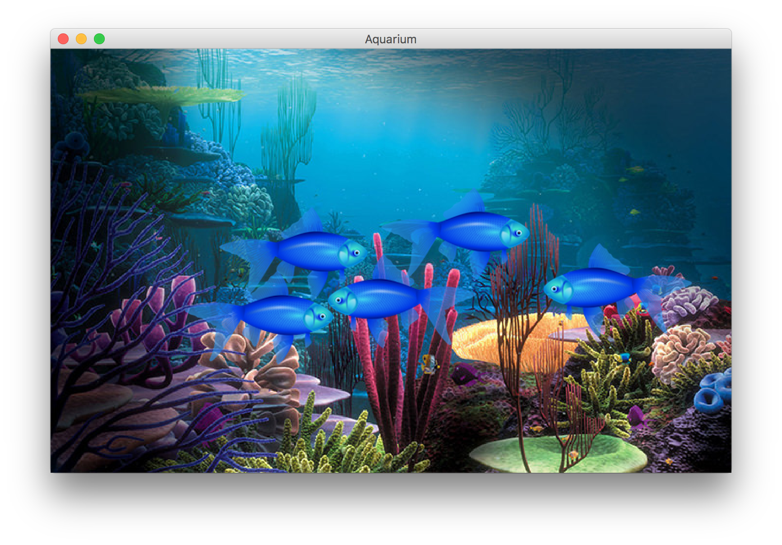
Preview: Aquarium
Let’s write a graphical program called Aquarium that simulates fish swimming around.
To decompose our code, we can make our own GCanvas subclass.

Slide 44
Plan for today
Announcements
Review: Classes
toString
this
Practice: Employee
Inheritance
Preview: Extending GCanvas
Recap

Slide 45
Recap
Classes let us define our own variable types, with their own instance variables, methods and constructors.
We can relate our variable types to one another by using inheritance. One class can extend another to inherit its behavior.
We can extend GCanvas in a graphical program to decompose all of our graphics-related code in one place.
Next time: Interactors and GUIs

