Slide 1
CS 106A, Lecture 9 Problem-Solving with Strings
suggested reading:
Java Ch. 8.5

Slide 2
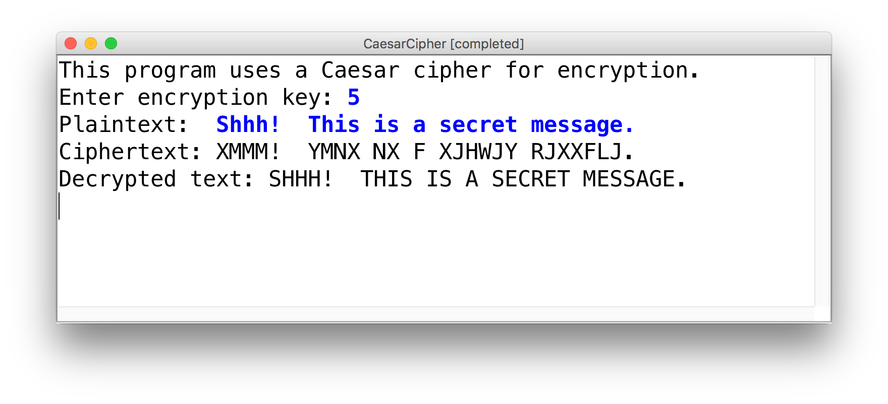
Learning Goals
Be able to write string algorithms that operate on each character.
Be able to build up new strings from existing strings using built-in String methods.

Slide 3
Plan For Today
Recap: Characters and Strings
Looping over Strings
Practice: Reversing a String
Practice: Palindromes
Practice: Caesar Cipher
Notes:
OAE for Midterm
Style guide update
Lecture 7 slides updated

Slide 4
Plan For Today
Recap: Characters and Strings
Looping over Strings
Practice: Reversing a String
Practice: Palindromes
Practice: Caesar Cipher

Slide 5





Text Processing

Slide 6
Char
A char is a variable type that represents a single character or “glyph”.
char letterA = 'A';
char plus = '+';
char zero = '0';
char space = ' ';
char newLine = '\n';
char tab = '\t';
char singleQuote = '\'';
char backSlash = '\\';
Notes:
Surrounded by single quotes
Can’t get char from user – but can get string, which we’ll see later

Slide 7
Char
Under the hood, Java represents each char as an integer (its “ASCII value”).
Uppercase letters are sequentially numbered
Lowercase letters are sequentially numbered
Digits are sequentially numbered
char uppercaseA = 'A'; // Actually 65
char lowercaseA = 'a'; // Actually 97
char zeroDigit = '0'; // Actually 48

Slide 8
Char Math!
We can take advantage of Java representing each char as an integer (its “ASCII value”):
boolean areEqual = 'A' == 'A'; // true
boolean earlierLetter = 'f' < 'c'; // false
char uppercaseB = 'A' + 1;
int diff = 'c' - 'a'; // 2
int numLettersInAlphabet = 'z' – 'a' + 1;
// or
int numLettersInAlphabet = 'Z' – 'A' + 1;
Notes:
Use all integer operators we have learned about

Slide 9
Side Note: Type-casting
If we want to force Java to treat an expression as a particular type, we can also cast it to that type.
'A' + 1 // evaluates to 66 (int)
(char)('A' + 1) // evaluates to 'B' (char)
1 / 2 // evaluates to 0 (int)
(double)1 / 2 // evaluates to 0.5 (double)
1 / (double)2 // evaluates to 0.5 (double)
Notes:
Casting just like in a play
Casts just the first term it sees!
Don’t need to always cast
Also some Character methods, but they look weird

Slide 10
Character Methods
Method | Description
Character.isDigit(ch) | true if ch is '0' through '9'
Character.isLetter(ch) | true if ch is 'a' through 'z' or 'A' through 'Z'
Character.isLetterOrDigit(ch) | true if ch is 'a' through 'z', 'A' through 'Z' or '0' through '9'
Character.isLowerCase(ch) | true if ch is 'a' through 'z'
Character.isUpperCase(ch) | true if ch is 'A' through 'Z'
Character.toLowerCase(ch) | returns lowercase equivalent of a letter
Character.toUpperCase(ch) | returns uppercase equivalent of a letter
Character.isWhitespace(ch) | true if ch is a space, tab, new line, etc.
Remember: these return the new char, they cannot modify an existing char!

Slide 11
Strings
A String is a variable type representing a sequence of characters.
String text = "Hi parents!";
Each character is assigned an index, going from 0 to length-1
There is a char at each index
index | 0 | 1 | 2 | 3 | 4 | 5 | 6 | 7 | 8 | 9 | 10
character | 'H' | 'i' | ' ' | 'p' | 'a' | 'r' | 'e' | 'n' | 't' | 's' | '!'

Slide 12
Strings vs. Chars
Remember: chars and length-1 strings are different!
char ch = 'A' DIFFERENT FROM String str = "A"
Notes:
Note that char ‘A’ is different from string “A”!

Slide 13
Creating Strings
String str = "Hello, world!";
String empty = "";
println(str);
// Read in text from the user
String name = readLine("What is your name? ");
// String concatenation (using “+”)
String message = 2 + " cool " + 2 + " handle";
int x = 2;
println("x has the value " + x);
Notes:
Next slide NEW

Slide 14
From Chars to Strings
char c1 = 'a';
char c2 = 'b';
// How do we concatenate these characters?
String str = c1 + c2; // ERROR: this is an int!
String str = "" + c1 + c2; // ✔
Notes:
Note that char ‘A’ is different from string “A”!

Slide 15
String Methods
Method name | Description
s.length() | number of characters in this string
s.charAt(index) | char at the given index
s.indexOf(str) | index where the start of the given string appears in this string (-1 if not found)
s.substring(index1, index2) or s.substring(index1) | the characters in this string from index1 (inclusive) to index2 (exclusive); if index2 is omitted, goes until end
s.toLowerCase() | a new string with all lowercase letters
s.toUpperCase() | a new string with all uppercase letters
These methods are called using dot notation:
String className = "CS 106A yay!";
println(className.length()); // 12

Slide 16
Substrings
A substring is a subset of a string.
String str = "Hello, world!";
String hello = str.substring(0, 5);
0 | 1 | 2 | 3 | 4 | 5 | 6 | 7 | 8 | 9 | 10 | 11 | 12
'H' | 'e' | 'l' | 'l' | 'o' | ',' | ' ' | 'w' | 'o' | 'r' | 'l' | 'd' | '!'

Slide 17
Substrings
A substring is a subset of a string.
String str = "Hello, world!";
String worldExclm = str.substring(7); // to end
0 | 1 | 2 | 3 | 4 | 5 | 6 | 7 | 8 | 9 | 10 | 11 | 12
'H' | 'e' | 'l' | 'l' | 'o' | ',' | ' ' | 'w' | 'o' | 'r' | 'l' | 'd' | '!'

Slide 18
Comparing Strings
Method | Description
s1.equals(s2) | whether two strings contain the same characters
s1.equalsIgnoreCase(s2) | whether two strings contain the same characters, ignoring upper vs. lower case
s1.startsWith(s2) | whether s1 contains s2’s characters at start
s1.endsWith(s2) | whether s1 contains s2’s characters at end
s1.contains(s2) | whether s2 is found within s1
Notes:
Don’t have to name them these, just examples

Slide 19
Plan For Today
Recap: Characters and Strings
Looping over Strings
Practice: Reversing a String
Practice: Palindromes
Practice: Caesar Cipher

Slide 20
Looping Over Strings
A common String programming pattern is looping over a string and operating on each character.
String str = "Hello!";
for (int i = 0; i < str.length(); i++) {
char ch = str.charAt(i);
// Do something with ch here
}

Slide 21
Looping Over Strings
A common String programming pattern is looping over a string and operating on each character.
// Prints out each letter on a separate line
String str = "Hello!";
for (int i = 0; i < str.length(); i++) {
char ch = str.charAt(i);
println(ch);
}
Notes:
Making new string on the right, putting it in variable on the left

Slide 22
Looping Over Strings
A common String programming pattern is looping over a string and operating on each character.
// Creates a new String in all caps
String str = "Hello!";
String newStr = "";
for (int i = 0; i < str.length(); i++) {
char ch = str.charAt(i);
newStr = newStr + Character.toUpperCase(ch);
}
println(newStr); // HELLO!
Notes:
Making new string on the right, putting it in variable on the left
If time: count upper case

Slide 23
Looping Over Strings
A common String programming pattern is looping over a string and operating on each character.
// Creates a new String in all caps
String str = "Hello!";
String newStr = "";
for (int i = 0; i < str.length(); i++) {
char ch = str.charAt(i);
newStr += Character.toUpperCase(ch);
}
println(newStr); // HELLO!
Notes:
Making new string on the right, putting it in variable on the left
If time: count upper case

Slide 24
Building Up New Strings
Another common String programming pattern is building up a new string by adding characters to it over time.
// Creates a new String in all caps
String str = "";
for (int i = 0; i < 5; i++) {
str += i;
}
println(str); // 01234
Notes:
Making new string on the right, putting it in variable on the left
If time: count upper case

Slide 25
Plan For Today
Recap: Characters and Strings
Looping over Strings
Practice: Reversing a String
Practice: Palindromes
Practice: Caesar Cipher

Slide 26
Exercise: Reversing a String
Let’s write a method called reverseString that takes one String parameter, and returns a new String with the characters in the opposite order.
reverseString("Hello!") -> "!olleH"
Notes:
Think pair share

Slide 27
Reversing a String
H
e
l
l
o
!

Slide 28
Reversing a String
H
e
l
l
o
!
!

Slide 29
Reversing a String
H
e
l
l
o
!
!

Slide 30
Reversing a String
H
e
l
l
o
!
!
o

Slide 31
Reversing a String
H
e
l
l
o
!
!
o

Slide 32
Reversing a String
H
e
l
l
o
!
!
o
l

Slide 33
Reversing a String
H
e
l
l
o
!
!
o
l

Slide 34
Reversing a String
H
e
l
l
o
!
!
o
l
l

Slide 35
Reversing a String
H
e
l
l
o
!
!
o
l
l

Slide 36
Reversing a String
H
e
l
l
o
!
!
o
l
l
e

Slide 37
Reversing a String
H
e
l
l
o
!
!
o
l
l
e

Slide 38
Reversing a String
H
e
l
l
o
!
!
o
l
l
e
H

Slide 39
Reversing a String
H
e
l
l
o
!
!
o
l
l
e
H

Slide 40
Reversing a String
String str = "Hello!";
String newStr = "";
for (??? ; ??? ; ???) {
...
}
Notes:
Making new string on the right, putting it in variable on the left
If time: count upper case

Slide 41
Reversing a String
String str = "Hello!";
String newStr = "";
for (int i = str.length() - 1; ??? ; ???) {
...
}
H
e
l
l
o
!
!
Notes:
Making new string on the right, putting it in variable on the left
If time: count upper case

Slide 42
Reversing a String
String str = "Hello!";
String newStr = "";
for (int i = str.length() - 1; i >= 0; ???) {
...
}
H
e
l
l
o
!
!
o
l
l
e
H
Notes:
Making new string on the right, putting it in variable on the left
If time: count upper case

Slide 43
Reversing a String
String str = "Hello!";
String newStr = "";
for (int i = str.length() - 1; i >= 0; i--) {
...
}
H
e
l
l
o
!
!
o
l
l
e
H
Notes:
Making new string on the right, putting it in variable on the left
If time: count upper case

Slide 44
Reversing a String
String str = "Hello!";
String newStr = "";
for (int i = str.length() - 1; i >= 0; i--) {
newStr += str.charAt(i);
}
Notes:
Making new string on the right, putting it in variable on the left
If time: count upper case

Slide 45
Reversing a String
H
e
l
l
o
!

Slide 46
Reversing a String
H
e
l
l
o
!
H

Slide 47
Reversing a String
H
e
l
l
o
!
e
H

Slide 48
Reversing a String
H
e
l
l
o
!
l
e
H

Slide 49
Reversing a String
H
e
l
l
o
!
l
l
e
H

Slide 50
Reversing a String
H
e
l
l
o
!
o
l
l
e
H

Slide 51
Reversing a String
H
e
l
l
o
!
!
o
l
l
e
H

Slide 52
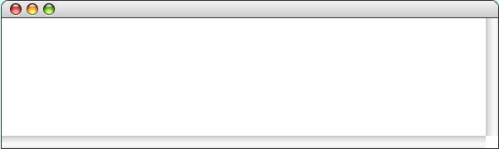
Reversing a String
public void run() {
println("This program reverses a string.");
String str = readLine("Enter a string: ");
String rev = reverseString(str);
println(str + " spelled backwards is " + rev);
}
private String reverseString(String str) {
String result = "";
for ( int i = 0; i < str.length(); i++ ) {
result = str.charAt(i) + result;
}
return result;
}
rev
str
DESSERTS
STRESSED
result
str
i
5
7
8
2
3
4
6
0
S
STRESSED
1
TS
RTS
ERTS
SERTS
SSERTS
ESSERTS
DESSERTS
ReverseString
This program reverses a string.
STRESSED
Enter a string:
STRESSED spelled backwards is DESSERTS
Using portions of slides by Eric Roberts

Slide 53
Plan For Today
Recap: Characters and Strings
Looping over Strings
Practice: Reversing a String
Practice: Palindromes
Practice: Caesar Cipher

Slide 54
Exercise: Palindromes
Let’s write a method called isPalindrome that takes one String parameter, and returns whether or not that String is a palindrome (the same forwards and backwards).
isPalindrome("racecar") -> true
isPalindrome("hi there") -> false
isPalindrome("kayak") -> true
Notes:
Think pair share, then live code

Slide 55
Plan For Today
Recap: Characters and Strings
Looping over Strings
Practice: Reversing a String
Practice: Palindromes
Practice: Caesar Cipher

Slide 56
Exercise: Caesar Cipher
Rotate alphabet by n letters (n = 3 in below)
n is called the key
Wrap-around at the end
Substitute letters based on this mapping
original
A | B | C | D | E | F | G | H | I | J | K | L | M | N | O | P | Q | R | S | T | U | V | W | X | Y | Z
D | E | F | G | H | I | J | K | L | M | N | O | P | Q | R | S | T | U | V | W | X | Y | Z | A | B | C
encrypt
Notes:
Live code

Slide 57
Exercise: Caesar Cipher
Rotate alphabet by a certain key, with wrapping
original
A | B | C | D | E | F | G | H | I | J | K | L | M | N | O | P | Q | R | S | T | U | V | W | X | Y | Z
D | E | F | G | H | I | J | K | L | M | N | O | P | Q | R | S | T | U | V | W | X | Y | Z | A | B | C
encrypt

Slide 58
Recap
Recap: Characters and Strings
Looping over Strings
Practice: Reversing a String
Practice: Palindromes
Practice: Caesar Cipher
Next time: reading text files

