Slide 1
CS 106A, Lecture 2 Programming with Karel
suggested reading:
Karel, Ch. 3-4

Slide 2

Plan For Today
(Re)Meet Karel the Robot
Announcements
Control Flow
For loops
While loops
If/else statements

Slide 3

Plan For Today
(Re)Meet Karel the Robot
Announcements
Control Flow
For loops
While loops
If/else statements

Slide 4
Meet Karel the Robot!
Notes:
keychain

Slide 5
Karel’s World
3
.
.
.
.
.
.
The intersection of a street and an avenue is a corner.
2
.
.
.
.
.
1
.
.
.
.
.
.
1
2
3
Each row is called a street.
3
4
5
Each column is called an avenue.

Slide 6
Walls
3
.
.
.
.
.
2
.
.
.
.
.
1
.
.
.
.
.
1
2
3
4
5
Karel cannot move through walls.

Slide 7
Beepers
3
.
.
.
.
.
2
.
.
.
.
.
1
.
.
.
.
.
Beepers mark locations in Karel's world. Karel can pick them up and put them down.
1
2
3
4
5

Slide 8

Karel Knows 4 Commands
move
turnLeft
putBeeper
pickBeeper
Notes:
Nouns done, now verbs

Slide 9
Karel Knows 4 Commands
move()
turnLeft()
“methods”
putBeeper()
pickBeeper()

Slide 10
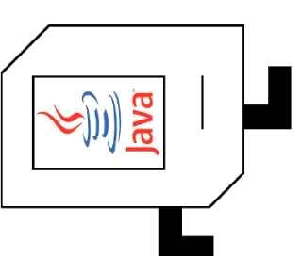
Commands: move
move makes Karel move forward one square in the direction it is facing.
Karel Commands
3
.
.
.
.
.
move
turnLeft
pickBeeper
putBeeper
2
.
.
.
.
.
1
.
.
.
.
.
.
1
2
3
4
5

Slide 11
Commands: move
move makes Karel move forward one square in the direction it is facing.
Karel Commands
3
.
.
.
.
.
move
turnLeft
pickBeeper
putBeeper
2
.
.
.
.
.
1
.
.
.
.
.
.
1
2
3
4
5

Slide 12
Commands: turnLeft
turnLeft makes Karel rotate 90° counter-clockwise.
Karel Commands
3
.
.
.
.
.
move
turnLeft
pickBeeper
putBeeper
2
.
.
.
.
.
1
.
.
.
.
.
.
1
2
3
4
5

Slide 13
Commands: turnLeft
turnLeft makes Karel rotate 90° counter-clockwise.
There is no turnRight command. (Q: Why not?)
Karel Commands
3
.
.
.
.
.
move
turnLeft
pickBeeper
putBeeper
2
.
.
.
.
.
1
.
.
.
.
.
.
1
2
3
4
5

Slide 14
Commands: turnLeft
turnLeft makes Karel rotate 90° counter-clockwise.
There is no turnRight command. (Q: Why not? A: No need!)
Karel Commands
3
.
.
.
.
.
move
turnLeft
pickBeeper
putBeeper
2
.
.
.
.
.
1
.
.
.
.
.
.
1
2
3
4
5
Notes:
Demo with cutout

Slide 15
Commands: pickBeeper
pickBeeper makes Karel pick up the beeper at the current corner. Karel can hold multiple beepers at a time in its "beeper bag".
Karel Commands
3
.
.
.
.
.
move
turnLeft
pickBeeper
putBeeper
2
.
.
.
.
.
1
.
.
.
.
.
.
1
2
3
4
5

Slide 16
Commands: pickBeeper
pickBeeper makes Karel pick up the beeper at the current corner. Karel can hold multiple beepers at a time in its "beeper bag".
Karel Commands
3
.
.
.
.
.
move
turnLeft
pickBeeper
putBeeper
2
.
.
.
.
.
1
.
.
.
.
.
.
1
2
3
4
5

Slide 17
Commands: putBeeper
putBeeper makes Karel put a beeper down at its current location.
pickBeeper and putBeeper are used to move beepers around.
Karel Commands
3
.
.
.
.
.
move
turnLeft
pickBeeper
putBeeper
2
.
.
.
.
.
1
.
.
.
.
.
.
1
2
3
4
5
Notes:
beeper bag

Slide 18
Commands: putBeeper
putBeeper makes Karel put a beeper down at its current location.
pickBeeper and putBeeper are used to move beepers around.
Karel Commands
3
.
.
.
.
.
move
turnLeft
pickBeeper
putBeeper
2
.
.
.
.
.
1
.
.
.
.
.
.
1
2
3
4
5
Notes:
beeper bag

Slide 19
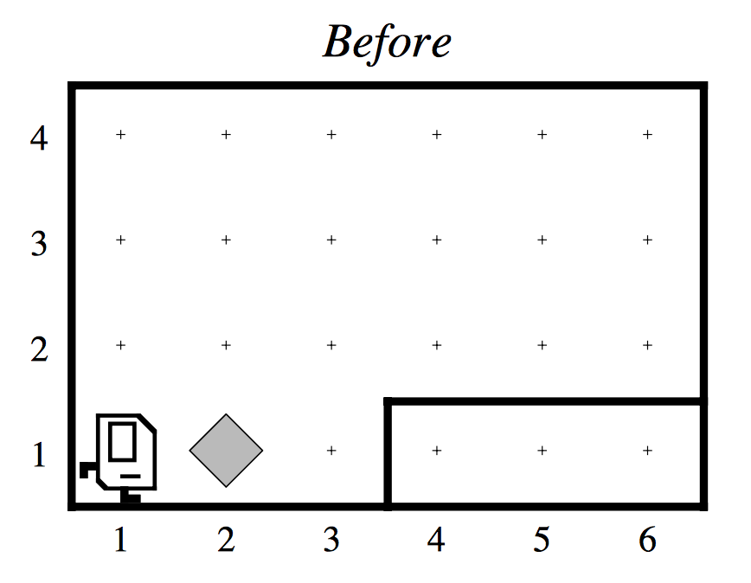
Our First Karel Program

Slide 20
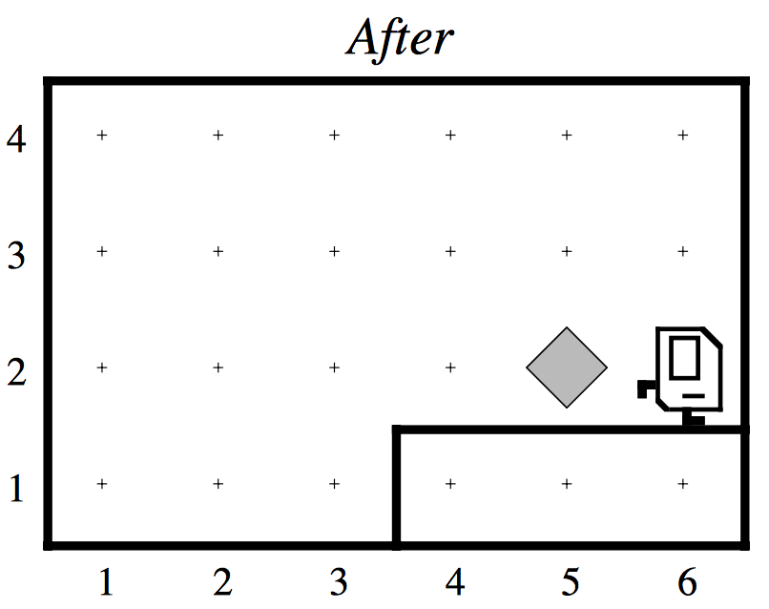
Our First Karel Program

Slide 21
Demo
Notes:
Use debugger, make sure to show to exit debugger view

Slide 22
Defining New Commands
We can make new commands (or methods) for Karel. This lets us decompose our program into smaller pieces that are easier to understand.
private void name() {
statement;
statement;
...
}
For example:
private void turnRight() {
turnLeft();
turnLeft();
turnLeft();
}

Slide 23
Plan For Today
(Re)Meet Karel the Robot
Announcements
Control Flow
For loops
While loops
If/else statements

Slide 24
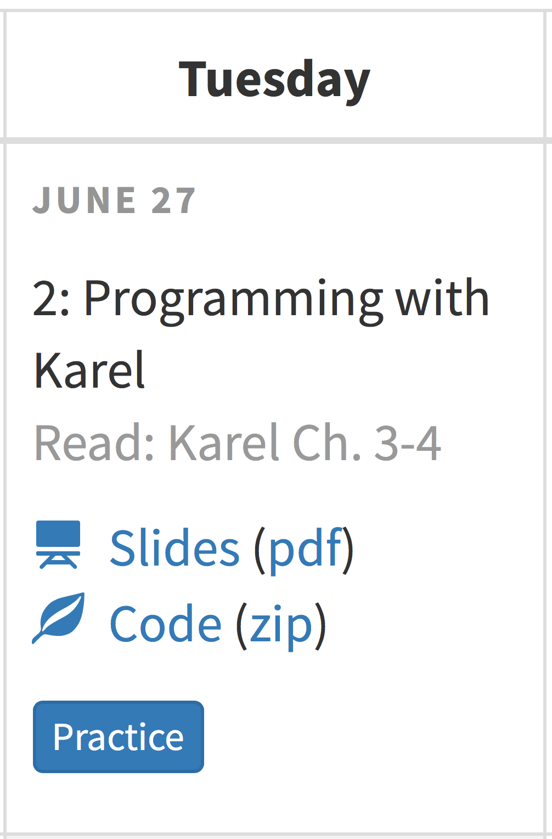
Announcements
Section assignments out on Wednesday
Section and LaIR start on Wednesday
Eclipse help session tonight
Extra Practice

Slide 25
Plan For Today
(Re)Meet Karel the Robot
Announcements
Control Flow
For loops
While loops
If/else statements

Slide 26
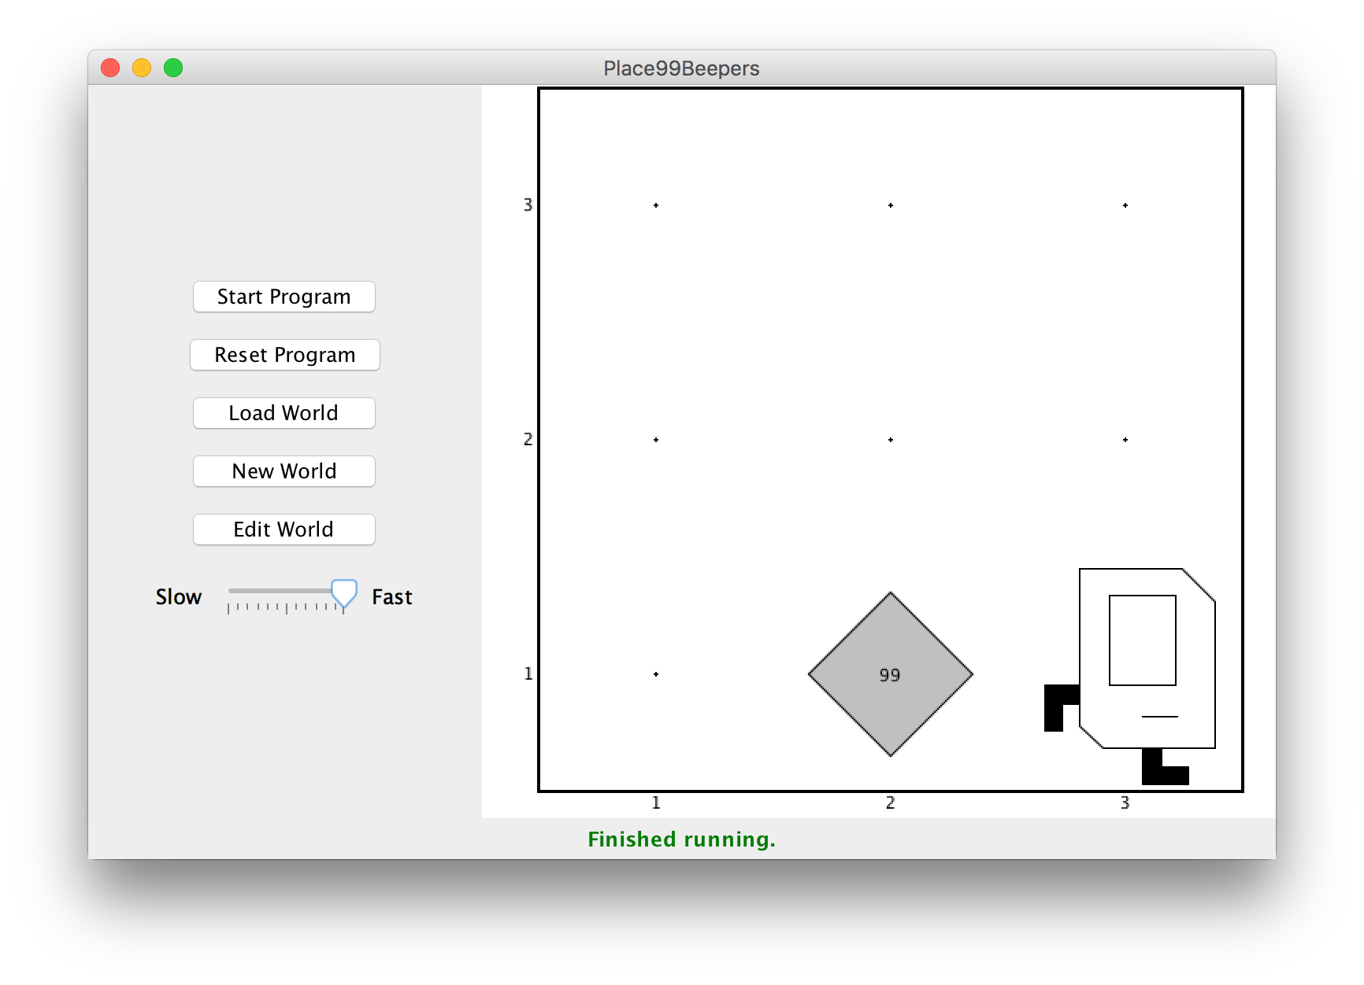
Control Flow: For Loops
I want to make Karel put 99 beepers down on a corner. How do I do this?
Notes:
With what we know right now, how?

Slide 27
Control Flow: For Loops
Can’t just say:
move();
putBeeper();
putBeeper();
putBeeper();
...
move();
This is too repetitive! Plus, it’s difficult to change (e.g. to 25 beepers).
Notes:
What if we had something better?

Slide 28
Control Flow: For Loops
Instead, use a for loop:
for (int i = 0; i < max; i++) {
statement;
statement;
...
}
Repeats the statements in the body max times.
Notes:
Executes statements in order – NOT repeating each one individually

Slide 29
Control Flow: For Loops
Now we can say:
move();
for (int i = 0; i < 99; i++) {
putBeeper();
}
move();
This is less repetitive, and is easier to change (e.g., to 25 beepers).

Slide 30
Control Flow: For Loops
Some examples of using for loops:
// turns Karel right
for (int i = 0; i < 3; i++) {
turnLeft();
}
// Moves Karel in a square
for (int i = 0; i < 4; i++) {
move();
turnLeft();
}
Notes:
Download a blank Karel project and see the square for yourself!

Slide 31
Plan For Today
Announcements
(Re)Meet Karel the Robot
Control Flow
For loops
While loops
If/else statements

Slide 32
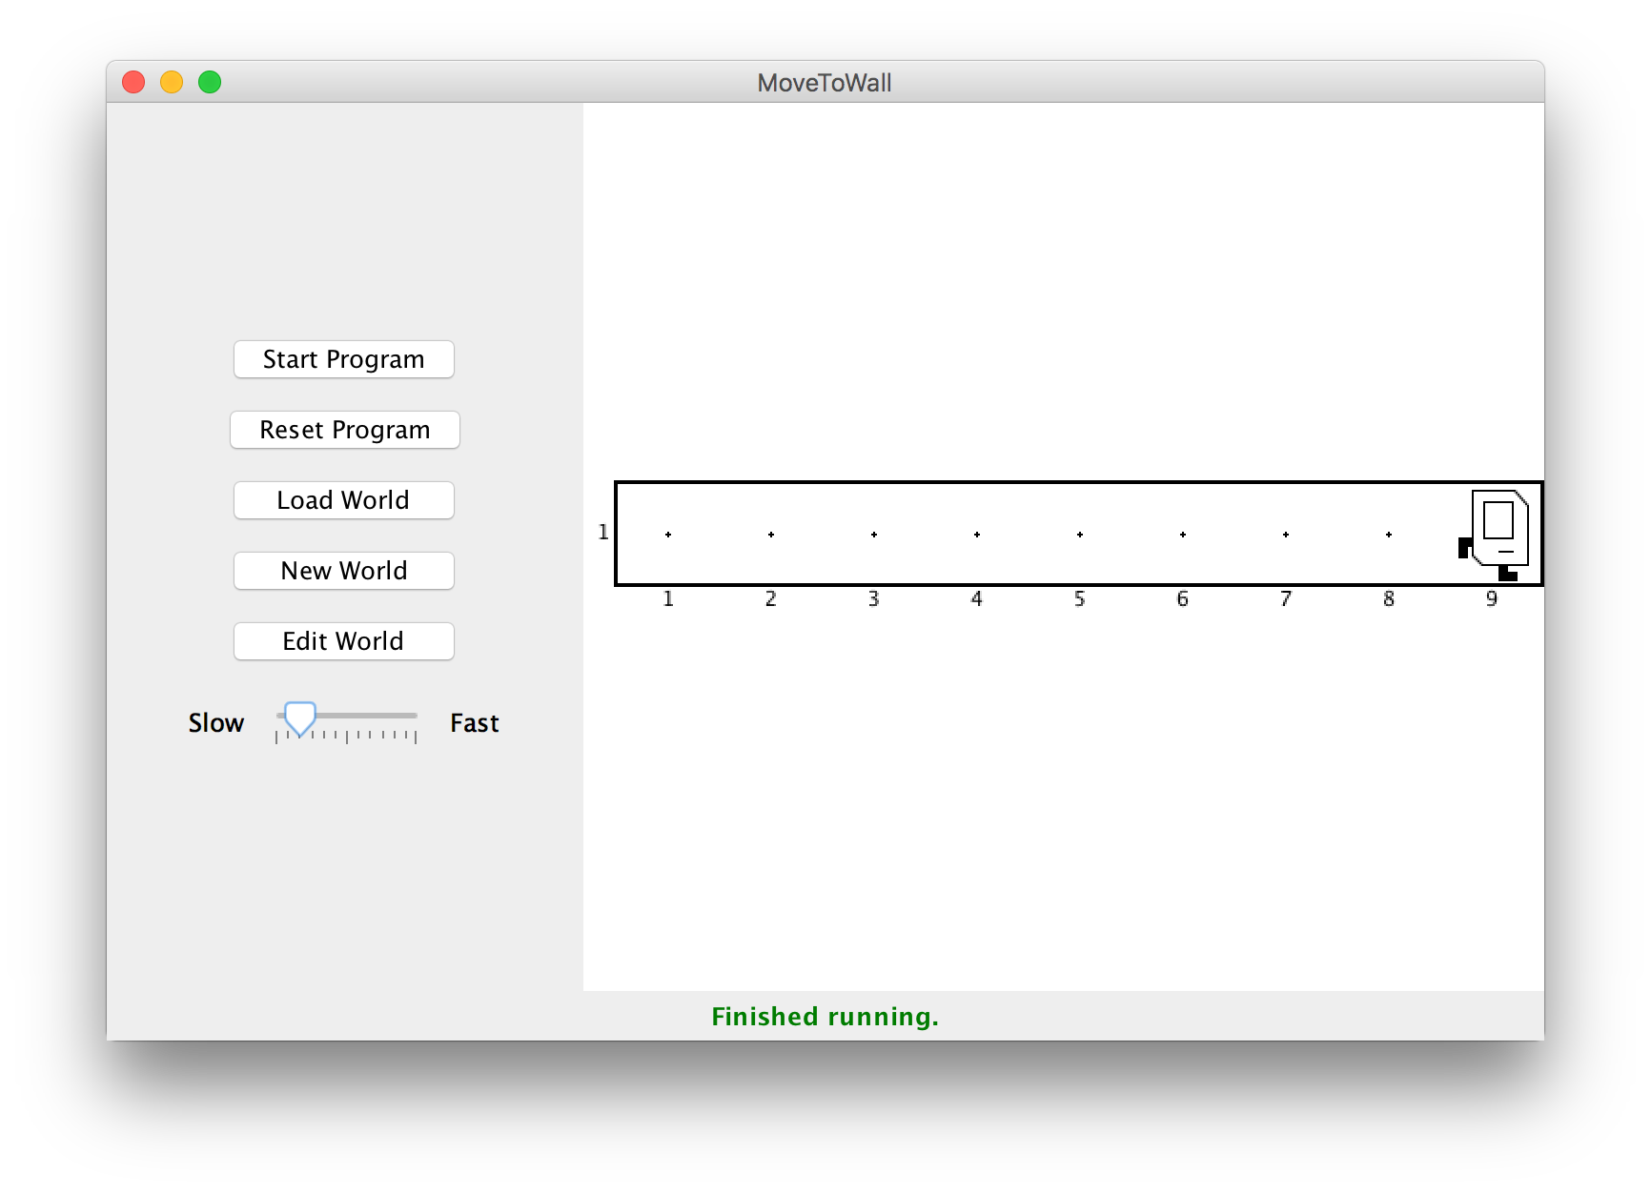
Control Flow: While Loops
I want Karel to move until it gets to a wall. How do I do this?

Slide 33
Control Flow: While Loops
Can’t just say:
move();
move();
move();
move();
...
This is too repetitive! Also, we might not know how far away a wall is. Plus, we want our program to be as generalized as possible and work in many different worlds.

Slide 34
Control Flow: While Loops
Instead, use a while loop:
while (condition) {
statement;
statement;
...
}
Repeats the statements in the body until condition is no longer true.
Each time, Karel executes all statements, and then checks the condition.
Notes:
Karel can ask some questions about its world / surroundings

Slide 35
Possible Conditions
Test | Opposite | What it checks
frontIsClear() | frontIsBlocked() | Is there a wall in front of Karel?
leftIsClear() | leftIsBlocked() | Is there a wall to Karel’s left?
rightIsClear() | rightIsBlocked() | Is there a wall to Karel’s right?
beepersPresent() | noBeepersPresent() | Are there beepers on this corner?
beepersInBag() | noBeepersInBag() | Any there beepers in Karel’s bag?
facingNorth() | notFacingNorth() | Is Karel facing north?
facingEast() | notFacingEast() | Is Karel facing east?
facingSouth() | notFacingSouth() | Is Karel facing south?
facingWest() | notFacingWest() | Is Karel facing west?
This is Table 1 on page 18 of the Karel coursereader.
Notes:
Front, left, or right relative to Karel’s current direction

Slide 36
Control Flow: While Loops
while loop syntax for reference:
while (condition) {
statement;
statement;
...
}

Slide 37
Control Flow: While Loops
Now we can say:
while (frontIsClear()) {
move();
}
This is less repetitive, and it works in any size world!

Slide 38
Control Flow: While Loops
while loops can have compound conditions as well:
// “and”
while (frontIsClear() && beepersPresent()) {
...
}
// “or”
while (leftIsClear() || rightIsClear()) {
...
}
Notes:
Ampersand used to be 27th letter!
Karel can ask multiple questions about its world / surroundings

Slide 39
Loops Overview
I want Karel to repeat some commands!
Know how many times
Don’t know how many times
for loop
while loop
Notes:
E.g. “pick up all the beepers on this square”
E.g. “turn until you’re facing west”
E.g. “put down 5 beepers”

Slide 40
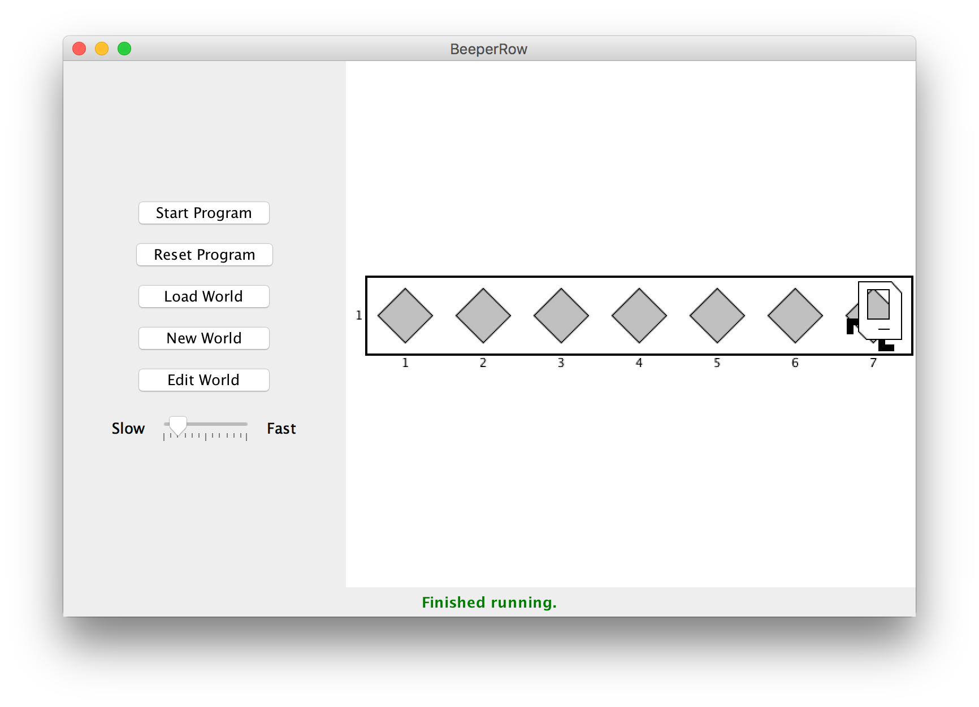
Loops Overview
I want Karel to put down a row of beepers until it reaches a wall. How do I do this?

Slide 41
Demo

Slide 42

Fencepost Problem
8 fence segments, but 9 posts!

Slide 43
Fencepost Structure
The fencepost structure is useful when you want to loop a set of statements, but do one part of that set 1 additional time.
putBeeper(); // post
while (frontIsClear()) {
move(); // fence
putBeeper(); // post
}
while (frontIsClear()) {
putBeeper(); // post
move(); // fence
}
putBeeper(); // post

Slide 44
Plan For Today
Announcements
(Re)Meet Karel the Robot
Control Flow
For loops
While loops
If/else statements

Slide 45
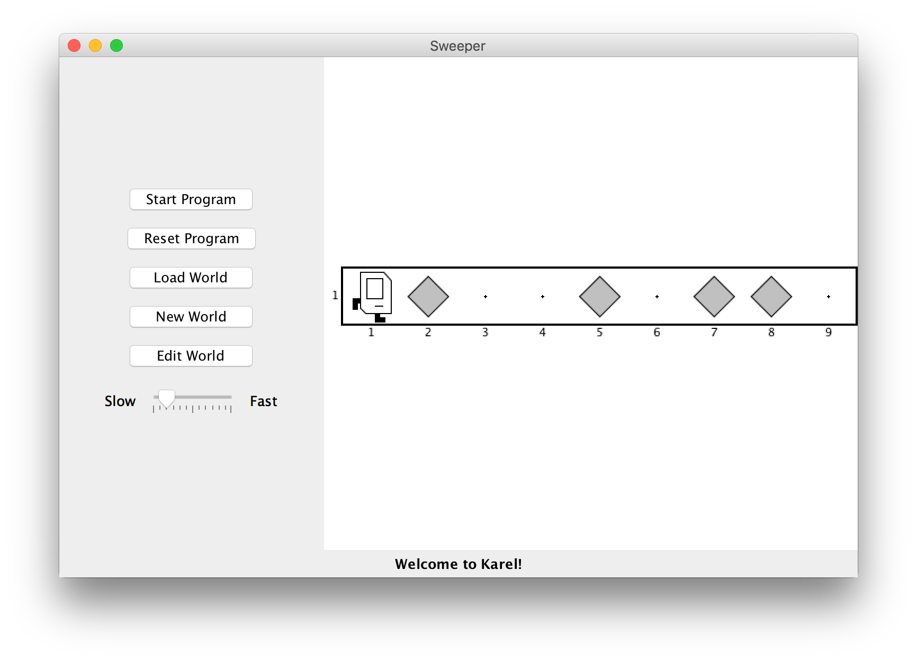
If/Else Statements
I want to make Karel clean up all beepers in front of it until it reaches a wall. How do I do this?
Notes:
Ask if time, else say beeperRow with pick instead of put is tempting

Slide 46
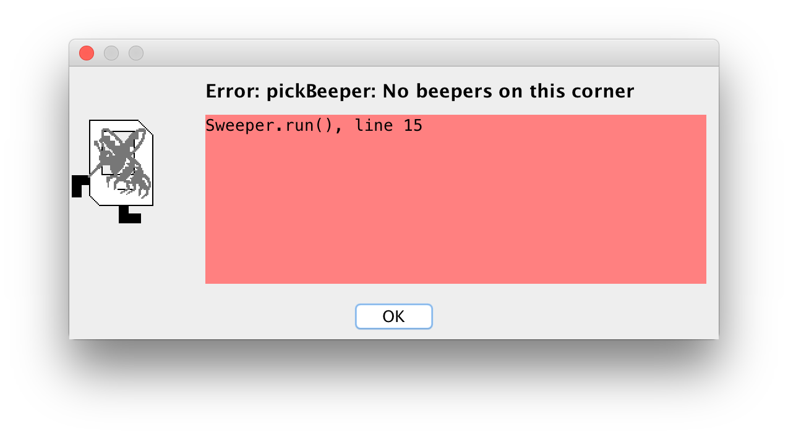
If/Else Statements
Can’t just say:
while (frontIsClear()) {
move();
pickBeeper();
}
This may crash, because Karel cannot pick up beepers if there aren’t any. We don’t always want Karel to pick up beepers; just when there is a beeper to pick up.

Slide 47
If/Else Statements
Instead, use an if statement:
if (condition) {
statement;
statement;
...
}
Runs the statements in the body once if condition is true.
Notes:
While loop but runs max onces

Slide 48
If/Else Statements
You can also add an else statement:
if (condition) {
statement;
statement;
...
} else {
statement;
statement;
...
}
Runs the first group of statements if condition is true; otherwise, runs the second group of statements.
Notes:
Karel can ask some questions about its world / surroundings

Slide 49
If/Else Statements
Now we can say:
while (frontIsClear()) {
move();
if (beepersPresent()) {
pickBeeper();
}
}
Now, Karel won’t crash because it will only pickBeeper if there is one.
Notes:
Could imagine inverting the world with a putBeeper in else statement

Slide 50
Recap
(Re)Meet Karel the Robot
Announcements
Control Flow
For loops
While loops
If/else statements
Next time: Karel Problem-Solving

