Slide 1
CS 106A, Lecture 3 Problem-solving with Karel
suggested reading:
Karel, Ch. 5-6

Slide 2

Plan For Today
Announcements
Recap: Control Flow
Control Flow: If/else
Decomposition
Demo: HurdleJumper
Practice: Debugging and Roomba

Slide 3
Plan For Today
Announcements
Recap: Control Flow
Control Flow: If/else
Decomposition
Demo: HurdleJumper
Practice: Debugging and Roomba

Slide 4
Announcements
Sections start today. Assignment on website
Late signups open
Email cs198@cs.stanford.edu with schedule conflicts
Fill out Annie’s form if not put with partner
LaIR starts tonight: ground floor of Tressider
Piazza for logistics + conceptual questions
Please raise hands!

Slide 5
Plan For Today
Announcements
Recap: Control Flow
Control Flow: If/else
Decomposition
Demo: HurdleJumper
Practice: Debugging and Roomba

Slide 6

Karel Knows 4 Commands
move()
turnLeft()
“methods”
putBeeper()
pickBeeper()

Slide 7
Defining New Commands
We can make new commands (or methods) for Karel. This lets us decompose our program into smaller pieces that are easier to understand.
private void name() {
statement;
statement;
...
}
For example:
private void turnRight() {
turnLeft();
turnLeft();
turnLeft();
}

Slide 8
Control Flow: For Loops
for (int i = 0; i < max; i++) {
statement;
statement;
...
}
Repeats the statements in the body max times.
Notes:
Executes statements in order – NOT repeating each one individually

Slide 9
Control Flow: While Loops
while (condition) {
statement;
statement;
...
}
Repeats the statements in the body until condition is no longer true.
Each time, Karel executes all statements, and then checks the condition.
Notes:
Karel can ask some questions about its world / surroundings

Slide 10
Possible Conditions
Test | Opposite | What it checks
frontIsClear() | frontIsBlocked() | Is there a wall in front of Karel?
leftIsClear() | leftIsBlocked() | Is there a wall to Karel’s left?
rightIsClear() | rightIsBlocked() | Is there a wall to Karel’s right?
beepersPresent() | noBeepersPresent() | Are there beepers on this corner?
beepersInBag() | noBeepersInBag() | Any there beepers in Karel’s bag?
facingNorth() | notFacingNorth() | Is Karel facing north?
facingEast() | notFacingEast() | Is Karel facing east?
facingSouth() | notFacingSouth() | Is Karel facing south?
facingWest() | notFacingWest() | Is Karel facing west?
This is Table 1 on page 18 of the Karel coursereader.
Notes:
Karel can ask questions about their surroundings

Slide 11
Loops Overview
I want Karel to repeat some commands!
Know how many times
Don’t know how many times
for loop
while loop

Slide 12
Fencepost Structure
The fencepost structure is useful when you want to loop a set of statements, but do one part of that set 1 additional time.
putBeeper(); // post
while (frontIsClear()) {
move(); // fence
putBeeper(); // post
}
while (frontIsClear()) {
putBeeper(); // post
move(); // fence
}
putBeeper(); // post

Slide 13
Plan For Today
Announcements
Recap: Control Flow
Control Flow: If/else
Decomposition
Demo: HurdleJumper
Practice: Debugging and Roomba

Slide 14
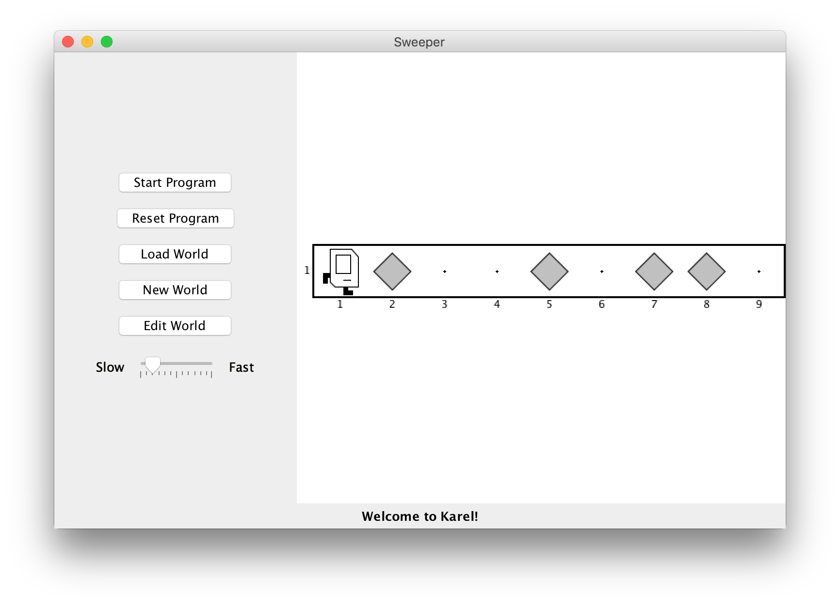
If/Else Statements
I want to make Karel clean up all beepers in front of it until it reaches a wall. How do I do this?
Notes:
Ask if time, else say beeperRow with pick instead of put is tempting

Slide 15
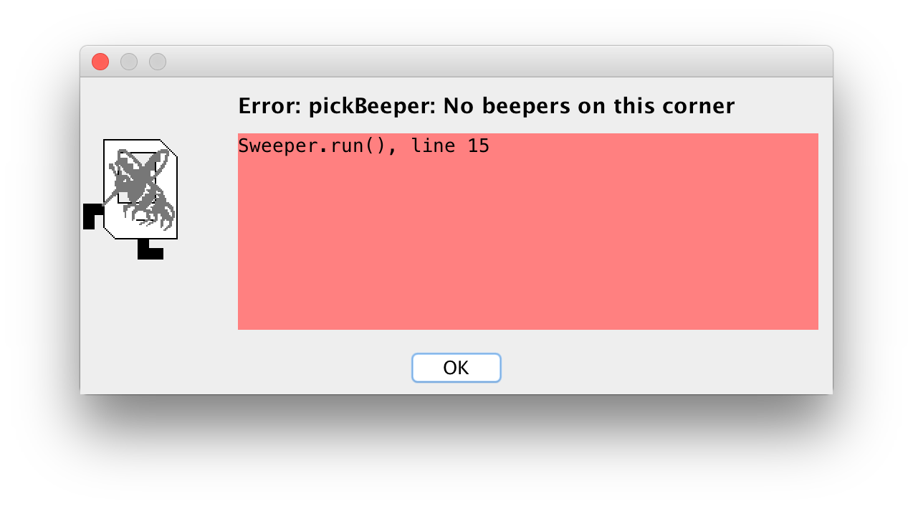
If/Else Statements
Can’t just say:
while (frontIsClear()) {
move();
pickBeeper();
}
This may crash, because Karel cannot pick up beepers if there aren’t any. We don’t always want Karel to pick up beepers; just when there is a beeper to pick up.

Slide 16
If/Else Statements
Instead, use an if statement:
if (condition) {
statement;
statement;
...
}
Runs the statements in the body once if condition is true.
Notes:
While loop but runs max once

Slide 17
If/Else Statements
You can also add an else statement:
if (condition) {
statement;
statement;
...
} else {
statement;
statement;
...
}
Runs the first group of statements if condition is true; otherwise, runs the second group of statements.
Notes:
Karel can ask some questions about its world / surroundings

Slide 18
If/Else Statements
Now we can say:
while (frontIsClear()) {
move();
if (beepersPresent()) {
pickBeeper();
}
}
Now, Karel won’t crash because it will only pickBeeper if there is one.
Notes:
Could imagine inverting the world with a putBeeper in else statement

Slide 19
Infinite Loops
Notes:
People with certain hair textures might use this (note for future lecturers: Colin says this to avoid making a reference that alienates people with kinky or curly hair, such as Black folks who often can’t relate when people from other cultures talk about hair care)

Slide 20
Infinite Loops
Lather
Rinse
Repeat

Slide 21

Infinite Loops
private void turnToWall() {
while(leftIsClear()) {
turnLeft();
}
}
Notes:
As a reminder, karel’s left is NORTH, not west, because east is front

Slide 22
Infinite Loops
private void turnToWall() {
while(leftIsClear()) {
turnLeft();
}
}

Slide 23
Infinite Loops
private void turnToWall() {
while(leftIsClear()) {
turnLeft();
}
}

Slide 24
Infinite Loops
private void turnToWall() {
while(leftIsClear()) {
turnLeft();
}
}

Slide 25
Infinite Loops
// Karel will keep turning left forever!
private void turnToWall() {
while(leftIsClear()) {
turnLeft();
}
}

Slide 26
Infinite Loops
private void turnToWall() {
while(leftIsClear()) {
if (frontIsBlocked()) {
turnLeft();
}
}
}
Notes:
What if Karel doesn’t even move?

Slide 27
Infinite Loops
// Karel will be stuck here forever!
private void turnToWall() {
while(leftIsClear()) {
if (frontIsBlocked()) {
turnLeft();
}
}
}
Notes:
Sometimes it doesn’t even look like you’re doing anything

Slide 28
Plan For Today
Announcements
Recap: Control Flow
Control Flow: If/else
Decomposition
Demo: HurdleJumper
Practice: Debugging and Roomba

Slide 29
Decomposition
Breaking down problems into smaller, more approachable sub-problems (e.g., our own Karel commands)
Each piece should solve one problem/task (< ~ 20 lines of code)
Descriptively-named
Well-commented!
e.g., getting up in the morning:
Wake up
Brush teeth
Put toothpaste on toothbrush
Insert toothbrush into mouth
Move toothbrush against teeth
…
…
Notes:
If you can’t name it easily and without “and”, it probably isn’t a good candidate!
Best compliment you can give about someone’s code: “obvious”

Slide 30
Top-Down Design
Start from a large task and break it up into smaller pieces
Ok (in fact, recommended!) to write your program in terms of commands that don’t exist yet
Notes:
Programming paradigm, which means way of doing things

Slide 31
Pre/post comments
precondition: Something you assume is true at the start of a method.
postcondition: Something you promise is true at the end of a method.
Recommendation: write these comments before implementing!
/*
* Karel picks up any beepers they find to their right.
* Pre: Karel is facing east at (1,1), which has no beeper.
* Post: Karel is facing east at the end of the first
* street. There are no beepers in the first street.
*/
private void sweepStreet() {
while (frontIsClear()) {
move();
if (beepersPresent()) {
pickBeeper();
}
}
}

Slide 32
Plan For Today
Announcements
Recap: Control Flow
Control Flow: If/else
Decomposition
Demo: HurdleJumper
Practice: Debugging and Roomba

Slide 33
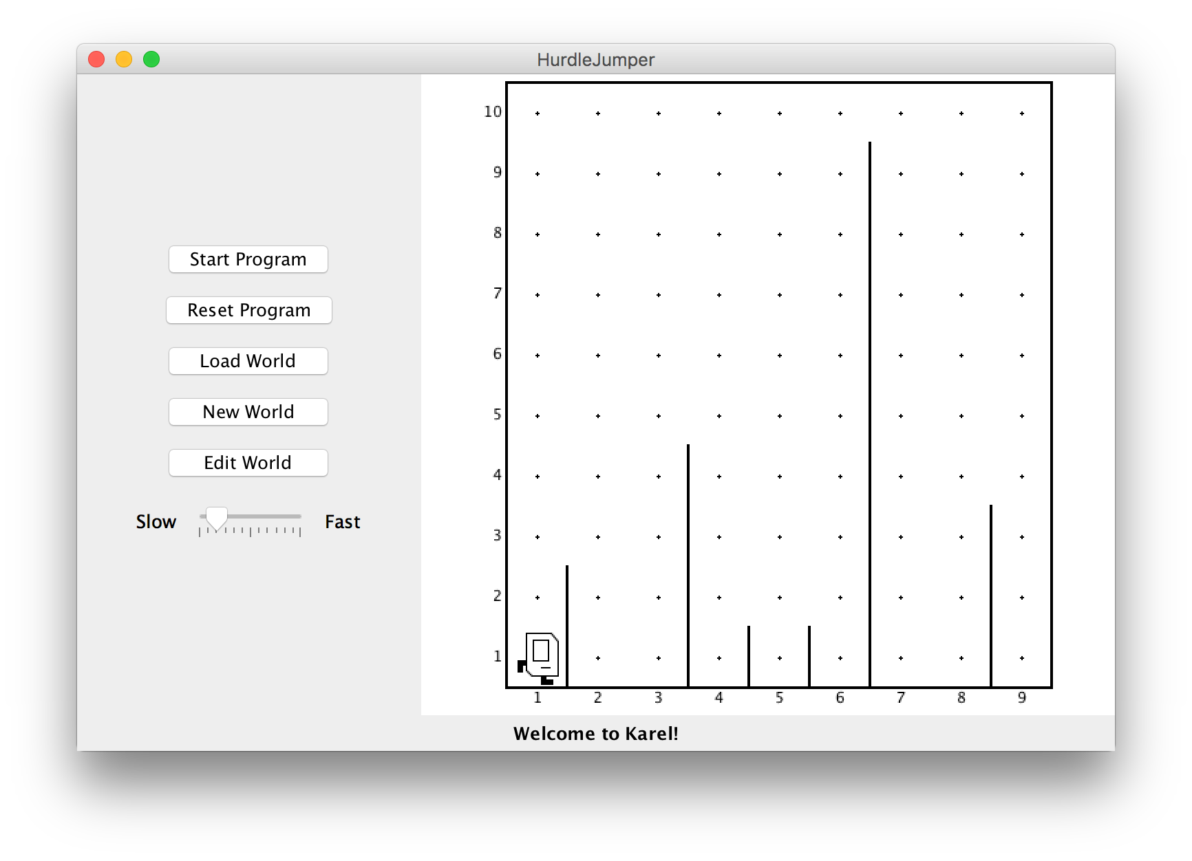
HurdleJumper
We want to write a Karel program that hops hurdles.
Karel starts at (1,1) facing East, and should end up at the end of row 1 facing east.
The world has 9 columns.
There are an unknown number of ”hurdles” (walls) of varying heights that Karel must ascend and descend to get to the other side.

Slide 34
HurdleJumper
Demo

Slide 35
Plan For Today
Announcements
Recap: Control Flow
Control Flow: If/else
Decomposition
Demo: HurdleJumper
Practice: Debugging and Roomba

Slide 36
Roomba
Write a Roomba Karel that sweeps the entire world of all beepers.
Karel starts at (1,1) facing East.
The world is rectangular, and some squares contain beepers.
There are no interior walls.
When the program is done, the world should contain 0 beepers.
Karel's ending location does not matter.
How should we approach this tricky problem?
8
.
.
.
.
.
.
.
.
7
.
.
.
.
.
.
.
.
6
.
.
.
.
.
.
.
.
5
.
.
.
.
.
.
.
.
4
.
.
.
.
.
.
.
.
3
.
.
.
.
.
.
.
.
2
.
.
.
.
.
.
.
.
1
.
.
.
.
.
.
.
.
1
2
3
4
5
6
7
8

Slide 37
Possible algorithm 1
8
.
.
.
.
.
.
.
.
7
.
.
.
.
.
.
.
.
6
.
.
.
.
.
.
.
.
5
.
.
.
.
.
.
.
.
4
.
.
.
.
.
.
.
.
3
.
.
.
.
.
.
.
.
2
.
.
.
.
.
.
.
.
1
.
.
.
.
.
.
.
.
1
2
3
4
5
6
7
8

Slide 38
Possible algorithm 2
8
.
.
.
.
.
.
.
.
7
.
.
.
.
.
.
.
.
6
.
.
.
.
.
.
.
.
5
.
.
.
.
.
.
.
.
4
.
.
.
.
.
.
.
.
3
.
.
.
.
.
.
.
.
2
.
.
.
.
.
.
.
.
1
.
.
.
.
.
.
.
.
1
2
3
4
5
6
7
8

Slide 39
Debugging

Slide 40
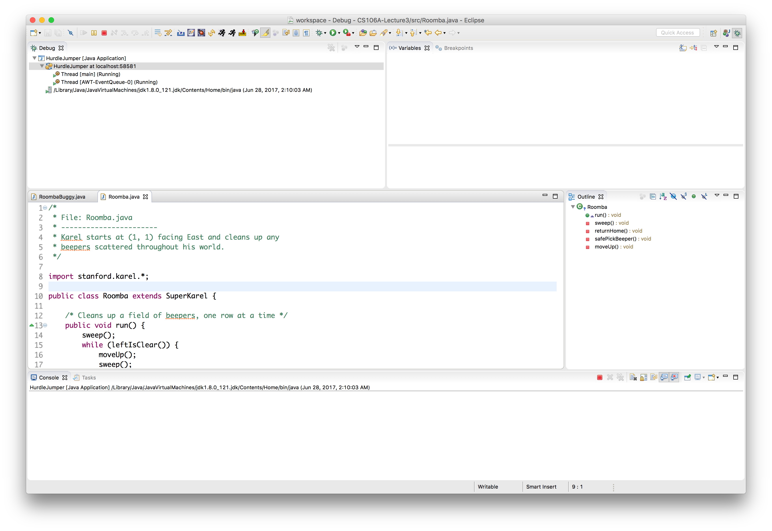
Debugging
Finding and fixing unintended behavior in your programs.
Try to narrow down where in your code you think the bug is occurring. (i.e., what command or set of commands)
We can use Eclipse to help us figure out what our program is doing.

Slide 41
BuggyRoomba
Demo

Slide 42
Possible algorithm 3
8
.
.
.
.
.
.
.
.
7
.
.
.
.
.
.
.
.
6
.
.
.
.
.
.
.
.
5
.
.
.
.
.
.
.
.
4
.
.
.
.
.
.
.
.
3
.
.
.
.
.
.
.
.
2
.
.
.
.
.
.
.
.
1
.
.
.
.
.
.
.
.
1
2
3
4
5
6
7
8

Slide 43
Possible algorithm 4
8
.
.
.
.
.
.
.
.
7
.
.
.
.
.
.
.
.
6
.
.
.
.
.
.
.
.
5
.
.
.
.
.
.
.
.
4
.
.
.
.
.
.
.
.
3
.
.
.
.
.
.
.
.
2
.
.
.
.
.
.
.
.
1
.
.
.
.
.
.
.
.
1
2
3
4
5
6
7
8

Slide 44
Practice: Roomba
Demo

Slide 45
Recap
Announcements
Recap: Control Flow
Control Flow: If/else
Decomposition
Demo: HurdleJumper
Practice: Debugging and Roomba
Next time: An introduction to Java

