Slide 1

Why Clojure Matters
Creighton Kirkendall
Principal Consultant SEI
Email: ckirkendall@gmail.com
Twitter: @crkirkendall
Github: https://github.com/ckirkendall

Slide 2
Why Clojure Matters
Lisp Refresher
Concurrency & State
  Java Concurrency and Mutability
  Identity vs State
  Immutability & Persistent Data Structures
  Clojure Example
Web Development
  The Death of MVC
  Pinot Noir (thirsty?)

Slide 3
Why Clojure Matters
Clojure Syntax (lisp)
Name | Clojure Syntax | Java Equivalent
Symbols | atom, foo-bar, *foo*, etc. | Variables Names
Literals | 42, "foo", nil, true, false, \c, :foo | Same
Keywords | :foo (like symbols, prefixed with colon) | None
Lists | (a b c) & '(a b c) | LinkedList
Vectors | [a b c] | Array
Maps (hashes) | {:a 1 :b 1} or {:a 1, :b 2} | Map
Sets | #{:a :b :c} | Set

Slide 4
Why Clojure Matters
Clojure Syntax (lisp) – defining a variable
Clojure Syntax | Java Equivalent
(def a “test”) | String a=”test”;

Slide 5
Why Clojure Matters
Clojure Syntax (lisp) – defining a function
Clojure Syntax | Java Equivalent
(fn [x] (println x)) #(println %1) | No parallel for in-line functions
(defn tmp [x] (println x)) | public void tmp(Object x){ System.out.println(x); }

Slide 6
Why Clojure Matters
Clojure Syntax (lisp) – calling a function
Clojure Syntax | Java Equivalent
(test “test”) | test(“test”);

Slide 7
Why Clojure Matters
Java and Concurrency
It's the mutable state, stupid. All concurrency issues boil down to coordinating access to mutable state. The less mutable state, the easier it is to ensure thread safety.
Java Concurrency in Practice

Slide 8
Why Clojure Matters
Java and Concurrency
Immutable objects are automatically thread-safe. Immutable objects simplify concurrent programming tremendously. They are simpler and safer, and can be shared freely without locking or defensive copying.
Java Concurrency in Practice

Slide 9
Why Clojure Matters
Java and Concurrency
A program that accesses a mutable variable from multiple threads without synchronization is a broken program
Java Concurrency in Practice

Slide 10
Why Clojure Matters
Java and Concurrency
Example

Slide 11
Why Clojure Matters
Identity vs State
Java
  Identity ← 1 to 1 → state
Clojure
  Identity ← 1 to N → state
  Version Control

Slide 12
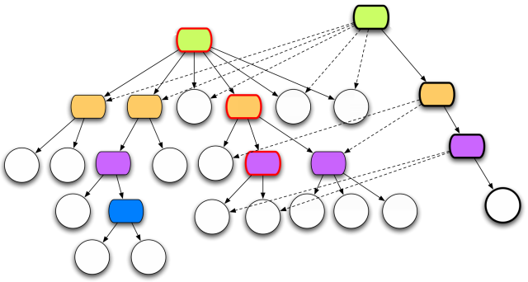
Why Clojure Matters
Immutability & Persistent Data Structures

Slide 13
Why Clojure Matters
Clojure Mutable State
All mutable state access is thread safe!
Atoms
  swap!
Refs
  dosync, alter, commute, ref-set
Agents
  send

Slide 14
Why Clojure Matters
Clojure Concurrency
Example

Slide 15
Why Clojure Matters
The Death Of MVC
What is wrong with MVC.
  Limited User Experience
  Resource Skill Set Limitations
The Rise of Service Oriented UIs (AJAX, JSON)
  Rich UI
  Rise of the JavaScript Developer
  Rise of SOA

Slide 16
Why Clojure Matters
Clojure and Clojurescript
Example

Slide 17
Why Clojure Matters
Q & A

