Slide 1
Embedded Software Engineering
Final Class Project Presentations
EECS Department, UC Berkeley
Christoph Kirsch
www.eecs.berkeley.edu/~fresco/giotto/course

Slide 2
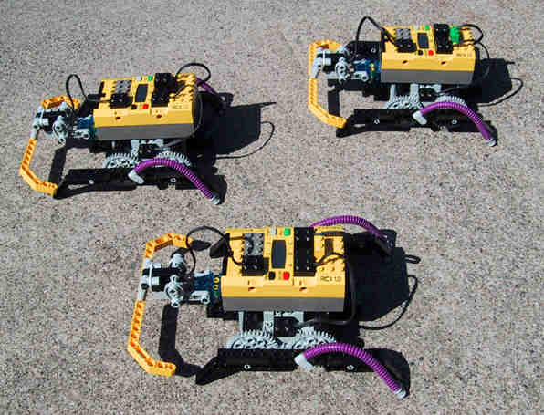
It’s fun

Slide 3
Schedule
Christoph: Introduction
Alvin, Daniel: Tutebot
Carlo, Jeff: Synchronous Computation
Paul, Jason: Scheduled Computation
Elaine, Steve: Code Generation
Ben, Shawn: Time-triggered Machine

Slide 4
Problem
Man-Machine
Interface
Instrumentation
Interface
Real-Time
Computer
System
Controlled
Object
Operator
Kopetz97
Methodologies for the implementation of
embedded real-time applications
Methodology: tool-supported, logical, compositional
Implementation: compositional, scalable, dependable

Slide 5
Embedded Programming
…requires the integration of:
Real-time scheduling/communication concepts
Logical RTOS: The embedded machine
Programming language design
Compiler design
Classical software engineering techniques
Formal methods

Slide 6
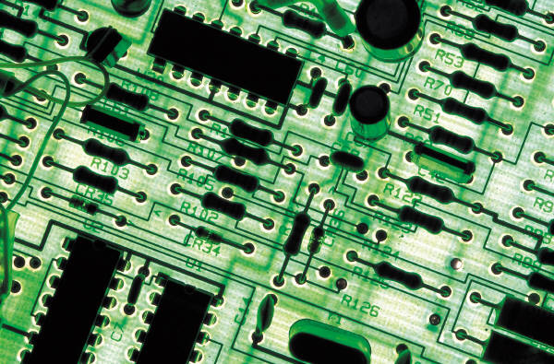
Concurrency
Task1
Task2
Message1
Host
Network
In addition:
Other resource constraints
Time constraints
Message2
Notes:
Real-time scheduling is the problem of serializing the access of multiple concurrent activities to, in general, multiple shared resources under real-time constraints: NP-complete.

Slide 7
The Task Model
f
Input ports
Output ports
a task is a subroutine *not* a coroutine [Wirth96]
runs to completion, possibly preempted
no synchronization points
known worst case execution time

Slide 8
RTOS Model
Activation
Passive
schedule
activate
terminate
Ready
Run
preempt
free
busy
Wait

Slide 9
Earliest Deadline First
Tasks
 | T₁ | T₂ | T₃ | T₄ | T₅
a_{i} | 0 | 0 | 2 | 3 | 6
C_{i} | 1 | 2 | 2 | 2 | 2
d_{i} | 2 | 5 | 4 | 10 | 9
T₁
T₂
T₂
T₃
T₄
T₄
Buttazzo97
T₅
10
Time

Slide 10
Rate Monotonic Analysis
 | T₁ | T₂
C_{i} | 2 | 1
p_{i} | 5 | 10
Tasks
T₂
T₂
T₁
T₁
T₁
T₁
10
Time

Slide 11
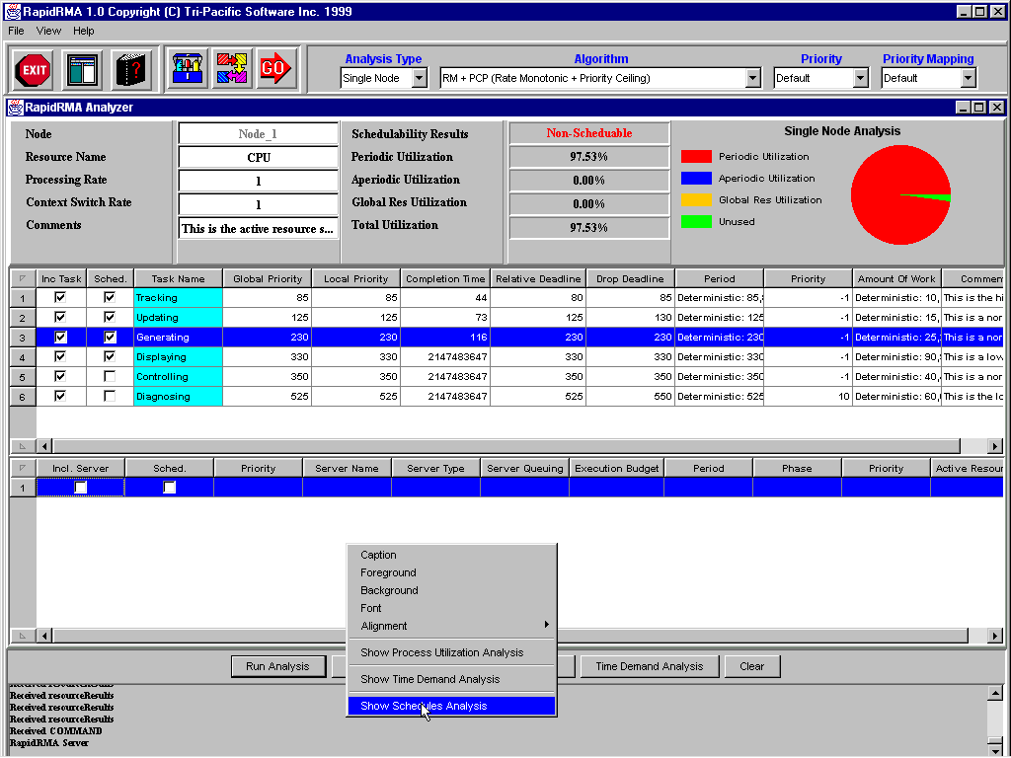
Elaine:
RapidRMA

Slide 12
Ben: Deferrable,Sporadic Servers
No slides available

Slide 13
Jeff: Wet Scheduling
No slides available

Slide 14
Alvin: Research Operating Systems
Objective: The ability to treat tasks with explicit timing constraints, such as periods and deadlines
Characteristics:
- Scheduling guarantee mechanisms
- Characterize tasks with additional parameters
- Avoidance of nondeterministic blocking time
Real-Time OS Design - 11

Slide 15
Shawn: WCET Analysis
d₁
x₁
B_{1.1}
s = k;
s
d₂
d₈
x₂
B_{2.1}
while (k < 10){
p_{(s,5.1)}
d₃
p_{(s,4.1)}
x₃
B_{3.1}
if (ok)
p_{(4.1,4.1)}
p_{(4.1,5.1)}
B_{4.1}
B_{5.1}
d₅
d₄
B_{5.1}
p_{(5.1,4.1)}
x₄
B_{4.1}
j++;
j = 0;
ok = true;
x₅
p_{(5.1,5.1)}
p_{(s,e)}
p_{(4.1,e)}
d₆
p_{(5.1,e)}
d₇
x₆
B_{6.1}
k++;
e
d₉
x₇
B_{7.1}
r = j;
d₁₀

Slide 16
Real-Time Communication
Message1
Network
Message2

Slide 17
The Communication Model
i
Input ports
Output ports
a connection is a function from input to output ports
a message is a valuation of the input ports
no predefined protocol, preemption possible
known worst case latency

Slide 18
Explicit Flow Control
Message1
Send time not known a priori
Sender can detect errors
Network
Message2

Slide 19
Control Area Network
M₁
M₂
Messages
M₁
0
0
0
0
0
0
0
1
0
1
0
M₂
0
0
0
0
0
0
1
0
1
1
1
11
Time

Slide 20
Paul: Strengths and Weaknesses of CAN
Widely accepted standard
Robust
  Handles extreme conditions (does not exhibit thrashing)
  Simple to configure
  Good error detection
  Two wire fault detection
Lots of hardware and software that support CAN

Slide 21
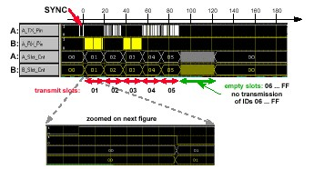
Jason: Byteflight
Slot Counters (FTDMA)
Notes:
FTDMA: flexible time division multiple access – distributed static medium access strategy where the right to transmit a frame is controlled by the progression of real time; requires a global time-base is available at all nodes
A sends Ids 2,4,5
B sends Ids 1,3
At sync end, waiting begins
When waiting is over, slot counters in all nodes switch to 1
B starts transmitting
When a node recognizes bus activity, it stops its counter
Wait starts again
No transmit request for 2,3
When slot counters reach 4, A transmits

Slide 22
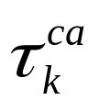
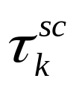

Carlo: Ethernet & Fieldbus War
What causes the variable latency?
u(t)
y(t)
T
(Sampling Jitter Ignored)
Actuator Node
Process
Sensor Node
Network
Controller Node
Computational Delay

Slide 23
Implicit Flow Control
Message1
Send time is known a priori
Receiver can detect errors
Network
Message2

Slide 24
Time-Triggered Protocol
M₁
M₂
Network
N₁
M₁
M₂
Time
Slot₁
Slot₂

Slide 25
Embedded Programming
…requires the integration of:
Real-time scheduling/communication concepts
Logical RTOS: The embedded machine
Programming language design
Compiler design
Classical software engineering techniques
Formal methods

Slide 26
The Embedded Machine
Functionality & Timing
Abstract RT Program
Compilation
Scheduling & Communication
E Code
Embedded Machine
RTOS
Distributed Platform

Slide 27
The E Machine
The embedded machine or E machine is a virtual scheduling machine
The E machine has:
  internal memory, external interface
  an instruction set similar to machine code
  a stack used for arguments and return addresses
The E machine provides a platform for generating distributed real-time schedules

Slide 28
Value Ports
Address
Value
Type
Example: Sensor Value

Slide 29
Signal Ports
Address
Counter
Integer
Example: Absolute Time

Slide 30
Memory and Interfaces
Internal
Memory
External
Interface
External
Interface
Sensors
Clocks
Task Communication
Actuators
Networks

Slide 31
The Task Model
f
Input ports
Output ports
a task is a subroutine *not* a coroutine [Wirth96]
runs to completion, possibly preempted
no synchronization points
known worst case execution time

Slide 32
The Task Model
f
g
Task Communication

Slide 33
The Communication Model
i
Input ports
Output ports
a connection is a function from input to output ports
a message is a valuation of the input ports
no predefined protocol, preemption possible
known worst case latency

Slide 34
The Communication Model
i
f
g
o
Sensors
Clocks
Actuators
Networks

Slide 35
E Machine Scheduling
i
f
E Machine
schedules
g
o
Tasks
Connections

Slide 36
A Time-Triggered Task
clk
Internal
Memory
1ms Tick
f
External
Interface
RT Clock

Slide 37
A Trigger
clk
@ 10ms
1ms Tick
f
an E machine schedule is a set of triggers

Slide 38
An Event-Triggered Task
gps
Internal
Memory
New GPS
f
External
Interface
GPS Receiver

Slide 39
The E Machine Scheduler
clk
@ 10ms
INACTIVE
Tick
f
gps
schedules
@ next
#
g
READY
RUN
E Machine Scheduler
Dispatcher

Slide 40
Scheduling Algorithm
clk
@ 10ms
INACTIVE
Tick
f
gps
schedules
@ next
#
g
READY
RUN
The scheduling algorithm, e.g, EDF is a parameter of E code

Slide 41
A Trigger
clk
@ 10ms
1ms Tick
f
How can we generalize triggers?

Slide 42
A Revised Trigger
clk
@ 10ms
1ms Tick
a:
psh(10)
cal(clk)(f)
emp(clk)(a)
pop
ret
E code for the E machine

Slide 43
E Code
clk
10ms
schedules
Interrupt!
f
a:
psh(10)
cal(clk)(f)
clk
@ 20ms
emp(clk)(a)
enables
Tick
a:
pop
ret
cal(clk)(f) assigns priority to f
emp(clk)(a) jumps to a: 10ms in the future

Slide 44
Timing
Task
psh(10)
psh(10)
cal(clk)(f)
f
cal(clk)(f)
f
emp(clk)(a)
emp(clk)(a)
pop
pop
ret
ret
0ms
0ms
10ms
10ms
14ms
20ms
20ms
26ms
Time

Slide 45
Synchronous vs. Scheduled Computation
Task
Scheduled Computation
Synchronous
Computation
Synchronous
Computation
0ms
0ms
10ms
10ms
14ms
20ms
20ms
26ms
Time

Slide 46
Synchronous vs. Scheduled Computation
clk
@ 10ms
INACTIVE
Tick
a:
gps
schedules
@ next
b:
READY
RUN
#
Synchronous computation
Kernel context
Trigger related interrupts disabled
Scheduled computation
User context

Slide 47
More E Code
clk
10ms
schedules
Interrupt!
f
a:
psh(10)
cal(clk)(f)
clk
@ 20ms
emp(clk)(a)
enables
Tick
a:
pop
ret

Slide 48
More E Code
clk
10ms
synchronously runs
Interrupt!
f
a:
psh(10)
com(f)
clk
@ 20ms
emp(clk)(a)
enables
Tick
a:
pop
ret

Slide 49
Giotto Example
Task
f
g
g
t
t
t+5ms
t+5ms
t+10ms
t+10ms

Slide 50
Update f’s Output Port
Task
M1: com(f_{output})
f
g
g
t
t
t+5ms
t+5ms
t+10ms
t+10ms

Slide 51
Update g’s Output Port
Task
M1: com(f_{output})
com(g_{output})
f
g
g
t
t
t+5ms
t+5ms
t+10ms
t+10ms

Slide 52
Load g’s Input Ports
Task
M1: com(f_{output})
com(g_{output})
com(g_{input})
f
g
g
t
t
t+5ms
t+5ms
t+10ms
t+10ms

Slide 53
f’s Deadline
Task
M1: com(f_{output})
com(g_{output})
com(g_{input})
psh(10)
f
g
g
t
t
t+5ms
t+5ms
t+10ms
t+10ms

Slide 54
Schedule f
Task
M1: com(f_{output})
com(g_{output})
com(g_{input})
psh(10)
cal(clk)(f)
f
g
g
t
t
t+5ms
t+5ms
t+10ms
t+10ms

Slide 55
g’s Deadline
Task
M1: com(f_{output})
com(g_{output})
com(g_{input})
psh(10)
cal(clk)(f)
add(-5)
f
g
g
t
t
t+5ms
t+5ms
t+10ms
t+10ms

Slide 56
Schedule g
Task
M1: com(f_{output})
com(g_{output})
com(g_{input})
psh(10)
cal(clk)(f)
add(-5)
cal(clk)(g)
f
g
g
t
t
t+5ms
t+5ms
t+10ms
t+10ms

Slide 57
Schedule Myself
Task
M1: com(f_{output})
com(g_{output})
com(g_{input})
psh(10)
cal(clk)(f)
add(-5)
cal(clk)(g)
emp(clk)(M2:)
f
g
g
t
t
t+5ms
t+5ms
t+10ms
t+10ms

Slide 58
Exit
Task
M1: com(f_{output})
com(g_{output})
com(g_{input})
psh(10)
cal(clk)(f)
add(-5)
cal(clk)(g)
emp(clk)(M2:)
pop
ret
f
g
g
t
t
t+5ms
t+5ms
t+10ms
t+10ms

Slide 59
Update g’s Output Port
Task
M2: com(g_{output})
f
g
g
t
t
t+5ms
t+5ms
t+10ms
t+10ms

Slide 60
Load g’s Input Ports
Task
M2: com(g_{output})
com(g_{input})
f
g
g
t
t
t+5ms
t+5ms
t+10ms
t+10ms

Slide 61
g’s Deadline
Task
M2: com(g_{output})
com(g_{input})
psh(5)
f
g
g
t
t
t+5ms
t+5ms
t+10ms
t+10ms

Slide 62
Schedule g
Task
M2: com(g_{output})
com(g_{input})
psh(5)
cal(clk)(g)
f
g
g
t
t
t+5ms
t+5ms
t+10ms
t+10ms

Slide 63
Schedule Myself
Task
M2: com(g_{output})
com(g_{input})
psh(5)
cal(clk)(g)
emp(clk)(M1:)
f
g
g
t
t
t+5ms
t+5ms
t+10ms
t+10ms

Slide 64
Exit
Task
M2: com(g_{output})
com(g_{input})
psh(5)
cal(clk)(g)
emp(clk)(M1:)
pop
ret
f
g
g
t
t
t+5ms
t+5ms
t+10ms
t+10ms

Slide 65
Embedded Programming
…requires the integration of:
Real-time scheduling/communication concepts
Logical RTOS: The embedded machine
Programming language design
Compiler design
Classical software engineering techniques
Formal methods

Slide 66
Concurrency
Parallel Composition
I/O Decomposition
Task1
Task2
Task1
Task2
Control
Data

Slide 67
Control Operators
Sequential
Parallel
Choice
Loop

Slide 68
Real-Time
Change of state
State
Function
Time
Event
Frequency
Time

Slide 69
Event-Triggered (ET) System
Data
Change of state
Time

Slide 70
Time-Triggered (TT) System
Data
Clock tick
Time

Slide 71
Esterel - Giotto
Esterel:
  Synchronous reactive language
  Event-triggered semantics
Giotto:
  Time-triggered semantics
  Distributed platforms

Slide 72
Sensor - Control Law - Actuator
Sensors
f
Actuators

Slide 73
Giotto: Time
Sequential:
Task
Time
Input
Output

Slide 74
Giotto: Operators
Sequential:
Task
Parallel:
Choice:
Mode
Program

Slide 75
Giotto: Helicopter Control
mode normal ( ) period 20ms
{
taskfreq 1 do servo = Control ( position ) ;
taskfreq 4 do position = Navigation ( GPS, position ) ;
}

Slide 76
Event - Reaction
Event
f
Reaction

Slide 77
Esterel: Event
Event:
emit S
await S
Time
Loop:
P
loop P each S

Slide 78
Esterel: Operators
Sequential:
P
Q
P ; Q
P
P
Parallel:
Choice:
Q
Q
P || Q
present S then P else Q

Slide 79
Esterel: Controller
module normal:
input A, B, R;
output O;
loop
[ await A || await B ];
emit O
each R
end module
R?
R?
A?.~R?
B?.~R?
R?
A?.B?.~R?.O!
B?.~R?.O!
A?.~R?.O!

Slide 80
Embedded Programming
…requires the integration of:
Real-time scheduling/communication concepts
Logical RTOS: The embedded machine
Programming language design
Compiler design
Classical software engineering techniques
Formal methods

Slide 81
Concurrency
Parallel Composition
I/O Decomposition
Task1
Task2
Task1
Task2
Task1
;
Task2
Task1
Task2
Task2
;
Task1
Task2
Task1

Slide 82
Real-Time
Task1
;
Task2
Task3
;
Task1
;
Task2
Task1
Time
Event
Frequency
Time
Deadline

Slide 83
Helicopter Control
Task
Control @ 50Hz
Navigation @ 200Hz
5
10
15
20
msec

Slide 84
Code
Task
5
10
15
20
msec

Slide 85
Embedded Programming
…requires the integration of:
Real-time scheduling/communication concepts
Logical RTOS: The embedded machine
Programming language design
Compiler design
Classical software engineering techniques
Formal methods

Slide 86
Abstract Data Type
Type
Interface: Set of methods

Slide 87
Abstract Interface
Empty
Interface: Set of methods

Slide 88
Object-Based vs. Object-Oriented
Port-Based Object
Interface: Ports + Control Methods

Slide 89
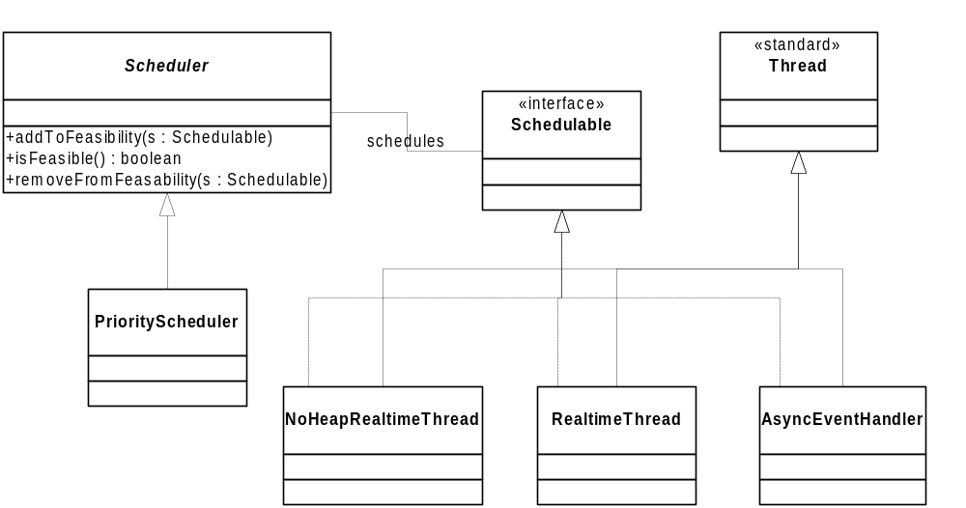
Steve: Real-Time Java

Slide 90
Embedded Programming
…requires the integration of:
Real-time scheduling/communication concepts
Logical RTOS: The embedded machine
Programming language design
Compiler design
Classical software engineering techniques
Formal methods

Slide 91
Formal Verification
Property Space
Data
Time
Control
Safety
Liveness
Safety: Wrong things never happen!
Liveness: Something useful will happen eventually!

Slide 92
Language Hierarchy
Universal
Design
Macros
expand
Non-Deterministic
Model
Automata
synthesize
analyze
Deterministic
Program
Code
compile
Sequential
Executable
Machine

Slide 93
Non-Determinism
Sequential
Parallel
Choice
Non-Determinism
A
E
Programming Operators
Modeling Operator

Slide 94
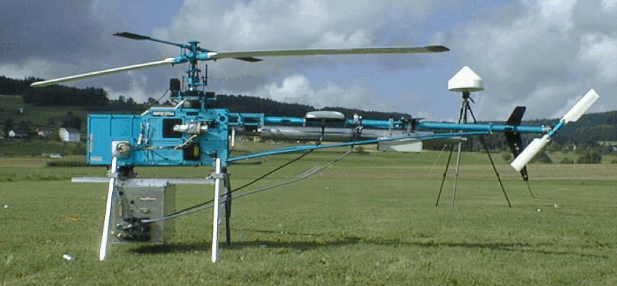
Helicopter…

Slide 95
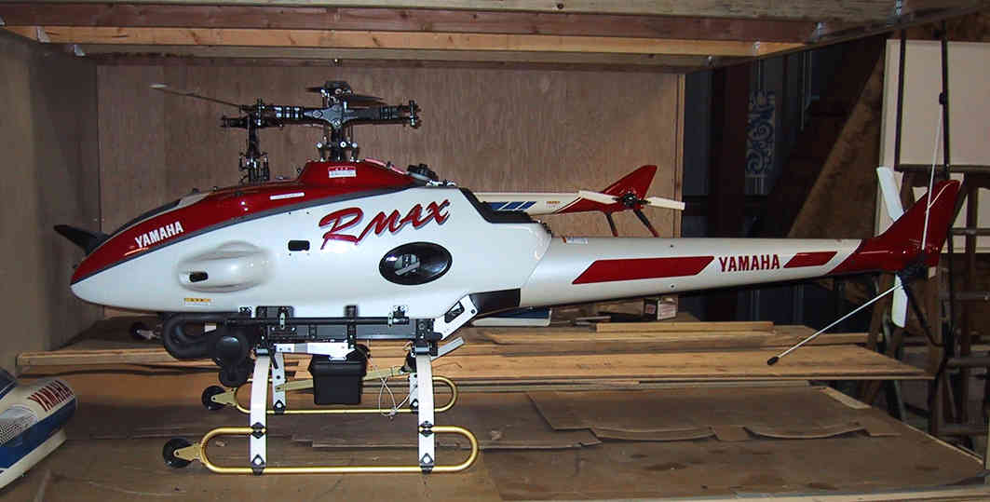
Helicopter…

Slide 96
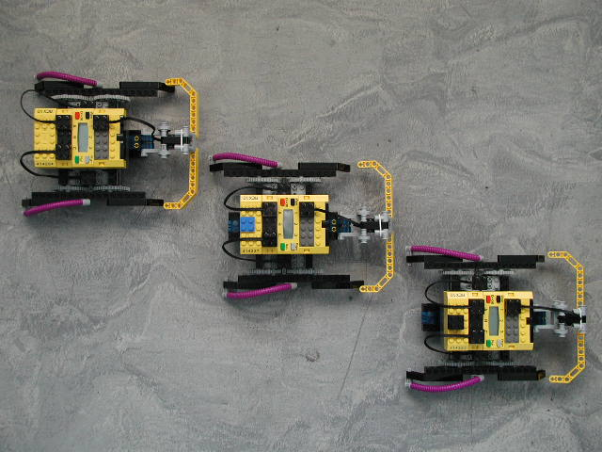
The Mindstorm Machine

