Slide 1
Multi-modal Control With the E Machine
Ben Horowitz and Shawn Schaffert
Project Presentation for EE 291 O
18 May 2001

Slide 2
Hardware Architecture
Intel 486 CPU, running the E machine
Laptop, running the simulator
Connected by
  Ethernet, for E machine/simulator communication
  Serial link, for monitoring the E machine
E machine (Intel 486)
Ethernet
Laptop
1-way serial link

Slide 3
Software Architecture
Intel 486 runs VxWorks
E machine runs as a VxWorks thread
Infrastructural services:
  Signal listener thread: detects presence of signals, sends signal stream to E machine. Short execution time
  Tick thread: generates clock signal at 100 Hz
  Communication thread: sends/receives messages to/from simulator

Slide 4
Software Architecture (2)
Tick
Signal listener
E machine
{T,C}, {C}, {T,C}, {T}, …
Communication
Intel 486
Simulator (Ptolemy II)
laptop

Slide 5
Software Architecture (3)
Implementation does not miss events:
  Signals are queued by signal listener, …
  Then consumed by the E machine
  Consumed immediately if E machine is idle, otherwise after current E machine execution terminates
Implementation can detect simultaneously present events:
  select() is used to monitor signals
  Current implementation detects tick signal & communication signal
  IO signals can be detected with no extra implementation complexity

Slide 6
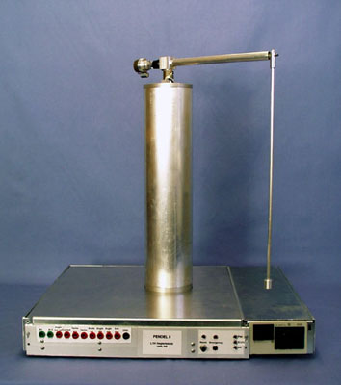
Demo: Pendulum + Controller
swingUp
catch
Furuta pendulum (simulated in Ptolemy II)
Giotto controller
(running as E code)

Slide 7
Demo: Furuta Pendulum
z
Outputs:
p
p. = derivative of p
t
t. = derivative of t
Input:
u = torque applied
to central axis
= 2nd derivative of p
t.
y.
p.
x

Slide 8
Demo: Giotto Controller
Energy controller:
calculate kinetic+potential energy; output u so that energy approaches 2lmg
Catch controller:
u = L_{p} * p + L_{p.} * p. +
L_{t} * t + L_{t.} * t.
(linear state feedback controller)
p
p.
energy cont.
t
u
t.
1
1
|t|>R2
freq. 1
|t|<R1
freq. 1
Period
10ms
p
p.
catch cont.
t
u
t.
1
1
Period
10ms

Slide 9
E Code for Giotto Controller
Swing_mode:
wrt(u)
red(env)
prd(inRegion1)
cmp(Catch_cntr:)
Energy_cntr:
psh(10)
emp(TIME)(Swing_mode:)
pop
com(energyCntr)
ret
Catch_mode:
wrt(u)
red(env)
prd(outsideRegion2)
cmp(Energy_cntr:)
Catch_cntr:
psh(10)
emp(TIME)(Catch_mode:)
pop
com(catchCntr)
ret

Slide 10
E Code for Communication
Comm:
psh(1)
emp(COMM)(Comm:)
pop
wrt(send_u)
ret

Slide 11
