Slide 1
Ethernet for Industrial Automation
Have fieldbus wars moved to a new battlefield?
Carlo Cloet
EE290-O Presentation
March 1st, 2001

Slide 2
Overview
Motivation
Basic principles behind Ethernet
Industrial Ethernet and field busses
Physical layer (OSI)
Data Link layer, determinism, control
Network & Transport Layer, UDP vs. TCP
Application Layer and interoperability
Conclusions

Slide 3
Motivation
Recent articles:
  Shoot-out at the Ethernet corral.
  InTech Magazine, February 2001
  Ethernet: A versatile network with a strong industrial track record and bright future.
  Control Solutions Magazine, January 2001
  Ethernet for control: Not exactly a “no-brainer”.
  Control Solutions Magazine, January 2001

Slide 4
And the list goes on...
  Ethernet’s Winning Ways.
  IEEE Spectrum, January 2001
  Ethernet Wins over Industrial Automation
  IEEE Spectrum, January 2001
  Is Ethernet Suitable for Motion Control?
  ServoTrends, January 2001
  Making Ethernet Work in Real Time
  Sensors Magazine, November 2000
What’s the hype all about??

Slide 5
Overview
Motivation
Basic principles behind Ethernet
Industrial Ethernet and field busses
Physical layer (OSI)
Data Link layer, determinism, control
Network & Transport Layer, UDP vs. TCP
Application Layer and interoperability
Conclusions

Slide 6
What is Ethernet?
Developed by Xerox PARC in 70’s for use as LAN in office environments.
IEEE 802.3 in 1983
ISO/IEC 8802-3 in 1985
  physical layer: media, configuration
  data link layer: MAC protocol, CSMA/CD

Slide 7
Ethernet Frame
Every device has unique address
Multicasting, broadcasting supported
Ethernet Header
Data Field
PA
SFD
DA
SA
Type
Data Packet
FCS
7
1
6
6
2
46-1500 bytes
4
An Ethernet II frame

Slide 8
CSMA/CD manages contention
Carrier Sense (CS)
Multiple Access (MA)
Collision Detect (CD)
Exponential Back-off Algorithm
  Slot time = 51μs on 10Mb/s
  Maximum wait time doubled until no collision (up to 10 times, stop after 16 attempts)
  Automatically adapts to network load
Intel Demo 1
Intel Demo 2

Slide 9
Reducing collision frequency
Split up network in multiple collision domains using bridges
Even better, use switches. Every port on a switch is its own collision domain, no more collisions between devices attached to the switch (temporary buffering and therefore still variable latency when contention for same port).
Intel animation*
(*) http://www.intel.com/network/learning_ctr/index.htm

Slide 10
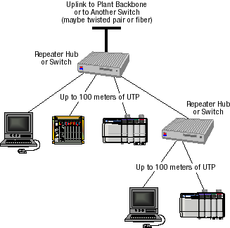
Network Topology with Switch
Preferably
high speed
Full Duplex,
Message Priority…
Fast development!

Slide 11
Overview
Motivation
Basic principles behind Ethernet
Industrial Ethernet and field busses
Physical layer (OSI)
Data Link layer, determinism, control
Network & Transport Layer, UDP vs. TCP
Application Layer and interoperability
Conclusions

Slide 12
Industrial Ethernet is nothing new!
Ethernet has been used in automation applications for more than 15 years. It is the oldest LAN technology on the factory floor.
Most PLCs have Ethernet option now. Ethernet that transmits programs, diagnostics, operator data is in widespread use.

Slide 13
So then what IS new?
Internet revolution has resulted in extremely cheap switches, thereby making Ethernet more deterministic.
Ethernet is high speed (+100Mb/s) vs. low speed fieldbus networks (< 12Mb/s).
Distributed intelligence/vertical integration are hot topics. Intelligent devices require large data transfers. Demand for bandwidth!

Slide 14
Focus of recent articles
The main discussion topic seems to be the extent Ethernet can reach up and down through the levels of the control hierarchy.
Access/set production data or controller parameters via a web browser? Shared database? Intelligent, distributed devices. Can Ethernet replace fieldbuses for control loops?

Slide 15
“Fieldbus wars”.
Ethernet appeared in early 80’s. First fieldbusses in late 80’s. Fieldbusses offer deterministic communications for networked field devices (reduced wiring).
Fieldbuses immensely popular, 1001 choices: see website overview.
Ethernet has accelerated the discussions on “fieldbus of the future”.

Slide 16
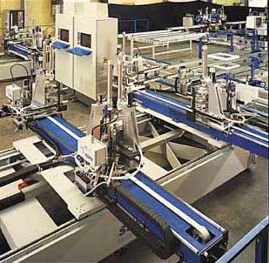
Prototype Ethernet Application
Production line for vinyl windows at Willi Stürtz Maschinenbau GmbH in Neustadt/Wied, Germany. The entire production line is based on Ethernet technology: machine tool controllers on the factory floor communicate directly with a higher, supervisory-level network in which the
company's enterprise resource planning (ERP) database resides. Instructions for the controllers on the floor are sent from this database. Credit: Jetter USA Inc.

Slide 17
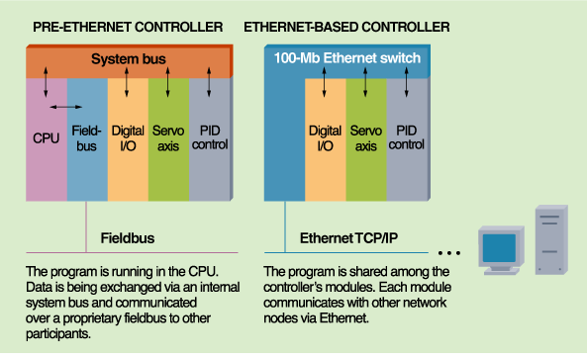
Ethernet Scheme used by Jetter
CPU
CPU
CPU
Credit: Jetter USA Inc

Slide 18
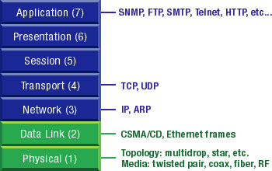
Discussion follows OSI stack

Slide 19
Overview
Motivation
Basic principles behind Ethernet
Industrial Ethernet and field busses
Physical layer (OSI)
Data Link layer, determinism, control
Network & Transport Layer, UDP vs. TCP
Application Layer and interoperability
Conclusions

Slide 20
Ethernet Physical Layer
Good:
  Industrial quality switches and cabling available (fiber is noise immune).
  One wiring scheme can handle multiple protocols. “Wire now, decide later”. Each fieldbus physical layer is different.
  Configuration guidelines well understood, also by personnel from IT department.

Slide 21
Ethernet Physical Layer
Bad:
  Ubiquitous and cheap office grade components are not suitable for industrial environments. “Ethernet is cheap” is questionable (many ≠ opinions).
  Every node needs CPU to process network stack. A ‘webserver’ on every sensor may be optimistic.
  Switches are active devices, need power.

Slide 22
Overview
Motivation
Basic principles behind Ethernet
Industrial Ethernet and field busses
Physical layer (OSI)
Data Link layer, determinism, control
Network & Transport Layer, UDP vs. TCP
Application Layer and interoperability
Conclusions

Slide 23
Ethernet Data Link Layer
How deterministic is Ethernet?
  CSMA/CD inherently nondeterministic.
  Switches and 100Mb/s Ethernet dramatically reduce backoff times.
Statistical analysis provides order of magnitude
  Assume isolated subnet
  Small, identical frames
  Lightly loaded network

Slide 24
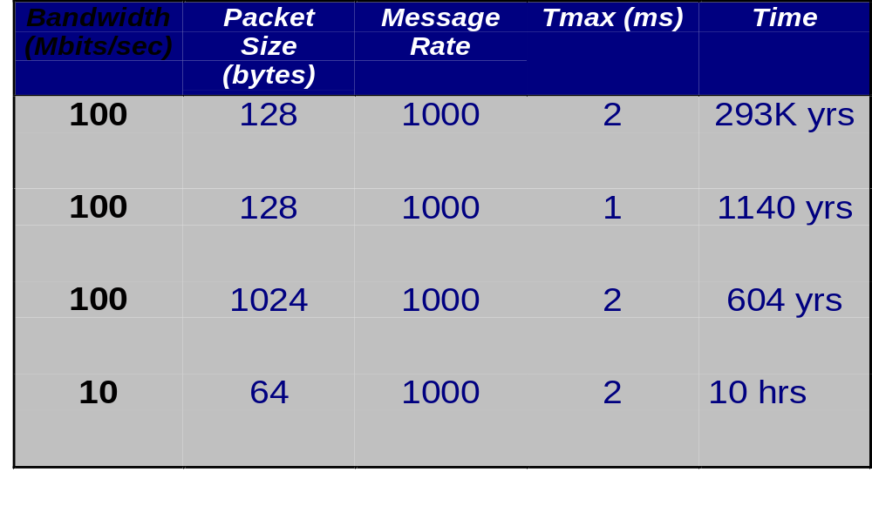
Statistical Analysis
For a 99% confidence interval:
Schneider S. et al., “Can Ethernet be Real Time?”

Slide 25
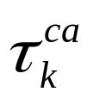
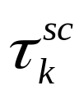

CL Control with Variable Latency
What causes the variable latency?
u(t)
y(t)
T
(Sampling Jitter Ignored)
Actuator Node
Process
Sensor Node
Network
Controller Node
Computational Delay

Slide 26
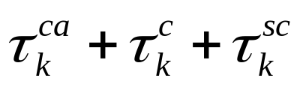
Equivalent Block Diagram
T
Actuator Node
Delay
Process
Sensor Node
Equivalent Process with Variable Delay
Controller Node
Other option: ignore network, keep same process, just assume varying computational delay in controller

Slide 27
Why is delay undesirable?
Delay in a control loop reduces phase margin. This could cause instability, but even before that, performance is severely affected.
Matlab Demo.

Slide 28
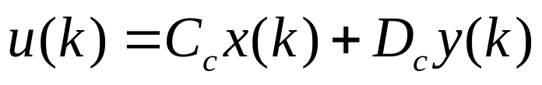
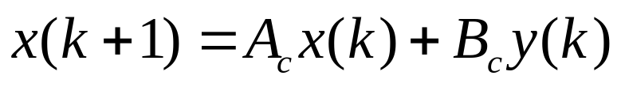
Effect on Control Performance
If delay is short compared to sampling period, performance hardly affected.
How do we minimize delay?
  Keep network load low
  Implement controller correctly: generate output before state update
Controller
y(k)
u(k)
First Output:
Then calculate:

Slide 29
If delay cannot be ignored...
Approach 1: assume delay of 1 sample period during control design and only apply control action at next sample time.
This makes variable delay constant.
Easy solution for low bandwidth applications (delay = add. phase lag).
A fixed delay < T can also be explicitely accounted for in controller design.
Astrom K., Wittenmark B. : “Computer-Controlled Systems”, Prentice Hall.

Slide 30
If delay cannot be ignored...
Approach 2: treat variable delay as parametric uncertainty and use robust control methods. Complex!
Approach 3: let control algorithm actively compensate for varying computational delay. Allows good performance even for large delays, but gives time varying control law.
Nilsson J. et al.: “Stochastic Analysis and Control of Real-Time Systems with Random Time Delays”. Automatica, vol. 34, 1998.

Slide 31
Simulation results
Matlab demo with varying computational delay.
3 plots:
  system with no delay
  system with fixed delay, used in ctrl design
  system with varying delay, not compensated

Slide 32
Overview
Motivation
Basic principles behind Ethernet
Industrial Ethernet and field busses
Physical layer (OSI)
Data Link layer, determinism, control
Network & Transport Layer, UDP vs. TCP
Application Layer and interoperability
Conclusions

Slide 33
Network & Transport Layer
Ethernet by itself is not enough. Also need communication protocols.
TCP/IP vs. UDP, many others
TCP: connection oriented, unicast
UDP: connectionless, uni/multi/broadcast
Trade-off reliability - determinism, both must coexist on same network
UDP provides most flexibility for designing proper higher level protocol

Slide 34
Overview
Motivation
Basic principles behind Ethernet
Industrial Ethernet and field busses
Physical layer (OSI)
Data Link layer, determinism, control
Network & Transport Layer, UDP vs. TCP
Application Layer and interoperability
Conclusions

Slide 35
Application Layer and Interoperability
Application software must be compatible for effective communication
Telnet, http, SMTP, FTP well defined. Vendors adhere to standard (e.g. Lexmark)
Not so in industrial automation! Hard to combine equipment from ≠ vendors.

Slide 36
Towards one standard
Many fieldbus manufacturers have identified advantages of Ethernet physical layer (bandwidth) and transmit their protocols over Ethernet.
Can have multiple protocols over same network.
ProfiNet, IDA, Ethernet/IP, Modbus/TCP, Foundation Fieldbus HSE...

Slide 37
Overview
Motivation
Basic principles behind Ethernet
Industrial Ethernet and field busses
Physical layer (OSI)
Data Link layer, determinism, control
Network & Transport Layer, UDP vs. TCP
Application Layer and interoperability
Conclusions

Slide 38
Conclusion
For now, the use of fieldbus systems with seamless data transfer to Ethernet provides higher capability at lower installed cost, especially for systems with many devices, small data packets and update rate > 100 Hz.

Slide 39
Ethernet as Control Network?
Today, Ethernet is primarily information network.
Use for real-time control is application dependent.
  Bandwidth requirements?
  Performance requirements?
More and more applications may become candidates as latency variability decreases.

Slide 40
What the future holds
“One size fits all” will never apply to industrial automation (fieldbus wars). Similar to the way USB and Ethernet are complimentary, Ethernet use will grow in coexistence with other technologies. Not just one car brand either...
Ethernet will become standard interface for distributed intelligent devices with large “data on demand” requirements.

