Slide 1
Ptolemy and Code Generation for Embedded Systems
EE290o Spring 2001
Elaine Cheong
Steve Neuendorffer
(Fred Reiss)

Slide 2
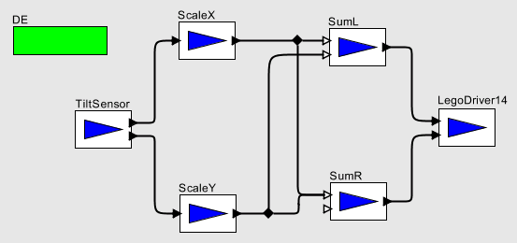
Ptolemy II
System for modeling of component based systems
Built in Java

Slide 3
Domains in Ptolemy II
Different set of semantics define how components interact in each domain
Examples
  Synchronous Dataflow (SDF)
  Finite State Machines (FSM)
  Discrete Event (DE)
  Giotto
  and more...

Slide 4
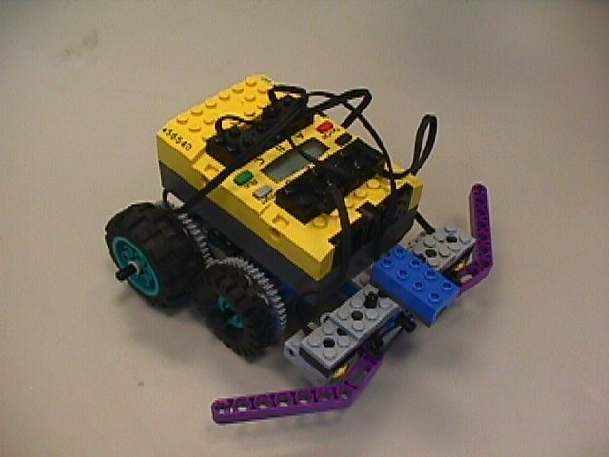
Ptolemy II Framework
Components
Domains
Code
Generation
Java Codegen
Graphical Editor
Ptolemy Infrastructure
Application
Components
Target Codegen
Application Target Implementation
Application Domain Infrastructure

Slide 5
Code Generation in Ptolemy II
Goal: Generate code that can run on an embedded target directly from the model
Transformation based on design-time knowledge of:
  Communication semantics
  Execution Scheduling
  Data Types
The simple case: Java to Java

Slide 6
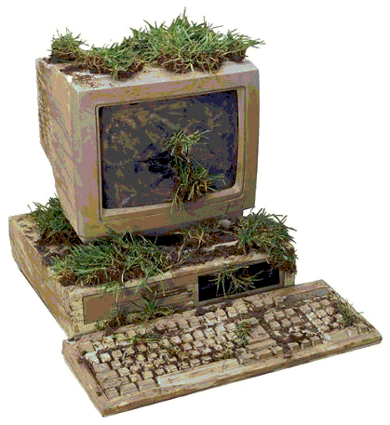
Write Once, Break Anywhere
Java Virtual Machines (JVMs) for embedded platforms are not fully compatible with desktop JVMs

Slide 7
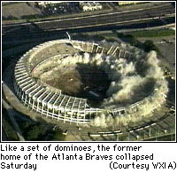
Embedded JVMs
Given these problems, how do we provide a proper Java foundation on an embedded platform??
Might only implement a subset of the bytecode instruction set
  Waba – No floating point
  KVM – No exceptions
Might only implement a subset of the runtime libraries
  Almost all, in some fashion.
APIs for sensors and actuators not present in desktop systems
  Lejos

Slide 8
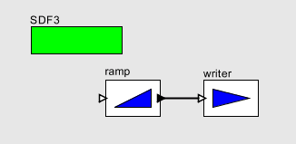
Implementation
Domain specific
code factory
Java
parsing
AST
AST
AST

Slide 9
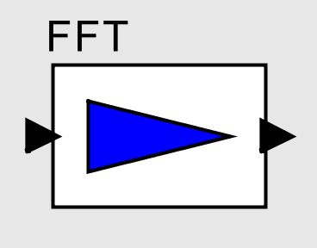
Optimizations
AST
Source
code parsing
transformations
Optimized
Code

Slide 10
SDF Code Generation Process
Gather model information
  scheduling, type resolution
Inline scheduling
  create inline method calls for the schedule
Communication specialization
  create a circular buffer for each connection
Type specialization
  reduce to Java native types

Slide 11
Targetting Embedded Java
This gets us optimized Java that no longer depends on Ptolemy.
To go embedded we still need to:
  Reduce the memory footprint as much as possible
  Bring in classes that the embedded platform doesn't have.

Slide 12
Offline Processing
desktop JDK
desktop JDK replacement classes
Remove classes already in embedded JDK
Remove classes that have desktop JDK replacement classes
ptII device driver APIs
(desktop)
subset of desktop JDK
Change references to base classes to point to embedded JDK extensions
embedded JDK
embedded JDK extensions
rewritten subset of desktop JDK
merge
ptII device driver APIs
(embedded)
merged libs
to Compile-Time Processing

Slide 13
Compile-time Processing
desktop JDK
compile against desktop JDK
desktop JDK replacement classes
.java files generated from Ptolemy II model
.class files
Change references to base classes to point to embedded JDK extensions
ptII device driver APIs
(desktop)
rewritten .class files
merge
embedded JDK
program
embedded JDK extensions
reachability analysis
no
☹
merged libs from offline process
yes
ptII device driver APIs
(embedded)
strip
☺
minimized program

Slide 14
Current Status
Code generation for Synchronous Data Flow, extended to Lejos Java VM.
  Tools are a bit rough around the edges
Future work:
  Giotto (and other domains)
  Retarget to other embedded JVMs

Slide 15
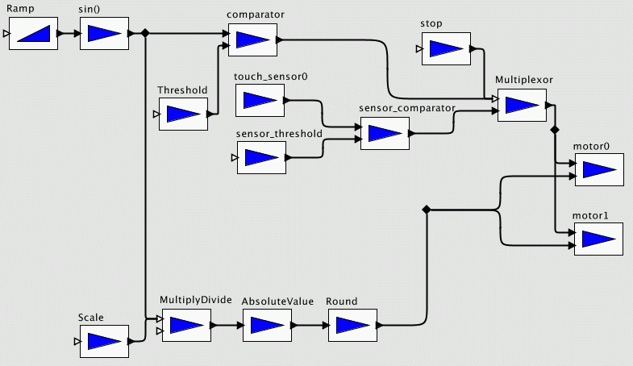

Demo!

Slide 16
Generated Code
  51 classes, 88 methods
  length 1 queues are (improperly) implemented as length 1 circular arrays
    Memory inefficient because indexes are always the same
  System.out allocates temporary objects, which makes it difficult to use in Lejos, which doesn't have garbage collection.
  7.5 Kb user code + 17 Kb for Lejos

