Slide 1

byteflight
Jason Souder

Slide 2
byteflight
Introduction
Motivation
Protocol Specifications
Physical Layer
Development Tools
Other Applications
Comparison to CAN and TTP

Slide 3
Introduction
Developed by BMW along with several semiconductor manufacturers
  Presented at the SAE 2000 conference
Combines the advantages of the synchronous and asynchronous protocols
Guarantees high data integrity at 10 Mbps
Message-oriented addressing via identifiers
Guaranteed latency for a certain number of high-priority messages
Collision-free bus access

Slide 4






BMW Developing Partners
Motorola, Transportation Systems
Elmos AG
Infineon AG (Siemens semiconductor)
Tyco EC (Siemens EC supplying connectors)
CRST GmbH
Weise GmbH
Notes:
Motorola: HC12BD32, HC12 with byteflight controller
Elmos: stand-alone byteflight controller, star coupler, transceiver chip
Infineon: complete byteflight transceiver
Tyco: optical connector with integrated byteflight transceivers
CRST: byteflight Analyzer
IXXAT: byteflight/CAN PCMCIA card, byteflight Analyser/32 tool
Stzp: byteflight conformance testing

Slide 5
byteflight
Introduction
Motivation
Protocol Specifications
Physical Layer
Development Tools
Other Applications
Comparison to CAN and TTP

Slide 6
Motivation
Amount of sensors, actuators, ECUs places high demands on data communication protocols
Trend towards replacing mechanical components with electrical systems
  e.g. brake- and steer-by-wire
  Convenience and safety critical items
  Electronic requirements usually cannot be met by a single ECU
    Solution: network various control modules using high-performance data bus

Slide 7
Motivation
Time triggered protocol (TTP) has been pushed by TTTech and has limited support from automakers
  Low flexibility
  Too slow
  Not suitable for unbalanced bandwidth requirements
Notes:
No automaker “driving” the standard
Flexible use of bandwidth: on-board diagnostics

Slide 8
Motivation
Controller area network (CAN) standard lacks the qualities needed for safety-critical systems
  Need fast, self-checking, synchronous, deterministic
  One node can block communication
  Safety-critical systems require deterministic protocols with fault-tolerant, fail silent behavior
Flexible use of bandwidth

Slide 9
byteflight
Introduction
Motivation
Protocol Specifications
Physical Layer
Development Tools
Other Applications
Comparison to CAN and TTP

Slide 10
Protocol
Description
Scheduling
Message Format
Error Handling

Slide 11
Protocol: Description
Combination of time and priority controlled bus access
Collision free communication
No arbitration loss
Datarate: 10 Mbps gross, >5 Mbps net at full bus load
Hardware guaranteed latency for a certain amount of high priority messages

Slide 12
Protocol: Description
Analytical check of worst case latency for high priority messages
Flexible bus access for low priority messages
Check of latencies for asynchronous messages is supported by system simulation tool
Transmitting device is not aware of whether it’s message was successfully received
Protocol does not guarantee all messages are received consistently by all devices

Slide 13
Protocol: Scheduling
Access to the bus is not controlled by the ‘master’
  Access is time-controlled
Assured latency for certain number of top priority messages
  Highest priority message cannot block the bus
At lower bus loads, low-priority messages can be transmitted as with asynchronous systems

Slide 14
Protocol: Scheduling
Slot counters perform scheduling
  At end of sync, each node starts its slot counter at 1
  When waiting is over, message ID 1 is transmitted
    Slot counter is stopped during message transmission
  Slot counter increments and appropriate messages are transmitted

Slide 15
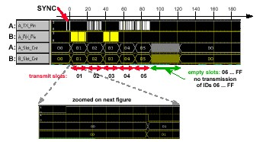
Protocol: Scheduling
Slot Counters (FTDMA)
Notes:
FTDMA: flexible time division multiple access – distributed static medium access strategy where the right to transmit a frame is controlled by the progression of real time; requires a global time-base is available at all nodes
A sends Ids 2,4,5
B sends Ids 1,3
At sync end, waiting begins
When waiting is over, slot counters in all nodes switch to 1
B starts transmitting
When a node recognizes bus activity, it stops its counter
Wait starts again
No transmit request for 2,3
When slot counters reach 4, A transmits

Slide 16
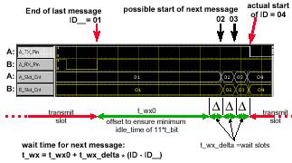
Protocol: Scheduling
Wait Times
Notes:
B transmits ID’s 1,4
A transmits ID’s 2,3
T_wx: wait time between messages
T_wx0: wait time after sync pulse
T_wx_delta: muliplicative of t_wx, = t_max (max propagation delay) + t_tolerance

Slide 17
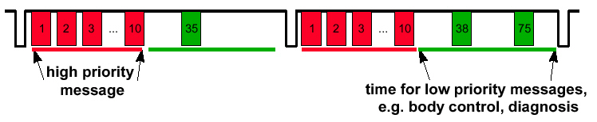
Protocol: Scheduling
Synchronous vs. Asynchronous
  High Priority Messages
    Once per sync frame
    Duration of sync frame: 250 μs (scalable)
  Low Priority Messages
    Flexible bus access for all identifiers

Slide 18
Protocol: Message Format
Start Sequence: 6x ‘0’ bits
ID: 8 bits, determines priority
LEN: 4 bits define data length, 4 bits additional information/data
DATA: up to 12 bytes
CRCH/L: 15 bit CRC sequence, 1 delimiter bit
Stop sequence: 2x ‘0’ bits

Slide 19
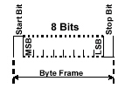
Protocol: Message Format
Byte Frame

Slide 20
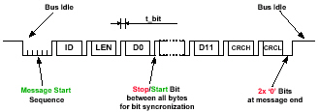
Protocol: Message Format
Notes:
T_bit: bit time, the time required to transmit 1 bit depends on the physical capacity of the transmission line, ~100ns nominal

Slide 21
Protocol: Message Format
Synchronization pulses occur about every 2500 x t_bit (100ns)
  An alarm condition is indicated by a narrower sync pulse
    Automatically reset after 1024 x t_bit
Any node can be configured as a bus master
  If the bus master breaks down, another node’s μC can take over
Wait time between messages: 11 x t_bit
Notes:
Sync pulse: normal 30 x t_bit, alarm 20 x t_bit

Slide 22
Protocol: Error Handling
Detection of bus activity during idle time
Detection of incorrect messages
  Incorrect CRC
  Corrupted or missing start sequence
  Start or stop bit error
Detection of illegal pulses
Detection of incorrect sync pulse
Function of error flags
Error recovery

Slide 23
Protocol: Error Handling
System Level
  Star Coupler
    Detection of protocol violating nodes
      Message format errors, slot mismatch, etc.
      Deactivate erroneous nodes
    Monitoring of optical transmission quality
  Physical Transceiver
    Switched off if “LED on” is received for more than 10μs
    Monitoring of optical transmission quality

Slide 24
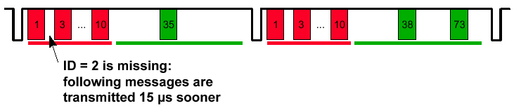
Protocol: Error Handling
Node Failure
  Only messages with valid CRC are made available for the CPU to read

Slide 25
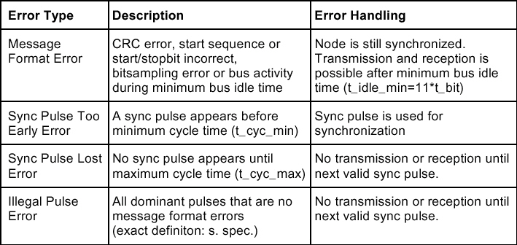
Protocol: Error Handling
Protocol Level

Slide 26
byteflight
Introduction
Motivation
Protocol Specifications
Physical Layer
Development Tools
Other Applications
Comparison to CAN and TTP

Slide 27
Physical Layer
NRZ coding on TX/RX between byteflight controller and transceiver chip
To reduce EMI, the physical layer uses optical transmission
  Star topology with bidirectional (half-duplex) communication on a single plastic optical fiber (POF)
  The transceiver chip, the light-emitting diode and the photodiode are integrated into the optical connector
Possible configurations: star, bus, cluster

Slide 28
Physical Layer
Bus together with transceiver is packaged into a single optical transceiver 6-pin device
Chip-on-chip construction
  Bidirectional plastic optical fiber enabled by an LED mounted on a concentric silicon photodiode
Bus diagnostic functions
Optical wakeup function
Possible: lower bitrates with electrical transceivers (e.g. CAN transceiver)

Slide 29
Available Components
Hardware implementation of protocol
  HC12BD32 with integrated byteflight controller (Motorola)
  Transceiver chip 100.34 for optical transmission (Infineon)
  Active intelligent star coupler E100.39 ASIC (Elmos)
  byteflight controller E100.38 (Elmos)
Notes:
ASIC: application specific integrated circuit

Slide 30
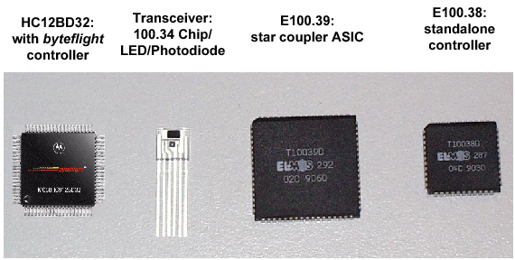
Available Components

Slide 31
HC12BD32 with byteflight
Based on HC12: CAN substituted by byteflight
16 programmable message buffers
  Transmit, receive, FIFO
Low power modes
  Stop 10 μA, wait 6 mA
Programmable wakeup via data bus
Notes:
FIFO: first in first out buffer

Slide 32
Transceiver Chip 100.34 (Infineon)
Optical transceiver
  Logic to light and light to logic
Bidirectional (half-duplex) data transfer
Uses a single plastic optical fiber (POF)
LED driver, transceiver chip, photodiode integrated in optical connector
NRZ coding for best bandwidth efficiency on POF
Notes:
NRZ: non return to zero
non-synchronizing because the receiver can’t retrieve the ticks of the clock of the sender from a monotone transmission signal
can be used in an asynchronous environment
to be used in synchronous environment, requires bit stuffing to support synch -> reduces efficiency
Manchester: 1 is low/high, 0 is high/low
requires additional bits

Slide 33
Transceiver Chip 100.34 (Infineon)
Independent recognition of ALARM-state
Error containment
  Switch off if “LED on” is received for more than 10 us
Monitoring of optical transmission quality integrated
Bus diagnostics
Sleep mode (10uA) and optical wakeup function

Slide 34
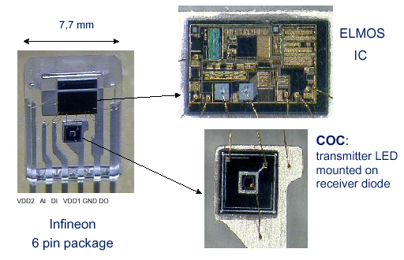
Transceiver Chip 100.34 (Infineon)

Slide 35
Intelligent Star Coupler E100.39
Connect up to 22 bus participants
SPI-Interface to
  switch on/off selected I/O’s
  send diagnostic information
Record the active participants in each frame of a transmission
Notes:
AND of all connected inputs and propagation of the signal to the connected outputs
AND of connected signals: ????
SPI interface: Serial Peripheral Interface

Slide 36
Intelligent Star Coupler E100.39
Count up the error information of each connected S/E module
  Error containment
    Individual nodes can be switched off
    e.g., “Babbling Idiots” switched off
Monitoring of optical transmission quality
Data recovery of the incoming bitstream

Slide 37
byteflight Controller E100.38
Standalone byteflight controller
Functionality according to byteflight module of HC12BD32
Bus interface for Motorola Power PC, HC12, Siemens C16x
  Clock supply for external μC via E100.38
Bit rate of 10 Mbps
Programmable timing-registers to configure protocol wait times
Programmable bus master function

Slide 38
byteflight Controller E100.38
16 message buffer in total, 14 byte wide each
Programmable buffer configuration (transmit, receive, FIFO)
CPU access by locking mechanism
10 interrupt sources
Low power sleep mode
Additional WAKEUP pin

Slide 39
Software in ECUs
Standardized communication software in all nodes
Safety-critical tasks are triggered and synchronized by protocol regardless of the state of non-safety tasks
  Do not contain additional interrupt service routine (ISR)
Non-safety critical tasks may contain several ISR’s

Slide 40
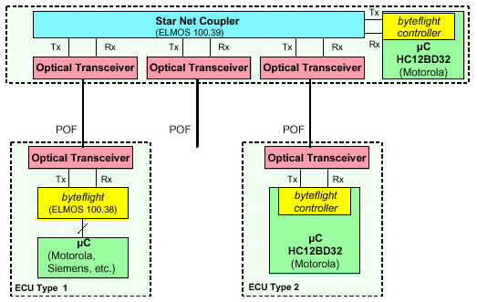
Possible Communication Structure
Source: http://www.byteflight.com/presentations/index.html, “Examples of Applications”

Slide 41
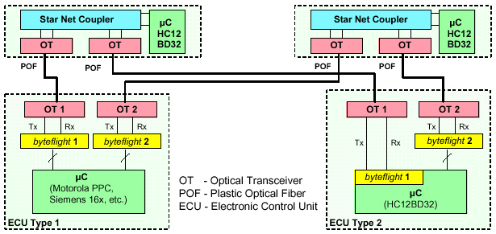
Redundant Communication Architecture
Source: http://www.byteflight.com/presentations/index.html, “Examples of Applications”
Notes:
Also possible to have redundant bus master in this system

Slide 42
byteflight
Introduction
Motivation
Protocol Specifications
Physical Layer
Development Tools
Other Applications
Comparison to CAN and TTP

Slide 43
Development Tools
siAnalyser/32 (IXXAT): universal analyzing and development tool for bus systems
  Simulation
  Monitoring
  Tracing
  Node emulation
  Support of different hardware platforms
  Resource management
  Hardware configuration
  Reception and transmission of bus messages
  Trace Client for trigger events

Slide 44
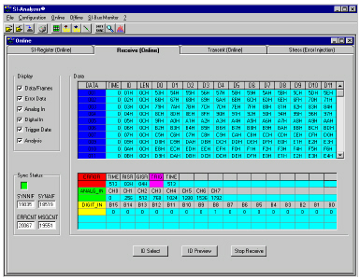
Development Tools

Slide 45
Development Tools
Bus analyzer (CRST)
  Online analysis
  Full trace of bus traffic
  Integrated hard disk
  Additional analog/digital channels
  Trigger logic
  Emulation of bus traffic
  Custom programming interface

Slide 46
Development Tools
Bus analyzer (CRST)
  Serves as an online and offline analysis tool to evaluate SI-Bus traffic
  Online:
    Direct read/write of SI-ASIC registers
    Receive/display bus data, error data, trigger events, analog/digital data and SYNC pulses
    Transmit messages in single shot and cyclic modes
  Offline:
    Offline display and analysis of previously captured bus traffic

Slide 47
Development Tools
Bus Monitor (Weise GmbH)
  Receive/transmit byteflight telegrams
  Online display of telegrams
  Electrical/optical interface

Slide 48
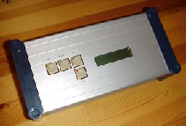
Development Tools
Bus Monitor

Slide 49
Development Tools
System simulation tool Ptolemy
  Modeling of byteflight networks from a byteflight library
  Evaluation of system trade offs
  Test of protocol alternatives
  Protocol extensions
  Evaluation of system behavior in error cases

Slide 50
byteflight
Introduction
Motivation
Protocol Specifications
Physical Layer
Development Tools
Other Applications
Comparison to CAN and TTP

Slide 51
Possible Applications
Passive and active safety
Combination with other non-safety critical applications:
  Separation of bus traffic and software tasks in safety critical and non-safety critical parts
Aerospace industry
Industrial applications

Slide 52
Industrial Applications
High speed data exchange at I/O-level
Minimum cable costs
No EMI
Closed loop and time-scheduled control
Only 1 optical fiber for all data: parameters, sensors, control and diagnosis
Low cost, high reliability, high data integrity

Slide 53
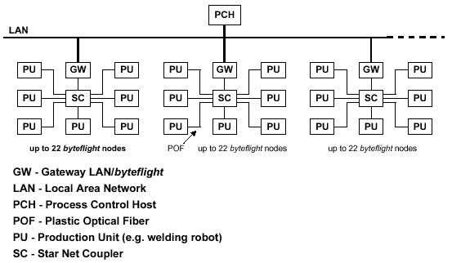
Industrial Applications

Slide 54
byteflight
Introduction
Motivation
Protocol Specifications
Physical Layer
Development Tools
Other Applications
Comparison to CAN and TTP

Slide 55
Comparison to CAN and TTP
Cost of microcontroller with an integrated byteflight controller is expected to be equivalent to CAN
CAN
  Use is fading because it is event-based
  Subject to “babbling idiot mode”
    Faulty sensor transmits a stream of meaningless data to the controller
    Block the transmission of critical signals from other sensors
    Ties up bus and controller
  ISO standard
  Working on time-triggered revision

Slide 56
Comparison to CAN and TTP
TTP
  Robust protection against errors in signaling provided by a TDMA based architecture
  Clock synchronization for controlling the slots at all nodes is a distributed collection scheme
  Architecture includes a hardware “bus guardian” that can prevent a node from grabbing the bus due to a software error
  Typically 2 Mbps over copper
  “Leading candidate,” Delphi Automotive
  TTP nodes are expected to cost 2-4 times that of a CAN node

Slide 57
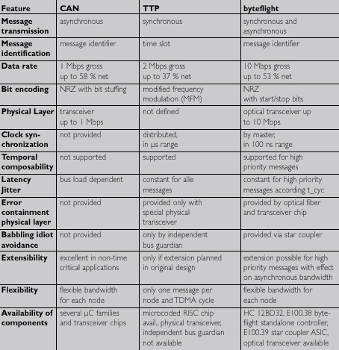
byteflight vs. CAN vs. TTP

Slide 58
Conclusions
byteflight will be used by BMW in a production car in the next 2 years
  Possible application: to help airbag inflation systems take better account of passenger size and position
“Middle ground” between TTP and CAN
  20 times faster than CAN
  Low cost

Slide 59
Further Development
Adaptable cycle time
Adaptable bit rate regardless of CPU clock
Slot mismatch detection for each individual message
Fault tolerant clock synchronization
A single clock master implies a single point of failure
  Acceptable for airbags (warning light), but not for by-wire

Slide 60
byteflight

