Slide 1

E-Machine:
Scheduled Computation Through Re-entrant Interrupts
Paul Griffiths
Jason Souder
11 May 2001
EECS 290O

Slide 2
LegOS E-Machine
Introduction
E-Machine Tasks
E-Machine Scheduling
Demo

Slide 3
E-Machine Fundamentals
Scheduled vs. Synchronous Computation
  Scheduled
    Given Deadline
    Tasks sorted according to some algorithm, e.g. earliest-deadline first
  Synchronous Computation
    Execute Immediately
Scheduled Computation
  Tasks must be able to be interrupted and return to task with next highest priority

Slide 4
E-Machine
Kernel Modifications
  Time handler
  Interrupt Handler
  No task management by native kernel
  No program management by native kernel

Slide 5
E-Machine
main()
Scheduler
Interpreter
Dispatcher

Slide 6
E-Machine
Scheduler
  Called by timer interrupt handler
  Checks *trigger_list
  Checks *pre_ready_list for any tasks to add to ready list
  Sorts the tasks in a linked list according to EDF
  Calls the dispatcher
  Returns control to timer interrupt handler

Slide 7
E-Machine
Interpreter
  Maintains all op-code implementations
  Connection between op-codes and platform

Slide 8
E-Machine
Dispatcher
  Called by the scheduler
  Checks the *inactive_list for tasks whose deadlines have passed
  Navigates to the end of the scheduled list of computations
  Calls task on *run_list
  Returns to the scheduler

Slide 9
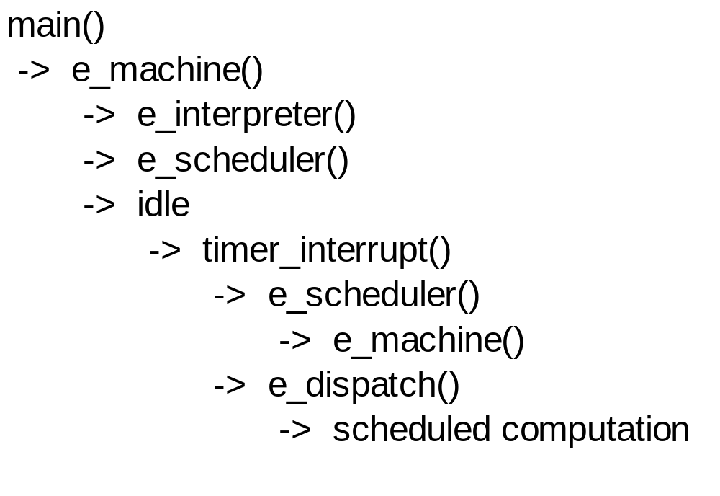
E-Machine Interrupts
Re-entrant interrupts

Slide 10
E-Machine - Demo
Op-Codes
int opcode[CODELEN][4] = {
{ PSH, 10000, 0 , 0},
{ CAL, CLOCK, (int)hello, 0},
{ ADD, -6000, 0, 0},
{ EMP, CLOCK, 6, 0},
{ POP, 0, 0, 0},
{ RET, 0, 0, 0},
{ PSH, 2000, 0, 0},
{ CAL, CLOCK, (int)world, 0},
{ POP, 0, 0, 0},
{ RET, 0, 0, 0}};

Slide 11
E-Machine – Demo
Functions
void hello(int *lint_s, int *lint_v )
{
int i;
long int begin_t = sys_time;
while( sys_time-begin_t < 10000 )
{
cputs("HELLO");
lcd_refresh();
for( i=0; i<30000; i++) {}
}
cls(" ");
lcd_refresh();
}
void world(int *lint_s, int *lint_v )
{
int i;
long int begin_t = sys_time;
while( sys_time-begin_t < 2000 )
{
cputs("WORLD");
lcd_refresh();
for( i=0; i<30000; i++ ){}
}
cls(" ");
lcd_refresh();
}

Slide 12
LegOS E-Machine
Task Scheduling in “HELLO WORLD”
WORLD
HELLO
t = 4sec
t = 6sec

Slide 13
LegOS E-Machine
Questions

