Slide 1
Worst-case Execution Time (WCET) Estimation
Shawn Schaffert

Slide 2
Outline
Introduction
WCET problem & analysis
Cinderella before cache modeling
Cinderella with cache modeling
Conclusion

Slide 3
Introduction

Slide 4
Motivation
Recent growth in embedded systems
Real-time applications have strict requirements
Often assumed by schedulers
Hardware-software partition driven by timing constraints
Impractical to simulate every situation

Slide 5
Previous Work & Other Work
General area of program analysis (Nielson, Nielson, & Hankin)
In general, undecidable; equivalent to the halting problem (Puschner, Koza)
Decidable by introducing restrictions (Kligerman, Stoyenko and Puschner, Koza):
  No dynamic data structures
  No recursion
  Bounded loops
Fully associative caches modeling (Theiling, Ferdinand, Wilhelm)
Automatically extracting functional constraints (Gustafsson)
Notes:
out of place?

Slide 6
WCET Problem

Slide 7
Problem Statement
Given:
  Program
  Processor (and memory system)
Assume:
  Uninterrupted execution
Find:
  Upper bound on execution time (T_{max})
  Lower bound on execution time (T_{min})
Goals:
  Try to have tight bounds

Slide 8
Key Parts of Analysis
Program path analysis
  Sequence of instructions executed in worse (best) case
Micro-architectural modeling
  Representation of host processor and memory
  Use to compute how much real time is required to execute a sequence of instructions
Interplay between two makes analysis complex

Slide 9
Cinderella
(Before Cache Modeling)

Slide 10
Main Idea
Idea:
  Implicitly consider paths (not explicitly)
  Divide program into basic blocks
  Form problem as a integer linear programming (ILP) problem:
    Integer variables: number of executions of each part of program
    Linear objective: maximum (minimum) execution time
    Linear constraints: structure and function of program
  ILP is worst case exponential time, good in practice
Notes:
out of place?

Slide 11
Divide into basic blocks
i = 10;
store(i);
n = 2*i;
store(n);
void store(int i)
{
...
}
B₁
x₁
B₃
B₂
x₃
x₂

Slide 12

Objective Function
B_{i} = basic block i
x_{i} = number of times the block B_{i} is executed
c_{i} = worst case running time of block B_{i}
Lower bound computed analogously

Slide 13
Program Structural Constraints
d₁
i = 10;
store(i);
n = 2*i;
store(n);
void store(int i)
{
...
}
B₁
x₁
d₄
d₂
B₃
B₂
x₂
d₃
d₅
x₁ = d₁ = d₂
x₂ = d₂ = d₃
d₄ = d₂ + d₃

Slide 14
Program Structural Constraints
d₁
/* k >=0 */
s = k;
while (k < 10){
if (ok)
j++;
else {
j = 0;
ok = true;
}
k++;
}
r = j;
x₁
B₁
s = k;
d₂
d₈
x₂
B₂
while (k < 10){
d₃
x₃
B₃
if (ok)
d₅
d₄
B₅
x₄
B₄
j++;
j = 0;
ok = true;
x₅
d₆
d₇
x₆
B₆
k++;
d₉
x₇
B₇
r = j;
d₁₀

Slide 15
Program Functionality Constraints
Structural constraints abstract functionality away
Program behavior provides more constraints
Loop Bounds

Slide 16
Functionality Constraints
check_data() {
x₁ int i, morecheck, wrongone;
x₂ morecheck = 1; i = 0; wrongone = -1;
x₃ while (morecheck) {
x₄ if (data[i] < 0) {
x₅ wrongone = i; morecheck = 0;
}
else
x₆ if (++i >= 10)
x₇ morecheck = 0;
}
x₈ if (wrongone >= 0)
x₉ return 0;
else
x₁₀ return 1;
}
Constraints
x₂ ≤ x₄
x₄ ≤ 10x₂
(x₅ = 0 & x₇ = 1) |
(x₅ = 1 & x₇ = 0)
x₅ = x₉
Notes:
note first how this function was broken into basic blocks

Slide 17
Solving the Constraints
ILP solver requires constraints that are:
  equalities
  inequalities
  conjunctions of the above
Disjunctions ⇒ Separate Cases (exponentially many)

Slide 18
Micro-architectural Modeling
Simple model to estimate c_{i}’s
Reduce basic blocks to assembly code and use hardware manual to bound each instruction
Does not model cache memory well

Slide 19
Cinderella
(With Cache Modeling)

Slide 20
Cache Modeling
Model direct-mapped instruction cache
Requires:
  Modify cost function (cache hit and miss have different costs)
  Add linear constraints to describe relationship between cache hits and misses

Slide 21
Direct-Mapped Cache
Main Memory
Cache Memory
m bits
n bits
2^{n}
xx..xx 00..00 00…00
…
xx..xx 00..00 11…11
xx..xx 00..01 00…00
…
xx..xx 00..01 11…11
…
…
…
xx..xx 00..00 00…00
…
xx..xx 00..00 11…11
xx..xx 00..01 00…00
…
xx..xx 00..01 11…11
2^{m}
…

Slide 22
Basic Idea
Basic blocks assumed to be smaller than entire cache
Subdivide instruction counts (x_{i}) into counts of cache hits (x_{i}^{hit}) and misses (x_{i}^{miss})
Line-block (or l-block) is a contiguous sequence of code within the same basic block that is mapped to the same cache line in the instruction cache
Either all hit or all miss in a l-block

Slide 23
Example of subdividing basic blocks into line blocks
B_{1.1}
Color Cache Set
B₁
B_{1.2}
0
B_{1.3}
1
B_{2.1}
2
B₂
B_{2.2}
3
B_{3.1}
B₃
B_{3.2}

Slide 24
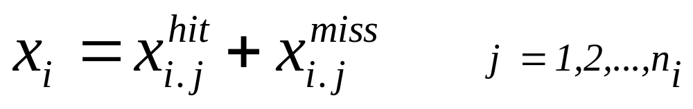
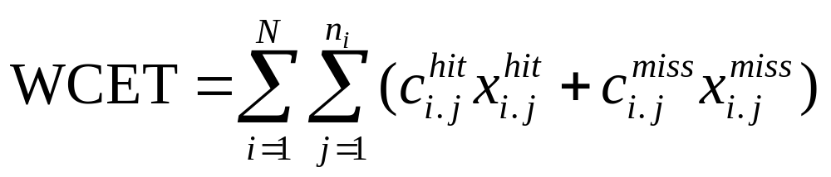
ILP Modification
Modified cost function
Cache constraints
  Cache conflict graph
  User functionality constraints

Slide 25
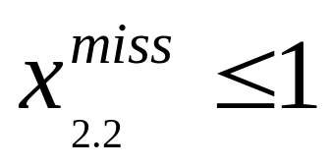
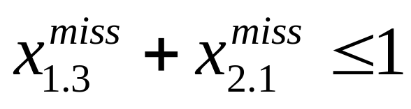
Cache Constraint Examples
No conflicting l-blocks
B₁
Two nonconflicting l-blocks are mapped to same cache line
B₂
B₃

Slide 26
Cache Conflict Graph
Constructed for every cache set containing two or more conflicting l-blocks
Contains:
  start node (represents start of program)
  end node (represents end of program)
  node B_{k.l} for every l-block in the cache set
Edge from B_{k.l} to B_{m.n} if control can pass between them without passing through any other l-blocks of the same cache set.

Slide 27
Cache Conflict Graph Example
start
p_{(k.l,k.l)}
p_{(s,m.n)}
p_{(s,k.l)}
p_{(k.l,m.n)}
B_{k.l}
B_{m.n}
p_{(m.n,k.l)}
p_{(m.n,m.n)}
p_{(k.l,e)}
p_{(m.n,e)}
end
p_{(s,e)}

Slide 28
Cache Constraints Example
Cache
d₁
x₁
B_{1.1}
s = k;
d₂
d₈
x₂
B_{2.1}
while (k < 10){
d₃
x₃
B_{3.1}
if (ok)
d₅
d₄
B_{5.1}
x₄
B_{4.1}
j++;
j = 0;
ok = true;
x₅
d₆
d₇
x₆
B_{6.1}
k++;
d₉
x₇
B_{7.1}
r = j;
d₁₀

Slide 29
Cache Constraints Example
d₁
x₁
B_{1.1}
s = k;
s
d₂
d₈
x₂
B_{2.1}
while (k < 10){
p_{(s,5.1)}
d₃
p_{(s,4.1)}
x₃
B_{3.1}
if (ok)
p_{(4.1,4.1)}
p_{(4.1,5.1)}
B_{4.1}
B_{5.1}
d₅
d₄
B_{5.1}
p_{(5.1,4.1)}
x₄
B_{4.1}
j++;
j = 0;
ok = true;
x₅
p_{(5.1,5.1)}
p_{(s,e)}
p_{(4.1,e)}
d₆
p_{(5.1,e)}
d₇
x₆
B_{6.1}
k++;
e
d₉
x₇
B_{7.1}
r = j;
d₁₀

Slide 30
Cache Constraints Example
d₁
x₁
B_{1.1}
s = k;
s
d₂
d₈
x₂
B_{2.1}
while (k < 10){
p_{(s,1.1)}
d₃
x₃
B_{3.1}
if (ok)
p_{(1.1,6.1)}
d₅
B_{1.1}
B_{6.1}
d₄
B_{5.1}
x₄
B_{4.1}
j++;
j = 0;
ok = true;
x₅
p_{(6.1,6.1)}
p_{(1.1,e)}
d₆
p_{(6.1,e)}
d₇
x₆
B_{6.1}
k++;
e
d₉
x₇
B_{7.1}
r = j;
d₁₀

Slide 31
Implementation
Hardware:
  Intel QT960 development board
  Intel i960KB processor (32 bit RISC processor) at 20MHz
  128KB main memory
  512 byte direct-mapped instruction cache (32 x 16-byte lines)
Software tool Cinderella:
  Reads executable code
  Constructs control flow graph(CFG) and cache conflict graph(CCG)
  Derives structural constraints
  Annotates source files
  User provides functionality constraints

Slide 32
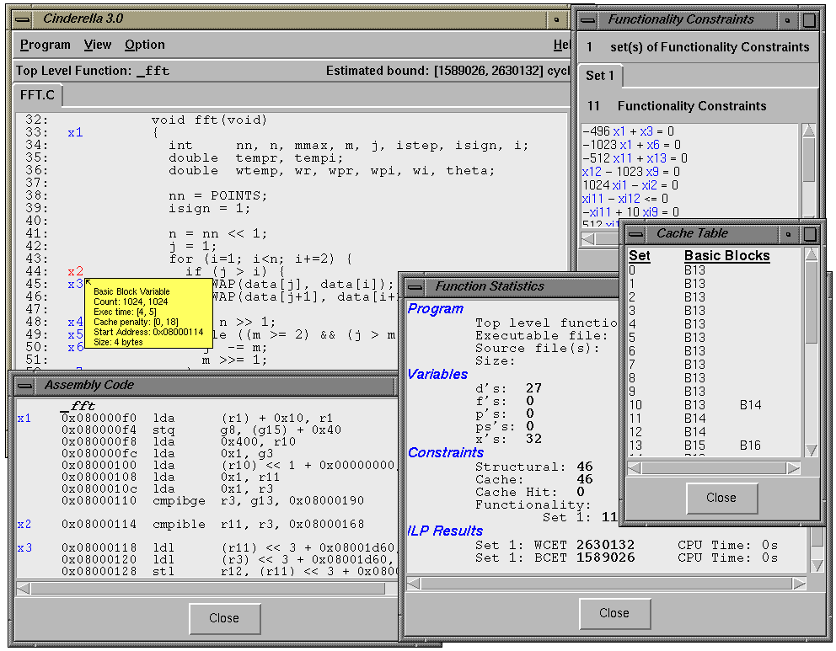

Slide 33
Set of Benchmarks
Function | Description | Lines | Bytes
check_data | Example from Park’s thesis | 23 | 88
circle | Circle drawing routing in Gupta’s thesis | 100 | 1588
des | Data Encryption Standard | 192 | 1852
dhry | Dhrystone benchmark | 761 | 1360
djpeg | Decompression of 128x96 color JPEG | 857 | 5408
fdct | JPEG forward discrete cosine transform | 300 | 996
fft | 1024-point Fast Fourier transform | 57 | 500
line | Line drawing routine in Gupta’s thesis | 165 | 1556
matcnt | Summation of 2100x100 matrices from Arnold | 85 | 460
matcnt2 | Matcnt with inlined functions | 73 | 400
piksrt | Insertion sort | 19 | 104
sort | Bubble sort of 500 elements from Arnold | 41 | 152
sort2 | sort with inlined functions | 30 | 148
stats | Sum, mean, var of two 1000 element arrays | 100 | 656
stats2 | stats with inlined functions | 90 | 596
whetstone | Whetstone benchmark | 196 | 596

Slide 34
Comparison with actual running times
Function | Measured WCET (cycles) | Estimated WCET (cycles) | Ratio
check_data | 4.30 x 10² | 4.91 x 10² | 1.14
circle | 1.45 x 10⁴ | 1.54 x 10⁴ | 1.06
des | 2.44 x 10⁵ | 3.70 x 10⁵ | 1.52
dhry | 5.76 x 10⁵ | 7.57 x 10⁵ | 1.31
djpeg | 3.56 x 10⁷ | 7.04 x 10⁷ | 1.98
fdct | 9.05 x 10³ | 9.11 x 10³ | 1.01
fft | 2.20 x 10⁶ | 2.63 x 10⁶ | 1.20
line | 4.84 x 10³ | 6.09 x 10³ | 1.26
matcnt | 2.20 x 10⁶ | 5.46 x 10⁶ | 2.48
matcnt2 | 1.86 x 10⁶ | 2.11 x 10⁶ | 1.13
piksrt | 1.71 x 10³ | 1.74 x 10³ | 1.02
sort | 9.99 x 10⁶ | 27.8 x 10⁶ | 2.78
sort2 | 6.75 x 10⁶ | 7.09 x 10⁶ | 1.05
stats | 1.16 x 10⁶ | 2.21 x 10⁶ | 1.91
stats2 | 1.06 x 10⁶ | 1.24 x 10⁶ | 1.17
whetstone | 6.94 x 10⁶ | 10.5 x 10⁶ | 1.51

Slide 35
Estimated Cache Misses
Program | DineroIII Simulation | Estimated Worst-Case Cache Misses | Ratio
circle | 443 | 458 | 1.03
des | 3872 | 4188 | 1.08
dhry | 8304 | 8304 | 1.00
djpeg | 230861 | 316394 | 1.37
fdct | 63 | 63 | 1.00
line | 99 | 101 | 1.02
stats | 47 | 47 | 1.00
stats2 | 44 | 44 | 1.00
whetstone | 18678 | 18678 | 1.00

Slide 36
ILP Solver Performance
No. of Variables
No. of Constraints
Function
d’s
f’s
p’s
x’s
Struct.
Cache
Funct.
ILP branches
Time(sec.)
check_data
12
0
0
40
25
21
5+5
1+1
0+0
circle
8
1
81
100
24
186
1
1
0
des
174
11
728
560
342
1059
16+16
13+13
171+197
dhry
102
21
503
504
289
777
24x4+26x4
1x8
0x3+2+0+1x2+4
djpeg
296
20
1816
416
613
2568
64
1
87
fdct
8
0
18
34
16
49
2
1
0
fft
27
0
0
80
46
46
11
1
0
line
31
2
264
231
73
450
2
1
3
matcnt
20
4
0
106
59
61
4
1
0
matcnt2
20
2
0
92
49
54
4
1
0
piksrt
12
0
0
42
22
26
4
1
0
sort
15
1
0
58
35
31
6
1
0
sort2
15
0
0
50
30
27
6
1
0
stats
28
13
75
180
99
203
4
1
0
stats2
28
7
41
144
75
158
4
1
0
whetstone
52
3
301
388
108
739
14
1
2

Slide 37
Conclusions

Slide 38
Conclusions and Future Work
Conclusions:
  Method to estimate bounds on running time of a program on a given processor
  Modeled direct-mapped instruction cache
  Uses ILP to consider paths implicitly (not explicitly)
  Software tool: cinderella
Future Work
  Improving hardware model: data cache memory & register windows
  Automatically derive some of the functionality constraints
  Adapt cinderella to other embedded platforms (Motorola M68000)

