Slide 1

Real-Time Java
How I learned to stop worrying and love abstraction.
Steve Neuendorffer

Slide 2
Outline
Java Overview
  Threads
  Monitors
  Garbage Collection
Real-Time Java
  Thread priorities
  Memory management
Implementations

Slide 3
Java Threads
Priority driven scheduler
  Algorithm unknown.
  Number of priorities unknown.
  May be time sliced/not time sliced.
  Allows mapping onto a wide variety of native threading models (NT, Unix, etc.)
  It is not generally safe to explicitly transfer control from one thread to another (killing threads, asynchronous transfer of control)

Slide 4
Critical sections
Synchronized blocks (Monitors)
  Any object can be a monitor
  Only one thread can hold a monitor at the same time
  Be careful to acquire monitors in order, or deadlock can occur
static Object monitor = new Object();
public void foo() {
synchronized(monitor) {
// Do Something
}
}

Slide 5
Garbage Collection
No Pointers
  There is no way to create an absolute memory reference
No explicit way to free dynamically allocated memory
  Objects that have no references are automatically cleared
  Circular references are tricky, so you end up having to do reachability analysis on the reference graph
  No control over the garbage collector

Slide 6
Embedded Systems and Java
The abstractness of Java makes it difficult to create real-time embedded systems
  Most embedded systems rely on manual management of threads and memory to meet real-time guarantees.
  So, how can we build facilities to offer better control of these things on top of Java, without breaking the nice abstraction that Java provides?

Slide 7
Guiding principles
General applicability
Backward compatability
Write Once, Run Anywhere
Reflect current practice
Not impede future development
Predictable execution
No syntactic extensions
Allow variation in implementation
  But enforce that they are documented

Slide 8
Real-time Java enhancements
More control over thread scheduling
Manual control of memory allocation
Access to physical memory
Expanded specification of synchronized
Asynchronous event handling
  ala interrupt handlers
Asynchronous transfer of control
Asynchronous thread termination

Slide 9

Threads

Slide 10
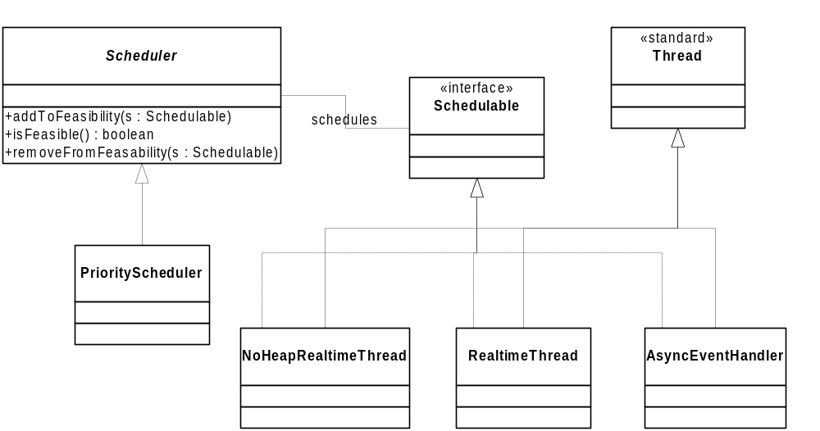
Threads

Slide 11
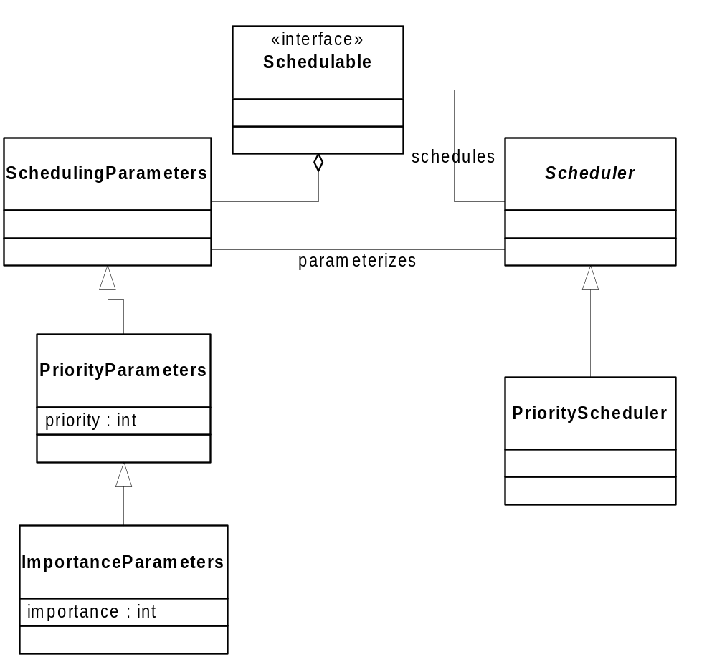
Priority Scheduling

Slide 12
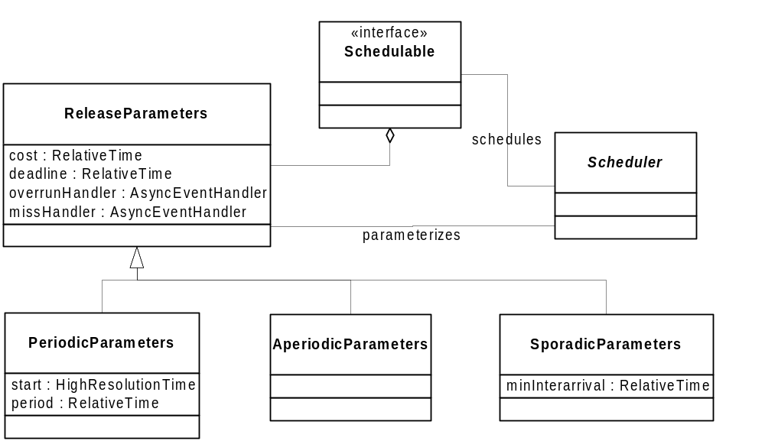
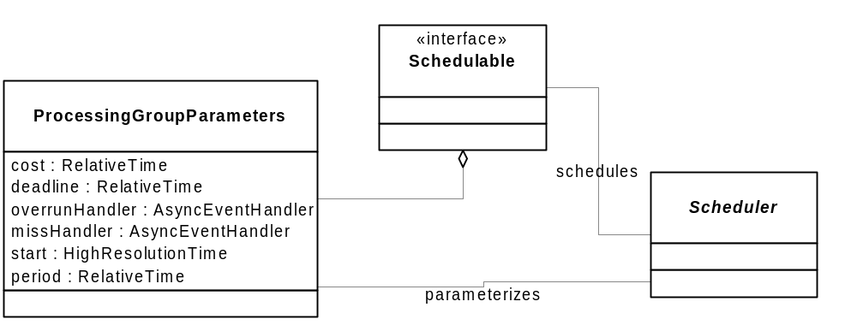
Advanced Scheduling

Slide 13

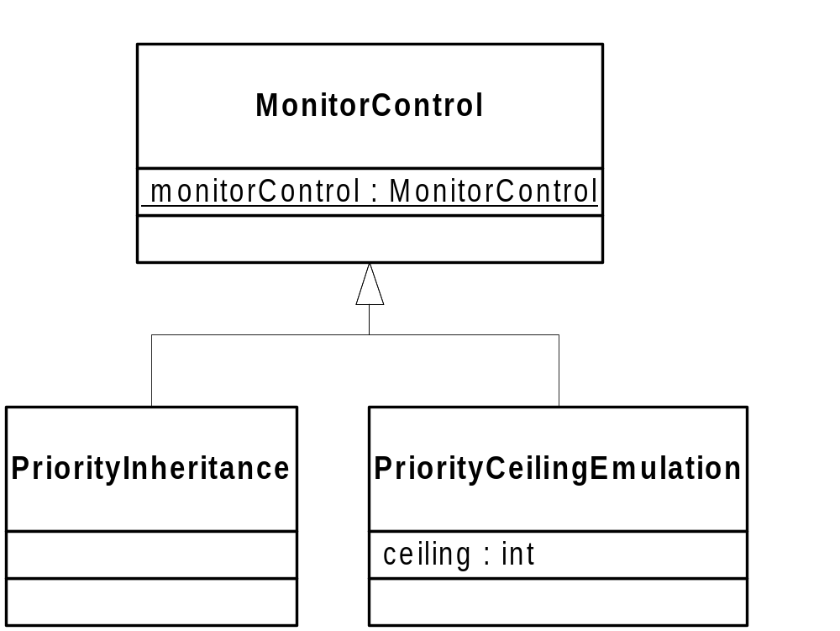
Monitors
static Object monitor = new Object();
public void foo() {
synchronized(monitor) {
// Do Something
}
}
However, there is no way to have a NoHeapRealtime thread and a regular thread synchronize on the same object!

Slide 14
Wait Free Queues
Allow communication between hard-realtime and soft-realtime threads.
Thread
Blocking
reads and writes
WaitFreeWriteQueue
WaitFreeReadQueue
WaitFreeDequeue
Non-Blocking
reads and writes
NoHeapRealtime Thread

Slide 15
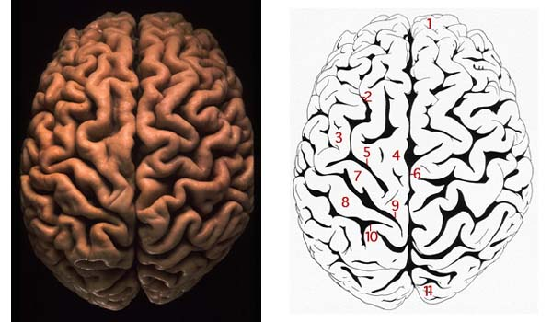
Memory

Slide 16
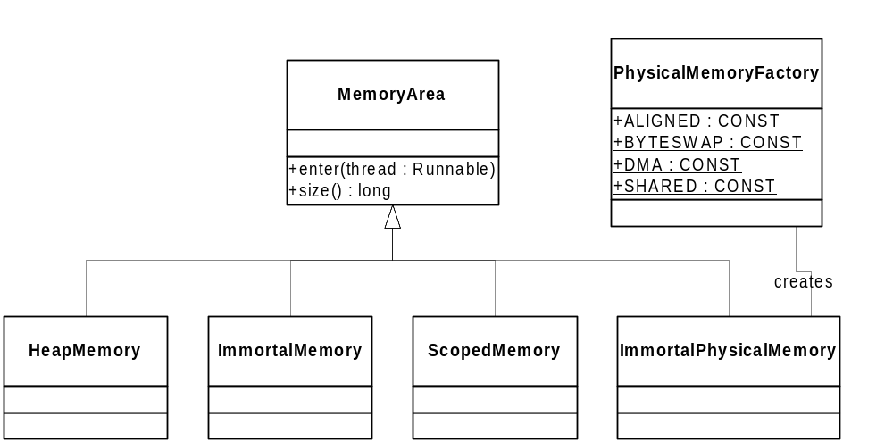
Memory Management
State of the art in Garbage Collection is not enough to provide real-time guarantees

Slide 17
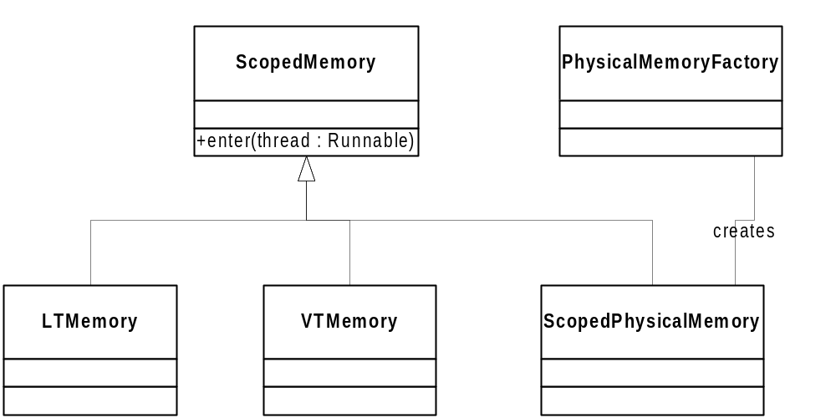
Memory Scopes
Makes explicit the scope of a dynamically allocated object
Linear
allocation time
Variable
allocation time

Slide 18
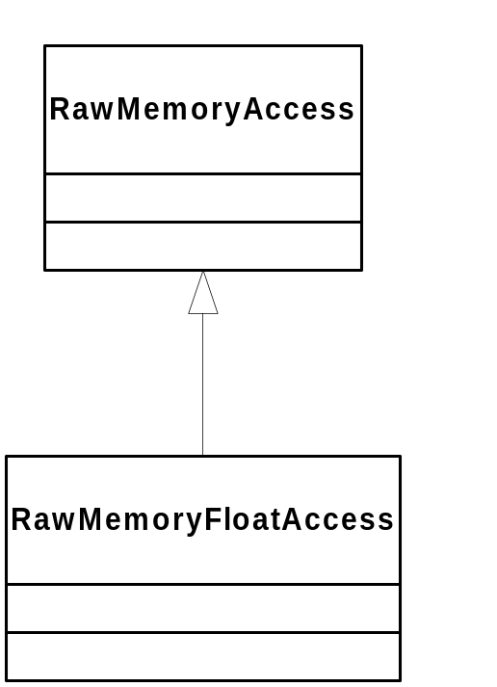
Raw Memory
Allows access as
bytes, short,
ints, and longs
Allows access as
floats and doubles
as well
Primarily useful for memory mapped I/O
especially in device drivers.
Java references cannot be placed in raw memory

Slide 19
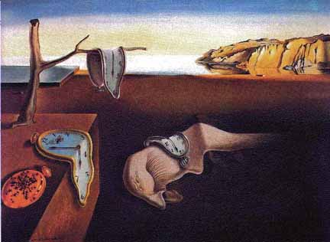
Surreal Time?

Slide 20
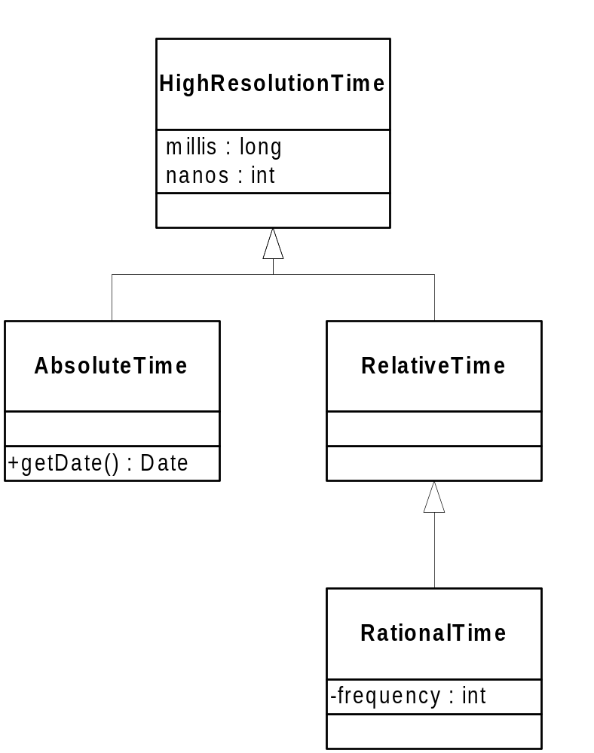
Real Time!
start times,
stop times
computation time,
latencies
uncritical
periods

Slide 21
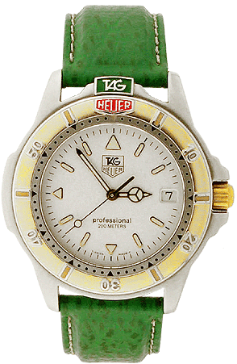
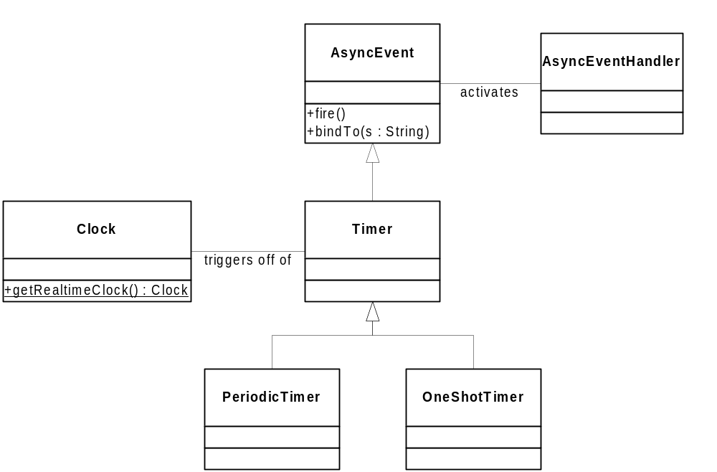

Timers

Slide 22
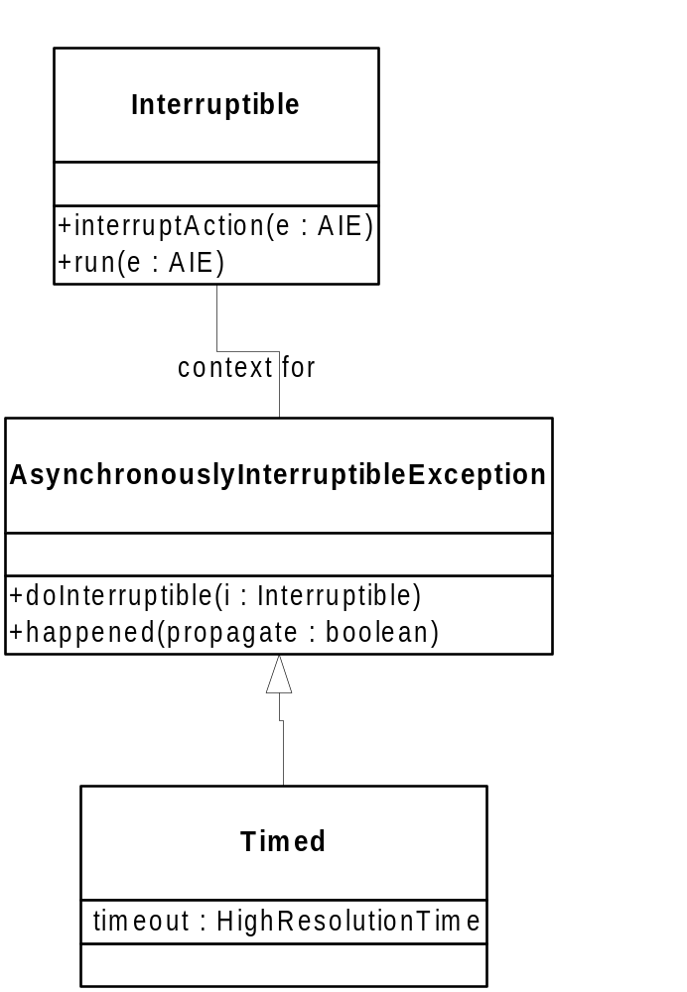
Asynchronous Transfer of Control
An active object that
contains a bit of code that
can be interrupted
Thrown from the run() method
of an Interruptible

Slide 23
Asynchronous Transfer of Control
aie.doInterruptible(new Interruptible() {
public void run(AsynchronouslyInterruptedException e)
throws AsynchronouslyInterruptedException {
// something that may be interrupted
}
public void interruptAction(
AsynchronouslyInterruptedException e) {
// React to the interruption
}
}
(new Timed(new RelativeTime(50.0))).doInterruptible(…);

Slide 24
Discussion
How could we implement Giotto?
How could we implement the embedded machine?
How could we implement (model?) TTA?
How could we implement (model?) an embedded control system?

