Slide 1
Embedded Software Engineering
3 Unit Course, Spring 2002
EECS Department, UC Berkeley
Christoph Kirsch
www.eecs.berkeley.edu/~fresco/giotto/course-2002

Slide 2
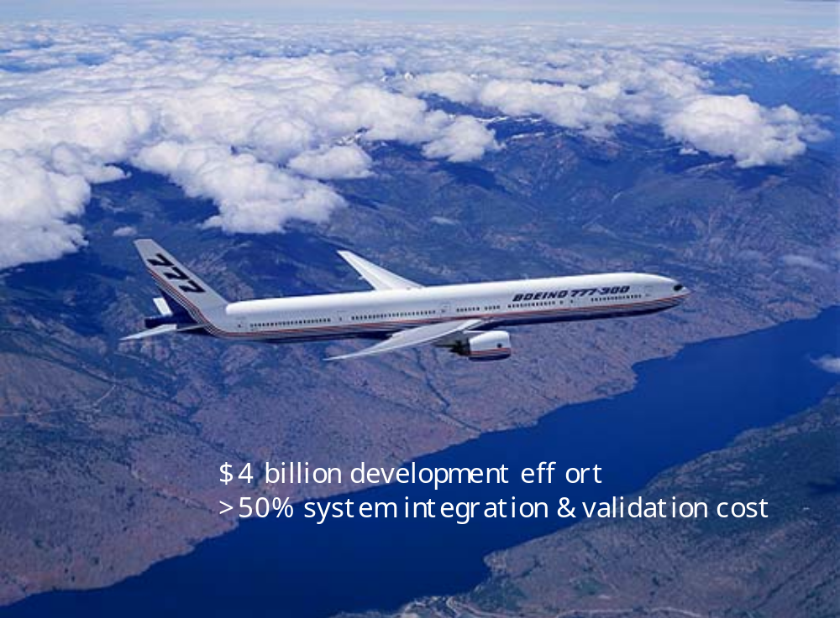
It’s significant

Slide 3
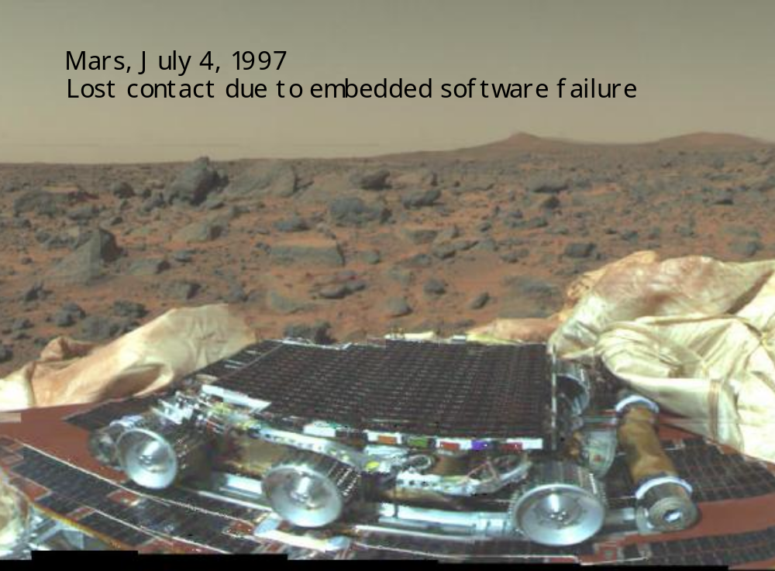
It’s tricky

Slide 4
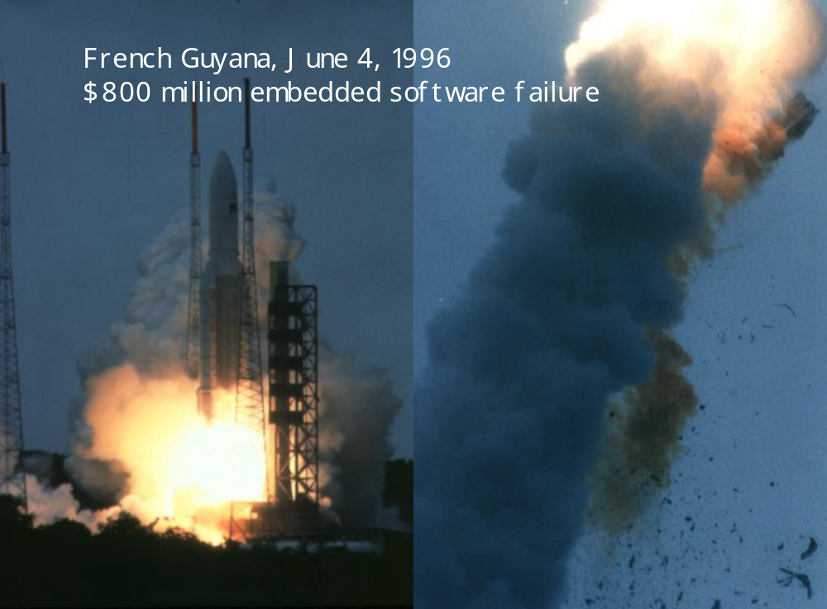
It’s risky

Slide 5
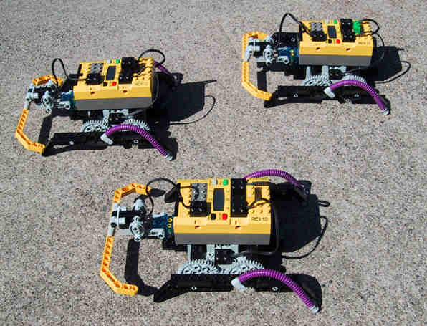
It’s fun

Slide 6
Problem
Man-Machine
Interface
Instrumentation
Interface
Real-Time
Computer
System
Controlled
Object
Operator
Kopetz97
Methodologies for the implementation of
embedded real-time applications
Methodology: tool-supported, abstract, compositional
Implementation: compositional, scalable, dependable

Slide 7
Engine Controller
@ 6000rpm,
10ms for 360º
0.1°
Temporal accuracy of 3μsec
Up to 100 concurrent software tasks
Hard real-time: no missed deadlines

Slide 8
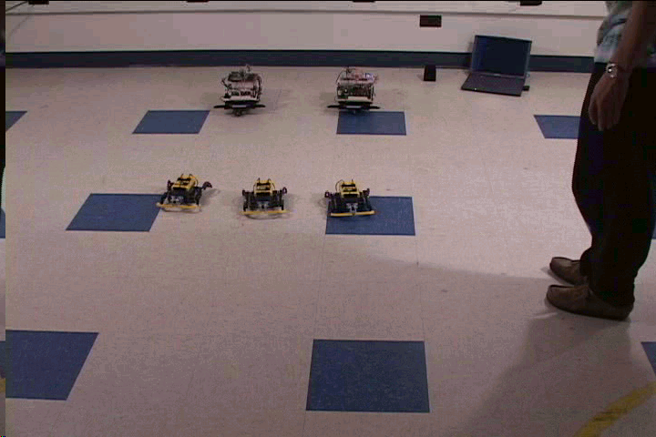
Video Streaming
25 frames/sec
Dynamic resource allocation
Soft real-time: degraded QoS

Slide 9
Real-Time Systems
Characteristics | Hard | Soft
Response time | Hard-required | Soft-desired
Peak-load performance | Predictable | Degraded
Control of pace | Environment | Computer
Redundancy | Active | Checkpoint
Error detection | Autonomous | User assisted
Kopetz97

Slide 10
Microcontroller Market
Cost
Performance

Slide 11


Mechatronics
Drive-by-wire
Fly-by-wire

Slide 12
Embedded Software Engineering
You
Solver/Checker
Compiler
Real-Time Operating System
Functionality
Design
Models
Simulation/Verification
Programs
Execution
Tasks
Scheduling

Slide 13
Real-Time
@
Not later than
for
Time
Time-instant
Deadline
Duration
Notes:
Time in the sense of discrete time; system correctness depends on the time at which results are produced.
Real in the sense that a system must react to external stimulus synchronously; thus internal time = external time.

Slide 14
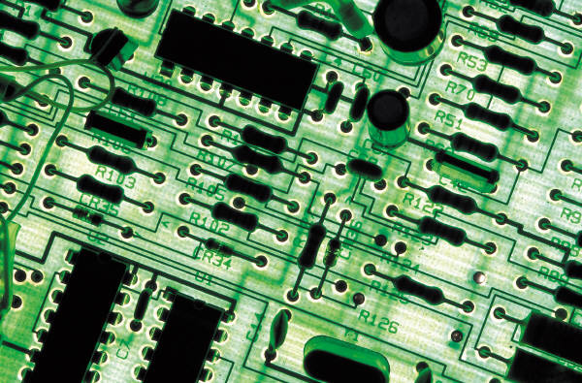
Concurrency
Task1
Task2
Message1
Host
Network
In addition:
Other resource constraints
Time constraints
Message2
Notes:
Real-time scheduling is the problem of serializing the access of multiple concurrent activities to, in general, multiple shared resources under real-time constraints: NP-complete.

Slide 15
Sequential Programming
1
2
Time
Notes:
Here: environment time vs. platform time
Next: problems: 1. close correspondence, 2. changes require recoding

Slide 16
Multiprogramming
1
2
5
3
4
Time
Notes:
Here: environment time vs. platform time
Next: problems: 1. close correspondence, 2. changes require recoding

Slide 17
Real-Time Programming
1
2
5
3
4
Time
Notes:
Here: environment time vs. platform time
Next: problems: 1. close correspondence, 2. changes require recoding

Slide 18
Embedded Software
Environment
Environment Processes
Software Processes
Software
Notes:
Here: environment time vs. platform time
Next: problems: 1. close correspondence, 2. changes require recoding

Slide 19
Environment vs. Platform Time
Environment
Environment Time
Platform Time
Software
Notes:
Here: environment time vs. platform time
Next: problems: 1. close correspondence, 2. changes require recoding

Slide 20
The Art of Embedded Programming
Environment
Embedded Programming
Software
Notes:
Here: environment time vs. platform time
Next: problems: 1. close correspondence, 2. changes require recoding

Slide 21
Embedded Programming
…requires the integration of:
Real-time operating system concepts
Embedded programming languages
Embedded compilers
SE, modeling, and simulation techniques
Formal methods

Slide 22
Real-Time Task
Input
f
Output
Worst case execution time

Slide 23
Real-Time Scheduling
Activation
Passive
activate
terminate
Active

Slide 24
Off-Line Scheduling
Table
Passive
activate
terminate
Active
Static System
Notes:
Static or dynamic resource consideration is a system characteristic.

Slide 25
On-Line Scheduling
Algorithm
Passive
activate
terminate
Active
Dynamic System
Notes:
Static or dynamic resource consideration is a system characteristic. Dynamic means the set of tasks is influenced by the environment.

Slide 26
Non-Preemptive Scheduling
Activation
Passive
schedule
activate
terminate
Ready
Run

Slide 27
Preemptive Scheduling
Activation
Passive
schedule
activate
terminate
Ready
Run
preempt

Slide 28
Shared Resources
Activation
Passive
schedule
activate
terminate
Ready
Run
preempt
free
busy
Wait

Slide 29
Scheduling Problem
Real-Time Scheduling
Soft
Hard
Off-line
On-line
Preemptive
Non-preemptive
Preemptive
Non-preemptive

Slide 30
Earliest Due Date
 | T₁ | T₂ | T₃ | T₄ | T₅
C_{i} | 1 | 1 | 1 | 3 | 2
d_{i} | 3 | 10 | 7 | 8 | 5
Buttazzo97
Processors
d₁
d₅
d₃
d₄
d₂
P₁
T₁
T₅
T₃
T₄
T₂
10
Time

Slide 31
Earliest Deadline First
Tasks
 | T₁ | T₂ | T₃ | T₄ | T₅
a_{i} | 0 | 0 | 2 | 3 | 6
C_{i} | 1 | 2 | 2 | 2 | 2
d_{i} | 2 | 5 | 4 | 10 | 9
T₁
T₂
T₂
T₃
T₄
T₄
Buttazzo97
T₅
10
Time

Slide 32
Real-Time Periodic Task
Input
f
Output
Frequency
Worst case execution time

Slide 33
Rate Monotonic Analysis
 | T₁ | T₂
C_{i} | 2 | 1
p_{i} | 5 | 10
Tasks
T₂
T₂
T₁
T₁
T₁
T₁
10
Time

Slide 34
Scheduling Anomalies
T₅
Processors
T₆
T₁
T₉
T₄
T₇
T₈
P₃
T₃
T₆
T₈
P₂
T₂
T₄
T₅
T₇
P₁
T₁
T₉
12
Time

Slide 35
Shorter Computation Times
T₅
Processors
T₆
T₁
T₉
T₄
T₇
T₈
P₃
T₃
T₇
P₂
T₂
T₄
T₆
T₉
P₁
T₁
T₅
T₈
13
Time

Slide 36
More Processors
T₅
Processors
T₆
T₁
T₉
T₄
T₇
P₄
T₄
T₇
T₈
P₃
T₃
T₆
P₂
T₂
T₅
T₉
P₁
T₁
T₈
15
Time

Slide 37
Weaker Precedence
T₅
Processors
T₆
T₁
T₉
T₄
P₃
T₃
T₇
T₆
P₂
T₂
T₄
T₅
P₁
T₁
T₈
T₉
16
Time

Slide 38
Real-Time Communication
Message1
Network
Message2

Slide 39
Real-Time Message
Source
m
Target
Latency

Slide 40
Explicit Flow Control
Message1
Send time not known a priori
Sender can detect errors
Network
Message2

Slide 41
Implicit Flow Control
Message1
Send time is known a priori
Receiver can detect errors
Network
Message2

Slide 42
Explicit Flow Control: Priority
Message1
Medium-Access Protocols:
CSMA/CD - LON, Echelon 1990
CSMA/CA - CAN, Bosch 1990
FTDMA - Byteflight, BMW 2000
TDMA - TTP, Kopetz 1993
Network
Message2

Slide 43
Control Area Network
M₁
M₂
Messages
M₁
0
0
0
0
0
0
0
1
0
1
0
M₂
0
0
0
0
0
0
1
0
1
1
1
11
Time

Slide 44
Implicit Flow Control: Time
Message1
Medium-Access Protocols:
FTDMA - Byteflight, BMW 2000
TDMA - TTP, Kopetz 1993
Network
Message2

Slide 45
Time-Triggered Protocol
M₁
M₂
Network
N₁
M₁
M₂
Time
Slot₁
Slot₂

Slide 46
Literature
RT scheduling:
  Hard Real-Time Computing Systems: Predictable Scheduling Algorithms and Applications. G. Buttazzo. Kluwer, 1997.
RT communication:
  Real-Time Systems – Design Principles for Distributed Embedded Applications. H. Kopetz. Kluwer, 1997.
  Byteflight, CAN papers.

Slide 47
Embedded Programming
…requires the integration of:
Real-time operating system concepts
Embedded programming languages
Embedded compilers
SE, modeling, and simulation techniques
Formal methods

Slide 48
Concurrency
Parallel Composition
I/O Decomposition
Task1
Task2
Task1
Task2
Control
Data

Slide 49
Control Operators
Sequential
Parallel
Choice
Loop

Slide 50
Real-Time
Change of state
State
Function
Time
Event
Frequency
Time

Slide 51
Real World
Data
Time

Slide 52
Discrete Data
Data
d₃
d₂
d₁
d₀
Time

Slide 53
State
Data
d₃
d₂
d₁
d₀
State₀
State₁
State₂
Time
d₀
d₁
d₁
d₂
d₂
d₃

Slide 54
Continuous Time
Data
Start Event
Terminating Event
t₁
State₁
t₂
Time
Interval

Slide 55
Digital Clock
Data
Clock Tick @ 1/(t2-t1) Hz
t₁
t₂
Time
Granule

Slide 56
Discrete Time
Data
t₁
t₂
Time
State₁

Slide 57
Event-Triggered (ET) System
Data
Change of state
Time

Slide 58
Time-Triggered (TT) System
Data
Clock tick
Time

Slide 59
Esterel - Giotto
Esterel:
  Synchronous reactive language
  Event-triggered semantics
Giotto:
  Time-triggered semantics
  Distributed platforms

Slide 60
Event - Reaction
Event
f
Reaction

Slide 61
Esterel: Event
Event:
emit S
await S
Time
Loop:
P
loop P each S

Slide 62
Esterel: Operators
Sequential:
P
Q
P ; Q
P
P
Parallel:
Choice:
Q
Q
P || Q
present S then P else Q

Slide 63
Esterel: Controller
module normal:
input A, B, R;
output O;
loop
[ await A || await B ];
emit O
each R
end module
R?
R?
A?.~R?
B?.~R?
R?
A?.B?.~R?.O!
B?.~R?.O!
A?.~R?.O!

Slide 64
Sensor - Control Law - Actuator
Sensors
f
Actuators

Slide 65
Giotto: Time
Sequential:
Task
Time
Input
Output

Slide 66
Giotto: Operators
Sequential:
Task
Parallel:
Choice:
Mode
Program

Slide 67
Giotto: Helicopter Control
mode normal ( ) period 20ms
{
taskfreq 1 do servo = Control ( position ) ;
taskfreq 4 do position = Navigation ( GPS, position ) ;
}

Slide 68
Semantics
Task
Control @ 50Hz
Navigation @ 200Hz
5
10
15
20
msec

Slide 69
Input
Task
5
10
15
20
msec

Slide 70
Computation
Task
5
10
15
20
msec
Control Law
Navigation Integrator

Slide 71
Output
Task
5
10
15
20
msec

Slide 72
Literature
Esterel:
  The Foundations of Esterel. G. Berry. In Proof, Language and Interaction: Essays in Honour of Robin Milner. G. Plotkin, C. Stirling and M. Tofte, editors. MIT Press, 2000.
  Synchronous programming of reactive systems. N. Halbwachs. Kluwer, 1993.
Giotto:
  Embedded Control Systems Development with Giotto. B. Horowitz, T. Henzinger, C. Kirsch. 2001.
  Giotto: A Time-Triggered Language for Embedded Programming. B. Horowitz, T. Henzinger, C. Kirsch. 2001.

Slide 73
Embedded Programming
…requires the integration of:
Real-time operating system concepts
Embedded programming languages
Embedded compilers
SE, modeling, and simulation techniques
Formal methods

Slide 74
Concurrency
Parallel Composition
I/O Decomposition
Task1
Task2
Task1
Task2
Task1
;
Task2
Task1
Task2
Task2
;
Task1
Task2
Task1

Slide 75
Real-Time
Task1
;
Task2
Task3
;
Task1
;
Task2
Task1
Time
Event
Frequency
Time
Deadline

Slide 76
Helicopter Control
Task
Control @ 50Hz
Navigation @ 200Hz
5
10
15
20
msec

Slide 77
Read
Task
5
10
15
20
msec
Input

Slide 78
Write
Task
5
10
15
20
msec
Output

Slide 79
Worst Case Execution Time
Task
5
10
15
20
msec
Control Law
Navigation Integrator

Slide 80
Deadline
Task
5
10
15
20
msec

Slide 81
Code
Task
5
10
15
20
msec

Slide 82
Literature
Some compiler books:
  Compiler Construction, N. Wirth, Addison-Wesley, 1996.
  Compilers, Principles, Techniques, and Tools. A.V. Aho, R. Sethi, J.D. Ullman. Addison-Wesley, 1985.
  Compiler Design. R. Wilhelm, D. Maurer. Addison-Wesley, 1995.

Slide 83
Embedded Programming
…requires the integration of:
Real-time operating system concepts
Embedded programming languages
Embedded compilers
SE, modeling, and simulation techniques
Formal methods

Slide 84
Real-Time Task
Input
f
Output
Worst case execution time

Slide 85
Abstract Data Type
Type
Interface: Set of methods

Slide 86
Abstract Interface
Empty
Interface: Set of methods

Slide 87
Framework
Application-dependent
Application-dependent
Application-independent

Slide 88
Type vs. Task
?
Input
Output
Interface: Set of methods

Slide 89
Literature
Patterns & Frameworks:
  Design Patterns: Elements of Reusable Object Oriented Software. E. Gamma, J. Vlissides, R. Johnson, R. Helm. Addison Wesley, 1994.
  Design Patterns for Object-Oriented Software Development. W. Pree, E. Gamma. Addison Wesley, 1995.

Slide 90
Embedded Programming
…requires the integration of:
Real-time operating system concepts
Embedded programming languages
Embedded compilers
SE, modeling, and simulation techniques
Formal methods

Slide 91
Formal Verification
Property Space
Data
Time
Control
Safety
Liveness
Safety: Wrong things never happen!
Liveness: Something useful will happen eventually!

Slide 92
Language Hierarchy
Universal
Design
Macros
expand
Non-Deterministic
Model
Automata
synthesize
analyze
Deterministic
Program
Code
compile
Sequential
Executable
Machine

Slide 93
Non-Determinism
Sequential
Parallel
Choice
Non-Determinism
A
E
Programming Operators
Modeling Operator

Slide 94
Esterel: Verification
Model Checking
Automata
Automata
Automata
Esterel
Abstraction
“Bisimulation”
Property
Esterel

Slide 95
Esterel: Hierarchy
Design
Model Checking
Model
Non-Det. Automata
Bisimulation
Esterel
Deterministic Code
compile
Executable
Sequential Circuit

Slide 96
Giotto: Verification
Model Checking
Masaccio
Automata
Masaccio
Abstraction
“Refinement”
Property
Giotto

Slide 97
Giotto: Hierarchy
?
expand
Model Checking
Masaccio
Hybrid Modules
synthesize
Refinement
Giotto
Deterministic Code
compile
Executable
Seq. Stack Machine

Slide 98
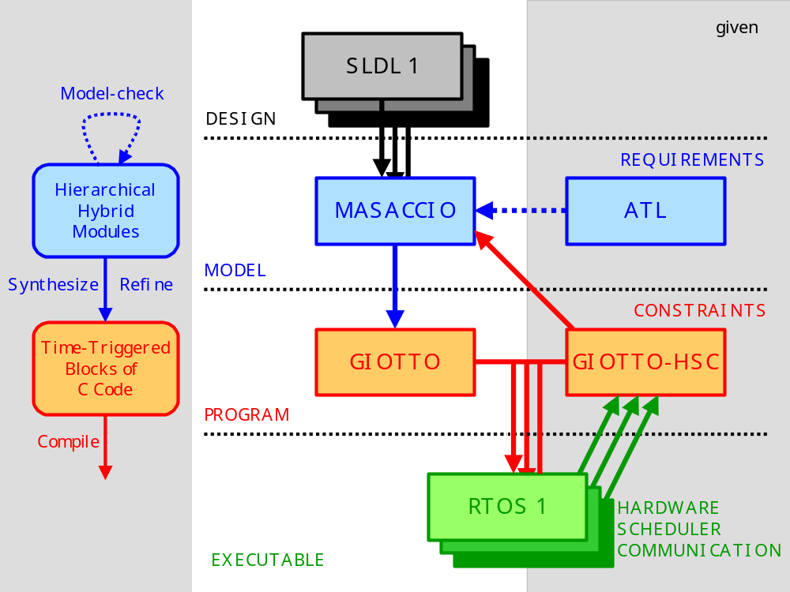
Giotto: Hierarchy

Slide 99
Literature
Esterel:
  Papers @ www.esterel.org
Giotto:
  T.A. Henzinger. Masaccio: A Formal Model for Embedded Components. LNCS 1872, Springer, 2000, pp. 549-563.

Slide 100
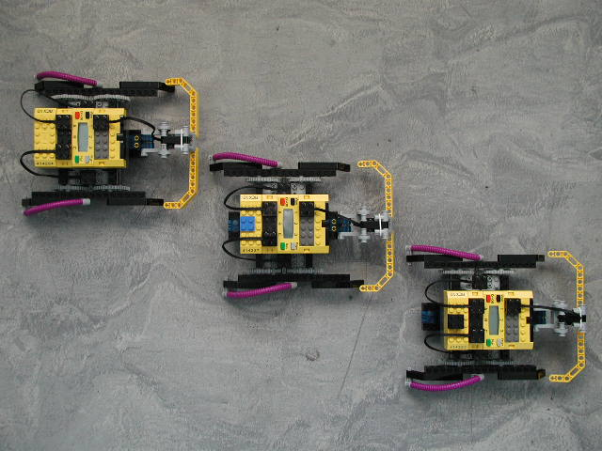
End

