Slide 1
Embedded Software Engineering
3 Unit Course, Spring 2002
EECS Department, UC Berkeley
Chapter 1: RTOS Concepts
Christoph Kirsch
www.eecs.berkeley.edu/~fresco/giotto/course-2002

Slide 2
The Art of Embedded Programming
Environment
Embedded Programming
Software

Slide 3
What Do We Really Need From an RTOS?
Environment
Environment Processes
Software Processes
Software

Slide 4
Environment Communication Services
Environment
Sensing
Memory
Actuating
Software

Slide 5
Environment Trigger Services
Environment
Software

Slide 6
Software Communication Services
Software
Sending
Memory
Receiving
Software

Slide 7
Software Trigger Services
Software
Software

Slide 8
Software Scheduling Services
Software
Real-Time Scheduler
Software

Slide 9
Summary: RTOS Services
Service | Implementation
Sensing/Actuating | Device Drivers
Environment Triggering | Interrupt Handlers
Software Communication | Shared Variables
Software Triggering | Signals
Software Scheduling | Scheduler

Slide 10
The Illusion of Concurrent Software
Software
t₁
t₂
t₁
t₃
t₂
t₁
Software

Slide 11
Abstractions for Multiprogramming
Programming Abstraction
Runtime Overhead
Process
Thread
Task
Subroutine/Coroutine
Protected Behavioral Function
Coroutine/MMU
Behavioral Function
Coroutine
Triggered Function
Subroutine
Function
Stack/List

Slide 12
Memory Model
Environment Ports
reads
actuates
Real-Time
Operating System
reads
Driver Ports
writes
reads
updates
Software Ports
Notes:
Here: environment time vs. platform time
Next: problems: 1. close correspondence, 2. changes require recoding

Slide 13
Definition: Task
A task is a function from its input and state ports to
its output and state ports
A task runs to completion (cannot be killed)
A task is preemptable
A task does not use signals (except at completion)
A task does not use semaphores (as a consequence)
API (used by the RTOS):
  initialize {task: state ports}
  schedule {task}
  dispatch {task: function}

Slide 14
So, what’s the difference between a task and a function?
A task has an operational semantics:
  A task is implemented by a subroutine and a trigger
  A task is either environment- or software-triggered
  The completion of a task may trigger another task

Slide 15
Task t₂ Preempts Task t₁
Task t₁
t₁
t₂
Task t₂

Slide 16
Who Triggers Task t₂?
Environment
t₁
t₂
Task t₂

Slide 17
Definition: Event and Signal
An event is a change of state in some environment ports
A signal is a change of state in some software ports
A synchronous signal is a change of state in some driver ports

Slide 18
Definition: Trigger
A trigger is a predicate on environment, software, driver ports
A trigger awaits events and/or signals
A trigger is enabled if its predicate evaluates to true
Trigger evaluation is atomic (non-preemptable)
A trigger can be activated by the RTOS
A trigger can be cancelled by the RTOS
A trigger can be enabled by an event or a signal
API (used by the RTOS):
  activate {trigger}
  cancel {trigger}
  evaluate {trigger: predicate}

Slide 19
My First RTOS
∀ tasks t: initialize(t);
∀ triggers g: activate(g);
while (true) {
if ∃ active-trigger g: evaluate(g) == true then
execute();
}
execute() {
scheduled-tasks := ∀ triggered-tasks t: schedule(t);
∀ scheduled-tasks t: dispatch(t);
}

Slide 20
RTOS Model: Reaction vs. Execution
Environment
Events
react()
execute()
Tasks
Software
Notes:
Here: environment time vs. platform time
Next: problems: 1. close correspondence, 2. changes require recoding

Slide 21
RTOS Model with Signals
Environment
Events
react()
execute()
Tasks
Signals
Software
Notes:
Here: environment time vs. platform time
Next: problems: 1. close correspondence, 2. changes require recoding

Slide 22
RTOS with Preemption
∀ tasks t: initialize(t);
∀ triggers g: activate(g);
while (true) {
if ∃ active-trigger g: evaluate(g) == true then
execute_concurrently();
}
execute_concurrently() {
scheduled-tasks := ∀ triggered-tasks t: schedule(t);
∀ scheduled-tasks t: dispatch(t);
}

Slide 23
Corrected RTOS with Preemption
∀ tasks t: initialize(t);
∀ triggers g: activate(g);
while (true) {
if ∃ active-trigger g: evaluate(g) == true then
execute_concurrently();
}
execute_concurrently() {
∀ triggers g: cancel(g);
scheduled-tasks := ∀ triggered-tasks t: schedule(t);
∀ triggers g: activate(g);
∀ scheduled-tasks t: dispatch(t);
}

Slide 24
Definition: Thread
A thread is a behavioral function (with a trace semantics)
A thread may be killed
A thread is preemptable
A thread may use signals
A thread may use semaphores
API (used by the RTOS or threads):
  initialize {thread: ports}
  schedule {thread}
  dispatch {thread: function}
  kill {thread}

Slide 25
So, what’s the difference between a thread and a task?
A thread is a collection of tasks:
  A thread is implemented by a coroutine
  A thread requires signals

Slide 26
Task t₂ Kills Task t₁: Coroutine
Task t₁
t₁
Kill t₁
t₂
Task t₂

Slide 27
Signal API
A signal can be awaited by a thread
A signal can be emitted by a thread
Signal emission is atomic (non-preemptable)
API (used by threads):
  wait {signal}
  emit {signal}
Literature:
  emit: send(signal)

Slide 28
Definition: Semaphore
A semaphore consists of a signal and a port
A semaphore can be locked by a thread
A semaphore can be released by a thread
Semaphore access is atomic (non-preemptable)
API (used by threads):
  lock {semaphore}
  release {semaphore}
Literature:
  lock: P(semaphore)
  release: V(semaphore)

Slide 29
Binary Semaphore (Signal)
lock(semaphore) {
if (semaphore.lock == true) then
wait(semaphore.signal);
semaphore.lock := true;
}
release(semaphore) {
semaphore.lock := false;
emit(semaphore.signal);
}
must be atomic

Slide 30
Binary Semaphore (Busy Wait)
lock(semaphore) {
while (semaphore.lock == true) do {}
semaphore.lock := true;
}
release(semaphore) {
semaphore.lock := false;
}
each round
must be atomic

Slide 31
The Embedded Machine
Environment
Events
react(): The Embedded Machine
execute(): The Scheduler and Dispatcher
Tasks
Software
Notes:
Here: environment time vs. platform time
Next: problems: 1. close correspondence, 2. changes require recoding

Slide 32
Proposal
Environment
Human: Programming in terms of environment time
Compiler: Implementation in terms of platform time
Software
Notes:
Here: environment time vs. platform time
Next: problems: 1. close correspondence, 2. changes require recoding

Slide 33
Platform Time is Platform Memory
Environment
Programming as if there is enough platform time
Implementation checks whether there is enough of it
Software
Notes:
Here: environment time vs. platform time
Next: problems: 1. close correspondence, 2. changes require recoding

Slide 34
Portability
Environment
Programming in terms of environment time
yields platform-independent code
Software
Notes:
Here: environment time vs. platform time
Next: problems: 1. close correspondence, 2. changes require recoding

Slide 35
Predictability
Environment
Programming in terms of environment time
yields deterministic code
Software
Notes:
Here: environment time vs. platform time
Next: problems: 1. close correspondence, 2. changes require recoding

Slide 36
The Task Model
Environment
sense
actuate
start
end
Software
Notes:
Here: environment time vs. platform time
Next: problems: 1. close correspondence, 2. changes require recoding

Slide 37
Preemptable…
Environment
sense
actuate
start
end
Software
Notes:
Here: environment time vs. platform time
Next: problems: 1. close correspondence, 2. changes require recoding

Slide 38
…but Atomic
Environment
f( ) =
1
1
2
Software
Notes:
Here: environment time vs. platform time
Next: problems: 1. close correspondence, 2. changes require recoding

Slide 39
The Driver Model
Environment
1
2
Software
Notes:
Here: environment time vs. platform time
Next: problems: 1. close correspondence, 2. changes require recoding

Slide 40
Non-preemptable, Synchronous
Environment
f( ) =
1
1
2
f( ) =
2
Software
Notes:
Here: environment time vs. platform time
Next: problems: 1. close correspondence, 2. changes require recoding

Slide 41
Syntax
Environment
s
t
1
1
2
a
Software
Notes:
Here: environment time vs. platform time
Next: problems: 1. close correspondence, 2. changes require recoding

Slide 42
A Trigger g
c
g
b:
Program
g : c’ ≠ c

Slide 43
An Embedded Machine Program
Environment
b:
call(a)
s
s
call(s)
t
2
1
1
2
1
schedule(t)
future(g,b)
a
a
Software
Notes:
Here: environment time vs. platform time
Next: problems: 1. close correspondence, 2. changes require recoding

Slide 44
Synchronous vs. Scheduled Computation
Environment
b:
call(a)
s
s
call(s)
t
2
1
1
2
1
schedule(t)
future(g,b)
a
a
Software
Notes:
Here: environment time vs. platform time
Next: problems: 1. close correspondence, 2. changes require recoding

Slide 45
Synchronous vs. Scheduled Computation
c
INACTIVE
g
b:
schedules
e
c:
READY
RUN
g’
Synchronous computation
Kernel context
Trigger related interrupts disabled
Scheduled computation
User context

Slide 46
Environment-triggered Code
Environment
1
2
Software
Notes:
Here: environment time vs. platform time
Next: problems: 1. close correspondence, 2. changes require recoding

Slide 47
Software-triggered Code
Environment
1
2
Software
Notes:
Here: environment time vs. platform time
Next: problems: 1. close correspondence, 2. changes require recoding

Slide 48
Trigger g: Input-, Environment-Triggered
g
b:
call(a)
call(s)
schedule(t)
future(g,b)

Slide 49
Time Safety
Environment
1
2
Software
Notes:
Here: environment time vs. platform time
Next: problems: 1. close correspondence, 2. changes require recoding

Slide 50
Input-deterministic If Time Safe
Environment
s
s
s
t
t
2
1
a
2
1
a
2
1
Software
Notes:
Here: environment time vs. platform time
Next: problems: 1. close correspondence, 2. changes require recoding

Slide 51
Environment-deterministic If Environment-triggered
Environment
s
s
s
t
t
2
1
2
1
2
1
a
a
a
Software
Notes:
Here: environment time vs. platform time
Next: problems: 1. close correspondence, 2. changes require recoding

Slide 52
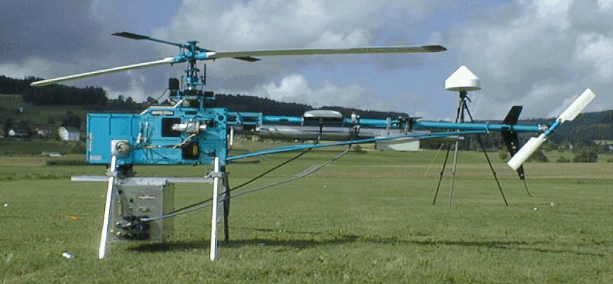
The Zürich Helicopter

Slide 53
Helicopter Control Software
Clock
c
Control
g
10
a
Actuator
g : c’ = c + 5
i
Navigation
5
Sensor
s
Notes:
Here: helicopter example, functionality
Next: helicopter example, functionality, matlab

Slide 54
Giotto Syntax (Functionality)
sensor gps_type GPS uses c_gps_device ;
actuator servo_type Servo := c_servo_init uses c_servo_device ;
output
ctr_type CtrOutput := c_ctr_init ;
nav_type NavOutput := c_nav_init ;
driver sensing (GPS) output (gps_type gps) { c_gps_pre_processing ( GPS, gps ) }
task Navigation (gps_type gps) output (NavOutput) { c_matlab_navigation_code ( gps, NavOutput ) }
…

Slide 55
Giotto Syntax (Timing)
…
mode Flight ( ) period 10ms
{
actfreq 1 do Servo ( actuating ) ;
taskfreq 1 do Control ( input ) ;
taskfreq 2 do Navigation ( sensing ) ;
}
…

Slide 56
Environment Timeline
0ms
5ms
10ms
a
i
Control
a
i
s
Navigation
s
Navigation
s
Block of synchronous code (nonpreemptable)
Scheduled tasks (preemptable)
Notes:
Here: helicopter example, timing, environment timeline execution
Next: …

Slide 57
E Code
0ms
5ms
10ms
b1: call(a_ctuating)
call(s_ensing)
call(i_nput)
schedule(Control [10])
schedule(Navigation[5])
future(g,b2)
a
i
Control
a
i
s
Navigation
s
Navigation
s
Notes:
Here: helicopter example, timing, environment timeline execution
Next: …

Slide 58
E Code
0ms
5ms
10ms
b2: call(s_ensing)
schedule(Navigation[5])
future(g,b1)
a
i
Control
a
i
s
Navigation
s
Navigation
s
Notes:
Here: helicopter example, timing, environment timeline execution
Next: …

Slide 59
Platform Timeline: EDF
0ms
5ms
10ms
a
i
a
i
s
s
s
Navigation
2ms
2ms
Control
3ms
5ms
Notes:
Here: helicopter example, timing, environment timeline execution
Next: …

Slide 60
Time Safety
Environment
s
t
1
1
2
a
Software
Notes:
Here: environment time vs. platform time
Next: problems: 1. close correspondence, 2. changes require recoding

Slide 61
Runtime Exceptions I
Environment
s
1
2
a
call(a_ctuating)
Software
Notes:
Here: environment time vs. platform time
Next: problems: 1. close correspondence, 2. changes require recoding

Slide 62
Runtime Exceptions II
Environment
s
call(s_ensing)
1
2
a
Software
Notes:
Here: environment time vs. platform time
Next: problems: 1. close correspondence, 2. changes require recoding

Slide 63
Runtime Exceptions III
Environment
s
schedule(t)
1
2
a
Software
Notes:
Here: environment time vs. platform time
Next: problems: 1. close correspondence, 2. changes require recoding

Slide 64
An Exception Handler e
Environment
b:
call(a)
s
schedule(t,e)
call(s)
1
2
e:
call(a’)
schedule(t)
future(g,b)
a
a’
Software
Notes:
Here: environment time vs. platform time
Next: problems: 1. close correspondence, 2. changes require recoding

Slide 65
How to Loose Determinism: Task Synchronization
0ms
5ms
10ms
a
i
a
i
s
s
s
Navigation
2ms
2ms
Control
2ms
3ms
4ms

Slide 66
How to Loose Determinism: Termination
Environment
s
terminate(t)
1
2
a
Software
Notes:
Here: environment time vs. platform time
Next: problems: 1. close correspondence, 2. changes require recoding

Slide 67
Time Liveness: Infinite Traces
Environment
s
s
1
2
1
a
Software
Notes:
Here: environment time vs. platform time
Next: problems: 1. close correspondence, 2. changes require recoding

Slide 68
Dynamic Linking
E Machine
Functionality
Code
E Code
b:
call(a)
t
call(s)
g
schedule(t)
future(g,b)
d

Slide 69
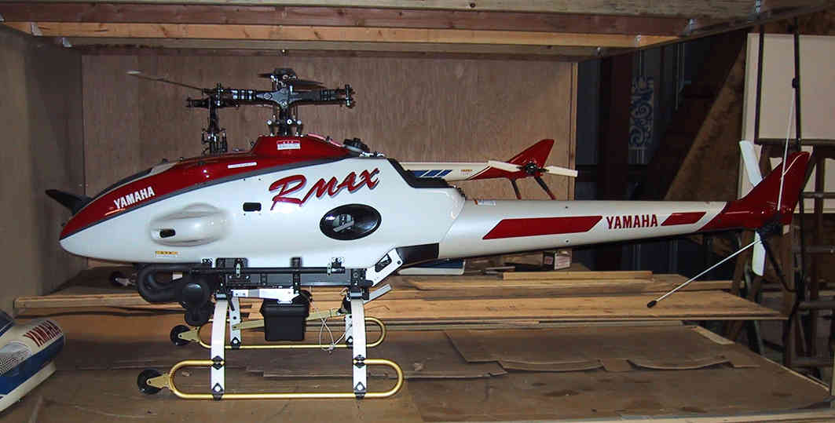
The Berkeley Helicopter

Slide 70
Platform Timeline: Time-triggered Communication
TDMA Slot
HeliCtr
HeliNet
HeliNav
t
t
t+5ms
t+5ms
t+7ms
t+10ms
t+10ms

Slide 71
Code Generation for HeliNav
b2: call(s_ensing)
schedule(Navigation[2])
schedule(Connection[(7,10)])
future(g,b1)
HeliCtr
HeliNav
t
t
t+5ms
t+5ms
t+7ms
t+10ms
t+10ms

Slide 72
Instructions
Synchronous
Driver:
Scheduled
Task:
t
d
call(d)
schedule(t)
Triggering:
g
b:
future(g,b)
g : c’ ≠ c

