Slide 1
Presenting:
Some Synchronization Issues When Designing Embedded Systems from Components by
Albert Benveniste
The Bay Team
Yanmei Li, Alessandro Pinto, Bruno Sinopoli

Slide 2
Focus
This paper looks at issues of synchrony, asynchrony and synchronization that arise in the design of embedded systems
Three areas of interest:
  Hybrid control systems
  Synchronous hardware design from IP’s
  Building software or hardware architectures composed of components that interact asynchronously

Slide 3
The issue in continuous time control systems
d(t)
Open loop system
y_{d}(t)
Physical system
y(t)

Slide 4
The issue in continuous time control systems
d(t)
Closed loop system
y_{d}(t)
e(t)
Analog Control system
u(t)
Physical system
y(t)
Σ
-
Issues:
  Approximation in space: modeling errors, noisy measurements, unknown disturbance
  Approximation in time: delay from sensing to actuating
Gain, phase margins are design metrics provide robustness with respect to those approximations

Slide 5
The issue in continuous time control systems
d(t)
Closed loop system
y_{d}(t)
e(t)
Digital Control system
u(t)
Physical system
y(t)
Σ
-
Digital control systems makes approximation in time worse due to sampling, A/D, D/A conversions
Bounds on maximum sampling will preserve performance, making the synchronous model still valid

Slide 6
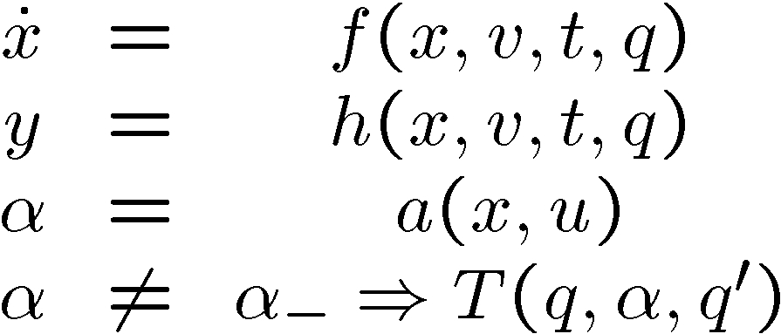
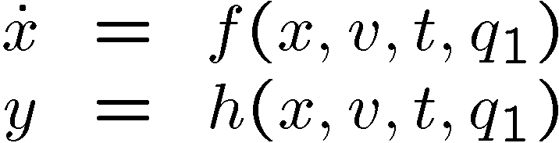
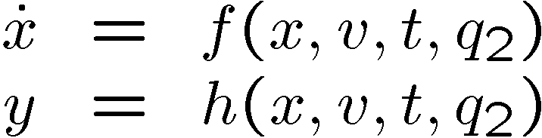
What about hybrid systems?
q₁
q₂
Time approximation errors can determine quite different behaviors

Slide 7
Why this difference?
Continuity ensures robustness to time jitters
A hybrid system, by introducing discreteness, i.e. discontinuity, is inherently susceptible to lack of synchrony in its components. Small errors in state estimation can trigger an undesired change of discrete mode, making behavior highly unpredictable

Slide 8
Synchronous Hardware Design from IP’s
Retiming
Transformations
Latency Insensitive Design
Models
Basic idea and two problems

Slide 9
Retiming
Use data-flow graph G to model synchronous hardware:
  vertices figure variables
  branches figure dependencies
    u v : v_{k} uses u_{k} for its computation
    u v : v_{k} uses u_{k-n} for its computation
    index n : weight of the branch
  weight of a path in the graph is the sum of the weights of its successive branches
We consider only well formed graphs(every circuit has a strictly positive weight)
n

Slide 10
Transformations
GOAL: To find modifications of G that will not change its semantics
Two primitive transformations:
  Moving latches around
  Upsampling

Slide 11

Transformations-1
Moving Latches Around:
u_{i} v => u_{i} v
v w_{j} => v w_{j}
  pick m latches from each ingoing branch of v, and move them to each outgoing branch of it
  this transformation does not change the map:(u_{i} , i = 1,…,p) (w_{j} , j = 1,…,q)
  ∀i=1,…,p: n_{i}-m 0 and ∀j=1,…,q: n_{j}+m 0
It is a semantic preserving transformation
n_{i}
n_{i}-m
n_{j}
n_{j}+m

Slide 12

Transformations-2
Upsampling:
Pick an integer J > 1
Set v_{m}’:= if m = kJ then v_{k} else
  means non_informative, not belonging to any useful domain,it represents a don’t care
Ignoring in v’ generates v
If we perform this globally using the same integer J at all vertices, we preserve the semantics

Slide 13
Latency Insensitive Design
At early stages of the design,both IP’s and the system can be regarded as completely synchronous, i.e., just as a set of modules that communicate by means of channels having “zero-delay”
At later stages of the design where real clocks are used, it adjusts automatically to any interconnect-delay,on-line
Notes:
If indeed the processes to be composed are patient,then adding an appropriate number of buffers yields a process that is latency equivalent to the strict composition. In practice, a patient system can be derived from a strict one as follows: first, we take each strict process Pm and we compose it with a set of auxiliary processes to obtain an equivalent patient process P0m. To be able to do so, all processes Pm must satisfy a simple condition (the processes must be stallable). Then, we put together all patient processes by connecting them with buffers.
Our goal is to define a group of functional processes that can be composed with a stallable process P to derive a patient process which is latency equivalent to P.

Slide 14

Models-1:strictly synchronous
A state x assigns an effective value to each variable v V
A strictly synchronous behavior is a sequence s = x1,x2,… of states
A strictly synchronous process is a set of strictly synchronous behaviors
A strictly synchronous signal is the sequence of values s_{v}=v(x1),v(x2),… , for v V given

Slide 15
Models-2: synchronous
This model is the same as in the previous case, but every domain of data is enlarged with some non-informative value( )
A state x assigns an informative or non-informative value to each variable v V
A synchronous behavior is a sequence of states
A synchronous process is a set of synchronous behaviors
A synchronous signal is the sequence of informative or non-informative values s_{v} = v(x1),v(x2),…, for v V given

Slide 16
Basic Idea
We wish to implement a strictly synchronous specification P by means of a synchronous process P^{l}, insensitive to latency. Then P^{l} replaces P and will be used as an IP block

Slide 17
Problem-1
How to model that a synchronous process P^{l} implements a strictly synchronous specification P, while being insensitive to latency?
Values of variables travel on wires of the design,and this causes latency.Such latency may differ for different variables (since different wires are used)

Slide 18
Problem-1 Solution
For v V , pick some signal
s_{v} = v(x1), v(x2), v(x3), … P
To reflect a wire-dependent latency, the same signal, observed later on along a wire, has (for example) the form
s_{v}^{l}= , v(x1), , v(x2), , , v(x3), …
can be inserted at arbitrary places of the original signal s_{v} . This is the mechanism of stalling a signal
Map X_{v} : s_{v}^{l} s_{v} giving the strict version of a stalled signal
Notes:
For P^{l} a process having V as set of variables, its image χV (P^{l} ) by χV is called the
strict process corresponding to P^{l}

Slide 19

Problem-1 Solution(cont.)
Patient process P :
For all s P, all input signal s_{i} of s, and all instant k, there exists another behavior stall (s) P, whose i-signal coincides with s_{i} before instant k, has a τ-event at k, and can be further stalled after k
Buffer:
  A single buffer is any process which has two variables v_{i} ,v_{o} , and has the identity process s_{vo} := s_{vi} as corresponding strict process
  A buffer is the parallel composition of finite single buffers involving disjoint sets of variables

Slide 20
Problem-1 Solution(cont.)
Theorem. If P^{l} and Q^{l} are patient processes,and B,B’are two buffers,then
X_{V} (P^{l} || B || Q^{l})=X_{V} (P^{l} || B’ || Q^{l})=P || Q
  P^{l} and Q^{l} are two processes having disjoint sets of variables, communicating through a buffer
  P,Q are the strict processes corresponding to P^{l} and Q^{l}
  X_{V} (P^{l}) represents the strict process corresponding to P^{l}
Implies that inserting a buffer does not change the corresponding strict process

Slide 21
Problem-2 and Solution
For a strict process P , how to build a patient process P^{l} such that X_{V} (P^{l})= P?
Enlarge G with additional branches: (environment) u
  where u V ^{i} (input variables)
m_{v} : the weight of each variable v of G
Moving of latches is encoded by the set of weights m_{V}

Slide 22
Problem-2 Solution(cont.)
∀ v V ,set initial value for m_{V}
m_{v} := 0
The original data structure to model the circuit is (G, 0)
(G, m_{v} ) is updated on-line at each reaction according to a update protocol

Slide 23
Problem-2 Solution(cont.)
Update Protocol:
  Case 1(trivial): All inputs of G receive informative values for the first round. Then the reaction proceeds as specified by G directly,and the circuit waits for a second set of input values
  Case 2: At least one input wire offers a non-informative value for the first reaction

Slide 24

Problem-2 Solution(cont.)
Case 2: Assume non-informative value occurs exactly for one single u V i
  model the reception of a noninformative value on input wire u via the insertion of a negative delay in the corresponding input branch of G :
  update G: [ u ] => [ u ]
  (u ) represents the set of the variables v V, there exists a path from u to v having zero weight. update the set of weights m_{V} :
    ∀ v (u ) : m_{v} := m_{v} - 1
    ∀ v (u ) : m_{v} := m_{v}
0
-1

Slide 25
Problem-2 Solution(cont.)
Use retiming rules for m_{v}=-1 at v (u ) :
  assuming the availability of one latch at the output wires belonging to (u )
  moving these latches backward until a variable not belonging to (u ) is reached
Compensate the negative delay in front of u by a positive one, therefore making the whole synchronization correct

Slide 26

Problem-2 Solution(cont.)
Generalized protocol:
  update G :
  s_{u}(x)= : [ u ]=>[ u ]
  update m_{V} :
  ∀v (U ) : m_{v} := m_{v} –1
  ∀v (U ) : m_{v} := m_{v}
  where (U ) = _{u:Su(x)=} u
n
n-1

Slide 27
Latency Insensitive Design
Take a design based on the assumption that computation in one functional block and communication among blocks take no time (synchronous hypothesis)
  i.e. the processes corresponding to the functional blocks and their composition are strict
Replace it with a design where communication does take time and, as a result, signals are delayed, but not changing the sequence of informative events
  i.e. replace with a set of patient processes
Notes:
we can replace all processes in a system of strict processes by corresponding patient processes, and the resulting system will be latency equivalent to the original one

Slide 28
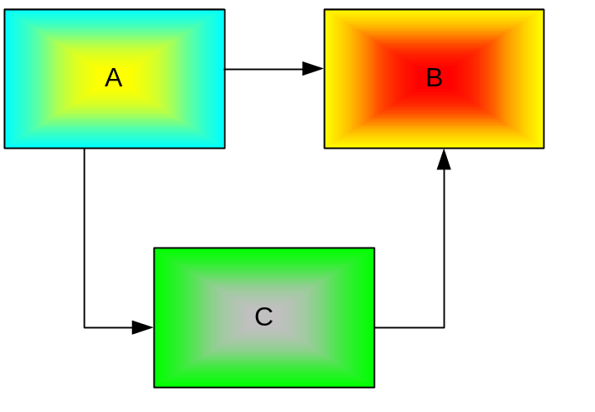
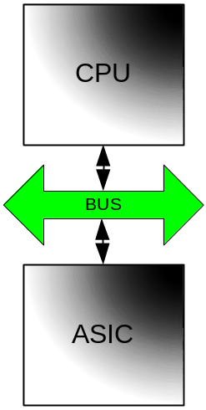

From Synch to GALS
Synchronous Specification
GALS Architecture

Slide 29
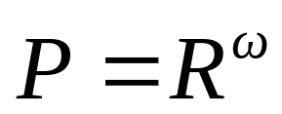
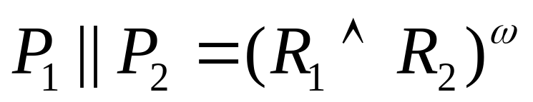
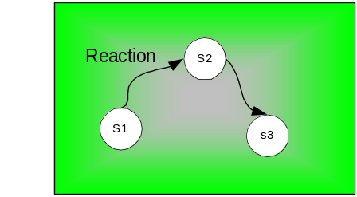
Synchronous Model
Processes = Sequence of reactions (R is a set of possible reactions)
Parallel composition = Pairwise conjunction of reactions (whenever composable)

Slide 30
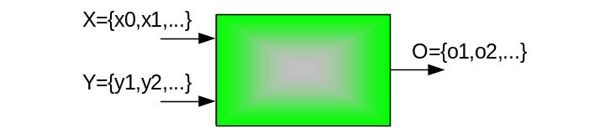
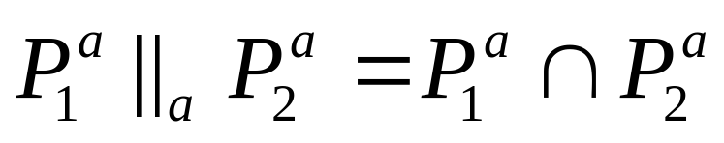
Asynchronous Model
Signals are Totally Ordered sequences of informative events
Behaviors are tuple of signals
Processes are set of behaviors
Composition is obtained by unifying common signals
The communication is modeled by unbounded FIFOs

Slide 31
Synch vs Asynch
In Synchronous models
  “Reaction based”
  Absence (⊥) can be sensed and used in the specification of behaviors
  A global tick exists
In Asynchronous models
  “Signal based”
  No global tick
  Reaction cannot be observed anymore
  ⊥ cannot be sensed

Slide 32
What are the Problems?
“What if a synchronous block receives its data form an asynchronous environment ?”
“What if we deploy a synchronous network of synchronous blocks onto a GALS architecture?”

Slide 33
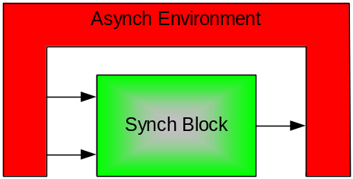
Synch block in Asynch environment
Input to the synchronous block are not “correct”
  The Environment provides sequence of totally ordered informative events
  The Process can sense absence and use it within a state

Slide 34
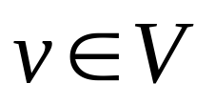
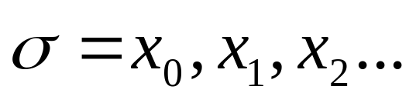
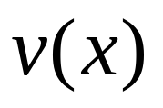

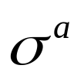
Desynchronization
V set of state variables of P
A state is a valuation of all (⊥ included)
behavior pf P (sequence of states)
valuation of variable v at state x
By removing all ⊥ from we obtain

Slide 35
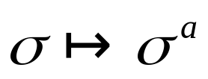
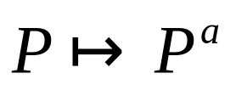
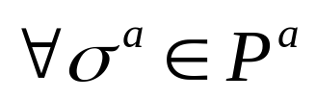

Endochronicity
define desynchronization of P
  This map is unique but not invertible
“If P satisfies a special condition called endochrony, then there exists a unique such that holds”

Slide 36
Endochronicity: Properties
Can be done on-line
Can be model checked
Given P, a wrapper W can be found such that P||W is endochronous

Slide 37
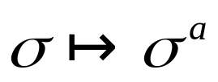
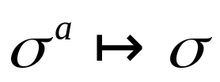
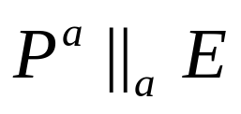
Solution to Problem 1
“What if a synchronous block receives its data form an asynchronous environment ?”
SOLVED
Endochrony

Slide 38
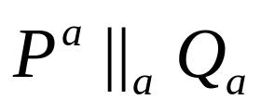
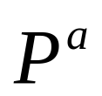
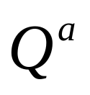
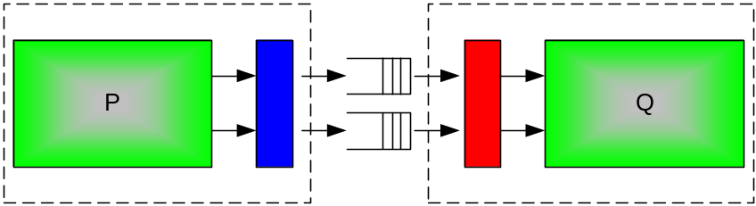
Network of blocks
We use the desynchronized version of P, Q
FIFOs

Slide 39
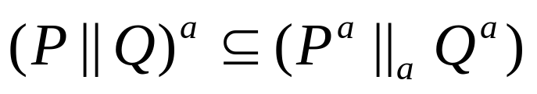
Isochronicity
In general
WE want the equality to hold (no spurious behavior due to asynchronous communication)
“If (P,Q) satisfies a special condition called isochrony then the equality indeed holds”

Slide 40
Isochronicity: Properties
It is compositional
It can be model checked
For any pair (P,Q) there exists (Wp,Wq) making (P||Wp,Q||Wq) an isochronous pair

Slide 41
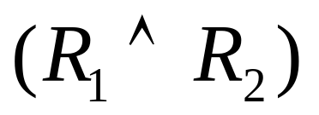
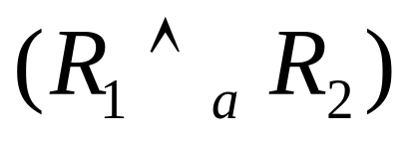
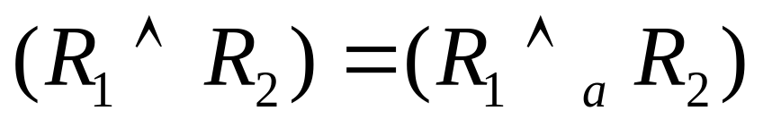
Isochronicity: Intuition
For composition we use
  In particular common variables are both present or absent
Weakly Synchronicity
  A given variable can be present in one component and absent in the other
Isonchronous pair (P,Q):

Slide 42
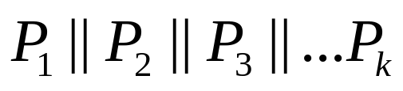

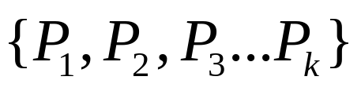
Methodology
Synchronous Network
  A-Each is endochronous
  B- form an isochronous network

Slide 43
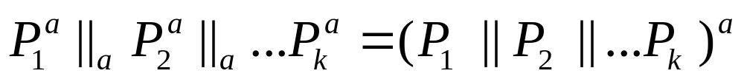
Methodology (cont’d)
Isochronicity guarantees that
Endochronicity guarantees that there exists
For each block the original synchronous semantics is preserved

Slide 44
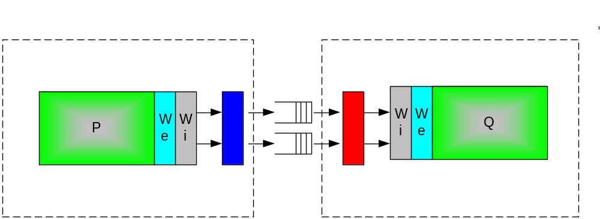
Solution to Problem 2
“What if we deploy a synchronous network of synchronous blocks onto a GALS architecture?”
SOLVED

Slide 45
Conclusion
General concern: build a correct by construction methodology for modular architecture
Similarities
  Stallable processes ≈ stuttering invariant
  Equalizer ≈
Differences
  No global clock != global clock
  Single clock != Milticlock (at the spec. level!)

