Slide 1
Hytech
Arkadeb Ghosal

Slide 2
Overview
Introduction
Hybrid automaton
What do we want?
A closer look
Demos
References

Slide 3
Overview
Introduction
Hybrid automaton
What do we want?
A closer look
Demos
References

Slide 4
What is Hytech?
A model checker for Hybrid systems
A tool for automated analysis of embedded systems
Procedure for checking linear CTL requirements of linear hybrid automata has been implemented in tool Hytech

Slide 5
Hytech Contributors
Thomas Henzinger
Rajeev Alur
Pei-Hsin Ho
Howard Wong-Toi
Peter Kopke
Jorg Preubig
Benjamin Horowitz
Rupak Majumdar

Slide 6
Overview
Introduction
Hybrid automaton
What do we want?
A closer look
Demos
References

Slide 7
Examples of Hybrid systems
manufacturing controllers
automotive and flight controllers
medical equipment
micro-electromechanical systems
robots
mission critical applications

Slide 8
Hybrid Automaton
A hybrid automaton A = (X, V, flow, inv, init, E, jump,Σ, syn)
  Variables
  Control Modes
  Flow conditions
  Invariant conditions
  Initial conditions
  Control switches
  Jump Conditions
  Events

Slide 9
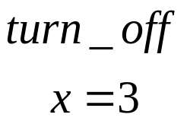
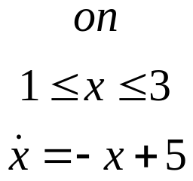
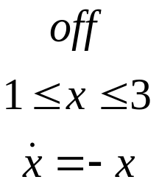

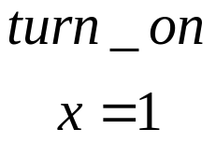
Thermostat automaton

Slide 10
Flow and jumps
states
  the state (on,1.5) is admissible while the state (on, .5) is not
jumps
  thermostat automaton has two jumps ((on,3), (off,3)) and ((off,1),(on,1))
flows
  ((off,3),(off,2)) and ((off,3), (off,2.5)) are flows of thermostat automaton
trajectories
  a finite sequence of admissible states
  first state is an initial state and each pair of consecutive states in the sequence is either a jump or flow

Slide 11
Overview
Introduction
Hybrid automaton
What do we want?
A closer look
Demos
References

Slide 12
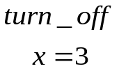
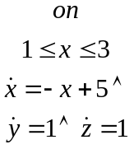
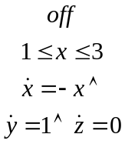
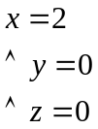

Safety requirements
what is a safety requirement?
  it asserts that nothing bad will happen
  often specified by describing the “unsafe” values
A satisfies the safety requirement specified by unsafe if the state assertion unsafe is false for all reachable states of A
Thermostat automaton augmented for safety verification

Slide 13
Computing reachable states
Given a state assertion unsafe we try to compute another state assertion reach which is true for reachable states of the automaton
  for a state assertion ϕ, Post(ϕ) is a state assertion that is true for the jump and flow successors of the ϕ-states
Success of computation of reach depends on
  Post(ϕ) can be calculated reasonably efficiently for a restricted class of hybrid automata called linear hybrid automata
  Iterative computation of reach must converge within a finite number of Post applications and this can be guaranteed for certain restricted class of linear hybrid automata such as class of timed automata

Slide 14


Linear Hybrid Automata
hybrid automaton A is linear hybrid automaton if it satisfies
  Linearity : for every control mode, the flow condition, the invariant condition, and the initial condition are convex linear predicates and for every control switch jump condition is a convex linear predicate
  flow independence : for every control mode, the flow condition is a predicate over the variables in only and not in
    quite limiting but it allows
      clocks
      stopwatches
      clocks with bounded drift

Slide 15
Linear Hybrid Automata
Theorem:
  If A is a linear hybrid automaton and ϕ is a linear state assertion for A, then Post(ϕ) can be computed and the result again is again a linear state assertion for A
    every flow curve can be replaced by a straight line between the two endpoints
This theorem enables
  automatic analysis
  safety verification
  temporal model checking

Slide 16
Overview
Introduction
Hybrid automaton
What do we want?
A closer look
Demos
References

Slide 17
Non-linear to linear hybrid automata
Clock Translation
Linear phase-portrait approximation

Slide 18
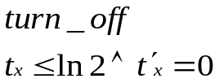
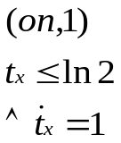
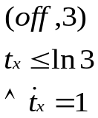

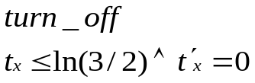

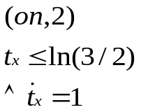
Clock translation

Slide 19
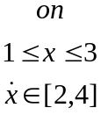
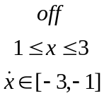

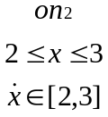
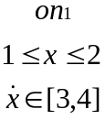
Linear phase-portrait approx.
Linear phase portrait approx. of thermostat automaton
Tighter Linear phase portrait approx. of thermostat automaton

Slide 20
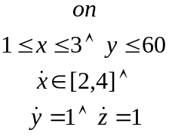
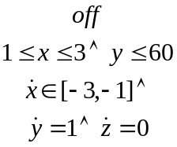

Safety Verification
Property to be verified:
The heater is active for less than 2/3 of the first hour of operation
Unsafe state:

Slide 21



Safety verification
y
z
Initial state
1
Jump successor: none
1/2
Flow successor
1/4
2
3
x
Jump successor
ϕ₀ state
Flow successor : closed

Slide 22
Safety verification
flow successors of ϕ₀ state
y
z
Initial state
1
Jump successor: none
1/2
Flow successor
1/4
2
3
x
Jump successor
ϕ₀ state
Flow successor : closed

Slide 23
Some related issues
Monitors
  safety requirements cannot always be specified by state assertions
  sometimes it is convenient to build a separate automaton, called a monitor
    it enters an unsafe state precisely when the original system violates a requirement
    it observes the original system without changing its behavior
    reachability analysis is then performed on the parallel composition of the system with the monitor

Slide 24
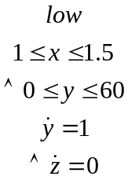

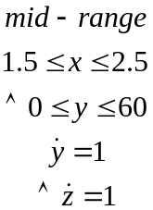

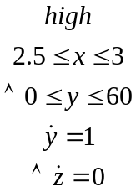

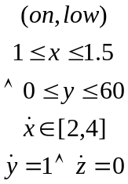
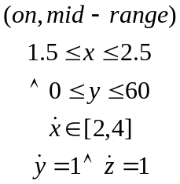
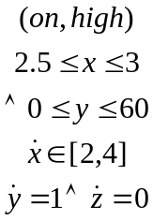


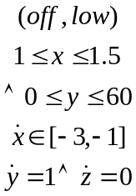
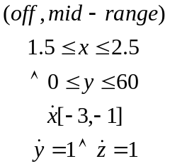
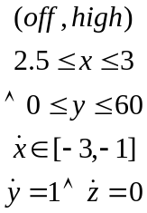
Monitors and Parallel Composition

Slide 25
Some related issues (cont.)
Parametric analysis
  High level system often use design parameters
    symbolic constants with unknown fixed values
    parameters are not assigned values until the implementation phase of design
goal
  to determine necessary and sufficient constraints on the parameters under which safety violations cannot occur

Slide 26
Overview
Introduction
Hybrid automaton
What do we want?
A closer look
Demos
References

Slide 27
Examples
A gas burner
Trajectories of a billiard ball
Temperature of a reactor core
Fischer’s timing based mutual exclusion protocol
Train-gate controller
Corbett’s distributed control system
Audio-control protocol

Slide 28
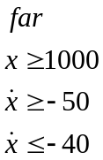
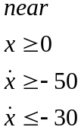
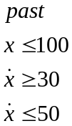




Train automaton

Slide 29

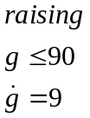



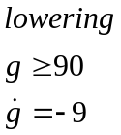


Gate Automaton

Slide 30


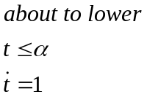

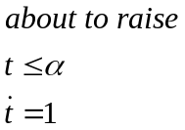
Controller automaton

Slide 31
Mutual Exclusion Protocol
repeat
repeat
await k = 0 ;k = c; delay b
until k = c;
Critical section
k := 0;
forever

Slide 32


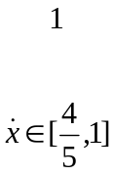

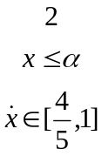

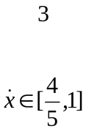

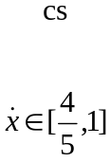



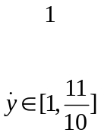

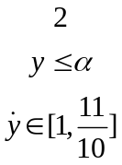



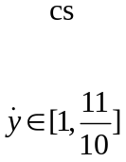
Mutual Exclusion Protocol
P₁:
P₂:

Slide 33
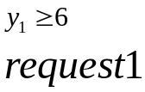

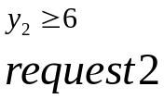




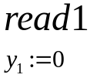
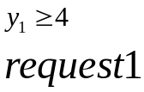

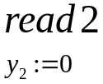

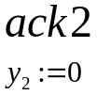

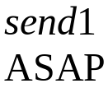


Corbett’s Distributed Controller
Sensor 1
Sensor 2

Slide 34

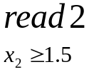






Corbett’s Distributed Controller
Scheduler

Slide 35

















Corbett’s Distributed Controller
Controller

Slide 36
Overview
Introduction
Hybrid automaton
What do we want?
A closer look
Demos
References

Slide 37
References
www-cad.eecs.berkeley.edu/~tah/Hytech

Slide 38
References
paper presented:
  Hytech: A Model Checker for Hybrid Systems
timed automaton
  A theory of timed automata
rectangular hybrid automaton
bisimulation
  The theory of hybrid automaton
Integrator computation tree logic(ICTL)
  Automatic Symbolic verification of Embedded Systems
examples and brief overview
  A user guide to Hytech
talk on hytech
  http://robotics.eecs.berkeley.edu/~koo/EE291E/Sp02/ (lec Apr 2 and 4)
a nice example
  A computational Framework for the verification and synthesis of Force-guided robotic assembly strategies (HSCC 2002)

