Slide 1
Platform-Based Embedded Software Design and System Integration for Autonomous Vehicles
EE 290-O, UC Berkeley
Presentation by: Darren Liccardo and
Mark McKelvin
April 11, 2002

Slide 2
References/Acknowledgements
Platform-Based Embedded Software Design and System Integration for Autonomous Vehicles, Benjamin Horowitz, Judith Liebman, Cedric Ma, T. John Koo, Alberto Sangiovanni-Vincentelli, Shankar Sastry

Slide 3
Part I: Outline
Overview
A Helicopter Based UAV Example
- Background for a model helicopter
- Analyze the current Flight Control System
- New Generation Flight Control System
Platform-Based Design Methods
- Synchronous control

Slide 4
Overview
What is the problem?
Automation control systems incorporate legacy code and components designed to operate independently (e.g. lacks re-usability)
These systems operate under strict timing and safety constraints
Current design strategies ignore or grossly estimate implementation constraints when designing control laws
Missed timing constraints and subtle transient errors cause costly re-designs in the system
Notes:
Remember, this is an introduction of what is to come.
Software designers used techniques that were unsound (eg. Communications among tasks implemented via common variables, and primitive operating systems). So, as long as the complexity of the systems to contol was low, this design methodology could yield working implementations. However, the Mars Polar Lander points out the risks when using an outdated approach when developing embedded controllers. A great deal of concern about the control of vehicles has created this push for more novel designs to take advantage of control theory, formal verification, integrated circuit technology, and software practices.
#1: This means that the current controller designs lack the ability to re-use software and hardware components. This results in unverifiable and inflexible systems.
MOST IMPORTANT: #3 is a situation that has its origins in the difficulty of mixing functional design with the actual implementation, and in the difficulty of evaluating quickly an alternative control law or implementation architecture.

Slide 5
Overview
What is the proposed solution?
Develop a methodology based on the concept of “platform-based” design
- Definition: a layer of abstraction that hides unnecessary information about the layers below
- Build in modularity
- Make code re-usable and substitution of new subsystems simple
Guarantee performance
- Use a time-based controller
- Using Giotto software platform versus other approaches
Notes:
Layer of abstraction…and yet carries enough information about the layers below to prevent design iterations.
Note: In this presentation, we focus on Giotto, and we will give an example where Giotto is being used in an autonomous helicopter. Also, we will present a hardware-in-the-loop simulation framework.

Slide 6
System Characteristics
The proposed methodology works to integrate systems…
…that contain a sizable amount of real-time embedded software
…that integrate subsystems originally designed to work independently of one another (i.e., sensors from various vendors).
…that must operate properly for human safety
…that often re-use existing code in the form of drivers or controllers
Example: a helicopter based UAV
Notes:
The choices of design solutions are somewhat application-dependent but the overall scheme is not, so that the example could provide a general guideline for the application of the proposed method. So the methodology proposed works particularly to integrate systems with the following key traits.
Furthermore, note that the last bullet is due to the fact that automation projects have long lives and many design iterations. Careful re-use of code often saves money and increases product quality. And, don’t forget to mention how a helicopter is a perfect example of a system that posses these traits, and is therefore used as an example of using a platform-based design and time-triggered controller.

Slide 7
A Helicopter Based UAV
Why a helicopter?
- A helicopter is a dynamically complex machine. One needs to combine sensors (GPS and INS), servo actuators, a wireless network, a central computer, and control laws describing the dynamics of the helicopter.
- An autonomous helicopter requires a complicated hybrid controller to control changes in flight modes and to sustain system stability.
Notes:
Make a clean transition from the previous slide into the helicopter example. May include how the helicopter exemplifies a system with the given traits (previous slide) and how the helicopter example serves as an example of the proposed methodology. Research up to this point has been mostly focused on concept—can we control a helicopter. We see its feasible to do basic autonomous flight capabilities, so now lets look at more elegant design to prove that this works. Basic abilities: hovering , forward flight, turning at a fixed point. More advanced include: formation flying and obstacle avoidance.
Reasons why basic flight is difficult: helicopter is unstable during hover, the control system needs to take an active role in stabiliaztion of the helicopter; a crash is very dangerous, even at low speeds; helicopter is an intricate machine, mechanical and electronic systems must operate harmoniously under harsh conditions, such as physical vibration and electromagnetic interference, and its difficult to obtain an accurate dynamic model. Difficult for accurate model because: helicopter controls are coupled, behaviors of the are not the same in different flight regimes, and airflow around a helicopter is chaotic.
Despite those challenges, BEAR, the Berkeley Aerial Robot team managed to build a working flight control system that makes autonomous flight possible.

Slide 8
Background for a Model Helicopter
Autonomous flight is difficult because:
The helicopter is unstable during hover
Crashes are dangerous (even at low speeds)
Electronic and mechanical systems must operate harmoniously under harsh conditions
Difficulty in obtaining an accurate dynamic model
- The controls are coupled
- Behaviors of a helicopter are different in various flight modes
Notes:
Research up to this point has been mostly focused on concept—can we control a helicopter. So, a question lingers, is it possible to control a helicopter? The answer is yes. And we see in this slide the challenges that designers face when trying to achieve basic autonomous flight.
Basic abilities: hovering , forward flight, turning at a fixed point. More advanced include: formation flying and obstacle avoidance.
Reasons why basic flight is difficult: helicopter is unstable during hover, the control system needs to take an active role in stabilization of the helicopter; a crash is very dangerous, even at low speeds; helicopter is an intricate machine, mechanical and electronic systems must operate harmoniously under harsh conditions, such as physical vibration and electromagnetic interference, and its difficult to obtain an accurate dynamic model. Difficult for accurate model because: helicopter controls are coupled, behaviors of the are not the same in different flight regimes, and airflow around a helicopter is chaotic.
Despite those challenges, BEAR, the Berkeley Aerial Robot team managed to build a working flight control system that makes autonomous flight possible.

Slide 9
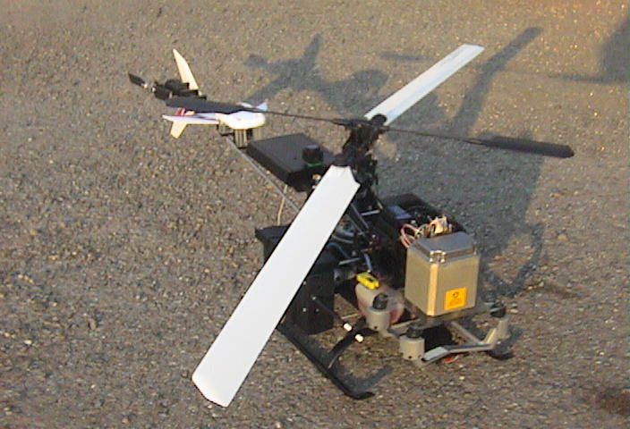
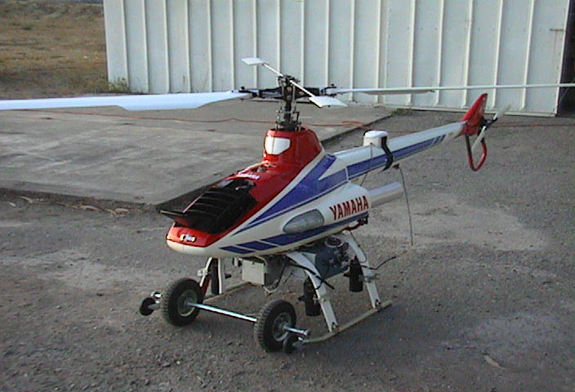
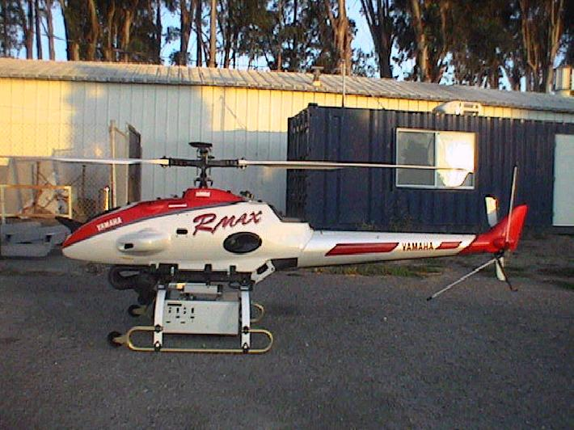
The Berkeley Aerial Robot (BEAR) Fleet
Kyosho Concept 60
Yamaha R-50
Yamaha R-Max
Notes:
We know up to this point why we are using helicopters. Now, this slide should introduce the BEAR helicopters. One of the first goals of the BEAR team was to build a flight control system for small, remotely controlled helicopters that can fly autonomously. Despite the challenges of achieving basic autonomous flight with helicopters, the BEAR team managed to successfully build a working flight control system that makes autonomous flight possible.

Slide 10
Current Flight Control System (Components)
Actuators
- consists of servo- motors to control helicopter dynamics (main rotor and tail rotor pitches)
Sensors
- Inertial Navigation System (INS)
- Global Positioning System (GPS)
Control computer
Control Computer
GPS
INS
Servos
Notes:
Servo motors controlled the main rotor collective pitch, longitudinal cyclic pitch, lateral cyclic pitch, and tail rotor collective pitch. It is assumed the throttle is governed by an engine so that it does not appear in the dynamic equations. The primary sensors are the INS and GPS. Next slide describes the sensors in more detail. Control computer uses a Kalman filter to provide frequent updates of the estimated state of the helicopter, and it computes the control law and send results to the acutator.
Control computer: Experimental system identification was used to obtain a dynamic model of the helicopter: the flight control computer logged the response of the helicopter and the pilot commands, and these logs were compared. The information attained through system ID was then used to synthesize a controller for the helicopter. See Shim 2000 for more info.

Slide 11
Current Flight Control System (Helicopter Dynamics)
P´(t) = V(t)
V´(t) = (1/m) R((t)) f(u(t))
´(t) = ((t)) (t)
´(t) = I⁻¹ [(u(t)) - (t) x (t)]
where the linear position and velocity are given by P(t) and V(t) respectively. Other parameters: m is the body mass;  is the angular velocity; I is the inertial matrix, I  ^{3 x3} ; Euler angles:  = [,,]^{T} ; input vector, u = [_{M} _{T}, B, A]^{T} (main rotor collective pitch, tail rotor collective pitch, longitudinal cyclic pitch, lateral cyclic pitch);  : ³  ^{3 x3} maps the body rotational velocity to Euler angle velocity; and
x = [P^{T} V^{T} ^{T} ^{T}]^{T} is the state vector.
Notes:
A closer look is taken at the complexity in the dynamics of the helicopter.
These equations are derived from N-E equations for a rigid body subject to body forces, f  ³ and torques,   ³ applied to the center of mass. P and V are also elements of ³. Euler angles are given by Theta which are phi, theta, and psi (I think its roll, pitch, yaw). For the input vector, u, we have the main rotor collective pitch, tail rotor collective pitch, longitudinal cyclic pitch, and the lateral cyclic pitch. Thus, controlling a helicopter is an extremely difficult task.

Slide 12
Current Flight Control System (Helicopter Dynamics)
For control design, experimental system identification was used to obtain the dynamic model of the helicopter
A specific set of output tracking controllers were designed
- Each with static feedback: u(t) = K_{i} (x(t), r(t)), where u(t) is associated with an output y_{i}(t) = h_{i}(x(t)) such that y_{i}(t) shall track r_{i}(t) where y_{i}, r_{i}  ⁴, h_{i} : ¹²  ⁴ , k_{i} : ¹² x ⁴  ⁴ for each i  {1, …, N} and N is the total number of output tracking controllers
- Hence, appropriate switching between the controllers allows high level tasks such as way-point navigation and high-altitude are accomplished
Notes:
Experimental system id, I do not know!!!!! However, the various output tracking controllers were designed to suit the multi-objective design specifications. And each controller had the static feedback form given. So high level tasks are accomplished. An approach for solving the swtiching problem among a collection of output tracking controllers is proposed in another paper (see references #7 from main paper). So based on the flight condition, the flight control system determines which controller should be switched to.

Slide 13
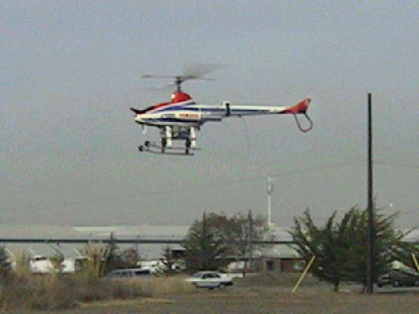
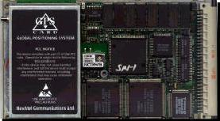
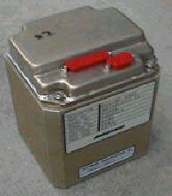
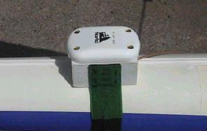
Current Flight Control System (Sensors Overview)
R-50 Hovering
Goal: basic autonomous flight
  Need: UAV with allowable payload
  Need: combination of GPS and Inertial Navigation System (INS)
GPS (senses using triangulation)
  Outputs accurate position data
  Available at low rate (5 Hz)
INS (senses using accelerometer and rotation sensor)
  Outputs estimated position with unbounded drift over time
  Available at high rate (100 Hz)
Fusion of GPS & INS provides needed high rate and accuracy
GPS Card
INS
GPS Antenna
Notes:
Here, the current or original goal of autonomous flight was to make it possible number one, then to be able to use a fusion of the two inputs into the system, namely the GPS and INS. The INS consists of accelerometers and rotational rate sensors that provide frequent estimations of the helicopter’s position, velocity, orientation, and rate of rotation. The error in estimate could grow unbounded over time. The GPS corrects the INS drift problem by providing a position measurement whose error is small and bounded over time, however, its accurate measurements are infrequent.

Slide 14
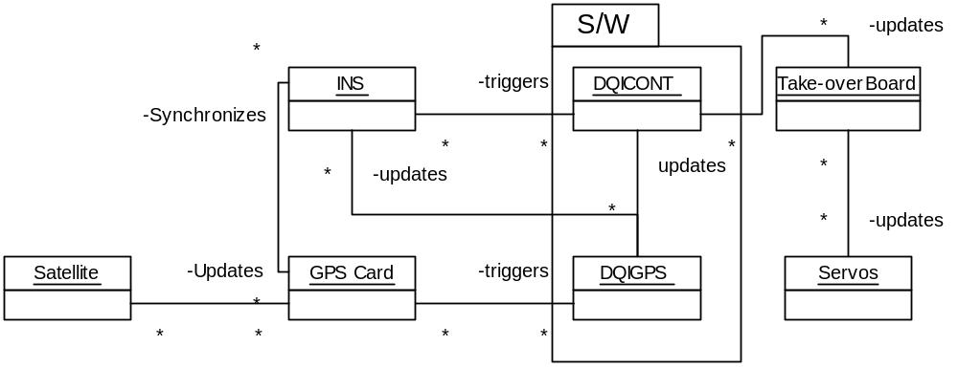
Two Concurrent Processes
DQIGPS
correct INS drift w/GPS
Slow (5Hz)
  1Hz for INS update
DQICONT
Main Control Loop
Fast (100Hz)
  50 Hz servo
  25 Hz network
Notes:
***May not include this slide, I will mention the jobs of the DQIGPS and dqicont in the previous slide.

Slide 15
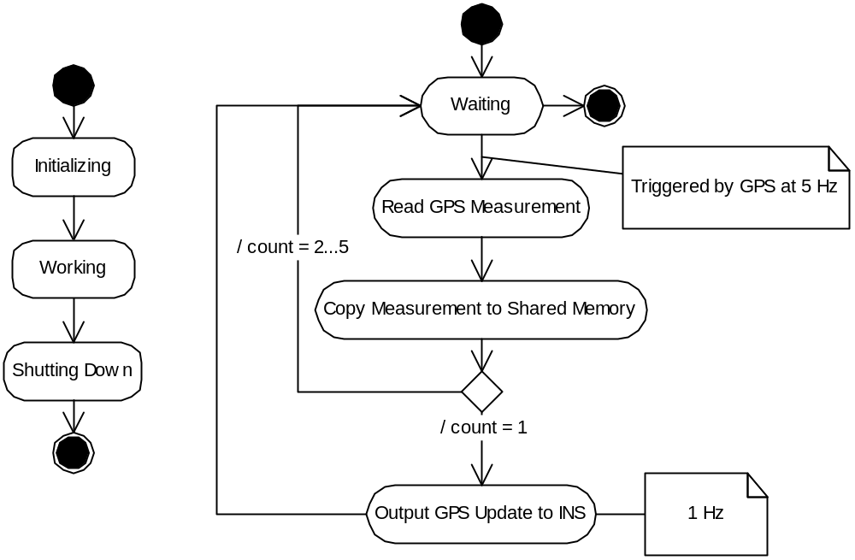
Process DQIGPS
(UML State & Activity Diagram)

Slide 16
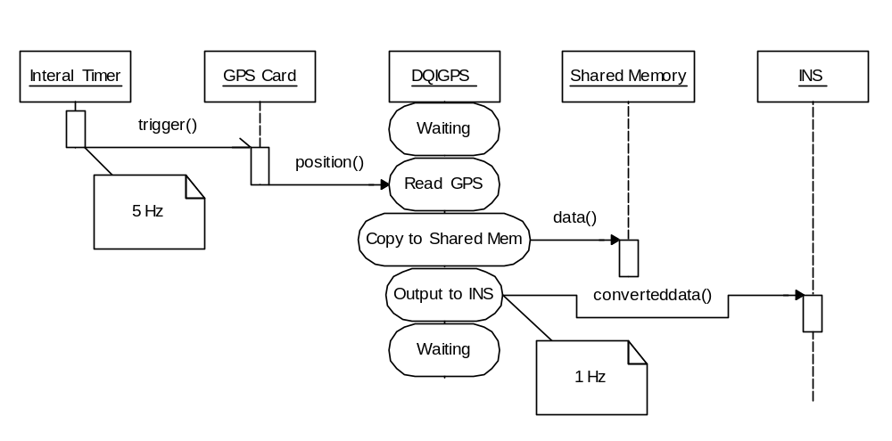
Process DQIGPS
(UML Sequence Diagram)

Slide 17
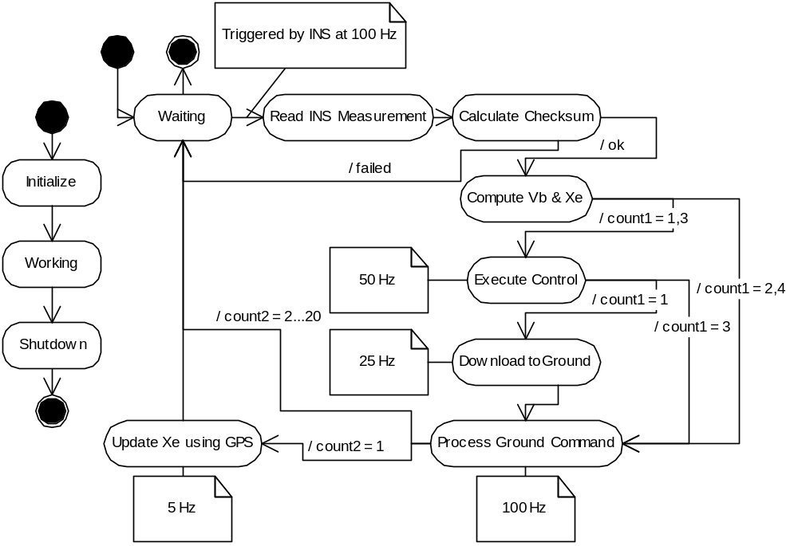
Process DQICONT
(State & Activity Diagram)
Notes:
I don’t know about this slide, I don’t quite know what “Compute Vb & Xe is!!!!!!

Slide 18
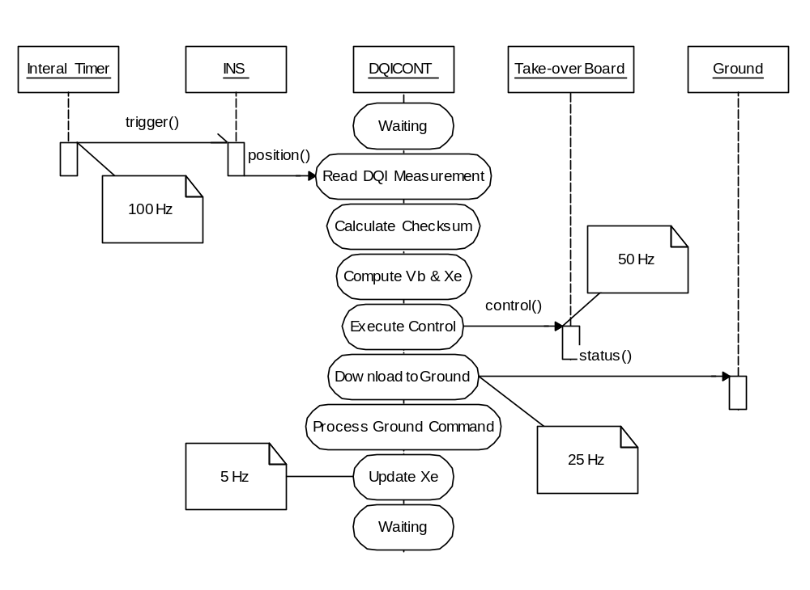
Process DQICONT
(UML Sequence Diagram)

Slide 19
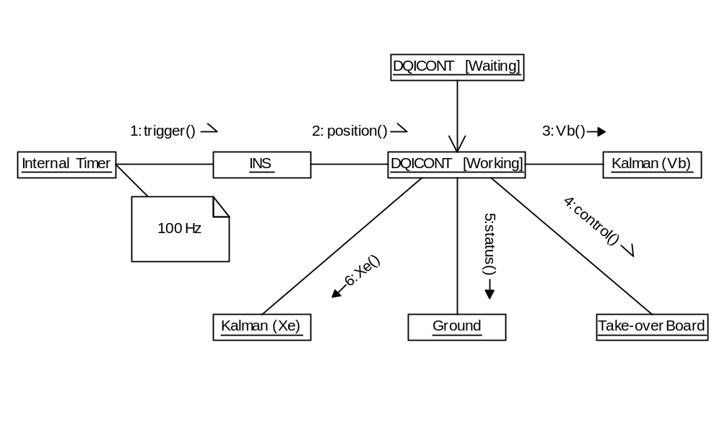
Process DQICONT
(Collaboration Diagram)
Notes:
Find out from paper what is Vb and Xe, and I may need refreshing up on the purpose/function of the collaboration diagram.

Slide 20
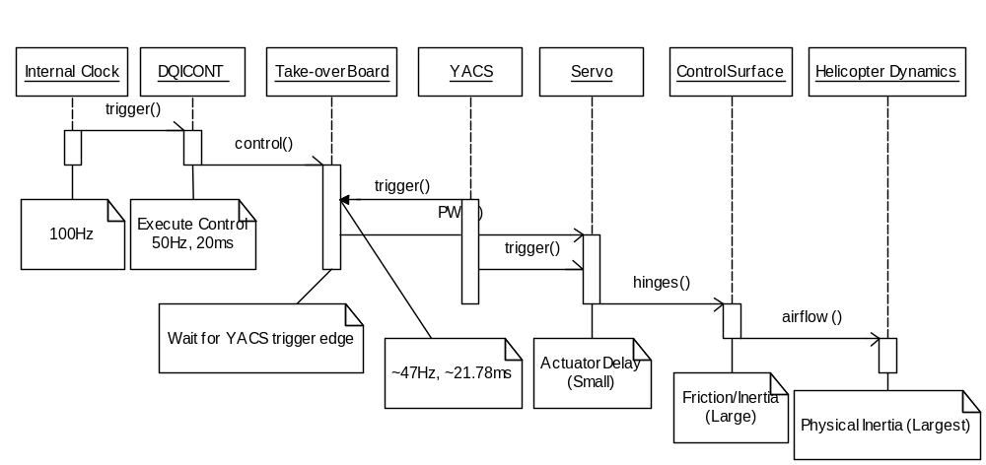
Who’s at the Controls?
(Sequence Diagram)
Notes:
I don’t know about using this one either because I don’t understand the “Take over Board” and YACS.

Slide 21
Who’s at the Controls?
Servo has different sampling period (21.78ms) than INS (20ms)
  phase difference constantly changing
Delay from DQICONT control calculation to PWM generation varies
  jitters by up to 20ms
  Problem: difficult to analyze

Slide 22
Current Flight Control System
(Sensor Configurations Example)
Sensors may differ in:
  - Data formats, initialization schemes (usually requiring some bit level coding), rates, accuracies, data communication schemes, and even data types
Differing communication schemes requires the most custom written code per sensor
Software Request
Software
Shared
memory
d
d
INS
GPS
INS
GPS
Pull Configuration
Push Configuration
Notes:
As I mentioned towards the beginning, changes need to be made to the hardware part of the system as well, in order to create an entirely synchronous hybrid system. First, the system needs one clock, which would be updated by the gps clock. Next the system would need an actuation scheme which could be time triggered. Cedric pointed out the issues involved with the current event driven servo system, time triggered actuators do exist on other helicopters. Finally, the sensors would need to be used in a pull configuration instead of the current push configuration. So upon a software request the sensors would provide the most recent data.

Slide 23
Current Flight Control System
(Limitations)
Diverse assortment of devices
- Each new device communicates differently (asynchronously)
- Lacks modularity
Event-based nature
- Sensors are set to “push” data
- Incoming data is processed and sends the control output to the actuators immediately
- Actuation does not occur synchronously, thus the system tolerates a substantial amount of jitter
- Non-deterministic timing behavior
Notes:
We have in general two main challenges which comes with these limitations on the current flight control system. Consider an example where the GPS and INS were synchronized with each other but not with the control computer. This means that the sensor data seen by the control computer is from 0ms to 10ms out-of-date. Due to clock drift, this amount of time is non-deterministic. New devices and components will require re-writing software and redesigns, as mentioned before.
Because of this event-based nature of the current system, the sensors will push data to the software system whenever data is available. What we want is a synchronous system which will operate only in a pull configuration such that the data from the sensors is obtained synchronously, and synchronous control allows for the use of a time-based scheme such as using Giotto.
Similarly the servos were triggered by a clock whose rate was independent of the control computer’s clock, so the actuation is asynchronous. Consequently, the physical behavior of the helicopter could vary greatly from the simulation results.
First generation is to demonstrate feasibility of autonomous flight, rather than design elegance. This led to fast flight computer reaction achieved by means of tightly coupled hardware devices and software.

Slide 24
Next Generation Flight Control System
Time-based design (Giotto)
- Allow easy analysis of its closed loop behavior
- Maintain compatibility with existing devices that are not time-based, such as sensors
- Creates a defined boundary between a system’s synchronous and asynchronous elements
Modular design (platform-based design)
- Ability to allow designer to choose between a mixture of devices
- Must allow a configuration of the same software to run on different helicopters which may have different physical dynamics and devices
Notes:
A system that can analyze and predict overall physical behavior. This is to be achieved by implementing a time-based, modular design.

Slide 25
Synchronous Control
Advantages of time-triggered framework:
  Allows for composability and validation
    These are important properties for safety critical systems like the UAV controller
  Timing guarantees ensure no jitter
Disadvantages:
  Bounded delay is introduced
    Stale data will be used by the controller
  Implementation and system integration become more difficult
Platform design allows for time-triggered framework for the UAV controller
  Use Giotto as a middleware to ease implementation:
    provides real-time guarantees for control blocks
    handles all processing resources
    Handles all I/O procedures

Slide 26
Platform-Based Design Overview
Universal design strategy
  Goal is design reuse
Decouple two design views
  Upper View: Application Space
  Lower View: Component Space
  Main motivation of project is this decoupling of the control process from the sensors & devices
Interact through well-defined interface
  Platform instance is an implementation of the interface
Both views help specify the platform making this a meet-in-the-middle approach
Application Space
Component Space

Slide 27
Platform Based Design for UAVs
Goal
  Abstract details of sensors, actuators, and vehicle hardware from control applications
How?
  Synchronous Embedded Programming Language (i.e. Giotto)
  Platform
Control Applications (Matlab)
Synchronous Embedded
Programming
(Giotto)
Application Space
Architectural Space
Sensors: INS, GPS
Actuators: Servo Interface
Vehicles: Yamaha R-50/R-Max

Slide 28
Platform Based Design for UAVs
Device Platform
  Isolates details of sensor/actuators from embedded control programs
  Communicates with each sensor/actuator according to its own data format, context, and timing requirements
  Presents an API to embedded control programs for accessing sensors/actuators
Language Platform
  Provides an environment in which synchronous control programs can be scheduled and run
  Assumes the use of generic data formats for sensors/actuators made possible by the Device Platform
Control Applications (Matlab)
Synchronous Embedded
Programming
(Giotto)
Application Space
Language Platform
Architectural Space
Device Platform
Virtual Avionics Platform
Sensors: INS, GPS
Actuators: Servo Interface
Vehicles: Yamaha R-50/R-Max

Slide 29
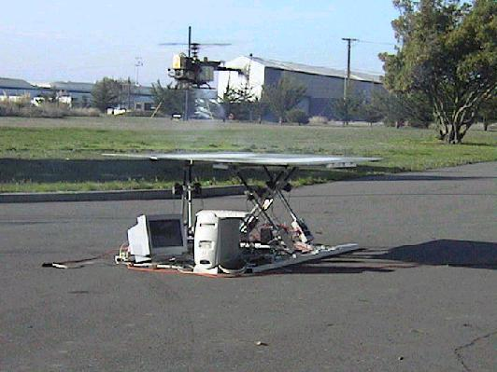
Recent Developments
Kyosho Concept 60
  Hovering ID Model
  Autonomous Hover
Yamaha R-50:
  Hovering ID Model
  Autonomous Hover
  Waypoint Navigation
Yamaha R-Max
  ?
Notes:
The recent developments of the model helicopters in the BEAR fleet. Just to note about the helicopters, the Yamaha R50 and Rmax have been easier to equip and fly due to their superior payload carrying ability. I suspect once this new design methodology passes simulation tests, that it will be implemented on the bulkier Rmax—for its ability to be equipped with more devices and its stability.

Slide 30
Outline: part II
Time-Based Control Platform
  Modern Control Architectures
  Platform Based Design with Giotto
Case Study: BEAR Helicopter
  Synchronous Control
  Helicopter Platform

Slide 31
Modern Control Architectures
Modern control architectures
  Programmable components
    µProcessors, DSP
  Memory
    FLASH, RAM, ROM
  Sensors and Actuators
Control laws implemented in software
Unique difficulties with this mapping

Slide 32
Difficulties Mapping Software Control to Programmable Architectures
Real-time
  Software is slower than hardware
  True concurrency is lost with single processor
  Efficient dynamic scheduling algorithms are unverifiable
Sensor and Actuator Characteristics
  Must be accounted for in software
  Must be abstracted for software portability

Slide 33
Introduce Abstraction
Use platform based design
Enforce static scheduling
  Restrict design space
  Verifiable real-time constraints
Use Giotto!

Slide 34
Platform Based Design with Giotto
Goal
  Abstract details of sensors, actuators, and vehicle hardware from control applications
  Real-time verification
How?
  Platform
  Synchronous Embedded Programming Language (i.e. Giotto)
Control Applications (Matlab)
Synchronous Embedded
Programming
(Giotto)
Application Space
Architectural Space
Sensors: INS, GPS
Actuators: Servo Interface
Vehicles: Yamaha R-50/R-Max

Slide 35
Introduction To Giotto
Giotto is an abstract programmer’s model for implementing embedded system software
Created to model periodic software tasks and mode switches with hard real-time constraints
Sensor readings and tasks (periodic functional units) are time triggered
Notes:
So giotto is an abstract model for implementing embedded system software. It has been created to model periodic systems that include mode switches, such as our own. However, Giotto allows for only time triggered architecture.

Slide 36
More Giotto
Giotto guarantees model will meet real-time requirements on any platform
  Separates the platform-independent from the platform-dependent concerns
  Abstracts away scheduling and platform-dependent issues
    Designer can concentrate on system model and assume deadlines are met independent of chosen platform
Notes:
The nice thing about giotto is that it guarantees that each task will meet specific timing deadlines which are set by the programmer. The programmer need not worry about processor scheduling or any platform dependent variables, as giotto takes care of this underlying layer.

Slide 37
Fitting Software Into Giotto
Model periodic functional units as tasks
  sensor data reading and control calculations occur periodically and can be modeled as tasks
A set of concurrent tasks make up one mode, for example: Hover Mode
Modes repeat until a mode switch is requested
Notes:
Giotto calls the periodic functional units tasks. In our case, there are several periodic functions, including the sensor data collection and the control block, these can be laid out as tasks. A set of tasks which occur concurrently make up what is called a mode. For example, the first mode we will look at is hover mode, which involves all of the periodic tasks cedric discussed. Giotto runs by repeating the mode until a mode switch is initiated.

Slide 38
Giotto Specifications
Communication is instantaneous
  Time is accounted for within the tasks
Input data cannot be refreshed in the middle of a task
Outputs from a task cannot be used until the task deadline time
Tasks are only guaranteed to finish by end time, not to start at beginning time
Notes:
There are some more things to note about the above diagram. First of all, the communication between tasks is set to require zero time, that communication time is accounted for by giotto within the tasks. Data cannot be taken into a task in the middle of its running time, but only at the beginning. Similarly, outputs from a task may not be used by other tasks before the end time, even if the data happens to be ready early. Finally, tasks are only guaranteed to finish by the end time and not necessarily promised to start at the beginning time.

Slide 39
V. Case Study: Helicopter UAV

Slide 40
Case Study: Helicopter
Goals:
  Incorporate asynchronous input devices and real-time controller
  Modular - to allow replacing subsystems
How?
  Use Platform-Based Design
  Use Time-Based Controller

Slide 41
UAV System:
Sensor Overview
R-50 Hovering
Goal: basic autonomous flight
  Need: UAV with allowable payload
  Need: combination of GPS and Inertial Navigation System (INS)
GPS (senses using triangulation)
  Outputs accurate position data
  Available at low rate & has jamming
INS (senses using accelerometers and gyroscopes)
  Outputs estimated position with unbounded drift over time
  Available at high rate
Fusion of GPS & INS provides needed high rate and accuracy
GPS Card
INS
GPS Antenna

Slide 42
UAV System:
Sensor Configurations
Sensors may differ in:
  Data formats, initialization schemes (usually requiring some bit level coding), rates, accuracies, data communication schemes, and even data types
Differing Communication schemes requires proprietary code for each sensor
Software Request
Software
Shared
memory
d
d
INS
GPS
INS
GPS
Pull Configuration
Push Configuration
Notes:
As I mentioned towards the beginning, changes need to be made to the hardware part of the system as well, in order to create an entirely synchronous hybrid system. First, the system needs one clock, which would be updated by the gps clock. Next the system would need an actuation scheme which could be time triggered. Cedric pointed out the issues involved with the current event driven servo system, time triggered actuators do exist on other helicopters. Finally, the sensors would need to be used in a pull configuration instead of the current push configuration. So upon a software request the sensors would provide the most recent data.

Slide 43
Control Tasks
Two tasks:
  Sensor Fusion
    Inputs from sensors
    Kalman filter for GPS and INS
  Control
    Computes control law
    Output to actuators

Slide 44
Synchronous Control: Giotto
INS
driver
Measurement
Fusion
Measurement
Fusion
Measurement
Fusion
GPS
Controller
Controller
Actuator
Time = t ms
Time = t +10ms
Time = t +30ms
Notes:
In order to minimize this problem we would like to specify that the control block must finish sooner than 20ms. However we do not need the control outputs more often. Therefore this diagram would be closer to an ideal model.

Slide 45
Delay Analysis
Data In
INS
driver
Measurement
Fusion
Measurement
Fusion
Measurement
Fusion
Data Out
GPS
Use Data
Controller
Controller
Actuator
Time = t ms
Time = t +10ms
Time = t +30ms
Notes:
In order to minimize this problem we would like to specify that the control block must finish sooner than 20ms. However we do not need the control outputs more often. Therefore this diagram would be closer to an ideal model.

Slide 46
III. Synchronous Control
Advantages of time-triggered framework:
  Allows for composability and validation
    These are important properties for safety critical systems like the UAV controller
  Timing guarantees ensure no jitter
Disadvantages:
  Bounded delay is introduced
    Stale data will be used by the controller
  Implementation and system integration become more difficult
Platform design allows for time-triggered framework for the UAV controller
  Use Giotto as a middleware to ease implementation:
    provides real-time guarantees for control blocks
    handles all processing resources
    Handles all I/O procedures

Slide 47
Reduced Delay Model
INS
driver
Measurement
Fusion
Measurement
Fusion
Measurement
Fusion
GPS
Controller
Controller
Actuator
Time = t ms
Time = t +10ms
Time = t +15ms
Notes:
In order to minimize this problem we would like to specify that the control block must finish sooner than 20ms. However we do not need the control outputs more often. Therefore this diagram would be closer to an ideal model.

Slide 48
Ideal Giotto System
Would like to guarantee that control block finishes as the system requires (say 5ms), but still only runs every 20ms
  would like to model as follows:
Sensors
SF
SF
SF
SF
w1=10
x
w1=10
x
w1=10
x
w1=10
x
v
C
F
C
F
x
exit
w2=5
exit
w2=5
exit
Notes:
In order to minimize this problem we would like to specify that the control block must finish sooner than 20ms. However we do not need the control outputs more often. Therefore this diagram would be closer to an ideal model.

Slide 49
Reduced Delay Giotto System
Cannot model such a system in Giotto
  Giotto mandates that finish time of a task be based on its periodicity
  Instead create a new model
    call the control block with frequency = max delay tolerated but only actually compute control when needed
Sensors
SF
SF
SF
SF
w1=10
x
w1=10
x
w1=10
x
w1=10
x
v
C
F
C
F
v
C
F
C
F
v
C
F
C
F
v
C
F
C
F
x
x
x
x
exit
w2=5
w2=5
exit
w2=5
w2=5
exit
w2=5
w2=5
exit
w2=5
w2=5
exit
exit
exit
exit
exit
Notes:
However, that picture cannot be modeled in giotto since giotto mandates that the finish time is linked to the periodicity of the task. We suggest this new model which does conform to the giotto standards and also guarantees that the control finished within 5ms but does not run more often than needed. In this model the control block is called with a frequency which is linked to the maximum delay tolerated, however the control block is only actually computed every few times, on the blocks with the stars

Slide 50
Platform Based Design for UAVs
Device Platform
  Isolates details of sensor/actuators from embedded control programs
  Communicates with each sensor/actuator according to its own data format, context, and timing requirements
  Presents an API to embedded control programs for accessing sensors/actuators
Language Platform
  Provides an environment in which synchronous control programs can be scheduled and run
  Assumes the use of generic data formats for sensors/actuators made possible by the Device Platform
Control Applications (Matlab)
Synchronous Embedded
Programming
(Giotto)
Application Space
Language Platform
Architectural Space
Device Platform
Virtual Avionics Platform
Sensors: INS, GPS
Actuators: Servo Interface
Vehicles: Yamaha R-50/R-Max

Slide 51
The Control Computer
Goal: Control UAV via sensors/actuators
Data Processor
  Handles the timing/interrupt of sensors and actuators
  Moves sensor/actuator data
    No format conversion
    Saves time for Giotto tasks
Shared Memory
  Serves as bridge between synchronous and asynchronous parts of system
  Circular buffer: allow simultaneous read/write
GPS
INS
Actuator
VAP
Data Processor
GPS
Message
INS
Message
Actuator
Message
Giotto
API
Library
Control
Measurement Fusion
Control Computer

Slide 52
The Control Computer
Giotto Program
  Where control algorithms (Control) and Kalman filter (Measurement Fusion) reside as Giotto tasks
API Library
  Allows control programs to interpret sensor data and send data to actuator as generic, device independent format
  Implemented as C routines
GPS
INS
Actuator
VAP
Data Processor
GPS
Message
INS
Message
Actuator
Message
Giotto
API
Library
Control
Measurement Fusion
Control Computer

Slide 53
Example – From Computer’s Point of View
RTOS
2
3
6
13
Serial
Buffer
4
Data
Processor
Giotto
Data
Processor
5
14
shm
mem
shm
1
8
10
15
9
GPS/INS
Lib
7
11
Lib
Servo
Interface
12
Measurement
Fusion
Control
GPS/INS sends sensor data via serial
RTOS generates interrupt
RTOS fires Data Processor as ISR
Data Processor gets sensor data
D/P saves sensor data to shared memory
RTOS fires Giotto process
Giotto fires Measurement Fusion task
M/F interprets sensor data via library
M/F computes combined measurement and stores it to memory
Giotto fires Control task
Control uses combined measurement
Control task generates control and saves it to shared memory
RTOS fires Data Processor
Data Processor gets control
D/P sends control to Servo Interface

Slide 54
Example – From Controller’s Point of View
Sensor
c_input sensor_input uses c_get_sensor_inputs;
.
.
.
task control(‘inputs’)(‘outputs’) { schedule c_control_task(‘inputs’)
}
.
.
.
taskfreq 1 do control(control_driver);
Refers to C function
  Sets shared memory for Giotto’s internal use
  Assumes shared memory will be filled with measurements
Refers to C controller function
  Assumes measurements are waiting in buffer that shared memory points to
  May call library functions to convert measurements
Giotto runs the control task
  Shared memory passed into control task by control_driver

Slide 55
The Simulator Computer
Models the environment surrounding Control Computer
Dynamical Model
  Helicopter Dynamics
Sensor/Actuator Models
  Simulate sensor/actuator timing behavior and data format
Shared Memory
  State and control information
  Circular Buffer
Simulator Computer
Dynamical Model
Plant Output
Plant
Input
GPS
Model
INS
Model
Actuator
Model
Control Computer

Slide 56
Combined
System
Simulator Computer
Dynamical Model
Plant Output
Plant
Input
HIL Simulator
GPS
Model
INS
Model
Actuator
Model
Plant
VAP
Sensor Suite
Actuator Suite
INS
GPS
Servos
Data Processor
UDP
GPS
Message
INS
Message
Actuator
Message
Virtual Avionics Platform
Synchronous Controller Process
Giotto
API
Library
API
Control
Control Computer
Measurement Fusion
Control Computer

Slide 57
Hardware-in-the-Loop Framework
Project uses platform based design & synchronous control to implement a controller computer that will:
  (eventually) fly on a UAV!
  (now) ‘flies’ a UAV simulator
Hardware-in-the-loop has several advantages:
  Safe & inexpensive testing
  Repeatable tests
  Partial simulations
    All have been useful for implementing the new design methodology
HIL Simulator
Sensor Data In
Actuator Out
Control Computation
Control Computer

Slide 58
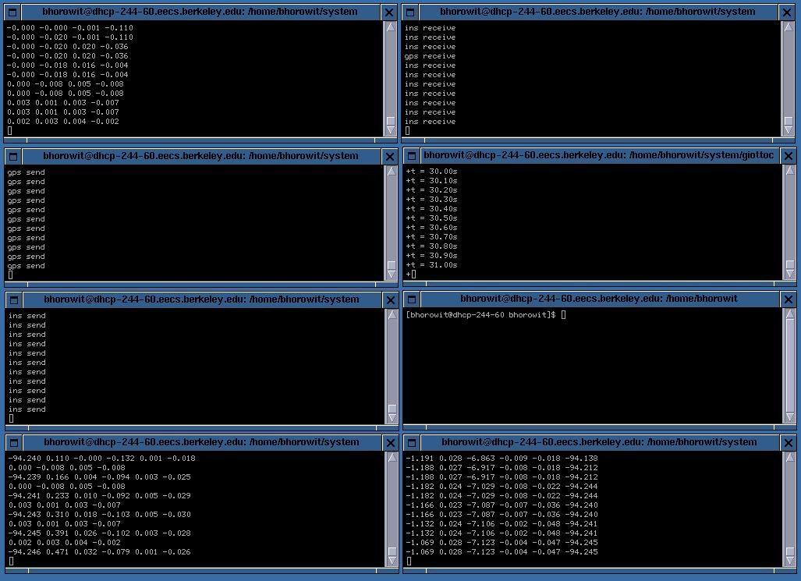
In Action – Process Windows Running
Plant’s
Receiver
Data
Processor
GPS
sensor
model
Giotto
Process
INS
sensor
model
Display
Outputs
Plant

Slide 59
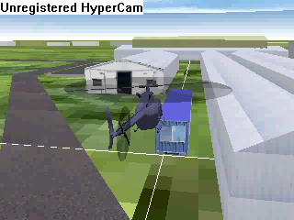
In Action – OpenGL Visualization

Slide 60
Conclusions
Developed Methodology
  Platform-based design
    Provides appropriate layers of abstraction
    Eases Software Reuse
    Eases Hardware Modifications
  Time-based control
    Verifiable real-time constraints
    Eases controller modifications

Slide 61
Conclusions
Original Control Application
New Control Application
Exchanging sensors
  Controller remains same!
  Platform adapts
    Handles new data types and formats
Exchanging controller
  New controller use the same API
  Giotto maintains timing requirements
Application Space
Language Platform
Architectural Space
Device Platform
Virtual Avionics Platform
Original Sensor Choice
New
Sensor Choice

Slide 62
Future Work – Nested Platforms
High Level Planning
Flight Modes/FSM
H
F
Software Control
Tasks
Control Output
Sensor Data
Helicopter Dynamics

Slide 63
Future Work – Nested Platforms
High Level Controller
Low Level Controller
Helicopter Architecture

Slide 65
References/Acknowledgements
Platform-Based Embedded Software Design and System Integration for Autonomous Vehicles, Benjamin Horowitz, Judith Liebman, Cedric Ma, T. John Koo, Alberto Sangiovanni-Vincentelli, Shankar Sastry

