Slide 1
Embedded Software in Network Processors – Models and Algorithms
By Lothar Thiele, Samarjit Chakraborty, Matthias Gries, Alexander Maxiaguine, and Jonas Greutert
Presented by Doug Densmore
Will Plishker
November 7, 2026

Slide 2
Outline
Introduction
Motivation
Model Computation for Packet Processing
Modeling Discrete Event Streams and Systems
Task Scheduling in Network Processor
Design Space Exploration
Concluding Remarks

Slide 3

Network Processors (NP)
Highly programmable, dedicated processors optimized to perform packet processing functions.
Two basic tasks
  Packet processing
  Traffic Management

Slide 4
Network Processors (NP)
Architecture and implementation depend very much on its placement in the network hierarchy.
Access Network Level
  Support a wide and varied range of packet processing. Relatively low data rates.
Core/Backbone Network Level
  High data rates but restricted processing capabilities.

Slide 5
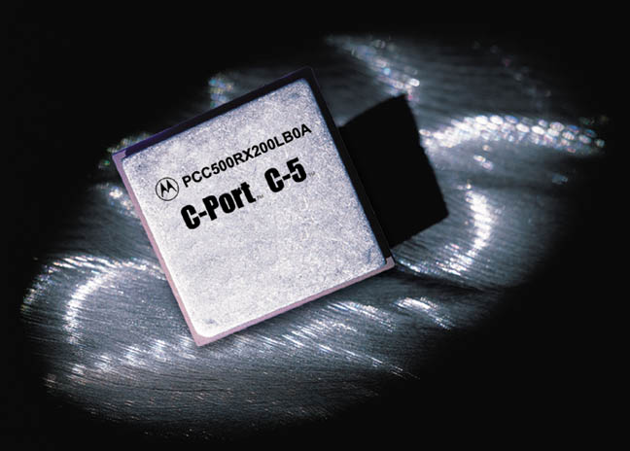
Examples of Network Processors
Intel IXP1200 Family
Motorola C-Port C-5
Lexra NetVortex
Agere PayloadPlus
Niraj Shah
  “Understanding Network Processors”

Slide 6
Motivation
Due to the highly programmable nature, software is an integral part of an NP.
Papers have proposed different software architectures for flexible configurable routers.
However, there has been no formal and unified study of this subject.
Need a formal study of packet processing devices!!

Slide 7
Motivation
Framework based on models used in packet scheduling
  Task and Resource Model for NP
  Calculus of packet streams and processing
Paper will consider two examples:
  Task scheduling in an embedded processor
  Hardware/Software interactions

Slide 8
Model of Computation for Packet Processing
Definition 1 – Task Structure
  Set of flows f ∈ F
  Set of tasks t ∈ T
  Connected, directed, and acyclic task graph G(f), for each flow f.
  G(f) consists of a set of task nodes T(f) and a set of directed edges E(f).
  G(f) has a unique source node s(f).

Slide 9
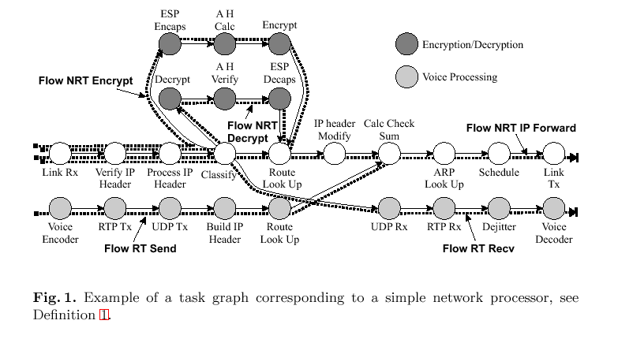
Task Graph

Slide 10
Model of Computation for Packet Processing
Definition 2 – Resource Structure
  Set of resources s ∈ S
  S→ R⁺ = relative cost of a resource (i.e. power, area)
  M ⊆ T x S defines the possible mapping of t ∈ T to resources.

Slide 11
Model of Computation for Packet Processing
Definition 3 – Timing Properties
  To each flow f ∈ F there is an end to end deadline d:F→ R⁺
  If a task t can be executed on a resource s, then it creates a “request” w. w(t,s) ∈ R⁺
  This request can be thought of as a number of instructions.

Slide 12
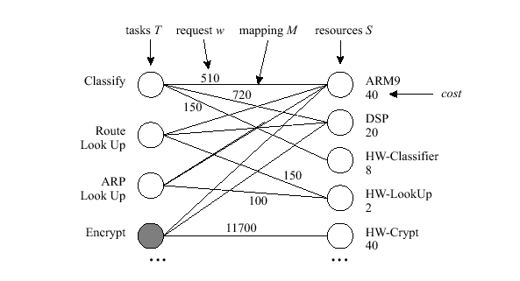
Example of a resource structure

Slide 13
Modeling Discrete Event Streams and Systems
Traditionally event streams are modeled statistically.
Hard bounds are more appropriate modeled by discrete event streams and systems.
Arrival and service curves are bound.

Slide 14
Modeling Discrete Event Streams and Systems
Definition 4 – Arrival Service Function
  Arrival function R(t), denotes the number of events that have arrived in the interval [0,t].
  Service function C(t), denotes the number of events that could have been serviced in the interval [0,t].
  Events may be packets, bytes, instructions, etc.
  C(t) and R(t) are non-decreasing

Slide 15
Modeling Discrete Event Streams and Systems
Definition 5 – Arrival and Service Curves
  Two time instances s and t
  Δ = t-s
  Upper arrival curve α^{u}(Δ) and lower arrival curve α^{l}(Δ)
  α^{l}(Δ) ≤ R(t)-R(s) ≤ α^{u}(Δ)
  Upper service curve β^{l}(Δ) and lower service curve β^{u}(Δ)
  β^{l}(Δ) ≤ C(t)-C(s) ≤ β^{u}(Δ)

Slide 16
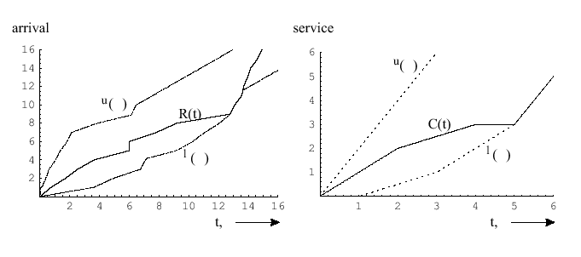
Arrival and Service Curves

Slide 17
Modeling Discrete Event Streams and Systems
Definition 6 – Curves and Flows
  To each flow f there are associated upper and lower arrival curves.
  To each resource s there are associated upper and lower service curves.

Slide 18
Modeling Discrete Event Streams and Systems
Definition 7 – FUNction Processing
  Given a resource node s with its corresponding service function C(t) and an event stream described by the arrival function R(t) being processed by s, we have:
  R’(t) = min{R(u) + C(t) – C(u)}
    Amount of computation delivered to process event stream
  C’(t) = C(t) – R’(t)
    Remaining computation available
  0 ≤ u ≤ t

Slide 19
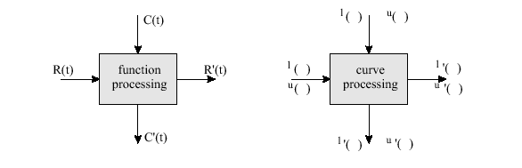
Processing of event streams

Slide 20
Modeling Discrete Event Streams and Systems
Proposition 1 – Curve Processing
  Given an event stream described by the arrival curves α^{l}(Δ) and α^{u}(Δ) and a resource node described by the service curves β^{l}(Δ) and β^{u}(Δ) , then the following expressions bound the remaining service function of the resource node and the arrival function of the processed event stream.

Slide 21
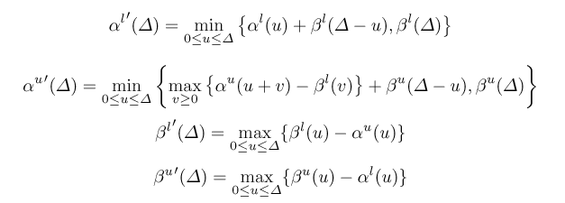
Modeling Discrete Event Streams and Systems

Slide 22
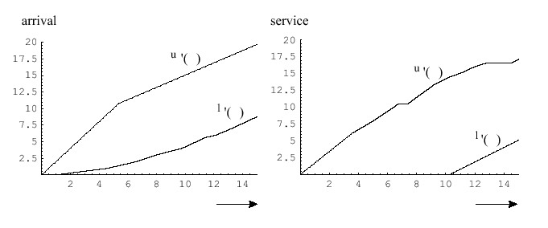
Processing of the Curves

Slide 23
Simple Processing Network Example
Set of flows, f₁,…,f_{n}
Associated event streams R1(t),…,Rn(t) ordered according to decreasing priority.
Each flow, f_{i} must have a task t_{i} executed on one resource s with an associated request w(t_{i},s)
Arrival curves for flow f_{i}
Service curves for resource node s

Slide 24
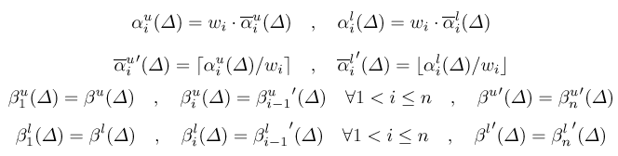
Simple Processing Network Example

Slide 25
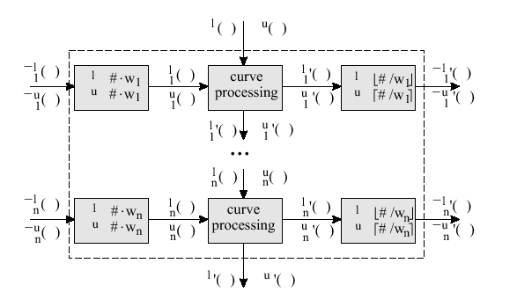
Diagram showing a processing network

Slide 26
Task Scheduling in Network Processors
Problem: Schedule the CPU cycles of the processor to process a mix of real-time and non-real-time packets.
All real time packets meet their deadlines.
Non-real-time packets experience minimum processing delay.
EDF based scheduling method

Slide 27
Task Scheduling in Network Processors
Given flows F
  Two disjoint subsets, F_{RT} and F_{NRT}
All flows f_{i} ∈ F_{RT} have deadlines d(f_{i})
Constrained by upper arrival curve α^{u}_{i}
Processing cost of flow f_{k} on a single resource s is denoted by w(f_{k})

Slide 28
Task Scheduling in Network Processors
Flows in F_{NRT} have no time constraints
Used to model packet streams corresponding to bulk data transfers such as FTP.
Processing cost of each packet flow, f_{k}, on a single resource s is denoted by w(f_{k}) – same as for F_{RT}

Slide 29
Task Scheduling in Network Processors
Objective of this scheduling algorithm:
  To guarantee that all real time packets meet their associated deadline.
  That non-real-time packets experience the minimal possible delay.
  Associate with each non-real-time flow f_{j} a weight φ_{j}, and use that weight to allocate CPU cycles.

Slide 30
Task Scheduling in Network Processors
Hierarchical EDF
Weighted Fair Queuing for non-real-time flows based on Generalized Processor Sharing algorithm.
  Divides CPU bandwidth between NRT flows based on their respective weights.
Non-real-time flows assigned deadlines by WFQ and then scheduled by EDF along with RT Flows.

Slide 31
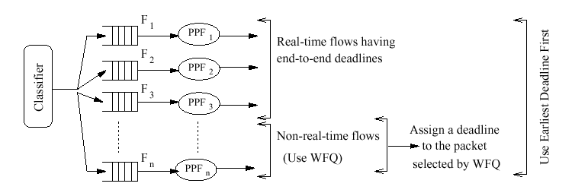
Task Scheduler Based on a Hierarchy of WFQ and EDF

Slide 32

Task Scheduling in Network Processors
Recall that α^{u} is the upper arrival curve, d(f_{i}) is the deadline, Δ is the time interval, and w(f_{i}) is the cost function.
α _{RT}(Δ) = sum of all alpha bars
β^{l} (Δ) has to be greater than α_{RT}

Slide 33
Task Scheduling in Network Processors
Recall NRT arrival curves are not specified so they can be specified by the following function.

Slide 34
Task Scheduling in Network Processors
For each packet selected by the WFQ scheduler for processing, if the packet belongs to flow f_{i} and has a packet processing requirement of w(f_{i}) then it is assigned a deadline:

Slide 35
Task Scheduling in Network Processors
Proposition 2 – Schedulability
  If the set of real-time flows is preemptively schedulable then the algorithm also schedules the real time flows such that all deadlines are met.

Slide 36
Task Scheduling in Network Processors
This scheduling algorithm is preemptive.
Arbitrary preemptions might be costly for any practical implementation.
Given that the execution time of a node is small compared to the total execution time of the whole task graph, the previous analysis gives a good approximation of an algorithm where preemption is allowed only at the end of each node.

Slide 37
Experimental Evaluation
Evaluated using the Moses tool-suite (modeling and simulation of discrete event systems)
Experimental setup consists of six flows
  3 Real-time
  3 Non-real-time
Each flow specified by a TSpec with parameters in terms of packets rather than bytes
A Tspec is described by a conjunction of two token buckets and an incoming packet complies with the specified profile only if there are enough tokens in both buckets.

Slide 38
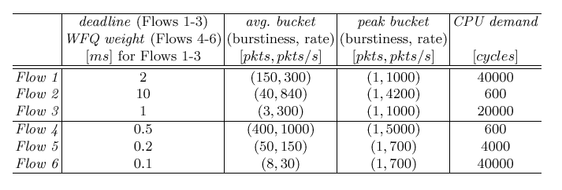
Specifications of the real-time and non-real time flows
Flow 1-3 Real Time
Flow 4-5 Non-real-time
1- Encryption
2- Video Traffic
3- Voice Encoding
4- FTP
5- HTTP
6-Email Traffic

Slide 39
Experimental Evaluation
Compared our algorithm with a plain EDF for real time and WFQ for non-real-time (i.e. not hierarchical).
Horizontal axis shows the simulation time
Vertical axis represents the delay experienced by the packet getting processed.

Slide 40
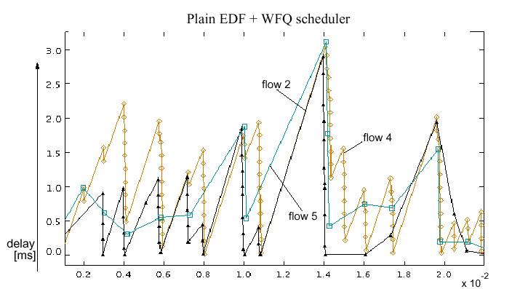
Experimental Evaluation

Slide 41
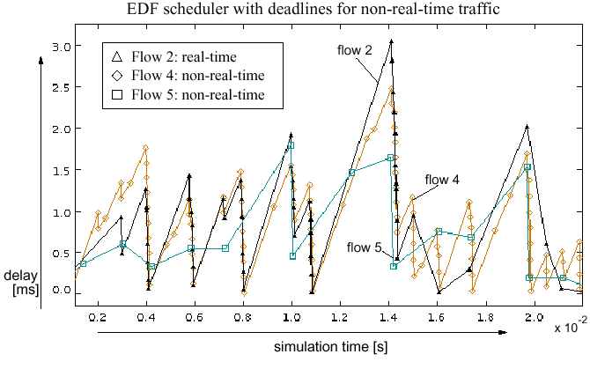
Experimental Evaluation

Slide 42
Experimental Evaluation
Bottom line:
  Non-real-time flows happen faster at the expense of real time flows, but not in such a way that deadlines are violated.
  Flows 4 & 5 (NRT) have shorter response time in the hierarchical algorithm at the expense of higher delay times for flow 2.

Slide 43
Design Space Exploration
It is expected that the next generation of network processors will consist of general purpose processing units and dedicated modules for executing run-time extensive functions.
Therefore we need to select appropriate functional units such that the performance is maximized under various constraints (cost, delay, power, etc)
How do we explore the design space of NP?

Slide 44
Design Space Exploration
Concentrate on the following questions:
  How can we estimate the performance of a network processor?
  How can we estimate delay and memory consumption of a hardware/software architecture?
Adopt a model based approach in combination with concepts of multi-objective optimization.

Slide 45
Design Space Exploration
Think of design space exploration as:
  Allocate resource nodes s ∈ S and bind the tasks t ∈ T of the flows f ∈ F to the allocated resource nodes such that upper and lower arrival curves for NRT flows are maximized, cost, memory, and power consumption are minimized and the deadlines d(f) associated to the flows are satisfied.
Note the RT flows often have a fixed arrival rate.

Slide 46
Design Space Exploration
NP consist of heterogeneous elements (RISC cores, DSPs, dedicated units, etc).
The purpose of the allocation is to select the right subset of these modules.

Slide 47

Design Space Exploration
This allows you to formalize the design space exploration problem
so that branch and bound search algorithms can be used to form the
points on Pareto curves.

Slide 48
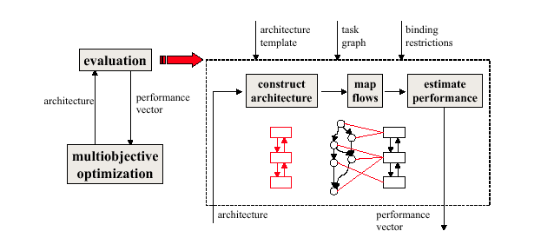
Design Space Exploration

Slide 49
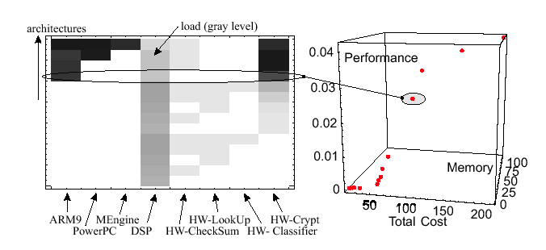
Design Space Exploration

Slide 50
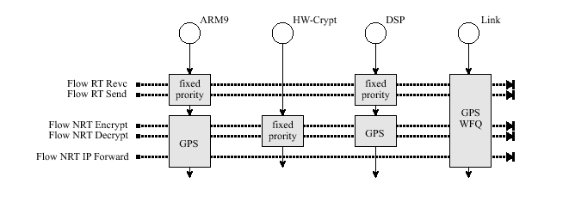
Simple Processing Network

Slide 51

Conclusion
Introduced a packet flow model.
Scheduling of real time and non-real time flows.
Design Space exploration methodology.
Many open issues in network processing!
Questions??

