Slide 1
An Introduction to TTCAN
(Time Triggered Controller Area Network)
Rahul Shah & Xuanming Dong
EE290O Class Discussion
March 7, 2002

Slide 2
Brief History
Developed by Bosch
Standardized in ISO 11898
First deployed in 1986
Used in:
  Automotive applications
  Industrial automation
  Embedded systems

Slide 3
CAN standards
CAN version 1.0
Standard CAN (version 2.0A)
Extended CAN (version 2.0B)
Time-Triggered CAN

Slide 4
CAN vs. LAN
Content addressing vs. node addressing
Strict priority based system
In case of collision, packet with higher priority gets through
Better fault tolerance
Engineered for known traffic patterns

Slide 5
Controller Area Network (CAN)

Slide 6
Layered Structure of a CAN Node
Application Layer
Object Layer Message Filtering Message and Status Handling
Transfer Layer Fault Confinement Error Detection and Signaling Message Validation Acknowledgement Arbitration Message Framing Transfer Rate and Timing
Physical Layer Signal Level and Bit Representation Transmission Medium

Slide 7
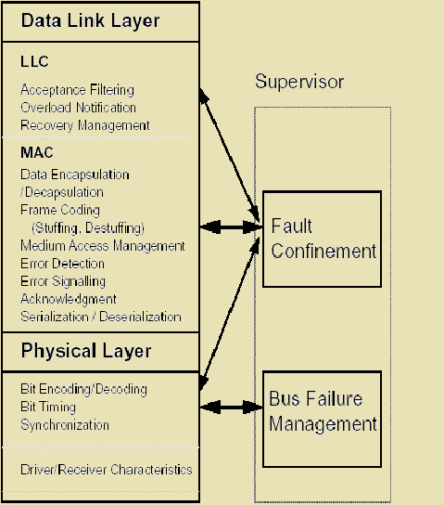
CAN Protocol Stack

Slide 8
CAN Bit Rates
Bus length (m) | Max. bit rate (b/s)
40 | 1M
100 | 500k
200 | 250k
500 | 125k
6 km | 10k

Slide 9
CAN Bus
Broadcast bus connected in wired-AND
Non-return to zero with bit stuffing
Dominant bit – 0
Recessive bit – 1
Bit wise arbitration
Tagged priority for every message

Slide 10
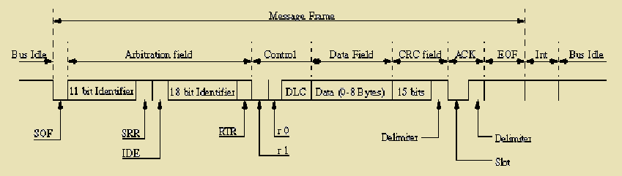
Message Types
Data Frame
“Hello everyone, here's some data labeled X, hope you like it!”

Slide 11
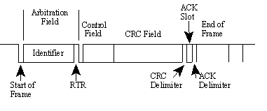
Message Types
Remote Frame
“Hello everyone, can somebody please produce the data labeled X?”

Slide 12
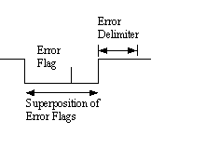
Message Types
Error Frame
Overload Frame
(everyone, aloud) “OH DEAR, LET'S TRY AGAIN”
“I'm a very busy little guy, could you please wait for a moment?”

Slide 13
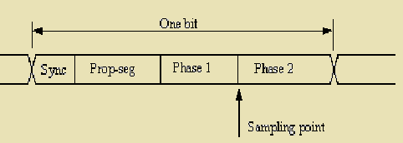
Bit Timing
Compensates for edge phase errors
– used during resynchronization
Compensates for physical delay on the bus
An edge is expected in this segment

Slide 14
Error Detection Mechanisms
Bit monitoring
Bit stuffing
Frame check
Acknowledgement check
Cyclic redundancy check (CRC)

Slide 15
Fault Confinement
Unit may be in three states:
  Error active
  Error passive
  Bus off
Two registers are maintained in every unit:
  Transmit error count
  Receive error count

Slide 16
CAN Advantages
Mature standard
Hardware implementation of the protocol
Simple transmission medium
Excellent error handling
Fine fault confinement

Slide 17
Time Triggered Controller Area Network (TTCAN)

Slide 18
Motivation of TTCAN
Under the bitwise arbitration of CAN, the access may be delayed, if some other message is already in the process of transmission or if another message with higher priority also competes for the bus.
Even the message with the highest priority may experience a small latency.
The lower the priority of a message is, the higher the latency jitter for the media access

Slide 19
The Goals of TTCAN
Reduce latency jitters
Guarantee a deterministic communication pattern on the bus
Use the physical bandwidth of a CAN network much more efficiently

Slide 20
TTCAN: Two Level Extension
Extension level 1
  Guarantees the time triggered operation of CAN based on the reference message of a time master
  Fault tolerance of that functionality is established by redundant time masters (potential time masters)
Extension level 2
  A globally synchronized time base is established
  A continuous drift correction among the CAN controllers is realized

Slide 21
Overview of TTCAN Mechanisms
Time bases, provided either by an internal or by an external clock
  Local_Time, Cycle_Time, and Global_Time
Three different types of time windows
  Exclusive time window, arbitrating time window, and free time window
Time-triggered and periodic communications clocked by a time master’s reference message
The system matrix specifies the sequence of messages transmitted in each basic cycle
At least one event-trigger should be freely programmable by the control unit

Slide 22
Local Time
Local_Time, a 16 bit integer value that is incremented each Network Time Unit (NTU)
The length of the NTU is the same for all nodes
It is generated locally, based on the local system clock period t_{sys} and the local Time Unit Ratio (TUR), NTU=TUR*t_{sys}
Different system clocks in the nodes require different (non-integer) TUR values
  TUR is a non-integer value and may be adapted to compensate for clock drift or to synchronize to an external time base.

Slide 23
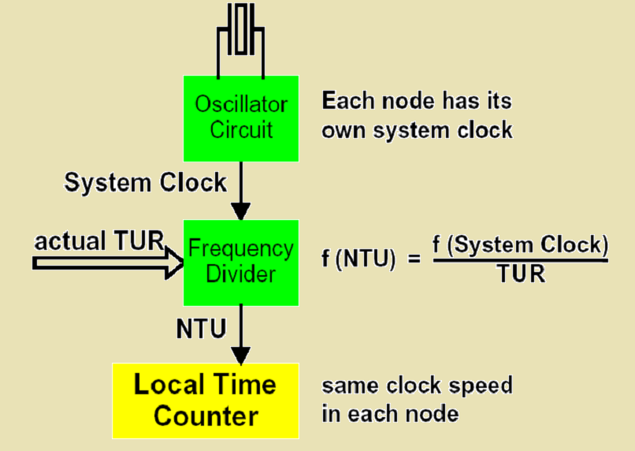
Local Time

Slide 24
Cycle Time
Each valid Reference Message starts a new basic cycle and causes a reset of each node’s Cycle_Time.
The value of Local_Time is captured as Sync_Mark at the start of frame (SOF) bit of each message. When a valid Reference Message is received, this message’s Sync_Mark becomes the new Ref_Mark
Cycle_Time is the actual difference between Local_Time and Ref_Mark, restarting at the beginning of each basic cycle when Ref_Mark is reloaded
Even in a software implementation of TTCAN, the capturing of Local_Time into Sync_Mark at each SOF must be done in hardware

Slide 25
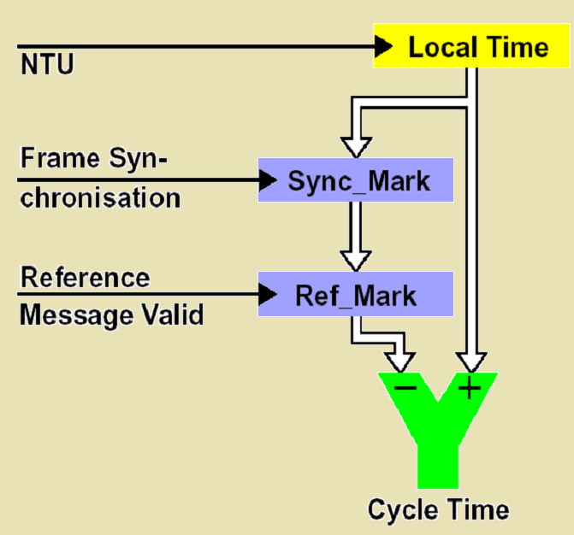
Cycle Time

Slide 26
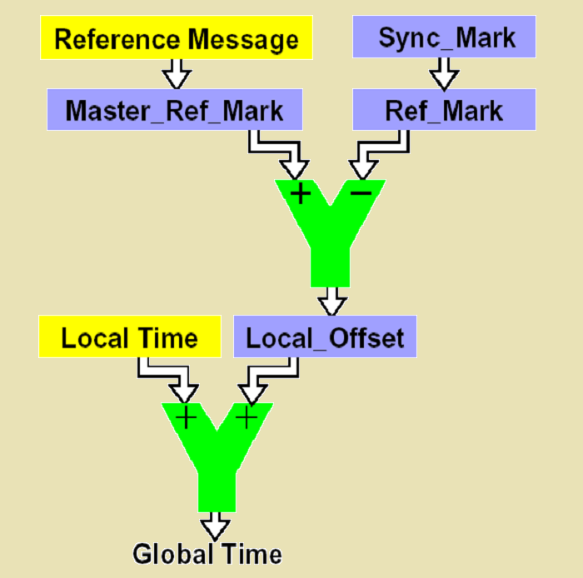
Global Time

Slide 27
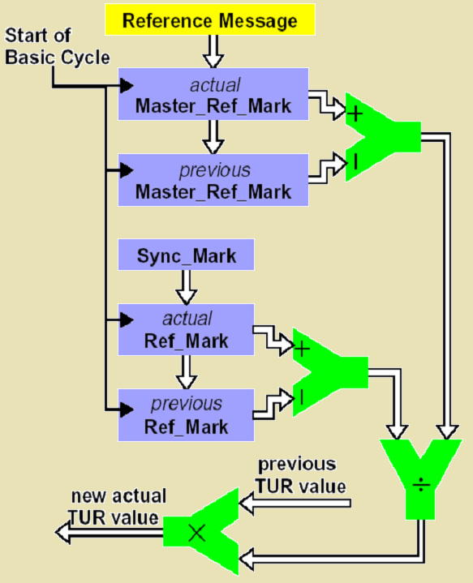
Drift Compensation

Slide 28
Time Windows
Exclusive window
  Exclusively reserved for one message, without competition for the CAN network access
  The automatic retransmission of messages that could not be transmitted successfully is disabled, guaranteeing that messages in exclusive time windows are not delayed
Arbitrating window
  During which messages can compete for the bus by the bitwise arbitrating mechanism of CAN
Free window
  Reserved for further extensions of the network

Slide 29
The Reference Message
The reference message can be easily recognized by its identifier
In extension level 1
  The reference message only holds some control information of one byte, the rest of a CAN message can be used for data transfer
In extension level 2
  The reference message holds additional control information, e.g. the global time information of the current TTCAN time master
  The reference message of level 2 covers 4 bytes while downwards compatibility is guaranteed. The remaining 4 bytes are open for data communication as well

Slide 30
The System Matrix
In TTCAN not all basic cycles necessarily have to be the same
Different basic cycles are distinguished by the cycle count
  A cycle count is incremented each cycle up to the maximum value after which it is restarted again
System matrix is obtained by combining all those different cycles
  It represents the communication overview of a TTCAN network
System matrix allows another useful exception
  Ignore the columns in the case of two or more arbitrating time windows in series

Slide 31
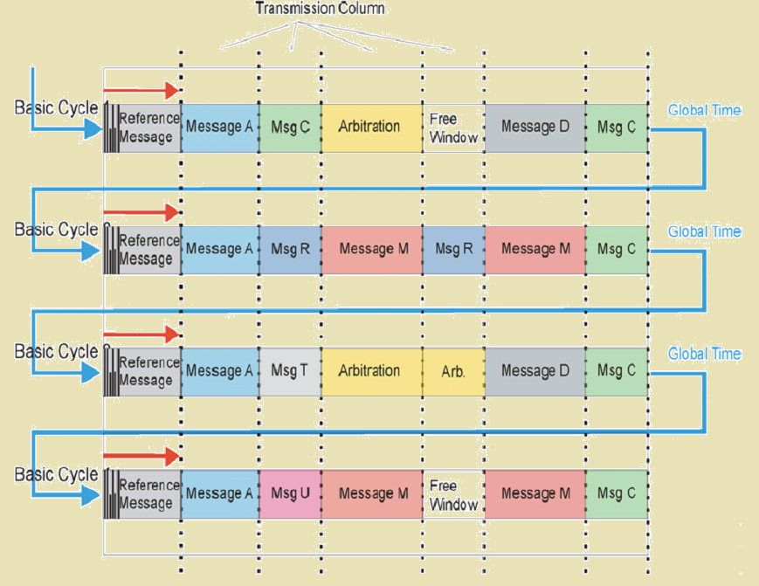
Example of a TTCAN System Matrix

Slide 32
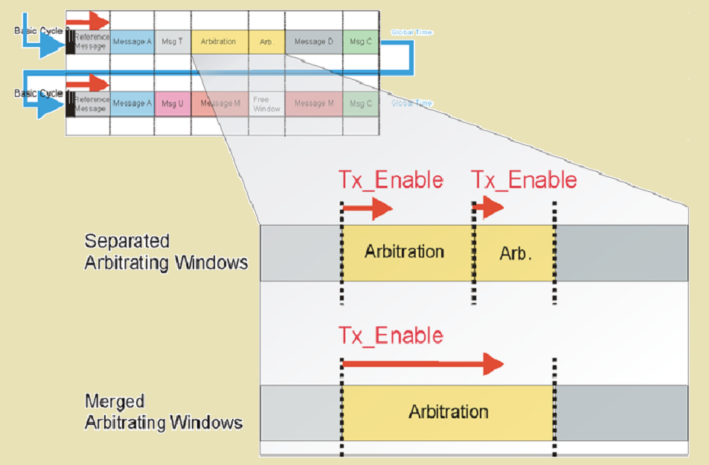
Merged Arbitrating Windows

Slide 33
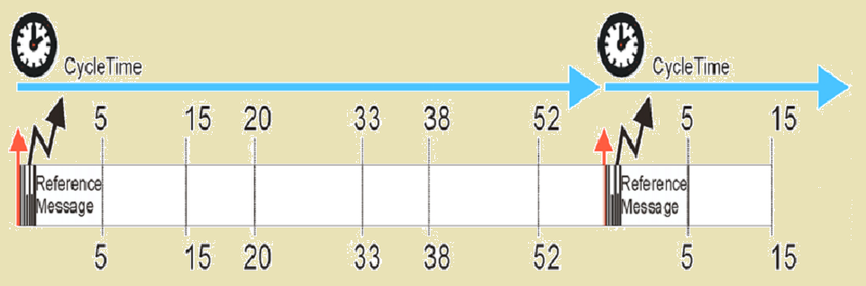
Cycle Time and Time Marks
A time mark furthermore consists of the base mark and the repeat count information.
  The base mark determines the number of the first basic cycle after the beginning of the matrix cycle in which the message must be sent/received.
  The repeat count determines the number of basic cycles between two successive transmissions/receptions of the message.

Slide 34
TTCAN Implementation
The TTCAN is expanded by two functional blocks: the Trigger Memory and the Frame Synchronization Entity (FSE)
The Trigger Memory stores the time marks of the system matrix that are linked to the messages in the Message RAM; the data is provided to the Frame Synchronization Entity
The Frame Synchronization Entity is the state machine that controls the time triggered communication. It synchronizes itself to the reference messages on the CAN bus, controls the cycle time, and generates Time Triggers. It is divided into six blocks:
  TBB: Time Base Builder
  CTC: Cycle Time Controller
  TSO: Time Schedule Organizer
  MSA: Master State Administrator
  AOM: Application Operation Monitor
  GTU: Global Time Unit

Slide 35
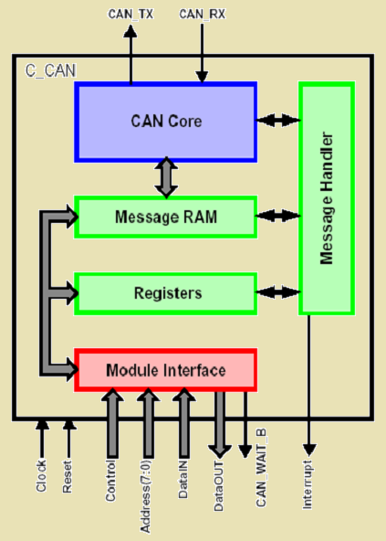
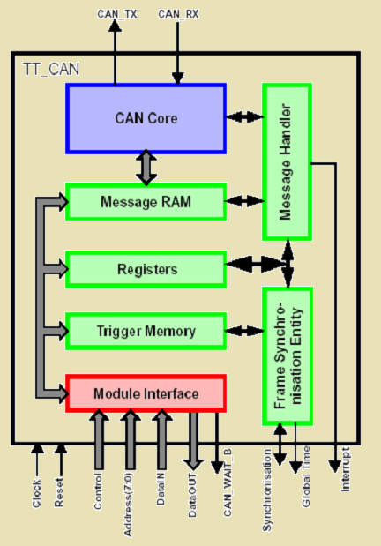
TTCAN Implementation
C_CAN
TT_CAN

