Slide 1
LegOS
Shannon Zelinski
Chris Cortopassi

Slide 2
Introduction
LegOS + RCX = Real Embedded System
Not far from real Motion Controllers
  Scheduling
  Network
  Application Developer API
  Motion
  I/O
  User Interface
Markus Noga’s LegOS replaces LEGO byte-code interpreter

Slide 3
Outline (bottom up)
Hardware
Assembly Language
Motor and Sensor Handling
Task Management: Threading
Network
“Introduction to the LegOS Kernel” by Stig Nielsson

Slide 4
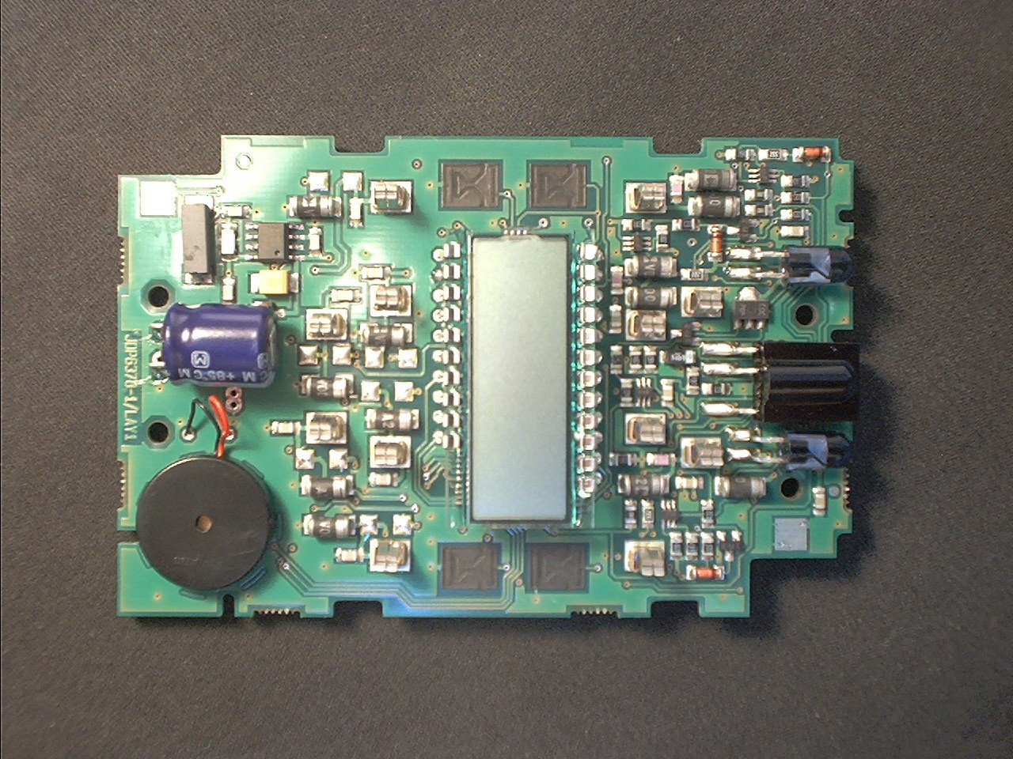
RCX (top)

Slide 5
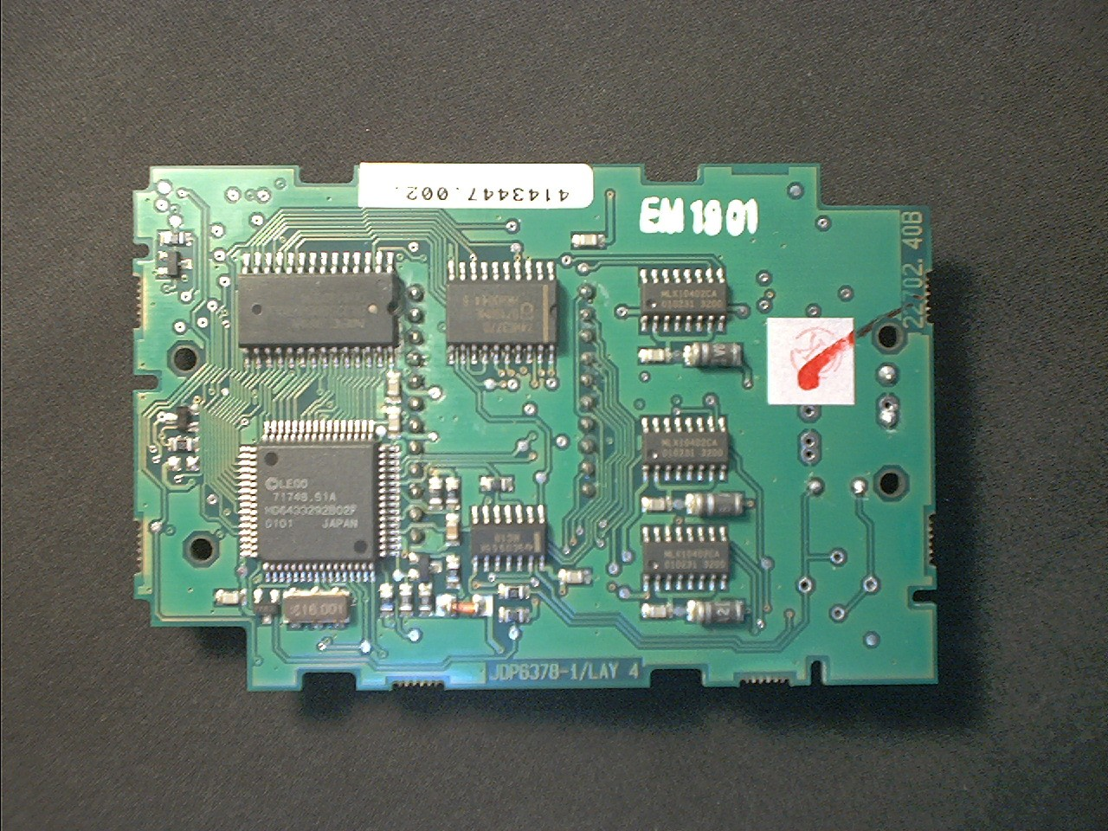
RCX (bottom)

Slide 6
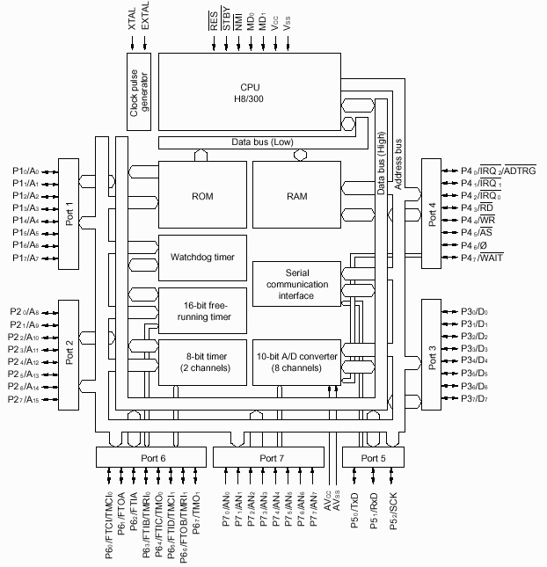
Hitachi H8/3292 Microcontroller
16 MHz
8 bit
16 bit
16k
512 bytes
Bus Control
Address
Data
All ports can be
configured as
general I/O
Timers
A/D
UART

Slide 7
RCX Connectivity
Microcontroller
Timer Interrupt
32k RAM
Address,
Data,
Bus Control
16-bit timer
Motors
8-bit timer 0
Sound
LCD
8-bit timer 1
IR
Network
Sensor 3
Sensor 2
Sensor 1
Battery
A/D
UART
Light,
Touch,
Rotation
“unused” I/O
Buttons
Sensor power

Slide 8
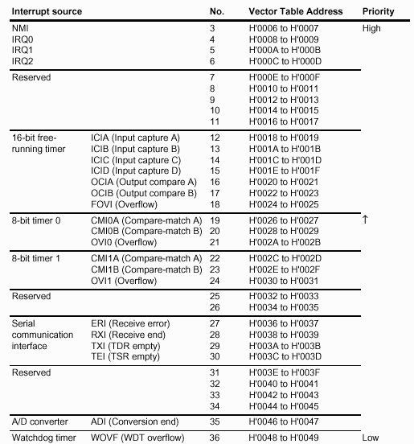
Hardware Interrupts
Timer
Interrupt
Network
Sensors
LegOS uses

Slide 9
Two Interrupt Vector Tables
0x0000 ROM Vector Table
0xFD90 RAM Vector Table
(changeable)
interrupt
ocia_vector
0x046C ROM Stub Handlers
RAM Handlers
jsr to
systime_handler
Not efficient, but without this indirection LegOS wouldn’t exist

Slide 10
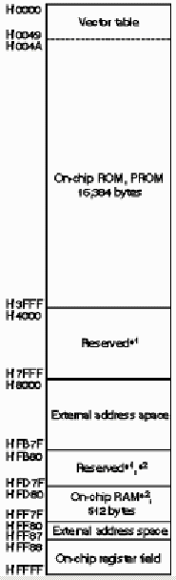
Memory
Provided by LEGO:
Sound Handlers
LCD Handlers
Mostly unused by LegOS
LegOS
User Programs
Thread Stacks
Heap
RAM
Motors
LCD
Memory
mapped I/O
RAM interrupt vector table

Slide 11
“Magic Numbers” Linker File: h8300.rcx
Memory Map
  ram: o = 0x8000, l = 0x6f30
Used ROM Functions
  lcd_show = 0x1b62
RAM Interrupt Vectors
  ocia_vector = 0x22
On-chip Module Registers
  T_OCRA = 0x94

Slide 12
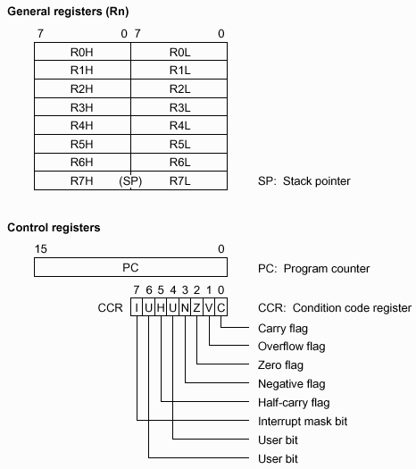
CPU Registers
Arguments (GCC)
Stack frame base pointer (GCC)
Branch Instructions

Slide 13
GCC Stack Frame
low address
SP
Local variables
0-3 arguments
callee
R6
Caller’s base pointer
PC
Callee arguments > 4
Stack grows
local variables
caller
0-3 arguments
Prev caller’s base pointer
PC
…
high address

Slide 14
H8/3292 Assembly Example
_Increment: ;Increment a global variable and call DoNothing
push r0 ;Save 16-bit register on stack
mov.w @_GlobalWord, r0 ;Copy global variable to register
add.b #0x1, r0L ;8-bit add 1 to r0L. Result is in r0L
mov.w r0, @_GlobalWord ;Copy register to global variable
jsr _DoNothing ;Jump to subroutine. Push PC, PC = DoNothing
pop r0 ;Restore register from stack before returning
rts ;Return from subroutine. Pop PC
_DoNothing: ;Does nothing
rts ;Return from subroutine. Pop PC

Slide 15
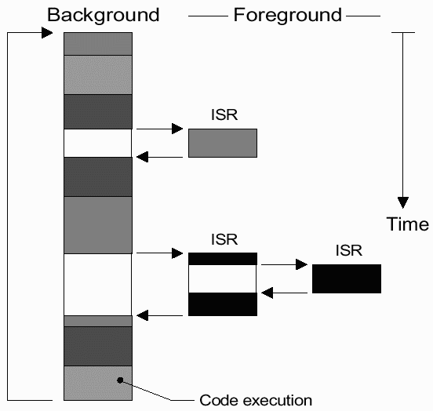
LegOS = Background + Foreground
Threads
user
kernel
Interrupts
A/D
timer
UART

Slide 16
Sensors (A/D Interrupt)
Touch
Light
Rotation
Conversion done
if(rotation)
  run state machine( )
channel++
Start conversion
LIGHT_X and TOUCH_X just “scale” A/D output registers
  => Can use Touch & Light on same input port!
Rotation = special case: ds_rotation_on(sensor)
ROTATION_X reads position from state machine…

Slide 17
Rotation Sensor State Machine
Converts repeating analog waveform to absolute position
0
voltage
0
1
+1
-1
0
invalid
time
3
2
Works if we can sample fast enough to not miss a state

Slide 18
Timer Interrupt
1 ms
Increment time
Check LNP inter-byte timeout
Motors
Sound
LCD Refresh
Buttons
Battery indicator
Thread switching
output
Input
(Poll environment)

Slide 19
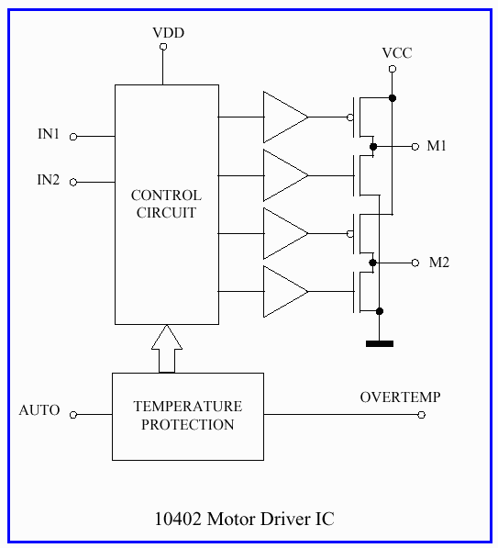
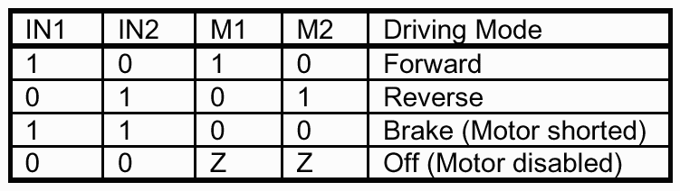

Three Monolithic H-Bridges
Memory mapped byte at 0xF000

Slide 20
Motor Handler (Open-loop)
struct MotorState{
char delta; //speed setting (actually torque)
char sum; //increment by delta every 1 ms
char dir; //2-bit output pattern when sum overflows
};
API:
motor_a_speed()
motor_a_dir()
256
1 ms
delta
Example:
delta = ¾ * 256
= 192
overflow
overflow
overflow
= sum

Slide 21
Bresenham’s Line Drawing Algorithm
Delta (speed)
1
128
192
256
256 ms
pulse
frequency
modulation
1 ms
“inverse” pulse
frequency
modulation

Slide 22
Motor Handler Implementation
(from 1 ms timer interrupt)
; motor A
...
; motor B
mov.w @_MotorBState, r0 ; simultaneously load delta and sum
add.b r0h, r0l ; add delta (r0h) to sum (r0l)
bcc NoOvrFl ; branch if carry clear (no sum overflow)
mov.b @_MotorBState+2, r6h ; overflow -> output drive pattern (dir)
xor.b r6h, r6l ; overlay b's output on top of a's
NoOvrFl: mov.b r0l, @_MotorBState+1 ; save sum (clears overflow flag)
; motor C
...
mov.b r6l, @0xf000:16 ; output motor waveform
struct MotorState
{
char delta; //0
char sum; //1
char dir; //2
};

Slide 23

Task Management
Paper Lingo: Task = Process = Thread
Semaphores
Structures
Scheduling Tasks
Creating New Tasks
Ending Tasks
The Life Of A Thread
Yes, sir.
Right away, sir.
I’ll give that task top
priority, sir.

Slide 24
Semaphores-API
semaphores are POSIX.
  When count!=0, share info accessible
  legOS semaphores init with count=1
Sem_wait
  suspends calling thread until count!=0, then automatically decreases count
Sem_trywait
  non blocking version of sem_wait for interrupt routines. Returns error if count==0
Sem_post
  increases count

Slide 25
Kernel Semaphores
tx_sem
  transfer access for IR tower etc.
mm_semaphore
  memory management for malloc
task_sem
  task structure chain for task management

Slide 26
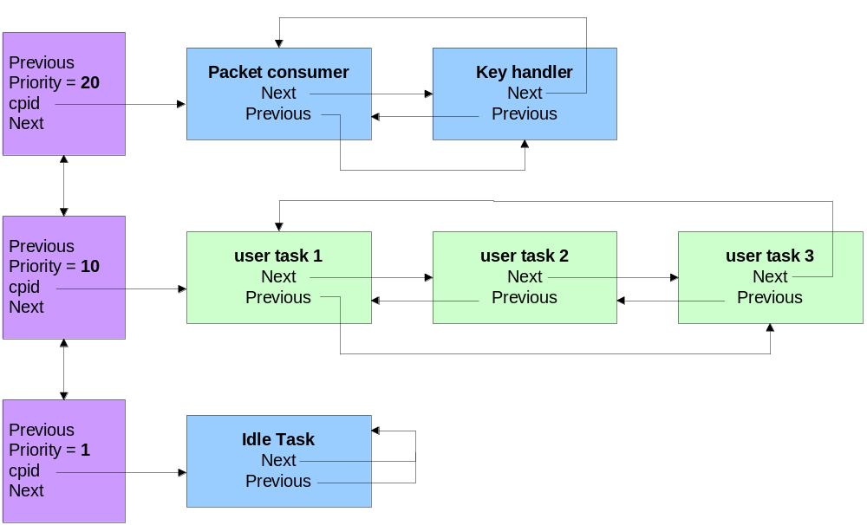
Task Structure Chain
Ordered chain of priority chain structures and task structures

Slide 27
Priority Chain Structure
struct _pchain_t
{ char priority; // numeric priority level
struct _pchain_t *next; // lower priority chain
struct _pchain_t *prev; // higher priority chain
struct _pdata_t *cpid; // current process in chain
};

Slide 28
Process Data Structure
struct _pdata_t
{
unsigned *sp_save; // saved stack pointer
char pstate; // process state
char *priority; // pointer to priority chain
struct _pdata_t *next; // next process in queue
struct _pdata_t *prev; // previous process in queue
struct _pdata_t *parent; // parent process (e.g. main)
unsigned *stack_base; // lower stack boundary
long(*wakeup)(long); // event wakeup function
long wakeup_data; // user data for wakeup fn
};

Slide 29
Process States
Dead - The process has terminated and its stack has been freed. Note: No task exists with pstate = dead.
Zombie - The process has terminated, but its stack has not yet been freed.
Waiting - The process is idle and waiting for an event.
Sleeping - The process is idle but
        ready to run.
Running - The process is running.

Slide 30
Wakeups: wait_event how wakeup fn and data are added to task structure
long wait_event
(long (*wakeup)(long),long data)
{
cpid->wakeup = wakeup;
cpid->wakeup_data = data;
cpid->pstate = P_WAITING;
yield(); //asm fn that calls tm_switcher
return cpid->wakeup_data;
}

Slide 31
wait_event example: msleep
int msleep(int msec)
{ //wait_event(*wakeup,data)
(void) wait_event(&tm_sleep_wakeup, sys_time + msec);
return 0;
}
//wakeup(data)
Static long tm_sleep_wakeup(long data)
{
return ((long)data)<=sys_time;
}

Slide 32
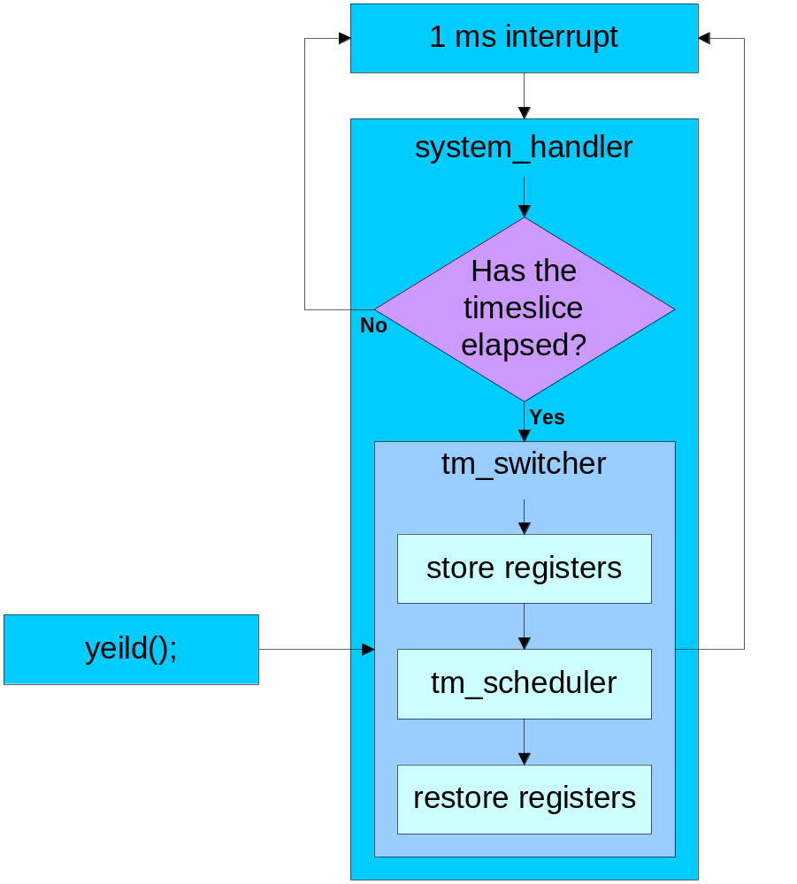
Scheduling Tasks
Last duty of system_handler is to check the timeslice.
Default timeslice = 20 ms.
tm_switcher and therefore tm_scheduler is called every 20 ms.
yeild(); will also call tm_switcher before the timeslice is up.

Slide 33
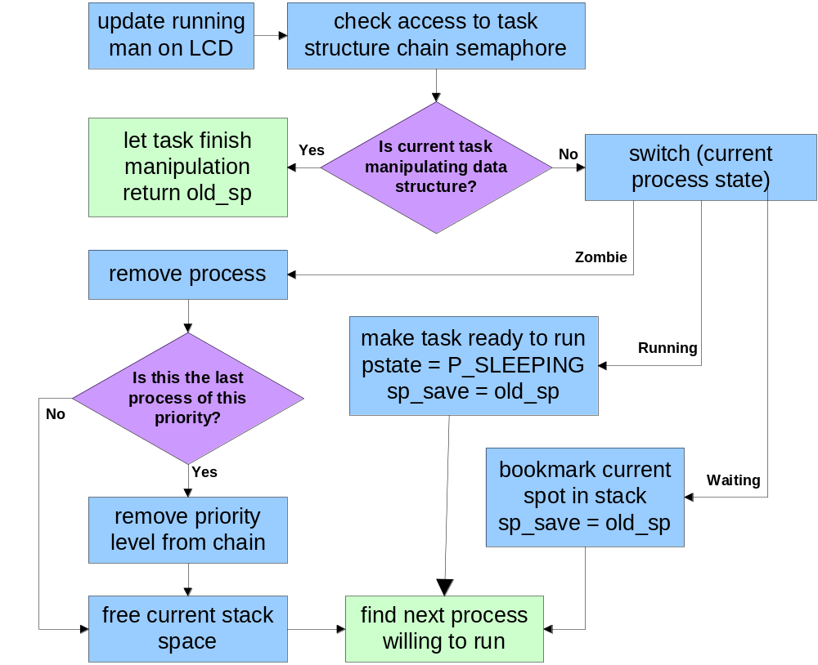
tm_scheduler: assessing current state

Slide 34
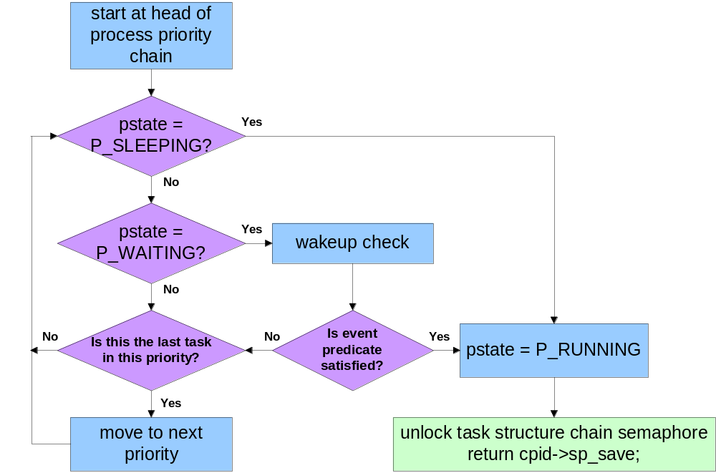
tm_scheduler: find next process

Slide 35
Prioritized Round-Robin

Slide 36
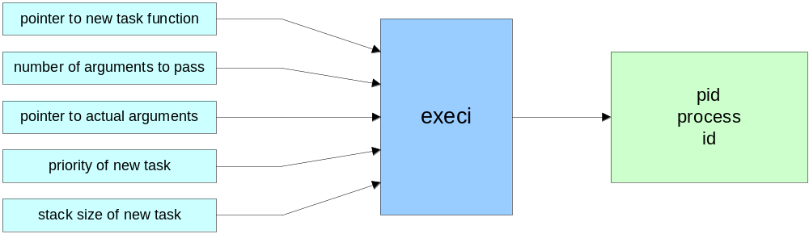
Creating New Tasks
unsigned execi
(int (*code_start)(int,char**), // pointer to new task function
int argc, // number of arguments to pass
char **argv, // pointer to actual arguments
char priority, // priority of new task
unsigned stack_size) // stack size of new task

Slide 37
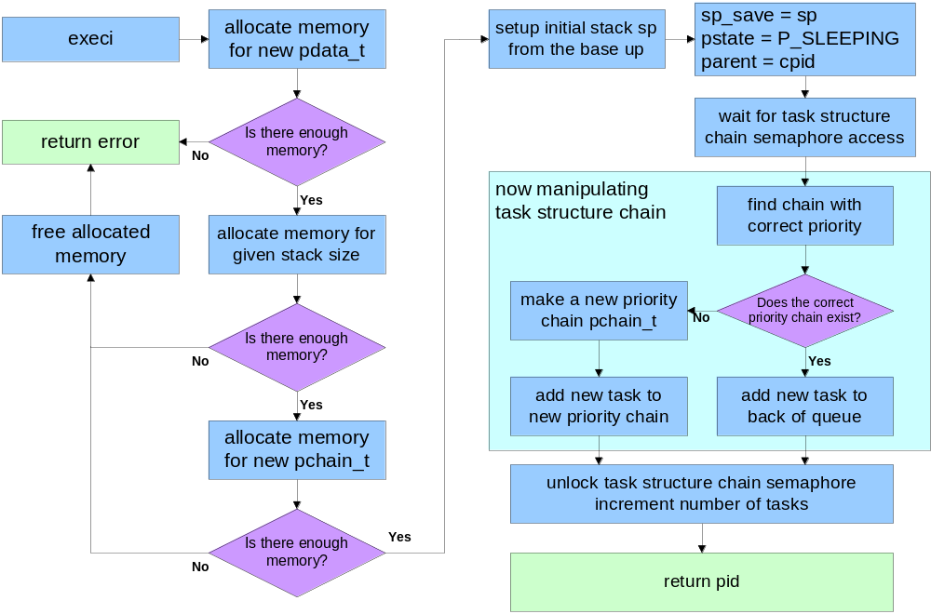
The execi function

Slide 38
New Task Stack Frame
pd->stack_base=sp; //setup initial stack
sp+=(stack_size>>1); //from the bottom up to base
*(--sp)=&exit; //finish by calling exit
*(--sp)=code_start; //entry point for task code
*(--sp)=0; //ccr for ROM timer interrupt
*(--sp)=0; //r6 for ROM timer interrupt
*(--sp)=&rom_ocia_return; //ROM return of system_handler
*(--sp)=argc; //r0 used by system_handler
*(--sp)=&systime_tm_return; //system return of tm_switcher
*(--sp)=argv; //r1
*(--sp)=0; //init r2 to 0 tm_switcher
*(--sp)=0; //init r3 to 0 registers
*(--sp)=0; //init r4 to 0
*(--sp)=0; //init r5 to 0

Slide 39
Exploring the Stack Frame
Last Part of System Handler
mov.b @_tm_current_slice,r6l
dec r6l
bne sys_noswitch
mov.w @_tm_switcher_vector,r6
jsr @r6 ;call tm_switcher
.
.
.
.
ret

Slide 40
Exploring the Stack Frame
tm_switcher (r7 = sp)
_tm_switcher:
mov.w r1,@-r7 ; save registers
mov.w r2,@-r7 ; from the current
mov.w r3,@-r7 ; task stack frame
mov.w r4,@-r7
mov.w r5,@-r7
mov.w r7,r0 ; arg for tm_scheduler
jsr _tm_scheduler ; call tm_scheduler
; ret from tm_scheduler
_tm_switcher_return:
mov.w r0,r7 ; set new sp
mov.w @r7+,r5 ; restore registers
mov.w @r7+,r4
mov.w @r7+,r3
mov.w @r7+,r2
mov.w @r7+,r1
rts ; return to new task
New Task Stack Frame
pd->stack_base=sp;
sp+=(stack_size>>1);
*(--sp)=&exit;
*(--sp)=code_start;
*(--sp)=0;
*(--sp)=0;
*(--sp)=&rom_ocia_return;
*(--sp)=argc; //R0
*(--sp)=&systime_tm_return;
*(--sp)=argv; //R1
*(--sp)=0; //R2
*(--sp)=0; //R3
*(--sp)=0; //R4
*(--sp)=0; //R5
Start of new sp is the stack base sp_save returned from tm_scheduler

Slide 41
Exploring the Stack Frame
Last Part of System Handler
mov.b @_tm_current_slice,r6l
dec r6l
bne sys_noswitch
mov.w @_tm_switcher_vector,r6
jsr @r6
;return from tm_switcher
_systime_tm_return:
mov.b @_tm_timeslice,r6l
sys_noswitch:
mov.b r6l,@_tm_current_slice
pop r0
; reset compare A IRQ flag
bclr #3,@0x91:8
rts ;ret to rom_ocia_return
New Task Stack Frame
pd->stack_base=sp;
sp+=(stack_size>>1);
*(--sp)=&exit;
*(--sp)=code_start;
*(--sp)=0;
*(--sp)=0;
*(--sp)=&rom_ocia_return;
*(--sp)=argc; //R0
*(--sp)=&systime_tm_return;
*(--sp)=argv;
*(--sp)=0;
*(--sp)=0;
*(--sp)=0;
*(--sp)=0;

Slide 42
Exit function
void exit(void)
{
enable_irqs(); //enable interrupts just in
//case the task disabled them
mm_reaper(); //free all blocks allocated
//by the current process
cpid->pstate = P_ZOMBIE;//ready to be deallocated
while(1)
yield(); //call tm_switcher before //timeslice is up
}

Slide 43
Kill Function
void kill(unsigned pid) //process ID
{
pdata_t *pd=(pdata_t*) pid; //setup a pointer to task to kill
if(pd==cpid) //if task to kill is currently running
exit(-1); //exit immediately
else //set up sp_save such that the next time
{ //the task runs it will exit immediately.
sem_wait(&task_sem); //wait for semaphore access
*( (pd->sp_save) + SP_RETURN_OFFSET )=&exit;
pd->pstate=P_SLEEPING; //make ready to run in case waiting
sem_post(&task_sem); //unlock semaphore access
}
}
killall(priority) will kill all tasks in the specified priority

Slide 44
The Life of a LegOS Process
Zombie
Waiting
wait_event ( )
wake-up (scheduler)
exit( )
free stack (scheduler)
kill( ), killall( )
Running
scheduler
scheduler
Dead
Sleeping
execi( )

Slide 45
LNP (LegOS Network Protocol)
UDP-like
  No arrival guarantees (no replies/retries)
  Packets that do arrive will be error-free
Two packet types
  “Integrity” = broadcast
  “Addressing” = unicast
Up to 16 nodes and 16 ports
Port 0 reserved for program loading

Slide 46
Packet formats
Integrity (broacast)
0xF0
Length
Data
CheckSum
1
1
0-255
1
Addressing (unicast)
0xF1
Length
Dest Port
Src Port
Data
CheckSum
1
1
1
1
0-253
1

Slide 47
LNP API
Receive
  lnp_addressing_set_handler(MY_PORT, MyRxHandler)
  MyRxHandler(char* Data, char Length, char Source)
    One per port (+1 for broadcast)
    Will be called from an interrupt, so pass Data to thread
Transmit
  Collision = lnp_addressing_write(char *Data,
  char Length, char DestAddrAndPort);
    Blocks until entire packet is sent
RCX Address: CONF_LNP_HOSTADDR = 0
  Must recompile LegOS to change :(
  PC Address = 8

Slide 48
Four LNP ISRs
Received a byte
  Reset inter-byte timeout
  if(receiving)
    Store incoming byte
    if(end of packet) call handler
  else //transmitting
    Check for collisions
Receive error (e.g. parity)
  if(receiving)
    Discard entire packet
  else //transmitting
    collision
Transmit buffer available
  Insert next byte (if there is one)
Done transmitting

Slide 49
The End
Hardware
Assembly Language
Motor and Sensor Handling
Task Management: Threading
Network

