Slide 1
TinyOS:
Embedded Software for Wireless Sensor Networks
Sinem Coleri
Anshuman Sharma

Slide 2
Outline
Motivation for Sensor Networks
Motivation for TinyOS
Development Environment for TinyOS
Scheduling in TinyOS
Event-driven Sensing
Communication
Conclusion

Slide 3
Outline
Motivation for Sensor Networks
Motivation for TinyOS
Development Environment for TinyOS
Scheduling in TinyOS
Event-driven Sensing
Communication
Conclusion

Slide 4
Motivation for Sensor Networks
Primary function
  Sample environment for sensory information
  Propagate or process data
Applications
  Traffic density measurements in highways
  Determination of duration of traffic lights
  Car detection in parking garages
  Environment monitoring
    Light, temperature
Notes:
Traffic density : put sensor nodes along the highway then measure the traffic and send this data to a backbone network and cars decide not to go to high traffic roads
Traffic light: put sensor nodes at all sides, count the # of cars, then give more time to high traffic side
Parking garage: each node is placed at one location, determine whether there is a car in its location and send this information wirelessly to BS, then BS guides cars to free spaces

Slide 5
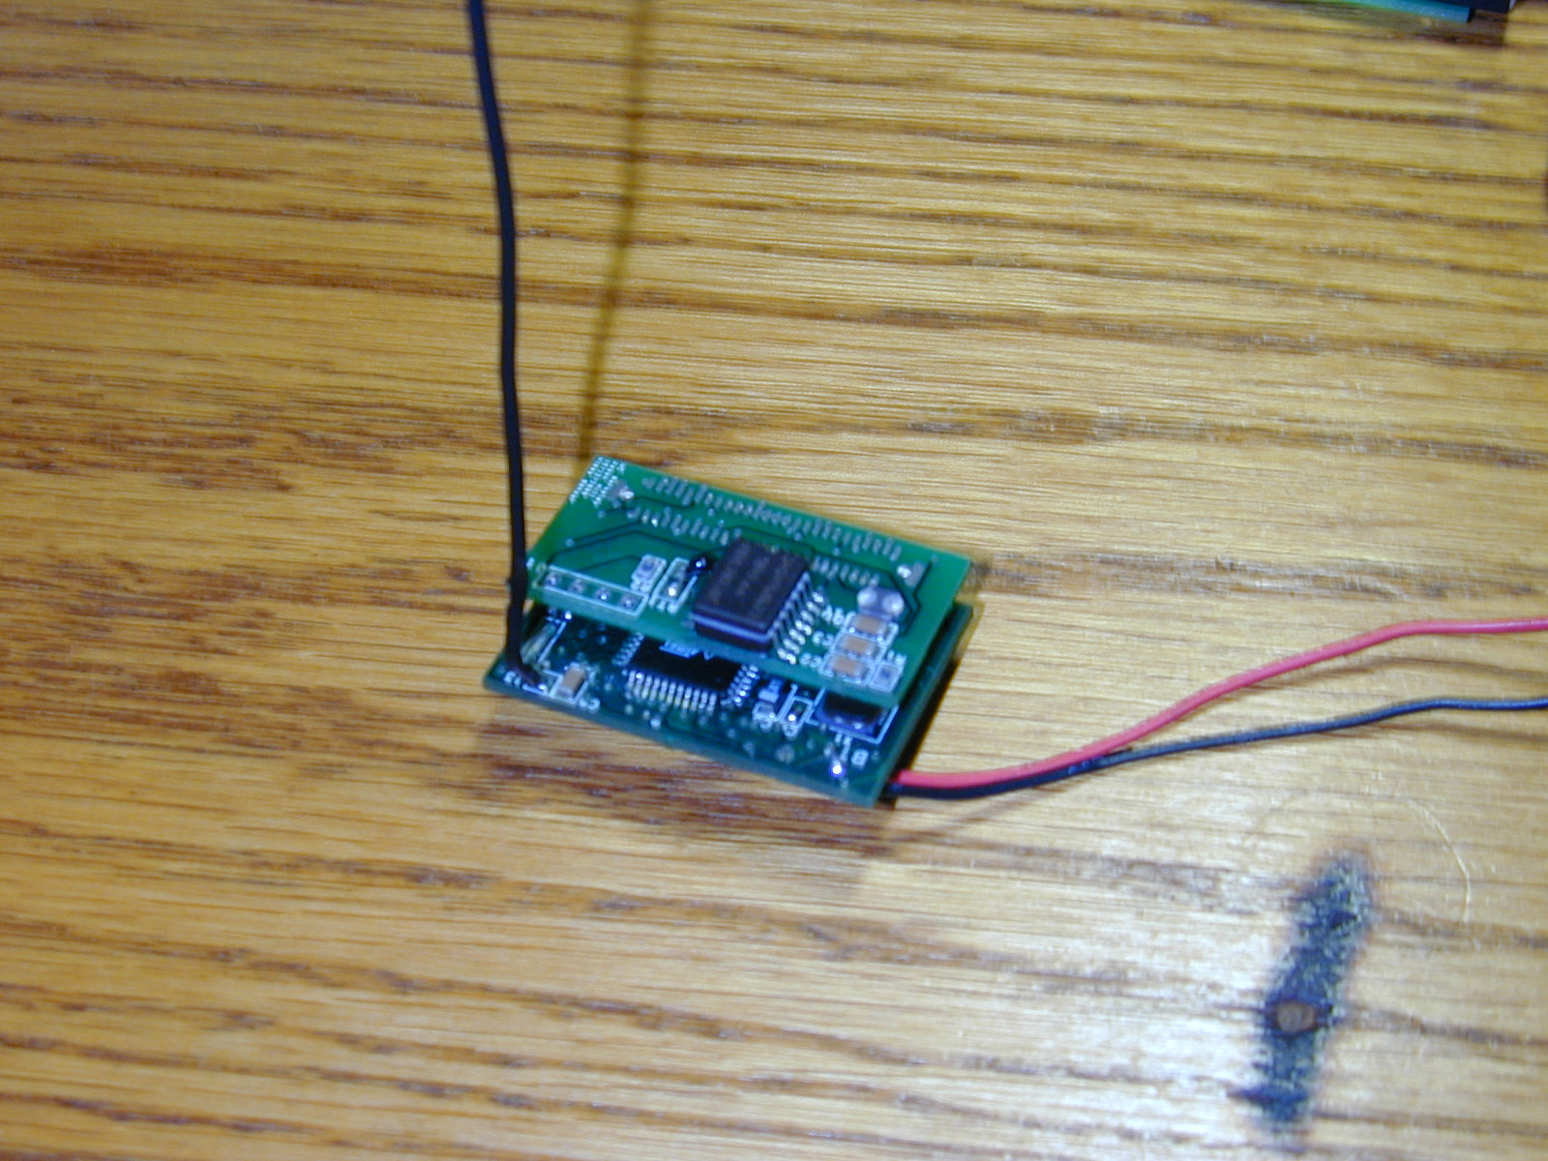
Hardware Platform
Current networked sensor
  Two board sandwich
    Main board with radio comm.
      4MHz, 8 bit MCU (ATMEL)
      512 bytes RAM, 8K ROM, 512 bytes EEPROM
      Small co-processor unit, serial port, LED outputs
      900 MHz radio (RF Monolithics)
    Sensor Board
      Light, temperature, magnetic field
Future networked sensors
  Communication, computation and MEMS devices in microscopic scale chips

Slide 6
Outline
Motivation for Sensor Networks
Motivation for TinyOS
Development Environment for TinyOS
Scheduling in TinyOS
Event-driven Sensing
Communication

Slide 7
Motivation for TinyOS
Requirements shaping the design of networked sensors
  Small physical size
    Constrains storage
  Low power consumption
    Constrains processing, communication
  Concurrency intensive operation
    Sampling sensor, streaming data from or into network, processing data simultaneously

Slide 8
Motivation for TinyOS (cont…)
Diversity in design and usage
  Requires efficient modularity
    Application specific devices, not general purpose
    Important to assemble just the software components to synthesize app. from hardware components
Notes:
Modularity must be efficient because there is not enough space, overhead of modularity must be eliminated
Carry only hardware needed for the application
Ex: an application with only one analog sensor, two analog sensors, digital sensor, not need LEDs

Slide 9
TinyOS
Simple component based OS
  Subset of components used for particular application
  Components are reentrant cooperating state machines
Efficient modular composition
  Overhead of modularity eliminated by static info
Maintains high level of concurrency in limited space
  Refusing requests for memory inside the application
Uses power efficiently
  Spending unused CPU cycles in sleep
  Turning radio off when not is use

Slide 10
Outline
Motivation for Sensor Networks
Motivation for TinyOS
Development Environment for TinyOS
Scheduling in TinyOS
Event-driven Sensing
Communication
Conclusion

Slide 11
Complete TinyOS application
Scheduler
Graph of components
  Each component has
    Interface(.comp)
    Internal Implementation(.c) (eg. VHDL, Verilog)

Slide 12
Complete TinyOS application:Component
Interface comprises of synchronous commands and asynchronous events
  Upper Interface
    Commands it implements
    Events it signals
  Lower Interface
    Commands it uses
    Events it handles
Internal Storage
  Structured into a fixed-size frame
Internal Concurrency
  Light-weight threads – tasks

Slide 13
Component Interface
//COUNTER.comp//
TOS_MODULE COUNTER;
ACCEPTS{
char COUNTER_START(void);
char COUNTER_INIT(void);
};
USES{
char COUNTER_SUB_CLOCK_INIT(char interval, char scale);
char COUNTER_SUB_OUTPUT_INIT();
char COUNTER_OUTPUT(int value);
};
HANDLES{
void COUNTER_CLOCK_EVENT(void);
char COUNTER_OUTPUT_COMPLETE(char success);
};
SIGNALS{
};
COUNTER_START
COUNTER_INIT
Counter Component
Internal Tasks
Internal State
COUNTER_SUB_OUTPUT_INIT
COUNTER_SUB_CLOCK_INIT
COUNTER_OUTPUT_COMPLETE
COUNTER_CLOCK_EVENT
COUNTER_OUTPUT
Commands
Events
Notes:
.comp used to create a header file

Slide 14
Complete TinyOS application:Component Entities
Command
  Function call across component boundaries
  Can post tasks, call commands
  Returns status
    Way of managing limited storage
  Example
    Sending packet
    Sampling sensor

Slide 15
Complete TinyOS application:Component Entities
Event
  Up-call for notification of action
  Interrupt at the lowest level
  Can post tasks, call commands, signal events
  Example
    Receiving packet
    Clock interrupt

Slide 16
Complete TinyOS application:Component Entities
Task
  Way to incorporate arbitrary computation
  Can post tasks, call commands, signal events
  Example
    Encoding a byte
    Performing CRC check

Slide 17
Complete TinyOS application:Component Entities
Fixed-size frame
  Internal storage
  Eliminates the overhead of dynamic memory
  Determines memory requirement in compile time
  Example
    State of component
    Packet to be sent

Slide 18
Description of Application
Describes the wiring of the interfaces
  1-1 wiring
  Events to multiple components
  Multiple components to the same command
Efficient modularity
  Optimization by static info
Notes:
Components linked together at compile time to eliminate unnecessary runtime overhead
.desc and .comp files are preprocessed to create header file that links the components together

Slide 19
Example Application Desc.
MAIN
main_sub_init
main_sub_start
counter_init
counter_start
COUNTER
counter_sub_clock_init
clock_event
counter_sub_output_init
counter_output
clock_init
clock_fire_event
int_to_leds_init
int_to_leds_output
CLOCK
INT_TO_LEDS
Notes:
Do not worry about naming

Slide 20
Example Application Desc.
include modules{
MAIN;
COUNTER;
INT_TO_LEDS;
CLOCK;
};
MAIN:MAIN_SUB_INIT COUNTER:COUNTER_INIT
MAIN:MAIN_SUB_START COUNTER:COUNTER_START
COUNTER:COUNTER_CLOCK_EVENT CLOCK:CLOCK_FIRE_EVENT
COUNTER:COUNTER_SUB_CLOCK_INIT CLOCK:CLOCK_INIT
COUNTER:COUNTER_SUB_OUTPUT_INIT INT_TO_LEDS:INT_TO_LEDS_INIT
COUNTER:COUNTER_OUTPUT INT_TO_LEDS:INT_TO_LEDS_OUTPUT

Slide 21
Outline
Motivation for Sensor Networks
Motivation for TinyOS
Development Environment for TinyOS
Scheduling in TinyOS
Event-driven Sensing
Communication
Conclusion

Slide 22
Scheduling
Events have higher priority
  Events preempt tasks
  Almost instantaneous event execution
    Not wait for long latency actions
    Small amount of work related to component state
Notes:
Two-level scheduling
Event call other event, commands, post tasks
Commands non-blocking request to lower level components, not wait for long-latency actions to take place
Events, commands, tasks do not block or spin wait
Instead of FIFO scheduler, priority-based or deadline-based structures can be used

Slide 23
Scheduling
Tasks have lower priority
  Tasks do not preempt events or other tasks
  Scheduled by FIFO scheduler
    Circular buffer keeping pointer to posted tasks
  Handled rapidly without blocking or polling
    Unused CPU cycles in sleep state
Notes:
In sleep state as opposed to actively looking for an interesting event

Slide 24
Scheduling
Initialize scheduler (init buffer that keeps tasks)
Issues init command (initialize all other components)
While(1){
  While(task buffer non-empty){
    Take the next task
    Execute it
    Remove the corresponding entry from buffer
    }
  sleep
  nop
}
Puts the processor to sleep but leaves the peripherals operating so that any of them can wake up the system
Hardware interrupt comes
Event handler{
…
…}
Interrupt handler{
……
Signal event
…
Post task to buffer
}
Put task to circular buffer
Notes:
After initializations, as long as no task in the queue, there is nothing to do and processor goes to sleep with interrupts still enabled
When an interrupt comes, interrupt handler executed and goes to next instruction after sleep. As a result of the interrupt, there has to be a task assigned. As long as there is a task, executes the task. In tasks, more tasks can be posted and this continues like that. If no more tasks to do, then nothing to do goes to sleep again
POWER-AWARE SCHEDULER: If no task, no need for the scheduler to wake up until a hardware event activity, another task can be scheduled only as a result of an event

Slide 25
Outline
Motivation for Sensor Networks
Motivation for TinyOS
Development Environment for TinyOS
Scheduling in TinyOS
Event-driven Sensing
Communication
Conclusion

Slide 26
Event-Driven Sensing
Clock interrupt
Clock event handler starts ADC conversion
CPU continues execution or sleeps if nothing else to do
Sensor interrupt at the end of conversion
Notes:
Demonstration of concurrency

Slide 27
Outline
Motivation for Sensor Networks
Motivation for TinyOS
Development Environment for TinyOS
Scheduling in TinyOS
Event-driven Sensing
Communication
Conclusion

Slide 28
Communication
Application Level Communication
Lower Layer Communication

Slide 29
Application Level Communication
Use TinyOS to construct a networking infrastructure
  Self-organized collection of devices
  Application Level Messaging
  Stack implementation
    Requires little storage and power

Slide 30
Tiny Active Messages
Uses the Active Messages (AM) paradigm
Overlapping communication and computation through lightweight procedure calls
Message contains handler name to be invoked on a target node
Handler does two things
  Extracts message from network
  Integrate data into computation or send response
Notes:
This works out well for TinyOS as it is event driven and allows a very lean communication stack to process
packets directly off the network.
The messaging component may refuse the send request, if its busy transmitting or receiving a message and does
not have resources with which to queue the request

Slide 31
Managing Packet Buffers
Traditional OS do this in kernel
Three main issues
  Encapsulation
  Data storage reuse
  Provision of input buffer
Notes:
-Traditional OS provide a simple unlimited user model at the cost of copying, storage management complexity
-Encapsulating useful data with transport header and trailer information
-determining when output message data storage can be reused
-providing an input buffer for an incoming message before its determined where it goes

Slide 32
Managing Packet Buffers (cont…)
Buffer provides holes for system specific encapsulation
The only pointers carried across boundaries
Send command causes transmit buffer to be “owned”
Ownership tracking is app. specific
The “done” event is sent to all components
Buffer exchange between message handler and system
Notes:
-holes for system specific encapsulation, such as routing information and error detection. These are files as the
packet moves down the stack
-references to message buffers are the only pointers carried across component boundaries
-Once the send command is called, the transmit buffer is owned by the network, until the messaging component signals
the transmission complete
-done event sent to all components with AM handlers. A component that gets a done signal for another’s transmission
may use the event to retry a previously refused request
-

Slide 33
Lower Layer Communication
Challenge is to move message from app storage to phy modulation of channel
We need a cross layer “data pump”
In the stack
  The upper component partitions data into subunits
  The lower component acks this and signals for the next delivery when ready
Message layer is the packet pump
byte-by-byte vs. bit-by-bit abstraction
Notes:
-without making copies, and similarly in the reverse direction
-It issues a command to request transmission of the first subunit
-the upper component provides the next subunit by calling the next subunit command
-packet layer puts stuff byte-by-byte on byte layer, on the radio- byte layer pumps data bit-by-bit
Uart has byte-by-byte built into hardware.
-Each component uses this framework to construct reentrant software state machine.

Slide 34
Lower Layer Communication(cont…)
No controller hierarchy
Higher level functions can still continue in parallel
At the base we have a state machine that does bit timing
RFM component abstracts the real time deadlines from higher layers
Encoding of data at the same time as transmission
Reception requires detection of data on channel
Notes:
-Traditional systems have a controller hierarchy that abstracts the device spec. charac.
and timing req. from main controller. Our hardware directly connects micro to radio.
Every bit is handled in real time and jitter is relayed onto the transmitted signal
-reception requires detection of data on the channel

Slide 35
Outline
Motivation for Sensor Networks
Motivation for TinyOS
Development Environment for TinyOS
Scheduling in TinyOS
Event-driven Sensing
Communication
Conclusion

Slide 36
Conclusion
Effective approach for highly constrained devices
Non-blocking, event driven model facilitates interleaving processor among multiple flows
Incremental processing of messages at different levels
Event and task logical concurrency used everywhere but in the hardware
Extremely modular design gives way to experimentation

