Slide 1
Time Safety Check
Tom Henzinger, Christoph Kirsch
Slobodan Matic
Embedded Software Engineering Discussion 03/14/02

Slide 2
Time safety: Motivation
RTOS
Traditional schedulability test checks for a feasible schedule
  for a given scheduling algorithm
  for given task assumptions (task models)
schedulability determinism
Embedded machine on top of RTOS
  interaction with the environment is completely separated from task execution
  E code is time safe if each task completes before its outputs are read (and new inputs are provided) - platform dependent property
  if E code is triggered by environment
    time safety determinism
  both timing and value predictability ensured

Slide 3
Approach
Deadlines implicitly specified in the E code:
  Operate on E code directly, without extracting task set model
more program analysis than schedulability test
(Giotto)
Program
(Giotto)
Program
WCET
WCET
(Giotto) Compiler
(Giotto) Compiler
E code
E code
Time Checker
Time Checker
unsafe
annotatedE code
unsafe
safe
E machine
E machine

Slide 4
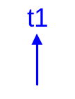
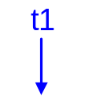
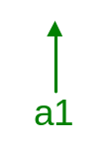
Problem statement
E code instructions (synchronous computation)
  core instructions:
  control flow instructions:
time-triggered E code
g(n): clk’=clk+n
platform dependent parameters of the algorithm
  WCET for each task
  EDF scheduling scheme
SCHEDULE(t1) | CALL(d1) | FUTURE(g,a1)
IF(c, a1, a2) | RETURN

Slide 5
Algorithm
develop the schedule using EDF algorithm to see if all deadlines are met
starting from initial trigger simulate execution of E code:
at each step of the algorithm scan the E code with label a for
  CALL and SCHEDULE completed(a)
  SCHEDULE scheduled(a)
  FUTURE future(a)
each step can be considered as state transition:
what’s the state? (task_config, trigger_config)
simple numeric test for time safety of a configuration
simulate until new state already visited or time violation occured
run the algorithm for the each assignment of conditional jumps

Slide 6
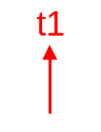
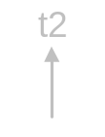
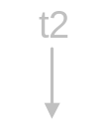
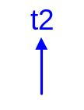


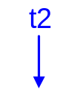

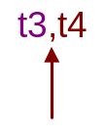

Basic state transition
WCET (t2) = 2.5
before
task
config.
after
WCET (t2) = 0.5
before
task
config.
after

Slide 7
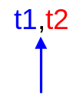

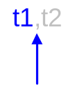

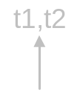
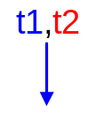

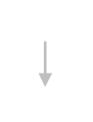
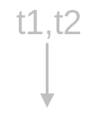
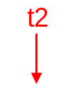
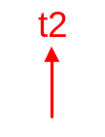

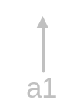
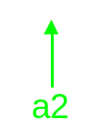
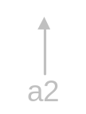
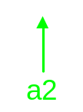

Two-task example
Ao = {(a1,0)}
WCET (t1)=1.5, WCET (t2)=1
4
d0
a1: | CALL(d0) | a2: | CALL(d2)
 | CALL(d1) |  | SCHEDULE(t2)
 | SCHEDULE(t1) |  | FUTURE(g(2),a1)
 | CALL(d2) |  | RETURN
 | SCHEDULE(t2)
 | FUTURE(g(2),a2)
 | RETURN
t1
d1
d2
2
t2
task
config.
trigger
config.

Slide 8

Two-task example (2)
Ao = {(a1,0)}
WCET (t1) = 1.5, WCET (t2) = 1.5
4
d0
a1: | CALL(d0) | a2: | CALL(d2)
 | CALL(d1) |  | SCHEDULE(t2)
 | SCHEDULE(t1) |  | FUTURE(g(2),a1)
 | CALL(d2) |  | RETURN
 | SCHEDULE(t2)
 | FUTURE(g(2),a2)
 | RETURN
t1
d1
d2
2
t2
task
config.
trigger
config.

Slide 9

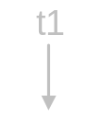
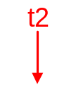
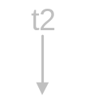
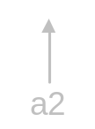
Phase-shifted task set
Ao = {(a1,0),(a2,3)}
WCET (t1) = 1.5, WCET (t2) = 0.5
a1: | SCHEDULE(t1) | a2: | SCHEDULE(t2)
 | FUTURE(g(2),a1) |  | FUTURE(g(2),a2)
 | RETURN |  | RETURN
task
config.
trigger
config.

Slide 10
Non-EDF schedule
Ao = {(a1,0)}
WCET (t1) = 1.5, WCET (t2) = 1
a1: | SCHEDULE(t1) | a2: | SCHEDULE(t2)
 | SCHEDULE(t2) |  | FUTURE(g(2),a2)
 | FUTURE(g(2),a2) |  | RETURN
 | RETURN
task
config.
trigger
config.

Slide 11

IF instruction example
Ao = {(a1,0),(a2,0)}
WCET (t1)=1.5, WCET (t2)=0.5
a1: | SCHEDULE(t1) | a2: | IF(c,a2’,a2’’)
 | FUTURE(g(2),a1) | a2’: | SCHEDULE(t2)
 | RETURN | a2’’: | FUTURE(g(1),a2)
 |  |  | RETURN
c = false
c = true

Slide 12
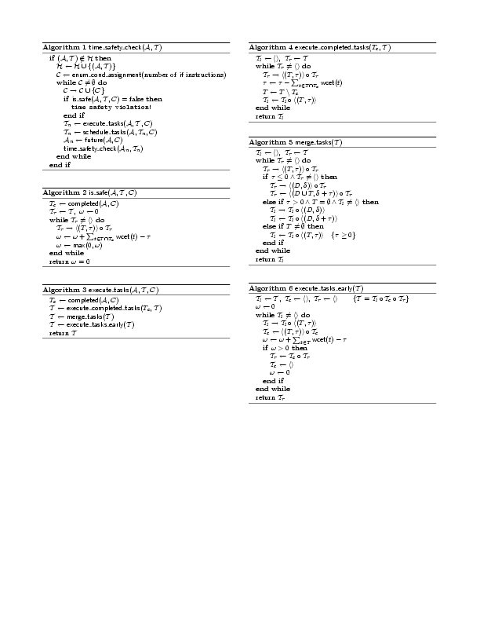
Pseudo code

Slide 13
Pseudo code (2)

Slide 14
Results and future work
implemented as TimeChecker class in the current Giotto compiler
  without IF : fast decision
  with IF instructions :
    and explicit enumeration of program branching paths : reasonable response times if n<10
    and some simple code analysis : fast decision
    e.g. branching on task and driver guards can be avoided
future
  find patterns in configuration: simplified time safety proof
  compositional time safety check

