Slide 1
Our RTOS
(Homework #1)
EE 290O
Yang Zhao
Arkadeb Ghosal

Slide 2
Introduction
A simple application
E code and opcode
The E interpreter
A mode switching example
Demos

Slide 3
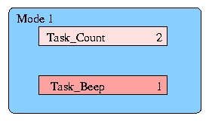
The application
0: CALL count_driver;
CALL beep_driver;
SCHEDULE count;
SCHEDULE beep;
FUTURE (timer, 5);
5: CALL beep_driver;
SCHEDULE beep;
FUTURE (timer, 0);

Slide 4
eco[0].opcode = CALL;
eco[0].fn = &count_driver;
eco[1].opcode = CALL;
eco[1].fn = &beep_driver;
eco[2].opcode = SCHEDULE;
eco[2].fn = &count;
eco[3].opcode = SCHEDULE;
eco[3].fn = &beep;
eco[4].opcode = FUTURE;
eco[4].fn = &wait_time;
eco[4].arg1 = 1000;
eco[4].arg2 = 5;
eco[5].opcode = CALL;
eco[5].fn = &beep_driver;
eco[6].opcode = SCHEDULE;
eco[6].fn = &beep;
eco[7].opcode = FUTURE;
eco[7].fn = &wait_time;
eco[7].arg1 = 1000;
eco[7].arg2 = 0;
Emachine(em);
enum opcode
int (*fn) ()
int arg1
int arg2
CALL
Driver
SCHEDULE
Task
FUTURE
Handler
Argument
Line #
COND
Driver
Line #

Slide 5
The E Interpreter
switch(em->eco[i].opcode) {
case NOP:
break;
case CALL:
(*(em->eco[i].fn))(0, em);
break;
case SCHEDULE:
k = execi( em->eco[i].fn, 0, em, 1, DEFAULT_STACK_SIZE);
if (k==-1) { cputs("err"); }
break;
case FUTURE:
m = em->eco[i].arg1;
(*(em->eco[i].fn))(m, 0); //returns when trigger is true
i = em->eco[i].arg2 - 1;
break;
default:
break;
}

Slide 6
An event triggered application
eco[0].opcode = CALL;
eco[0].fn = &count_driver;
eco[1].opcode = CALL;
eco[1].fn = &beep_driver;
eco[2].opcode = SCHEDULE;
eco[2].fn = &count;
eco[3].opcode = SCHEDULE;
eco[3].fn = &beep;
eco[4].opcode = FUTURE;
eco[4].fn = &wait_button_pressed;
eco[4].arg1 = BUTTON_PROGRAM;
eco[4].arg2 = 5;
eco[5].opcode = CALL;
eco[5].fn = &beep_driver;
eco[6].opcode = SCHEDULE;
eco[6].fn = &beep;
eco[7].opcode = FUTURE;
eco[7].fn = &wait_time;
eco[7].arg1 = 1000;
eco[7].arg2 = 0;
Emachine(em);
0: CALL count_driver;
CALL beep_driver;
SCHEDULE count;
SCHEDULE beep;
FUTURE (button, 5);
5: CALL beep_driver;
SCHEDULE beep;
FUTURE (timer, 0);

Slide 7
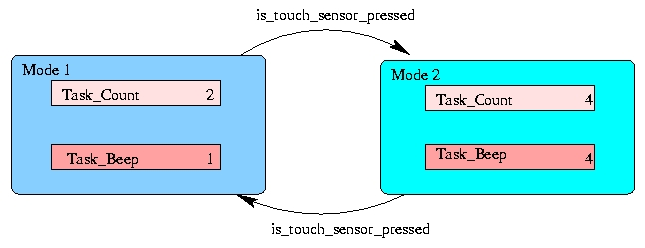
Mode switches !!

Slide 8
The E code for two modes
0: CALL count_driver;
CALL beep_driver;
CALL touch1 _driver;
COND (read_touch1, 10);
SCHEDULE count;
SCHEDULE beep;
FUTURE (timer1, 7);
7: CALL beep_driver;
SCHEDULE beep;
FUTURE (timer1, 0);
10:CALL count_driver;
CALL beep_driver;
CALL touch1 _driver;
COND (read_touch1, 0);
SCHEDULE count;
SCHEDULE beep;
FUTURE (timer2, 10);

Slide 9
The conditional operator
eco[3].opcode = COND;
eco[3].fn = &read_touch1_driver;
eco[3].arg1 = 10; // if toucheded
case COND:
m = em->eco[i].arg1;
if ((*(em->eco[i].fn))(m, 0)) {
i = em->eco[i].arg1 - 1;
}
break;

Slide 10
Demo
Simple time triggered system
RTOS handling both time-trigger and event- trigger
The demo illustrating mode-switches

Slide 11
Future work
Modifying the mode switch mechanism
Finding the optimum no. of arguments and E codes required
Encoding the project problem to E code

