Slide 1
Dual Task Code Review
Doug Densmore
Will Plishker
EE290o
November 8, 2026

Slide 2
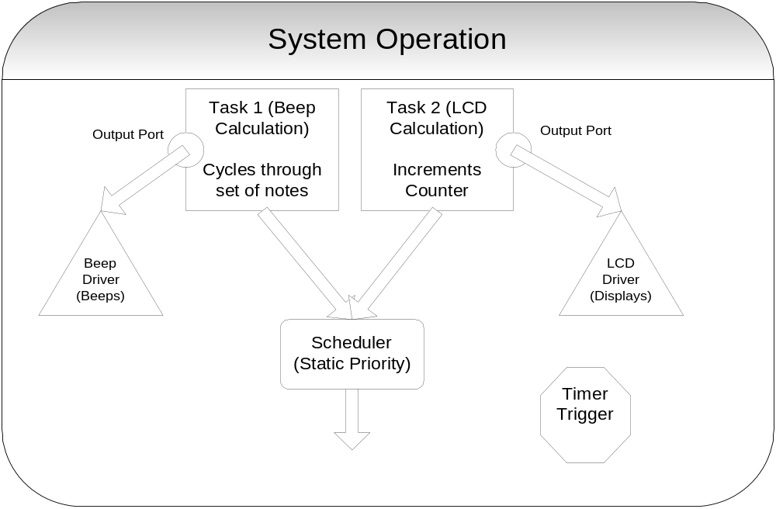
Composition of the System

Slide 3
Ecode/RTOS/Scheduler
b1: Call (beep_driver)
Call (lcd_driver)
Schedule (beep_task, 1)
Schedule (lcd_task, 1)
Future (b2)
b2:
Call (beep_driver)
Schedule(beep_task, 1)
Future (b1)
Trigger
RTOS
Trigger
Interpreter

Slide 4
Code
int main(int argc, char **argv) {
while(1) {
if(rtos_timer>35) {
rtos_timer= 0;
while(ecode[i].opcode!=future) {
if(ecode[i].opcode==call)
(*(ecode[i].driver))();
if(ecode[i].opcode==schedule){
scheduled_tasks[head_scheduled_tasks] = ecode[i].task;
head_scheduled_tasks++;
}
i++;
}
i = ecode[i].index;
execute();}
}
return 0;
}
void execute() {
while(head_scheduled_tasks) {
head_scheduled_tasks--;
scheduled_tasks[head_scheduled_tasks].fp();
}
}
typedef enum {
call,
schedule,
future,
}Opcode;
typedef struct {
void(*(fp))();
int priority;
}Task;
typedef struct {
Opcode opcode;
int index;
void(*driver)();
Task task;
}Ecode;

