Slide 1
EE290O Project
Yang Zhao
Arkadeb Ghosal
May 14, 2002

Slide 2
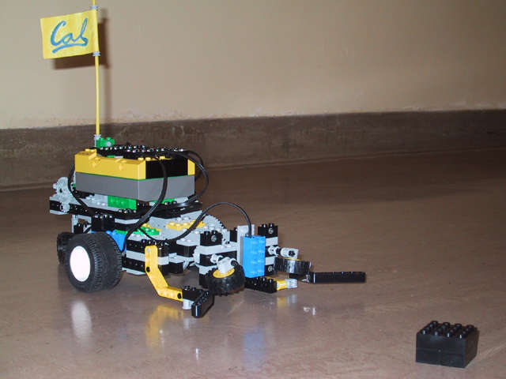
Demo I
A rectangular playground
Robot scans the field
If any object is found it picks it up and returns to the starting point

Slide 3
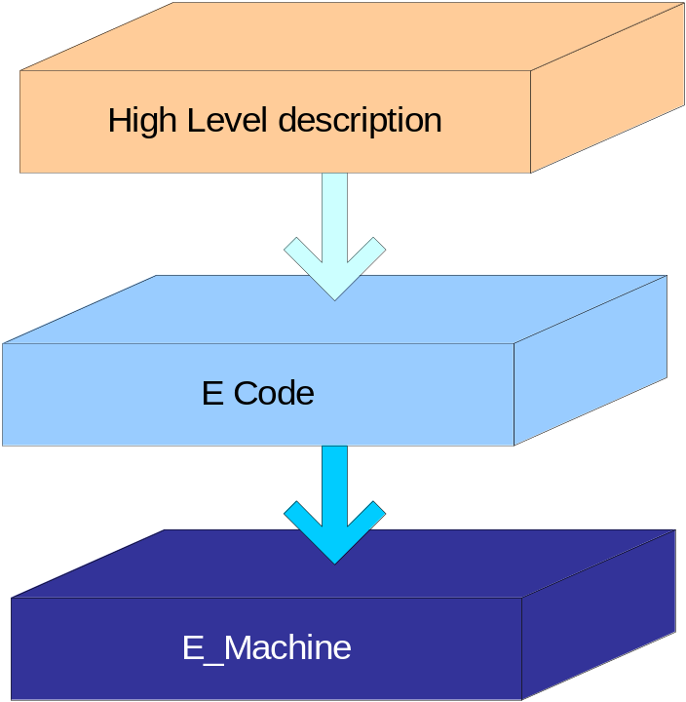
Implementation strategy
Design from a high-level
Guard the implementation by real-time programming concepts introduced in this course.
  Use Giotto concept: tasks, drivers, triggers, modes, to describe our design
Implement the application by e-code based on our E machine

Slide 4
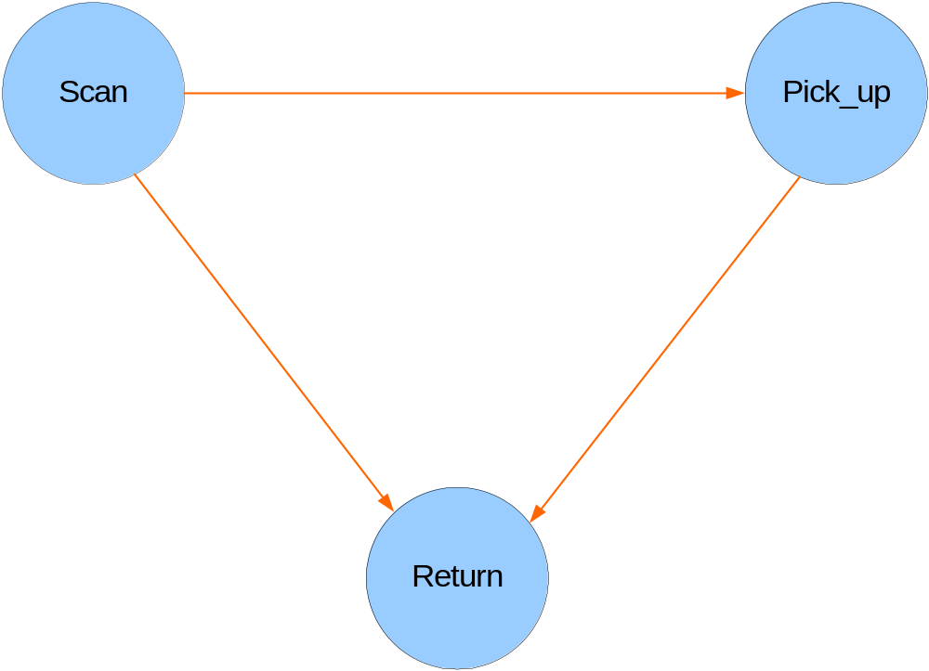
High Level Description
move the robot,
detect the object
check whether length of track covered or not
If an object is detected
Pick the object
If whole field has
been scanned
If the object has been picked
Return to the original point

Slide 5
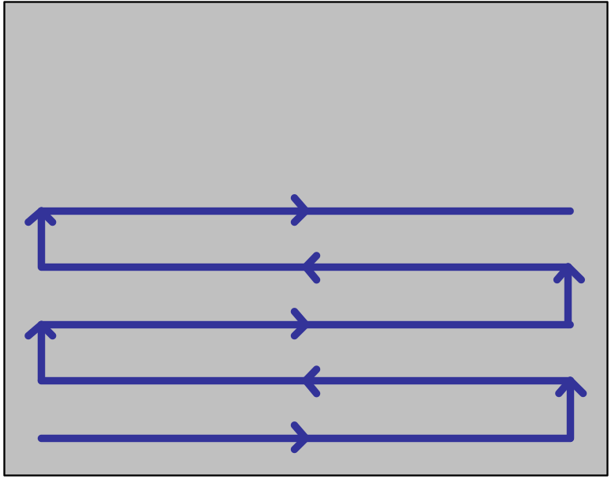
Our Scan Algorithm
Scanning technique is very simple
  Not the best but it serves our purpose
  The robot covers a pre-specified distance called the track
  If it detects any object on the track it goes to the pick up task.
  Otherwise on completion of an even track, it takes an left U-turn and continue.
  On comletion an odd track, it takes an right U-turn and continue.
Shows one track of the robot
3
2
1
0
U-turn taken by the robot
Notes:
This actor outputs the sum of the inputs so far

Slide 6
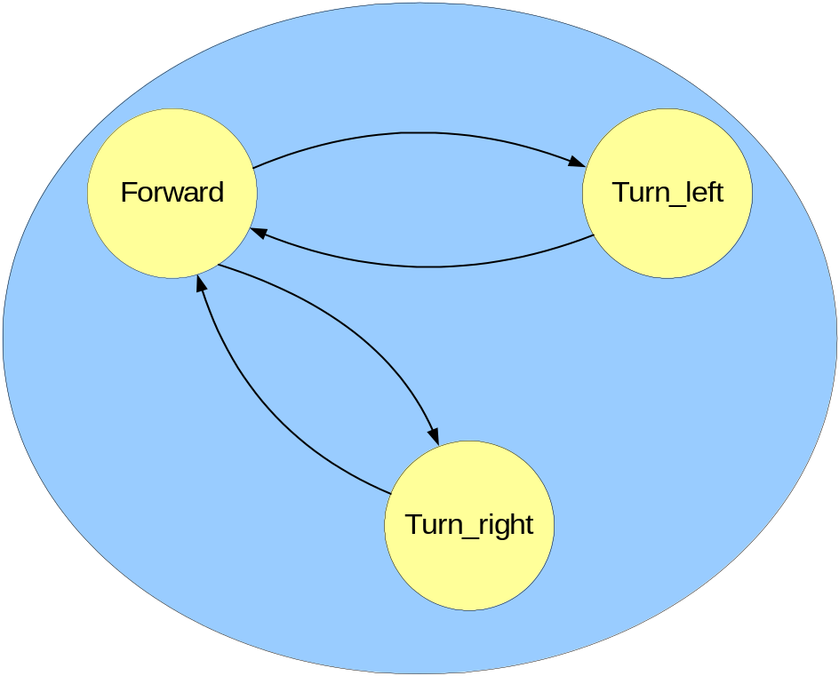
Refine the Scan task
move forward,
detect the object
check length of track covered
Scan
Turn robot by 180° towards left
check timer
If arrived && track is even
If turn is over
If arrived && track is odd
If turn is over
Turn robot by 180° towards right
check timer

Slide 7
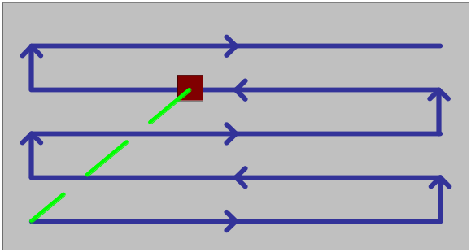
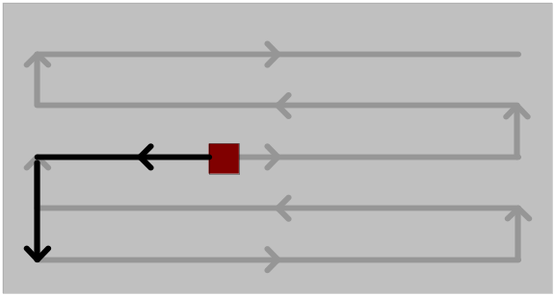
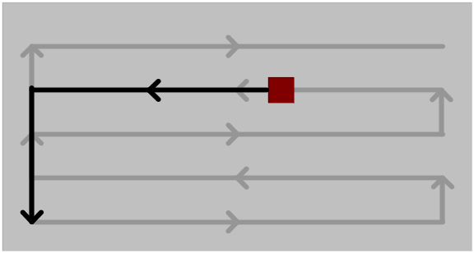
Return Algorithm
Ideally, should take the shortest straight line distance
  There isn’t suitable math function in LegOS to get the angle
Approximate the ideal return..
  If the object is at an even numbered track, reverse, turn right by 90° and move to the origin
  If the object is at an odd numbered track, go forward, turn left by 90° and move to the origin
3
2
1
0
Even numbered
track
2
Odd numbered
track
3

Slide 8
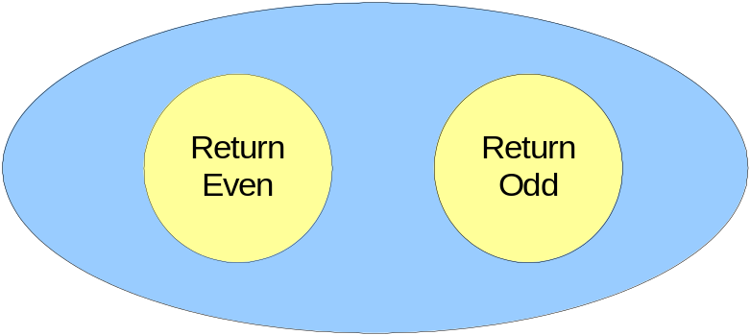
Refine the Return task
Retrun
return from an even track
return from an odd track

Slide 9
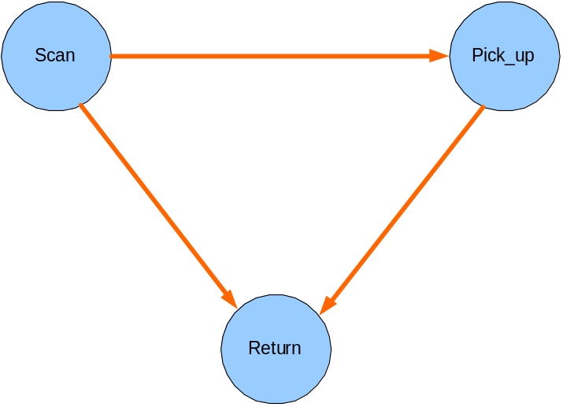
A closer look
Scan the field with the robot
check detection sensor
check length of track covered
Pick up object
Check timer
move forward,
check detection sensor
check length of track covered
If sensor detects object
Turn robot by 180° towards left
check timer
If arrived && track is even
If it has finished scanning
If turn is over
If object has been picked up
Return to the origin
If arrived && track is odd
If turn is over
If track is even
If track is odd
Turn robot by 180° towards right
check timer

Slide 10
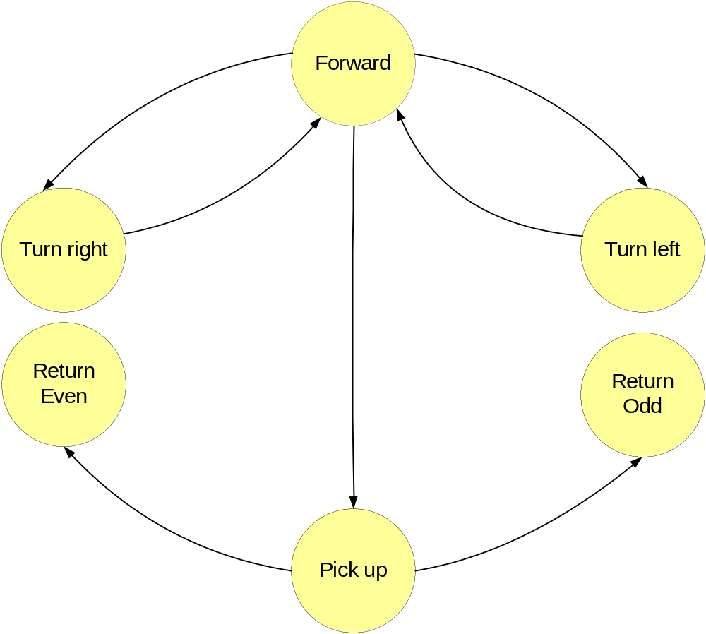
The Giotto conceptualization
forward
check light sensor, check rot_1 sensor
arrived ∧ no_object ∧ CT is_odd → CT++
arrived ∧ no_object ∧ CT is_even → CT++
time_out
time_out
right_turn
check time trigger
left_turn
check time trigger
object is detected → record the value of Rotation_1
back_even
check time trigger
back_odd
check time trigger
time_out ∧ CT is even
time_out ∧ CT is odd
pick_up
check time trigger

Slide 11
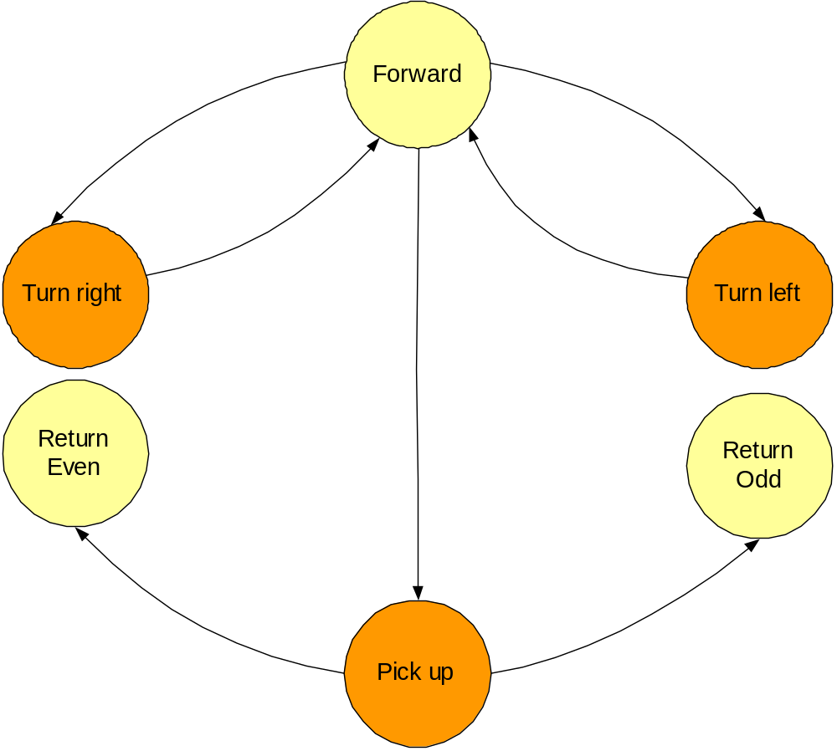
Adding concurrent tasks
forward
check light sensor, check rot_1 sensor
arrived ∧ no_object ∧ CT is_odd → CT++
arrived ∧ no_object ∧ CT is_even → CT++
time_out
time_out
right_turn
output_ CT
check time trigger
left_turn
output_CT
check time trigger
object is detected → record the value of Rotation_1
back_even
check time trigger
back_odd
check time trigger
time_out ∧ CT is even
time_out ∧ CT is odd
pick_up
beep
check time trigger

Slide 12
What do we use ?
motors
  motor a -- move forward
  motor b -- the radar motor
    combining motor a,b robot can take any turn
  motor c -- picks the object
sensors
  rotation sensors
    rot_1, counts the no. of rotations taken by motor a
    rot_2, does the same thing for motor b
  light sensor
    detects object of pre-specified darkness
object
  a black plastic cuboid of approx size 4cm X 1 cm

Slide 13
The Giotto Code
sensor
light_sensor uses read_light_sensor
rot_1_sensor uses read_rot1_sensor
rot_2_sensor uses read_rot2_sensor
//task declarations
task forward .. schedule c_forward()
task pick .. schedule c_pick()
task beep .. schedule c_beep()
task show .. schedule c_show()
task left_turn .. schedule c_left_turn()
task right_turn .. schedule c_right_turn()
task back_even .. schedule c_back_even()
task back_odd .. schedule c_back_odd()
//mode_switch driver
driver got_a_block .. if dark_true(light_sensor) then switch
driver arrived_even .. if arrived_even_true (counter) then switch
driver arrived_odd .. if arrived_even_true (counter) then switch
driver is_even .. if track_is_even_true (counter) then switch;
mode mode_forward
//checks whether got_a_block or track over
//invokes task forward
mode got_a_block
//checks whether ready to go back by time
//invokes pick up
//invokes beep
mode go_back_odd
//performs the return to origin task from
//an odd_numbered track
mode go_back_even
//performs the return to origin task from
//an even_numbered track
mode reg_turn_left
//checks whether to switch to mode_forward
//invokes U-turn in left direction
//LCD display of how many tracks has been covered
mode reg_turn_right
//checks whether to switch to mode_forward
//invokes U-turn in left direction
//display of how many tracks has been covered

Slide 14
The E code
LS TS RS_1 RS_2 CT
DARK FWD TURN_180 TURN_90 ROT_LEFT GAP
void read_light_sensor //writes to LS
void read_touch_sensor //writes to TS
void read_rot1_sensor //writes to RS_1
void read_rot2_sensor //writes to RS_2
void write_count
// read CT
// increments CT and write back
void set_rot1_sensor //sets SENSOR_1
void set_rot2_sensor // sets SENSOR_2
void stop_a // stop motor a
void stop_b, stop_c
void forward
// moving motor a in fwd dir
void pick // moving motor c forward
void drop // moving motor c in reverse
void beep
//play sound
int left_turn
//move b fwd ; move a fwd; move b in rev
int right_turn ...
void back_even
//read RS_1; read CT; calculate the Gap;;
//go bwd //90 degree right turn //go down
void back_odd …
void output_CT
// reads CT and writes on LCD
int arrived_even
//reads CT & RS_1
//checks whether CT is even and RS_1 has the req value
int arrived_odd …
int is_even
//reads counter value
//checks whether it is odd or even
int dark
//reads LS
//checks light sensor for prespeified darkness value

Slide 15
The E Code (cont.)
// the forward mode
CALL: set_rot1_sensor;
CALL: read_light_sensor;
CALL: read_rot1_sensor;
COND: arrived_even;
//if not arrived_even check whether arrived_odd
//if arrived_even, go to left_turn
COND: arrived_odd;
//if not arrived_odd resume going forward
//if arrived_odd, go to right_turn
SCHEDULE: forward;
FUTURE: time_trigger
//check sensor
//check dark sensor
COND: dark;
// if not dark continue moving FWD
// if dark pick up
//stop and pick up
CALL: read_rot1_sensor;
CALL: stop_a;
FUTURE: time_trigger;
//start to return
SCHEDULE: pick;
//left_turn mode after forward
CALL: stop_a;
CALL: write_count;
FUTURE: time_trigger;
//start moving forward
SCHEDULE: left_turn;
//right_turn mode after forward
CALL: stop_a;
CALL: write_count;
FUTURE: time_trigger;
//start moving forward
SCHEDULE: right_turn;
//stop mode_2 after pick up
CALL: stop_c;
COND: is_even;
//goto odd_return else goto even_return
SCHEDULE: back_even;
SCHEDULE: back_odd;

Slide 16
Demo II
work as a to-and-fro carrier
  move in between two fixed points
  pick up an object from one point and drop it off at another
  On reaching a point it waits for some pre-specified time and then turns back and returns to other point
  If an object is need to be send it should be kept in front of the robot and it would pick it up on signaling
    reaching the other point it drops off the object
  If it is blocked during moving it signals to move away and stops
    it resumes the motion once the obstacle has been moved

Slide 17
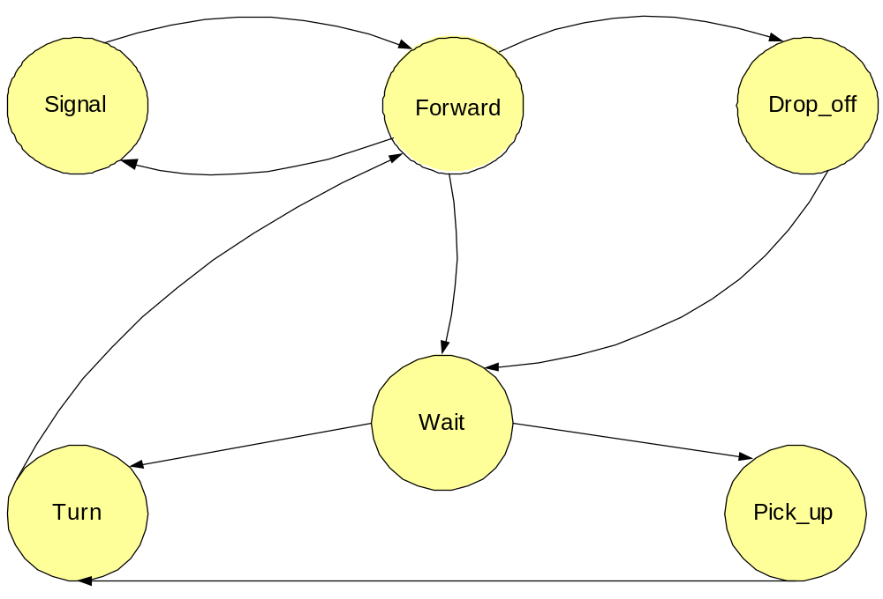
The modes
forward
check light sensor
check rot_1 sensor
Object removed
arrived ∧ carrying_object
beep
Check time trigger
drop
Check time trigger
Object detected
arrived ∧ no_object
time_out
time_out
time_out
button_pressed
Check time trigger
turn
Check time trigger
pick
Check time trigger
time_out

Slide 18
Conclusion
Things learned
  Real experience about real-time programming.
    not only software programming
    mechanical problems
    light sensor
    slight deviation can cause a lot of problems
  Understand and appreciate concepts introduced in this course more deeply.
Future dirction
  Feedback
  How to do efficient scanning
  Works together with Ptolemy

