Slide 1
Lego Navigation
Darren Liccardo
Mark McKelvin

Slide 2
Outline
Objectives and Motivation
Nasty Limitations
Giotto Structure
  Ports, drivers, tasks
    State estimator
    Controllers
    Comm
      Controller mode change
  Global state change (Giotto mode)
High level control (asynchronous communication)
  Java comm (UDP like packet delivery)
Demo

Slide 3
Motivation and Objectives
Objectives:
  Desire robot to navigate to arbitrary coordinates
  Create logical platform abstraction
Motivation:
  Allows maximum flexibility in path planning
  Allows (fast) straight line return paths
  Manage complexity

Slide 4
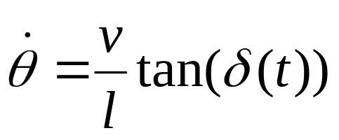
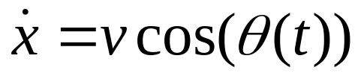
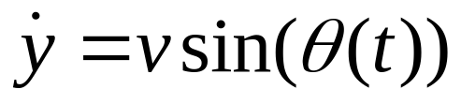






Bicycle Steering Model

Slide 5
Constrained Platform
Need trig functions for state estimation
Constraints:
  16-bit registers
  No floating point unit
  Low clock speed
Use software floating point to calculate (low-order) Taylor series expansions

Slide 6
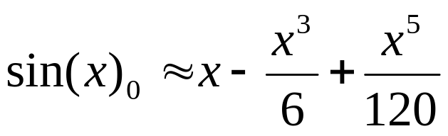
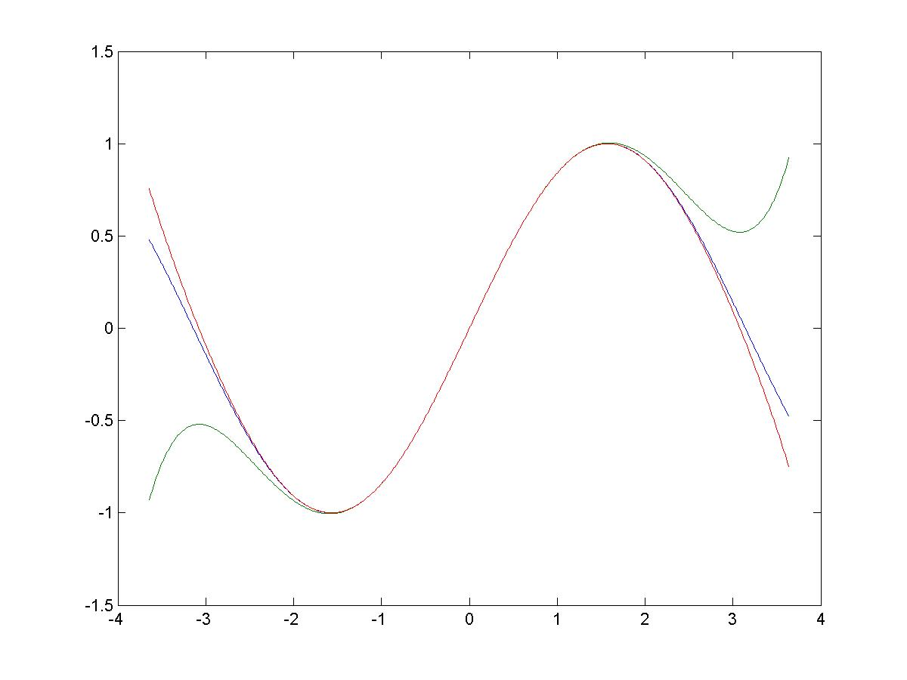
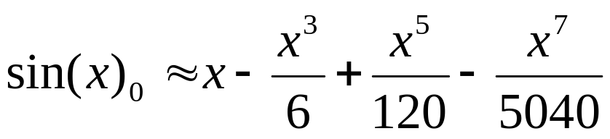
Taylor Series: sin

Slide 7
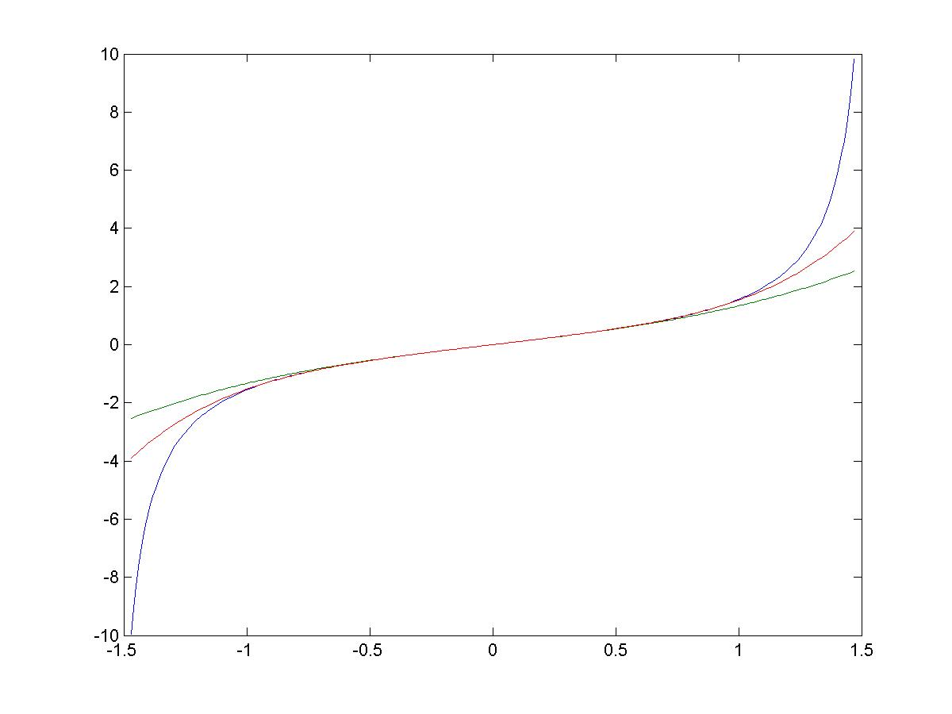
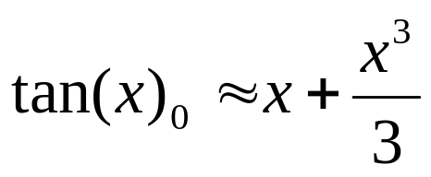
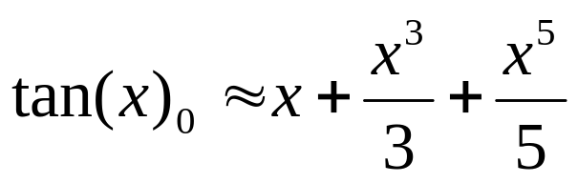
Taylor Series: tan

Slide 8
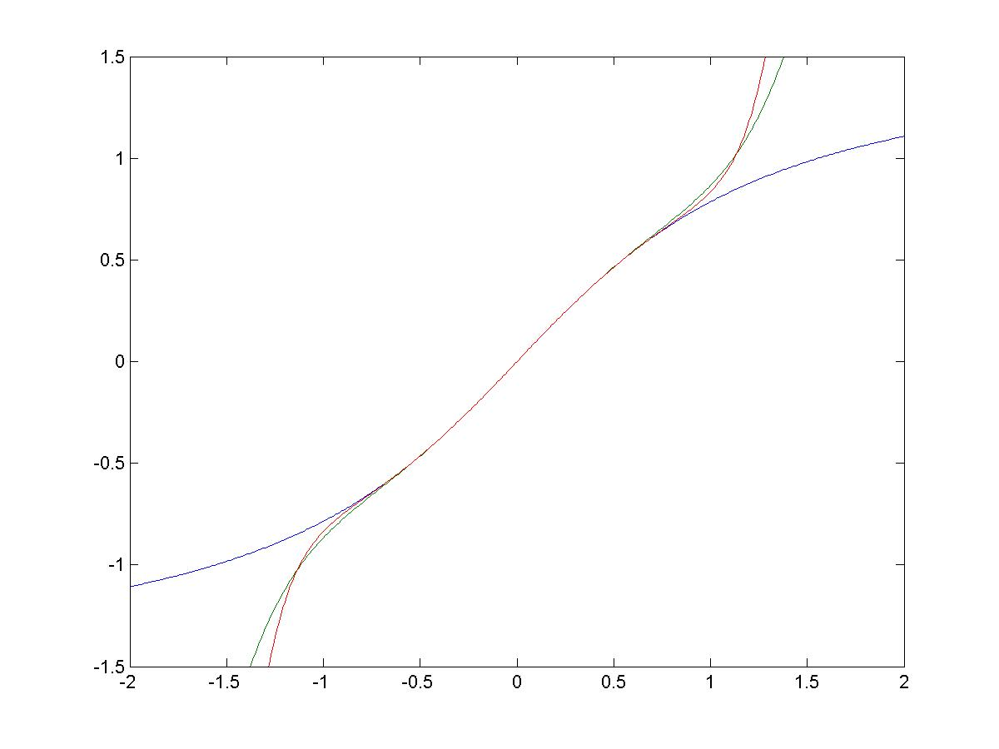
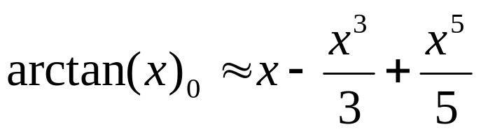
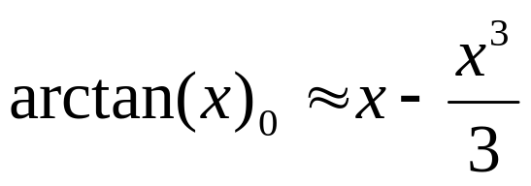
Taylor Series: arctan

Slide 9

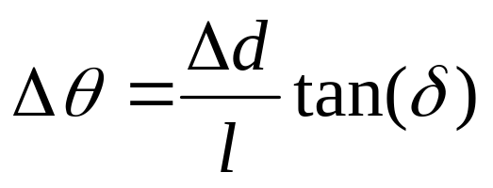


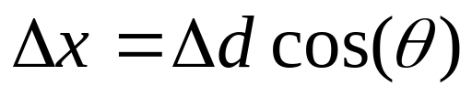
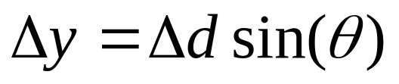
Giotto Task: State Estimator
Rotation drivers
State drivers
Drive rotation sensor
Steering rotation sensor

Slide 10

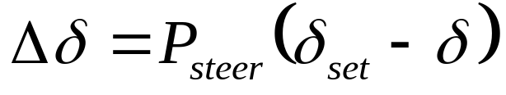
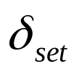
Giotto Task: Steering Controller
Rotation driver
steer rotation sensor
Motor driver
Set-point driver
Steer motor

Slide 11

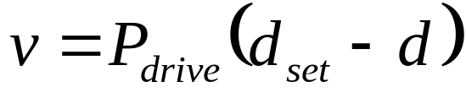
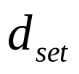
Giotto Task: Distance Controller
Rotation driver
Drive rotation sensor
Motor driver
Set-point driver
Drive motor

Slide 12

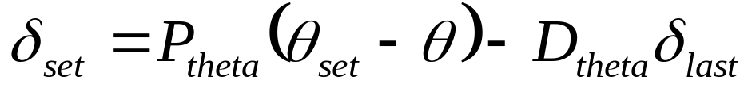

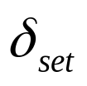
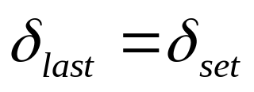
Giotto Task: Pointing Controller
State driver
steering driver
Set-point driver

Slide 13
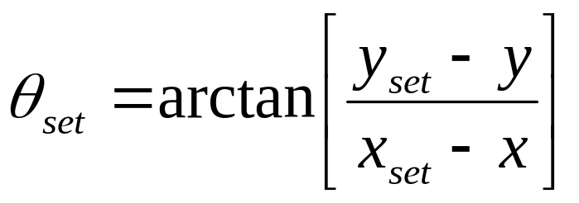
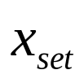
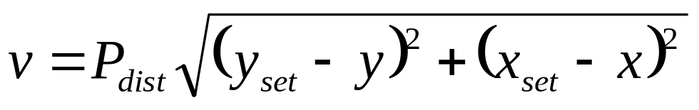
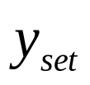
Giotto Task: Coordinate Controller
State drivers
Set-point driver
Set-point drivers
Drive motor
Motor driver

Slide 14
Giotto Control Overview
steering
pointing
coordinate
distance

Slide 15
Giotto Control Overview
steering
pointing
coordinate
distance
4
1
0
3
2

Slide 16
Giotto Control Overview
steering
pointing
coordinate
distance
4
1
0
3
2

Slide 17
Giotto Control Overview
steering
pointing
coordinate
distance
4
1
0
3
2

Slide 18
Giotto Control Overview
steering
pointing
coordinate
distance
4
1
0
3
2

Slide 19
Giotto Program:Navigation Mode
rotation
State
Estimator
State
Estimator
State
Estimator
State
Controller
Controller
motors
Time = t ms
Time = t +100ms
Time = t +300ms

Slide 20
Giotto Program: Navigation Mode
rotation
State
Estimator
State
Estimator
State
Estimator
State
State
Controller
Controller
motors
State
Set-point
Comm
IR
IR
Time = t +1800ms
Time = t +1900ms
Time = t +2000ms

Slide 21
Giotto Program: Mode Change
Block detected?
Block detected?
rotation
State
Estimator
State
Estimator
State
Estimator
State
State
Controller
Controller
motors
State
Set-point
Comm
IR
IR
Time = t +1800ms
Time = t +1900ms
Time = t +2000ms

Slide 22
Giotto Program: Pickup Mode
Block detected.
Goto (0,0)
rotation
State
Estimator
State
Estimator
State
Estimator
State
light
Lift Task
Hold Task
Set-point
Controller
motors
Lift motor
Lift motor
Time = t ms
Time = t +200ms
Time = t +3000ms

Slide 23

Nested Platforms
High Level Path Planning/Communication
Control Modes
x,y
δ,d
Giotto Control
Tasks
Motor Output
Sensor Data
Lego Dynamics

Slide 24
Platform Based Design with Giotto
Goal
  Abstract details of sensors, actuators, and vehicle hardware from control applications
How?
  Platform
  Synchronous Embedded Programming Language (i.e. Giotto)
Control Applications
Synchronous Embedded
Programming
(Giotto)
Application Space
Architectural Space
Sensors: rotation, light
Actuators: motors
Lego vehicle mechanics

Slide 25
Network Communication
Usages
  Debugging
  Real-time control
Characteristics
  Similar to unicast UDP messages
    Uses logical layer to “address” messages to specific hosts and ports
    no guarantee on packet delivery
    packets received are uncorrupted

Slide 26

Network Communication
RCX Implementation
  C (using LegOS functions*)
  Sends periodic messages
  Received data is stored in a buffer
  Buffer is checked periodically for new data (2s “pull” configuration)
PC Implementation
  Java (using JavaLNP**)
  Uses LNPManager class to handle LNP on the PC
    Creates a thread to keep IR tower awake
    Uses LNPListener interface to receive messages
  Sends aperiodic messages
  Immediately posts received data
periodic control tasks
Buffer (in/out)
in
out
RCX
IR link
* Markus Noga’s (www.noga.de/legOS/) LegOS
** Fabien Bergeret (fabien@bergeret.com) implementation of LNP using Java

Slide 27
Conclusions
Advantages
  Low overhead as compared to a TCP implementation
  User controls robot
  Great for debugging!!
  Can be used in LegOS Mindstorm games
Possible problems with communications:
  Time critical tasks
    Buffering received data
    Guaranteed packet arrival
Improvements
  Protocol implementation
    Assuring packets arrive

Slide 28
Conclusions
Used Developed Methodology
  Platform-based design
    Provides appropriate layers of abstraction
    Eases Software Reuse
    Eases Hardware Modifications
  Time-based control
    Verifiable real-time constraints
    Eases controller modifications

Slide 29
Demo
Control Modes via Communications Channel
Auto Route with block return

