Slide 1
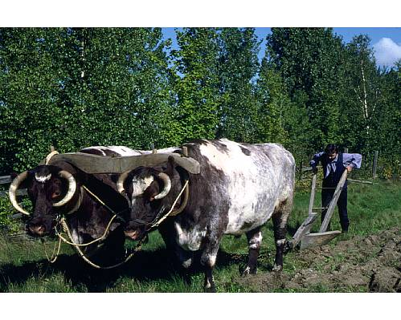
Boustrophedon BanditTM
Doug Densmore
Will Plishker
May 9, 2002
EE290o Final Demo

Slide 2
Outline
Goals
Coverage Path Planning Algorithms
Design Issues
System Structure
  Grid System
  Overall System Picture
  Code Segments
Conclusion

Slide 3
Physical Goals
Sweep a predefined, obstacle free, environment for a predetermined target.
Once the target is acquired, return to the point at which the search started with the target in tow.
Perform the task with no human interaction.

Slide 4
Software Goals
Potential to discuss time safety
Task and driver separation
Inner task communication
EMachine structure

Slide 5
Coverage Path Planning Algorithms
Emphasize the space swept out by the robots sensor.
Requires integrating the robot’s footprint (detector range) along the coverage path.
Similar to the traveling salesman problem but instead of just visiting neighborhoods, one must visit all points in the target environment

Slide 6
Coverage Path Planning Algorithms
Four types
  Heuristic (and random), approximate, partial-approximate, and exact cellular decomposition.
Many variations within each to include obstacles and multiple searching parties.
We focused on exact cellular decompositions. These are sets of non-intersecting regions and therefore planning is reduced to planning motions from one region to another.

Slide 7
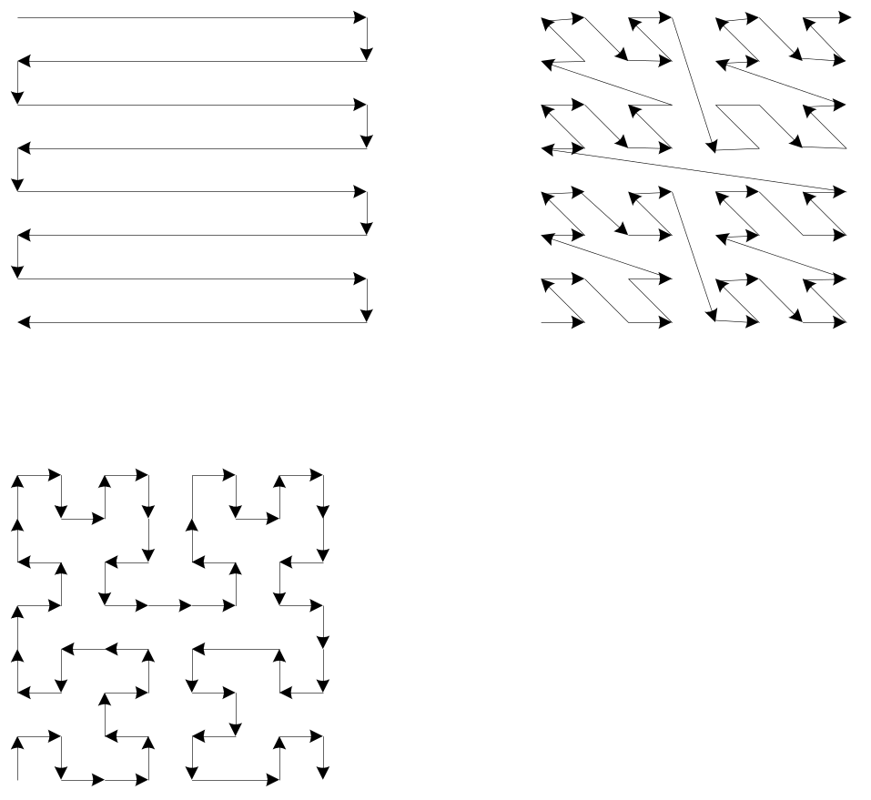
Exact Cellular Decompositions
Boustrophedon
Morton Order
These patterns often used
in raster scan
Boustrophedon means “way
of the ox” in Greek.
Pi-Order

Slide 8
Physical Design Issues
Environment
  Lighting, search surface, search size, traction
Vehicle
  Weight, sensor input limitations, funneling mechanism limitations

Slide 9
Software Design Issues
Trigger logic vs. Task Logic
  Put effort into tasks and kept basic trigger system. Same behavior, potentially time safe.
Granularity of Task
Mode Switching

Slide 10
System Relationships
Navigation
Navigation
  Tracks location, turning decisions
Beep
  Plays notes from “Mary Had a Little Lamb”
LCD
  Displays information such as position, rotation and light measurements.
Move
  Powers motor for one X or Y movement
Beep
LCD
LCD
Move
Move

Slide 11
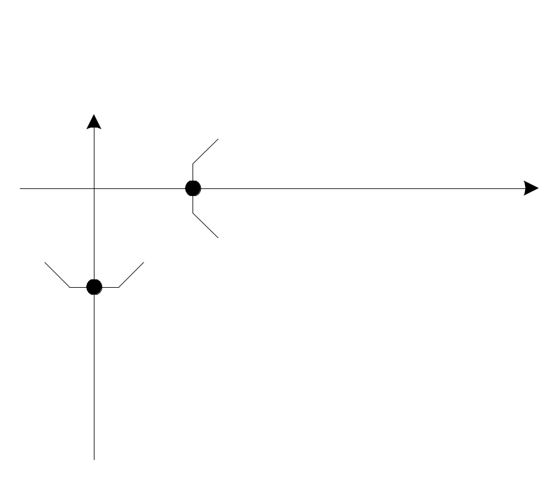
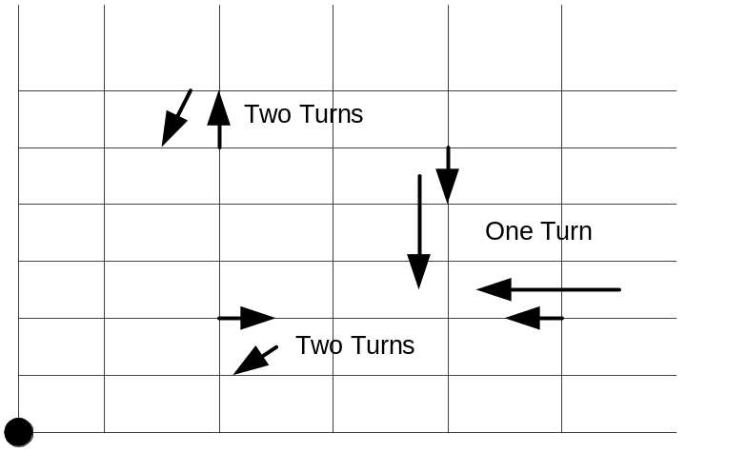
Grid System
Change in (X,Y)
Based on simple x and y coordinates
Theoretically the movement required to make a change in x is equal to the distance to change y.
Starting point is (0,0)
Location in reference to the starting point.
Returning to origin

Slide 12
Overall System Diagram
Beeper
Target
Rotation
Sensor
Beep
Driver
Light
Sensor
Rotation
Driver
Beep Task
Light
Driver
Motor
Driver
Motors
Inter-Task
Driver
Inter-Task
Driver
Move Task
Navigation
Task
Inter-Task
Driver
LCD
Screen
LCD Task
LCD
Driver

Slide 13
Code Segments
ecode[0].opcode = call; ecode[0].driver = beep_driver;
ecode[1].opcode = call; ecode[1].driver = lcd_driver;
ecode[2].opcode = call; ecode[2].driver = rotation_driver;
ecode[3].opcode = call; ecode[3].driver = motor_driver;
ecode[4].opcode = call; ecode[4].driver = intertask_driver;
ecode[5].opcode = call; ecode[5].driver = light_driver;
ecode[6].opcode = schedule; ecode[6].task.fp = beep_task; ecode[6].task.priority=2;
ecode[7].opcode = schedule; ecode[7].task.fp = lcd_task; ecode[7].task.priority=1;
ecode[8].opcode = schedule; ecode[8].task.fp = navigation_task; ecode[8].task.priority=1;
ecode[9].opcode = schedule; ecode[9].task.fp = move_task; ecode[9].task.priority=1;
ecode[10].opcode = future; ecode[10].index = 20;
ecode[20].opcode = call; ecode[20].driver = rotation_driver;
ecode[21].opcode = call; ecode[21].driver = lcd_driver;
ecode[22].opcode = call; ecode[22].driver = motor_driver;
ecode[23].opcode = call; ecode[23].driver = intertask_driver;
ecode[24].opcode = call; ecode[24].driver = light_driver;
ecode[25].opcode = schedule; ecode[25].task.fp = lcd_task; ecode[25].task.priority=1;
ecode[26].opcode = schedule; ecode[26].task.fp = move_task; ecode[26].task.priority=1;
ecode[27].opcode = future; ecode[27].index = 0;

Slide 14
Driver Code
void rotation_driver(){
rot_sensor_axel = ROTATION_1;
rot_sensor_dir = ROTATION_2;
if(reset_rot_sensor_axel)
ds_rotation_set(&SENSOR_1, 0);
reset_rot_sensor_axel = 0;
}
void motor_driver(){ //move forward
motor_a_dir(axel_motor_dir);
motor_a_speed(axel_motor_speed);
//turn motor
switch(turn_motor_dir){
case left_turn:
motor_b_dir(fwd);
motor_b_speed(turn_motor_speed);
break;
case right_turn:
motor_b_dir(rev);
motor_b_speed(turn_motor_speed);
break;
case no_turn:
motor_b_dir(off);
motor_b_speed(turn_motor_speed);
break;
}
motor_c_dir(arm_motor_dir);
motor_c_speed(arm_motor_speed);
}
void intertask_driver(){
moveInput.action_state = navigateOutput;
navigateInput.done_moving = moveOutput;
}
void beep_driver(){
dsound_play(beep_in);
wait_event(dsound_finished,0);
}//end beep
void lcd_driver(){
cputw(lcd_in);
}
void light_driver(){
if((light->value()<BLOCK_FOUND))
navigateInput.block_found = 1;
else if(!navigateInput.block_found)
navigateInput.block_found = 0;
moveInput.block_found = navigateInput.block_found;
if((moveInput.block_found)&&(light->value()>150))
moveInput.block_up = 1;
}

Slide 15
Code Tasks
void move_task() {
static Turn_State turn_state = start;
static int done_acked = 1;
static int do_once=0;
moveOutput = 0; //accept next command by saying not done
switch(moveInput.action_state) {
case right:
switch(turn_state) {
case start:
case turning:
case moving:
case left:
switch(turn_state) {
case start:
case turning:
case moving:
case forward:
switch(turn_state) {
case start:
case turning:
case moving:
case stopped:
default:
else {}
void lcd_task(){
lcd_in = (x<<8)|(y);
// lcd_in = rot_sensor_axel;
//lcd_in = light->value();
}
void beep_task(){
static note_t ourmusic[11];
static int i=0;
//array here
beep_in[0].pitch=ourmusic[i].pitch;
i++;
if(i>10) i=0;
}

Slide 16
Navigation Task
void navigation_task () {
  static Action_State action_state = stopped;
  if((action_state==stopped)) {
  switch(dir) {
  case forward:
  case right:
  case left:
  case backward:
  }
  } else if(!navigateInput.done_moving) {
  navigateOutput = action_state;
  } else { //else ack the end of move
  action_state = stopped;
  navigateOutput = action_state;
  }
  return;
  }

Slide 17

Conclusion
Difficult to balance task complexity with ecode complexity
Hardware is imprecise ☹
Ecode infrastructure limits the design of tasks
Oxen are good

Slide 18

References
H. Choset, Coverage for robotics – A survey of recent results, Annals of Mathematics and Artificial Intelligence (2001) pp113-126.
L.Villa, LegOs HOWTO, http://legos.sourceforge.net/
The NCGIA Core Curriculum in GIScience, http://www.ncgia.ucsb.edu/giscc/

