Slide 1
Esterel to Lego E-Code Generator
Rahul Shah and Xuanming Dong
EE 290O Final Project
May 08, 2002

Slide 2
Outline
Introduction
Major steps for cross-compiler
E-Machine platform
Demo
Conclusion

Slide 3
Project Description
Cross compile programs written in Esterel to run on the Lego RCX module
The Lego code uses the e-code paradigm used in the class
Synthesized code should take into account parallelisms in Esterel and sequentialize them

Slide 4
Major steps for cross-compiler
Parse the Esterel code, checking for valid tokens
Write code in form of a concurrent control flow graph (CCFG)
Synthesize a sequential control flow graph (SCFG)
Synthesize E-Code from the SCFG

Slide 5
Step 1: Parse (using perl)
Produce two output files:
  Stripped version of the Esterel program, containing just the program code
  A file of all the helper functions to be used with the “CALL” command of e-code
Check all input and output signals for validity
Limited subset of Esterel commands allowed

Slide 6
Step 2: Create a CCFG (using C)
Shows the entire code in parallel form
Identify dependencies between different forks in the program
The CCFG is an intermediate representation of the program
A 2-D array specifies the dependencies between commands

Slide 7
Array of dependencies
1 | 5 13 | 0 1 0 0 0 0 0 0
2 | 5 14 | 0 0 1 0 0 0 0 0
3 | 17 1 | 0 0 0 1 0 0 0 0
4 | 5 13 | 0 0 0 0 1 0 0 0
5 | 5 14 | 0 0 0 0 0 1 0 0
6 | 17 7 | 0 0 0 0 0 0 1 0
7 | 20 1 | 0 0 0 0 0 0 0 1
8 | 14 0 | 0 0 0 0 0 0 0 0

Slide 8
Step 3: Create a SCFG (using C)
For sequential flow, no problem!
For parallel forks, execute commands that do not depend on actions in the other fork
When switching to another fork, it is necessary to save the state in the current fork

Slide 9
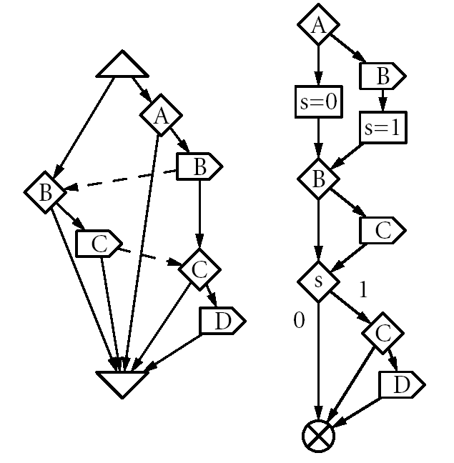
CCFG and SCFG

Slide 10
Step 4: Synthesize E-Code (using C)
Using the sequential code of Step 3, translate Esterel commands into E-Code commands
Need to do a double-pass to resolve cross-references between lines
Write the output file with the e-code ready to compile using the LegOS compiler

Slide 11
System Architecture
User Programs
Instruction Set of E-Machine
Trigger Lists
Computations
Scheduling
communications
LegOS & APIs
Processors, LCD, Beeps, Sensors, Motors

Slide 12
Instruction Set of E-Machine
NOP
JMP
CALL
SCHEDULE
FUTURE
RETURN
SLEEP

Slide 13
Triggers
Classification
  Sensor Triggers
    NULL_INPUT
    TOUCH_INPUT_1, TOUCH_INPUT_2, TOUCH_INPUT_3,
    LIGHT_LOW_1, LIGHT_HIGH_1, LIGHT_1_VALUE,
    LIGHT_LOW_2, LIGHT_HIGH_2, LIGHT_2_VALUE,
    LIGHT_LOW_3, LIGHT_HIGH_3, LIGHT_3_VALUE
  Timer Triggers
APIs
  Create_Trigger(signal, next, time)
  Insert_Trigger(trigger)
  Remove_Trigger(trigger)
  Cancel_Trigger(trigger)
  Evaluate_Trigger(trigger, predicate)

Slide 14
Project Demo
The robot performs a simple task:
  Move forward till it hits a wall or senses a dark surface below it
  Reverse direction and continue till it again hits a wall or senses a dark surface
  Continue this indefinitely….

Slide 15
The Esterel code
module project:
input LIGHT_LOW_2;
input TOUCH_INPUT_1;
output MOTOR_A_SPEED(integer), MOTOR_A_DIR(integer);
constant MOTOR_FWD, MOTOR_REV : integer;
constant TICKS_PER_SECOND = 1000 : integer;
loop
emit MOTOR_A_DIR(MOTOR_FWD);
emit MOTOR_A_SPEED(100);
await TOUCH_INPUT_1;
emit MOTOR_A_DIR(MOTOR_REV);
emit MOTOR_A_SPEED(100);
await LIGHT_LOW_2;
end loop

Slide 16
Synthesized C code (I)
#include <stdlib.h>
#include <sys/em.h>
#include <conio.h>
#include <unistd.h>
#include <time.h>
#include <dsound.h>
#include <dmotor.h>
#include <dsensor.h>
void function1() {
motor_a_dir(1);
}
void function2() {
motor_a_speed(100);
}
void function3() {
motor_a_dir(2);
}
void function4() {
motor_a_speed(100);
}

Slide 17
Synthesized C code (II)
int main() {
inst_t eco[10];
emachine_t *em;
ds_active(&SENSOR_1);
ds_active(&SENSOR_2);
ds_active(&SENSOR_3);
eco[0].opcode = CALL;
eco[0].arg1 = (int) &function1;
eco[1].opcode = CALL;
eco[1].arg1 = (int) &function2;
eco[2].opcode = FUTURE;
eco[2].arg1 = (int) TOUCH_INPUT_1;
eco[2].arg2 = (int) 4;
eco[3].opcode = RETURN;
eco[4].opcode = CALL;
eco[4].arg1 = (int) &function3;
eco[5].opcode = CALL;
eco[5].arg1 = (int) &function4;
eco[6].opcode = FUTURE;
eco[6].arg1 = (int) LIGHT_LOW_2;
eco[6].arg2 = (int) 8;
eco[7].opcode = RETURN;
eco[8].opcode = JMP;
eco[8].arg1 = (int) 0;
eco[9].opcode = NOP;
em = (emachine_t *) malloc (sizeof (emachine_t));
em->eco = eco;
em->eco_size = 10;
Emachine(em);
return 0;
}

Slide 18
The cross-compiler…

