Slide 1
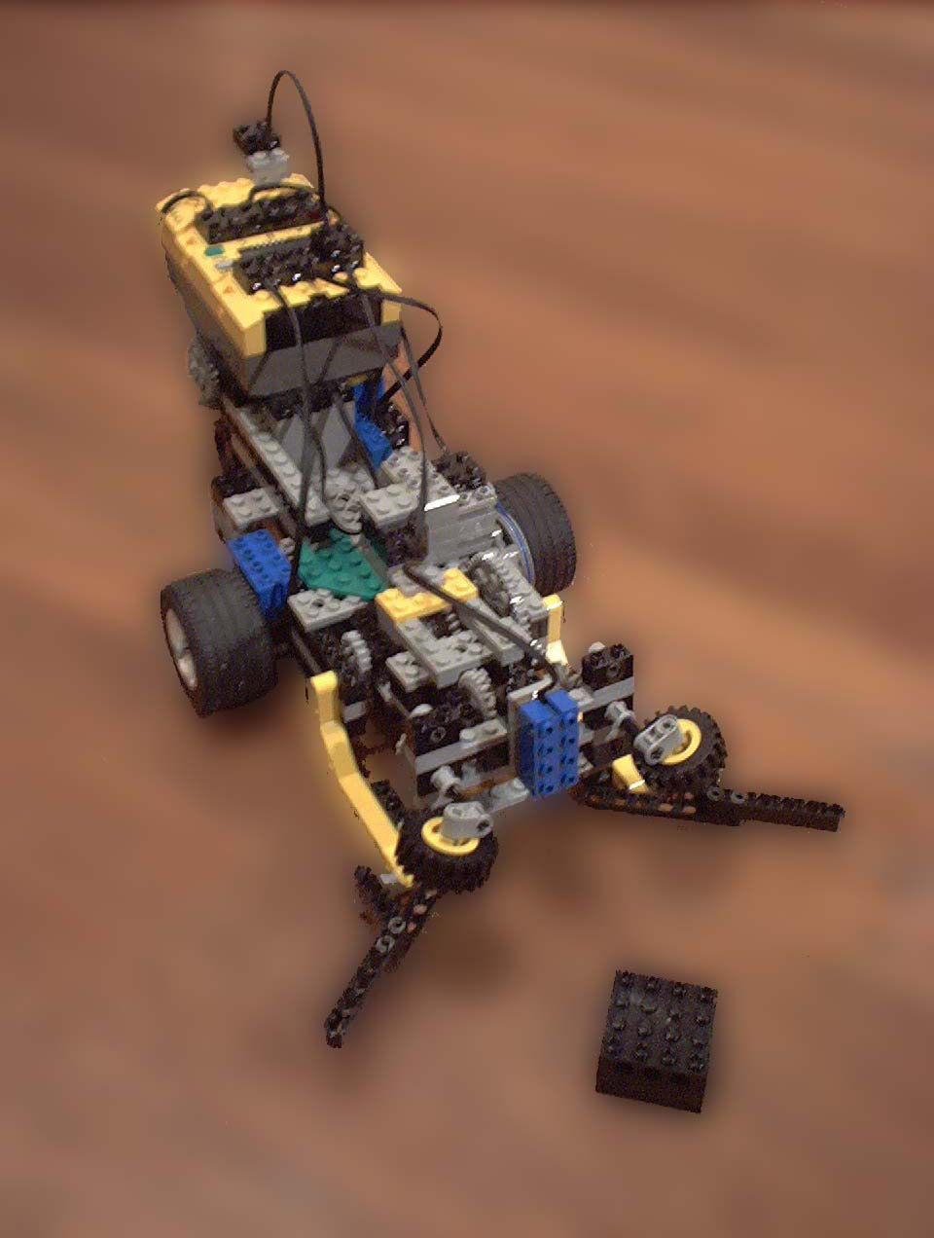
Search and Rescue Robot
Shannon Zelinski
Chris Cortopassi

Slide 2
Outline
Problem Formation
Implementation Goals
Low Level Control (reusable commands)
High Level Control (threading)
Scheduling

Slide 3
Problem Formation
Autonomous!
Search for block within contained rectangular area
Once found, pick up block, return it to starting point and orientation.
Ability to pause anywhere in process via network linked RCX

Slide 4
Implementation Goals
Simplicity
  Use minimal threads composed of sequential command blocks
  Steer and drive separately
  Fixed turning radius
  Snake search pattern
Accuracy
  Motor profiling
  Human calibration
  Weight distribution

Slide 5
Low Level Control
Change steering
  Steers to given absolute steering position
Drive
  Drives forward by the given relative distance
Arm control
  Opens and lifts arm or closes and lifts arm depending on the given direction

Slide 6
Velocity Profiling
Ideal
Smooth
Position
Profile
x
t
Ideal
Trapezoidal
Velocity
Profile
v
t
Anticipate target
Our
Simple
Approximation
v
t

Slide 7
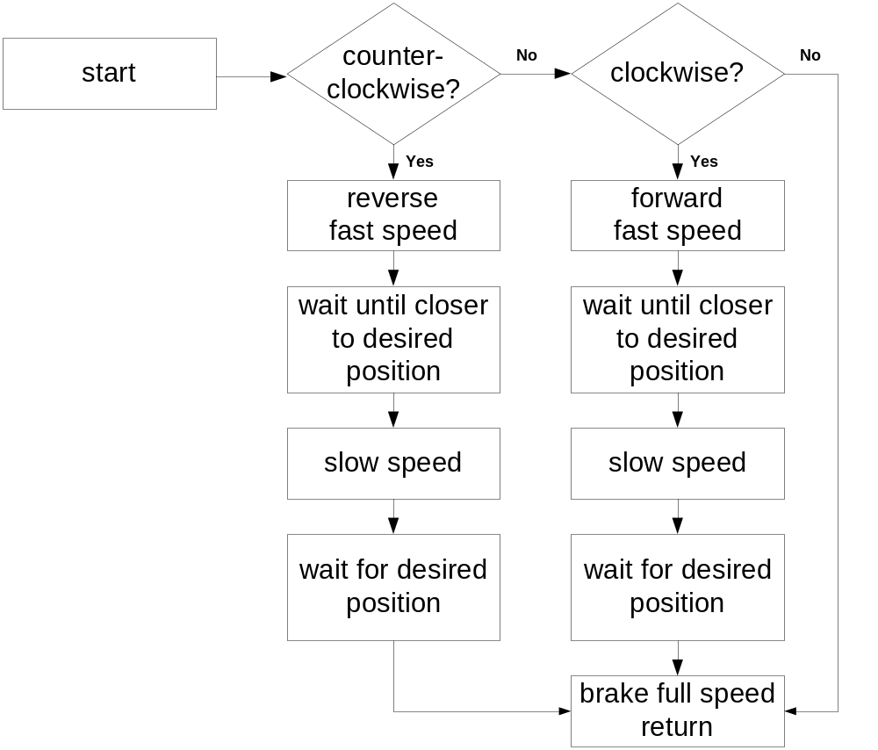
Change_steering(value)
Value=desired absolute steering position
Waits implemented with NULL while loops
Slow when close to avoid over shooting position

Slide 8
Steering_change code
void change_steering(int value)
{ // counterclockwise
if (value < ROT_STEER_DATA)
{
motor_c_dir(rev);
motor_c_speed(F_STEER_SPEED);
while(ROT_STEER_DATA > value + OVER_SHOOT) {} //NULL while loop
motor_c_speed(S_STEER_SPEED);
while(ROT_STEER_DATA > value) {}
}
// clockwise
else if (value > ROT_STEER_DATA)
{
motor_c_dir(fwd);
motor_c_speed(F_STEER_SPEED);
while(ROT_STEER_DATA < value - OVER_SHOOT) {}
motor_c_speed(S_STEER_SPEED);
while(ROT_STEER_DATA < value) {}
}
motor_c_dir(brake); //full speed breaking
motor_c_speed(255);
msleep(SLEEP_TIME);
}

Slide 9
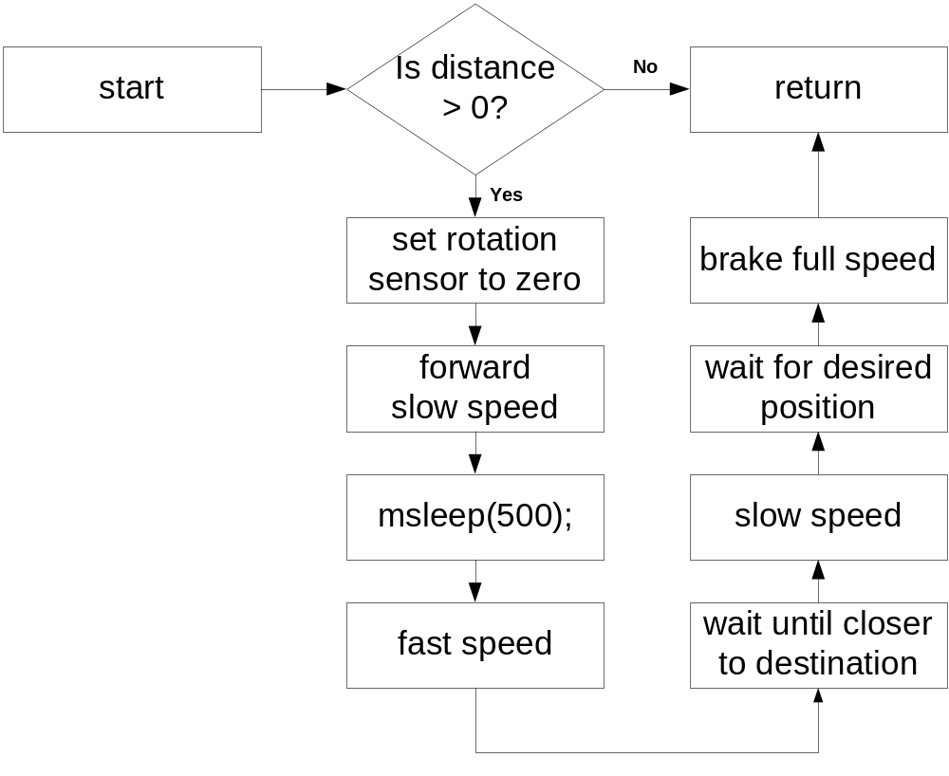
Drive(value)
Value=desired relative distance
Waits implemented with wait_event
Start at slow speed for less wheel slip
Slow when close to avoid over shooting position

Slide 10
Drive code
void drive(int distance)
{
if(distance > 0)
{ // set current position to zero
ds_rotation_set(&ROT_DRIVE_SENSOR, 0);
motor_b_dir(fwd);
motor_b_speed(S_DRIVE_SPEED);
msleep(500);
motor_b_speed(F_DRIVE_SPEED); // wakeup function used
wait_event(&drive_wakeup, distance - OVER_SHOOT);
motor_b_speed(S_DRIVE_SPEED);
wait_event(&drive_wakeup, distance);
motor_b_dir(brake); // full speed breaking
motor_b_speed(255);
msleep(SLEEP_TIME);
}
}

Slide 11
Arm(dir)
#define OPEN fwd //arm(OPEN) opens arm
#define CLOSE rev //arm(CLOSE) closes arm
void arm(short dir)
{
motor_a_speed(ARM_SPEED);
motor_a_dir(dir);
wait_event(&touch_wakeup, TOUCHED);
motor_a_speed(0);
msleep(SLEEP_TIME);
}

Slide 12
Threads
Search
  Run a snake pattern
Rescue
  Wait for block, return to starting position/orientation when found.
Pause
  Pause/resume Search/Rescue threads
Display
  Local and remote real-time display

Slide 13
Thread Priorities
DISPLAY
Display local
TX Network
PAUSE
Wait for pause
…
High
Priority
Network
Rx Handler
SEARCH
Drive
Turn
…
RESCUE
Wait for block
…
Low
Priority
State saved
during pause

Slide 14
Snake Search Pattern
180
180
Search Area
…
Y
Home
180
ΔX

Slide 15
Search Thread
Look for Block
Look for Block
STRAIGHT
Drive Y
Drive Y
Ignore Block
Ignore Block
Steer LEFT
Steer RIGHT
TURN
Drive 180
Drive 180
Steer CENTER
Steer CENTER
Leg++
Leg++

Slide 16
Rescue Pattern
Down Case
Up Case
180
Up: y
Down: Y - y
Home
90
90
Leg x ΔX

Slide 17
Rescue Thread
No
Wait for
Block
Steer LEFT
Drive 90
Kill search thread
Steer CENTER
Stop
Case 1
Close arm
Drive Leg x ΔX
Steer LEFT
Up
Leg
Yes
Drive 180
Steer LEFT
Steer CENTER
Drive 90
Case 2
Drive Y - y
Drive y
Steer CENTER
Leg++
Open Arm

Slide 18
Pause Thread
Wait for
Pause
wait_event to let lower
priority threads run
Save Motor Speeds
Speeds = 0
Wait for
Resume
Busy wait to block
lower priority threads
Restore Motor Speeds

Slide 19
Collision Handling
Pause/Resume important
Collisions frequent with two-way communication
  Add retries with “back off”
Results in high reliability, but not guaranteed
NODE 1
send(packet)
while(collision)
wait 100 ms
send(packet)
NODE 2
send(packet)
while(collision)
wait 0 ms
send(packet)
!
Important
avoids runaway
collisions

Slide 20
Scheduling
Wait_event
  Poll only once every 20ms
  Allows lower priority threads to run
While
  Poll continuously for 20ms
  Prevents wasting CPU cycles in idle

Slide 21
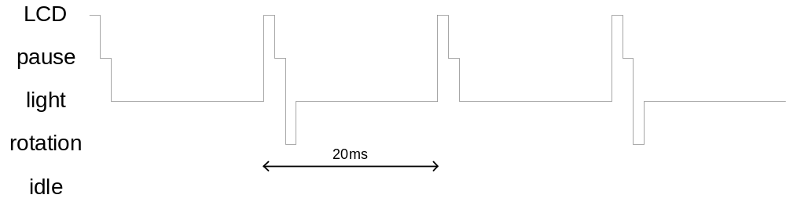
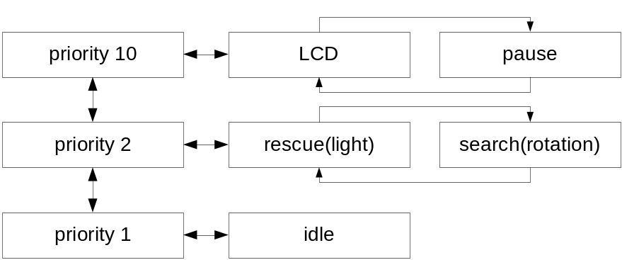
Driving straight
while
while
while
while

Slide 22
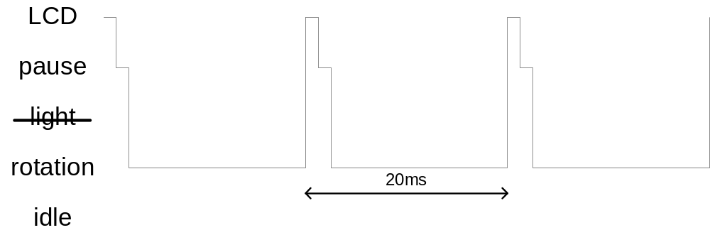
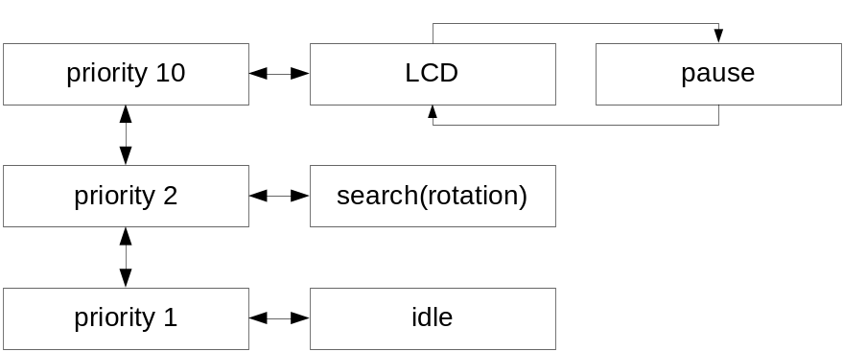
Changing steering
while
while
while

Slide 23
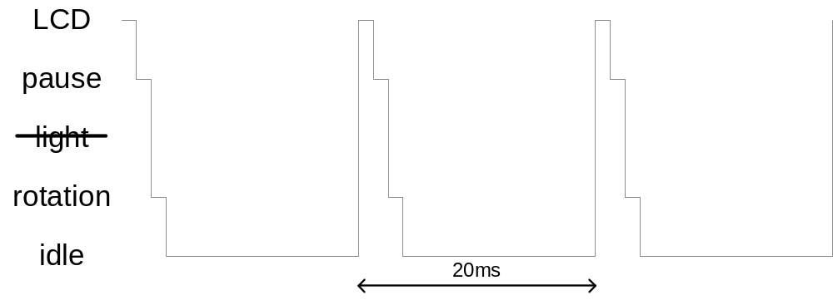
Driving turn

Slide 24
Search and Rescue Robot
Shannon Zelinski
Chris Cortopassi

