Slide 1
“Let There Be Light”
EE290-O
Sinem Coleri
Slobodan Matic
Anshuman Sharma

Slide 2
Motivation & Problem Definition
Setup
Algorithm Overview
Details
Communication
Problems
Conclusion

Slide 3
Motivation & Problem Definition
Setup
Algorithm Overview
Details
Communication
Problems
Conclusion

Slide 4

Ride in the future…
Mars Exploration
Autonomous Unit
  Microrover
“Ground-truthing”
Equipped
  3 scientific measuring devices
Courtesy: NASA

Slide 5
Precision & Accuracy
Avenue for development of real-time applications
Distributed tasks would be even more complex
Example:
  A platoon of robots exploring surface chemical composition and atmospheric structure

Slide 6
Motivation & Problem Definition
Setup
Algorithm Overview
Details
Communication
Problems
Conclusion

Slide 7
Experiment
To find an object emitting light of certain intensity
Leader robot
  Equipped with light sensor
Follower
  “Blind”, moves as directions are relayed

Slide 8
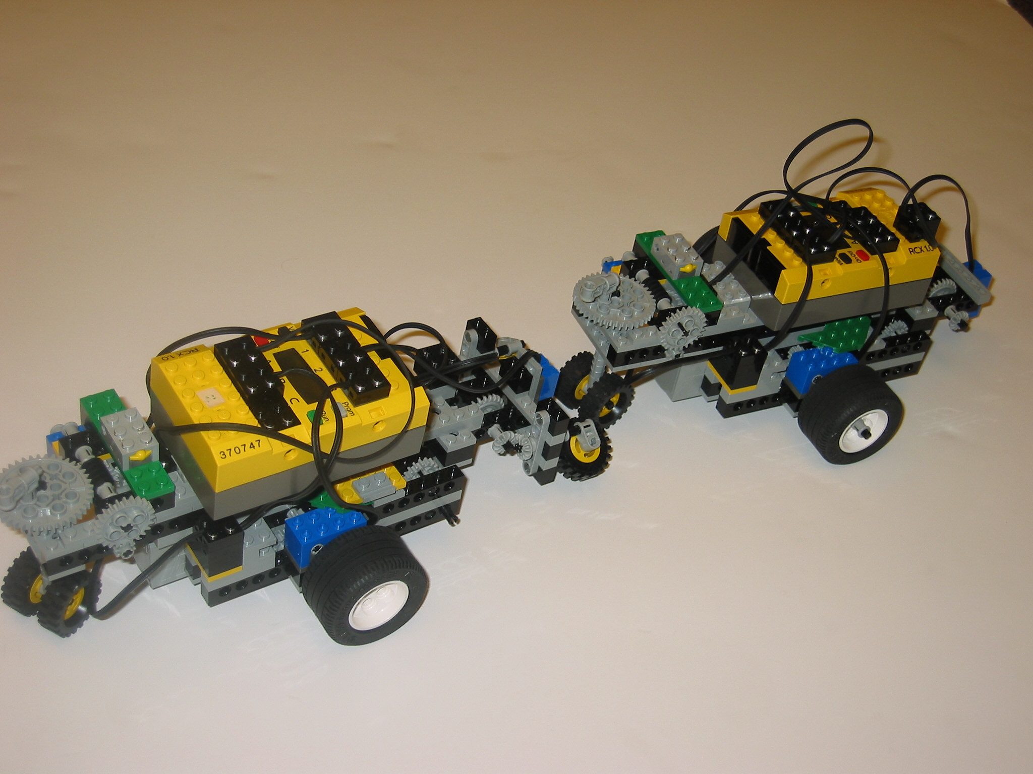
Experiment…
Leader starts
Identifies right direction – transmits
Follower starts from the position just behind the leader
Maintains a “distance” of 2 moves

Slide 9
Motivation & Problem Definition
Setup
Algorithm Overview
Details
Communication
Problems
Conclusion

Slide 10
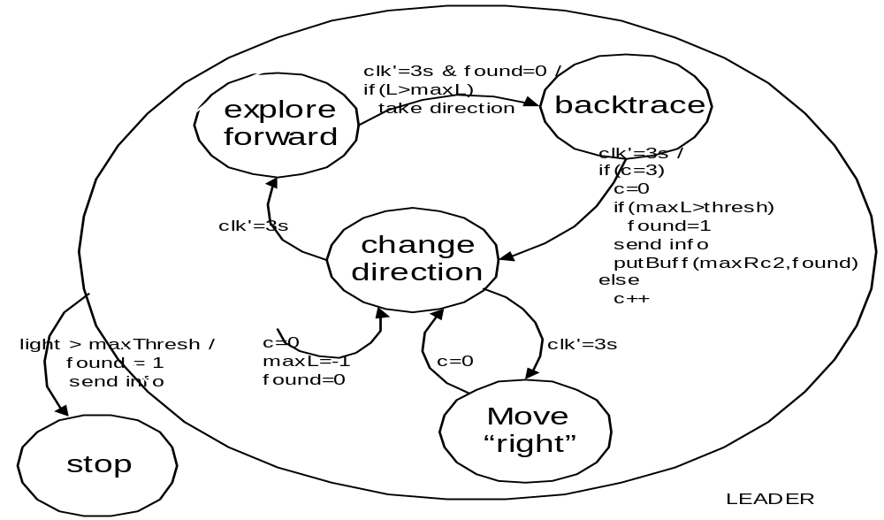
Leader

Slide 11
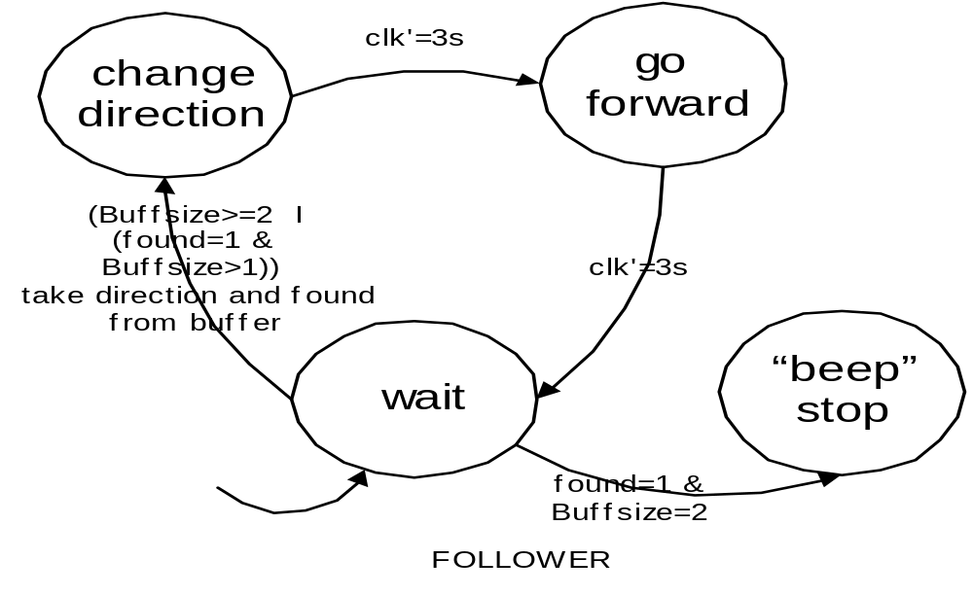
Follower

Slide 12
Motivation & Problem Definition
Setup
Algorithm Overview
Details
Communication
Problems
Conclusion

Slide 13
Leader program abstraction
T=36s
Rotation
Sensors
Control
s
120
s
a
Motors
a
ref
i
Reference
12
Light
Sensor
s
i
dir
Send
1
Notes:
Software Communication Shared Variables

Slide 14
Follower program abstraction
T=3s
Rotation
Sensor
Control
s
6
s
a
Motor
a
ref
i
Reference
1
Notes:
Environment Triggering Interrupt Handlers

Slide 15
Giotto task definition
LEADER
mode search() period 36000 {
actfreq 72 do motorT(updateT_dir_speed);
actfr eq 72 do motorR(updateR_dir_speed);
taskfreq 72 do control(input_control);
taskfreq 12 do reference(input_reference);
taskfreq 1 do send(input_send);
}
FOLLOWER
mode search() period 3000 {
actfreq 6 do motorT(updateT_dir_speed);
actfreq 6 do motorR(updateR_dir_speed);
taskfreq 6 do control(input_control);
taskfreq 1 do reference(input_reference);
}

Slide 16
Emachine
while (i < n_enabled_triggers) {
/* check enabled triggers for activation */
…
while (!end) { …
switch(e_code[pc].opcode) {
case OPCODE_IF:
/* evaluate condition and jump accordingly */
case OPCODE_FUTURE:
/* enable, insert and set trigger_time */
case OPCODE_CALL:
/* execute driver_code */
case OPCODE_SCHEDULE:
/* post task-specific semaphore */
case OPCODE_RETURN:
/* end == 1 */
}
}

Slide 17
Leader Ecode and functionality
instruction_t leader[MAXINSTR] = { … /* 11 */ CALL(T_motor_device_drv), /* 12 */ CALL(R_motor_device_drv), /* 13 */ IF(reference_cond,19), /* 14 */ IF(send_cond,16), /* 15 */ SCHEDULE(send_task), /* 16 */ CALL(reference_out_drv), /* 17 */ CALL(reference_drv), /* 18 */ SCHEDULE(reference_task), /* 19 */ CALL(control_drv), /* 20 */ IF(found_cond,24), /* 21 */ SCHEDULE(control_task), /* 22 */ FUTURE(500,11), /* 23 */ RETURN(), /* 24 */ … / * STOP mode Ecode */ } | void control_task() { T_speed = P*(T_g_ref - T_increment); T_dir = (T_speed < 0) ? fwd : rev; T_speed = (T_speed < 0) ? -T_speed : T_speed; /* the same for steering wheel */ } void control_drv() { T_increment = ROTATION_3; R_increment = ROTATION_1; } void T_motor_device_drv() { motor_b_dir(T_dir); motor_b_speed(T_speed); } void send_task() { … direction = read_circBuffer(&directions); … data[0]=direction; data[1]=found; … lnp_addressing_write(data,len,DEST_ADDR,MY_PORT; }

Slide 18
Follower Ecode and functionality
instruction_t follower[MAXINSTR] = { /* 0 */ CALL(T_motor_device_drv), /* 1 */ CALL(R_motor_device_drv), /* 2 */ IF(reference_cond,8), /* 3 */ CALL(reference_out_drv), /* 4 */ IF(found_cond,12), /* 5 */ IF(move_cond,8), /* 6 */ CALL(reference_drv), /* 7 */ SCHEDULE(reference_task), /* 8 */ CALL(control_drv), /* 9 */ SCHEDULE(schedule_task), /* 10 */ FUTURE(500,0), /* 11 */ RETURN(), … / * STOP mode Ecode */ }; | unsigned move_cond() { if ((directions.tail - directions.head) % SIZE_CIRCULAR) >= INTERVAL) { return 0; return 1; } void reference_drv() { dirNew = read_circBuffer(&directions); } void reference_task() { switch(++search) { case 1: if(dirNew > dir) R_l_ref = -R; if(dirNew < dir) R_l_ref = R; break; case 2: if((dirNew-dir) > 1) R_l_ref = -R; if((dirNew-dir) < -1) R_l_ref = R; break; case 3: T_l_ref = T; dir = dirNew; search= 0; break; } }

Slide 19
Motivation & Problem Definition
Setup
Algorithm Overview
Details
Communication
Problems
Conclusion

Slide 20
Communication in LegOS
Sending a packet
  Send function
    result = lnp_addressing_write(data, len, DEST_ADDR, MY_PORT)
Notes:
Data pointer to the data to send
Len how many bytes to send
DEST_ADDR address you are sending to
MY_PORT port that you are sending from
Function return 0 if successful

Slide 21
Communication in LegOS
Receiving a packet
  Registering handler function with LNP:
    lnp_addressing_set_handler(MY_PORT, packet_handler)
  Defining handler function called from LegOS interrupt routines
    void packet_handler(data, length, src) {…….}
Notes:
In order to receive data, you must set up packet handlers. Handler will be called whenever a packet arrives on that handler’s port.
Set up handler for each port you are expecting to receive data
First installs packet_handler function on port MY_PORT. Data received on that port, packet_handler function called
Second from interrupt routines, cannot be blocked
Src address of program that sent the packet

Slide 22
Communication-Network Interface(CNI)
Data-sharing interface between e-machine and communication
  Originally interface between host and TTP
    Communication related status info in shared memory
      Ex:global time
    Non-blocking Write (NBW) protocol for consistent data transfer from network to host
E-machine
Shared
Memory
CNI
Communication
Controller
Notes:
Normally part of TTP, which is a protocol for fault-tolerant distributed systems. In that system, shared memory and specific access mechanisms are needed for control status information. For example, synchronization provided by network and read by application. Current time info is in that area. TDMA access mechanism and controlled by the data stored in message descriptor list (MEDL). MEDL is also in shared memory

Slide 23
Communication-Network Interface(CNI)
  Our interface between e-machine and communication controller
    Movement and light info in shared memory
      Variable found showing whether light is found
      Variable keeping directions that leader robot has gone through
E-machine
directions
CNI
found
Communication
Controller

Slide 24
Non-Blocking Write(NBW) Protocol
Motivation
  Variable found
    Should not be accessed from communication controller and e-machine at the same time
    Should be updated in receiver handler without delay
      Handler is called from interrupt routine
Notes:
Only first requirement is enough for the usage of semaphore
Second requires NBW especially for receiver

Slide 25
Non-Blocking Write(NBW) Protocol
Writer is never blocked
  Writes new version of data into shared memory whenever a new message arrives
Reader retries read operation upon detection of write
Progress of
reading task
Reads from shared memory
Progress of
receive_handler
Write to shared memory

Slide 26
Non-Blocking Write(NBW) Protocol
Implementation
  Concurrency control field(CCF)
    Associated with each data type
typedef struct nBlockingType{
char value;
int CCF;
}nonBlockingType;

Slide 27
Non-Blocking Write(NBW) Protocol
Implementation
  Concurrency control field(CCF)
    Used to detect the data access of writer
void write(nonBlockingType * var, char val) {
……..
old_CCF = var->CCF;
var->CCF = old_CCF + 1;
DATA ACCESS
var->CCF = old_CCF + 2; }
char read(nonBlockingType * var) {
…
do {
CCF_begin = (var->CCF);
while ( (CCF_begin%2) == 1)
CCF_begin = (var->CCF);
DATA ACCESS
CCF_end = (var->CCF);
} while(CCF_end != CCF_begin);
…
Notes:
Testing this by putting sleep

Slide 28
Circular Buffer
Motivation
  Follower robot waits until a specific number of directions are accumulated
    To keep the distance between leader and follower constant
  Leader robot can get more than one correct direction before performing send operation
Notes:
Leader stops as soon as it finds the light and sends a packet. Before sending packet, …

Slide 29
Circular Buffer
Implementation
  Classical circular buffer description
typedef struct cBuffer{
char buffer[SIZE];
int head;
int tail;
}circularBuffer;

Slide 30
Circular Buffer
Implementation
  Reader never reads the same memory location as writer writes into
void write_circBuffer(circularBuffer * c, char val){
…….
if (c->head != ((c->tail + 1) % SIZE)){
c->buffer[c->tail] = val;
c->tail = (c->tail + 1) % SIZE;}
…..
char read_circBuffer(circularBuffer * c){
…..
if(c->head != c->tail){
ret = c->buffer[c->head];
c->head = (c->head + 1) % SIZE;
……
Notes:
Assume no overflow since the direction not make sense with overflow so do not write anything. Choose buffer size large enough

Slide 31
Motivation & Problem Definition
Setup
Algorithm Overview
Details
Communication
Problems
Conclusion

Slide 32
Not a “cake-walk”
Dependence on “quality” of batteries
Rotational errors – poor gear mechanics
Light source and light sensor
Communication requires line of sight

Slide 33
Solutions
Change batteries periodically
  Tweak code to reflect battery strength
Manually adjust gears to turn equally
  Leader uses more battery power
Different light orientations
  Active vs Passive sensing
Limit the distance between the bots
  Communicate without line of sight!!!

Slide 34
Motivation & Problem Definition
Setup
Algorithm Overview
Details
Communication
Problems
Conclusion

Slide 35
Phew!
Spent more time calibrating than developing logic
Algorithm modifications
  Leader smarts
LegOS needs power management!!

