Slide 1
Sortbot
E-Machine goes Lego

Slide 2
Introduction
Implementation of E-Machine and
S-Machine
Hardware: Lego Robotics Invention
Software:
RCX: brickOS Ver. 0.6.2.10
Programming Language: C++
Challange: Sorting lego bricks by colour

Slide 3
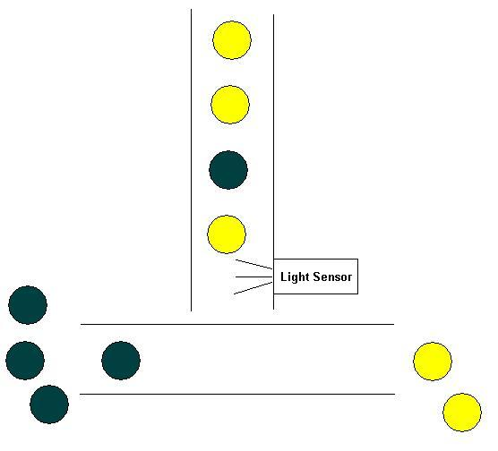
Sorting Lego Bricks

Slide 4
Hardware
2 conveyer bands (motor A and C)
1 light sensor (sensor 3)
1 touch sensor (sensor 2)
1 RCX
174 different lego parts
-> assembled together = Sortbot

Slide 5
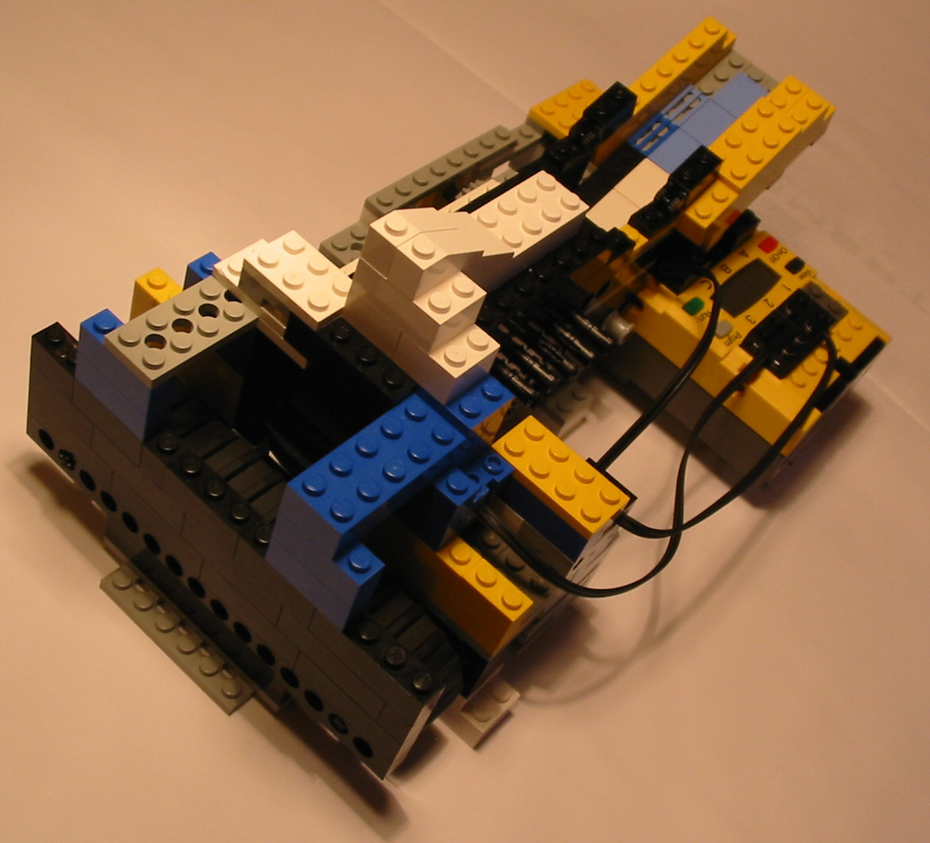
Hardware Cont.

Slide 6
Scheme
Motor C
Clock
Stop / change dir
L-Sensor
E-Machine
S-Machine
T-Sensor
Base frequenzy = 200 Hz

Slide 7
E-Code and S-Code
e00: if( halted, e05 )
e01: if( is_item, e08 )
e02: if( stop_c, e11 )
e03: future( 5, e00 )
e04: return s00: dispatch( halt_program[0] )
s01: dispatch( set_motor_c[0] )
e05: release( halt_program[5] ) s02: jump( s00 )
e06: future( 5, e00 ) s03: return
e07: return
e08: release( set_motor_c[500] )
e09: future( 5, e00 )
e10: return
e11: release( set_motor_c[5] )
e12: future( 5, e00 )
e13: return

Slide 8
Demo
Enjoy the demo!

