Slide 1

Programmable Temporal Isolation through Variable-Bandwidth Servers
Ana Sokolova
Department of Computer Sciences
University of Salzburg
joint work with
Christoph Kirsch and Silviu Craciunas
Notes:
I will present a particular scheduling problem and both our theoretical and experimental results
We start with the simplest definition of our process model

Slide 2
Process model
action α1
action α2
load
process
time
arrival
termination
response time
speed
action is a piece of code
process is a sequence of actions
Notes:
Consider a process that executes in time
Suppose that at a certain point in time we are at a certain point in the code of the process (we denote this as arrival)
At another point in time we want to arrive at a different location in the code
We call this an action, each action has a load that represents the time it takes for the action to finish if it were running alone on the cpu.
We are interested in the response time of an action.
In order to quantify the response time an action must execute its load with a certain speed. We will see later what this speed really is.

Slide 3

Problem
process 1
process 2
uniprocessor
.
.
.
process n
schedule the processes so that each of their
actions maintains its response time
Notes:
Now suppose we ave multiple processes, each with sequential actions running on the same processor.
The problem is how to schedule the processes such that the response time of each of their actions is maintained

Slide 4
Goal
solve the scheduling problem
(temporal isolation)
change execution speed of processes
(programmable)
solve admission problem
(changeable set of processes)
Solvable with variable
bandwidth servers (VBS)
Results:
a constant-time scheduling algorithm
a constant-time admission test
action α1
action α2
process
time
speed 1
speed 2
Notes:
Solve the scheduling problem, which scheduling processes in tempora lisolation, i.e. The reponse time of their actions is not affected by other concurrently running processes
Schedule the processes such that we can change the speed with which actions run, i.e. This means that the temporal isolation is programmable
Solve the admission problem, i.e. We have a changeable process set, meaning that new processes can enter the system and also processes can terminate
Solvabe with VBS and we present our results, namely a ct scheduling alg and ct admission test

Slide 5
Resources and VBS
virtual periodic resources
period π limit λ utilization λ/π
λ1
λ2
time
π1
π2
VBS is determined by a bandwidth cap (u)
VBS processes dynamically adjust speed (resource)
λ1/π1 ≤ u and λ2/π2 ≤ u
generalization of constant bandwidth servers (CBS)
[Abeni and Buttazzo 2004]
Notes:
We control the speed of action through the use of virtual periodic resources
A vpr is a pair of lambda, pi that allows a process to execute not more than lambda tiem units in pi time units. The utilization of a vpr is lambda/pi.
A VBS is a number that represents an upper utilization bound usually given in percentage of cpu time that a process can use.
Processes can dynamically adjust speed as long as .. holds
VBS can be seen as a generalization of CBS (Abeni and Buttazzo). CBS offer temporal isolation but processes cannot change the execution speed.

Slide 6
One process on a VBS
action α1
action α2
load
load
process
time
response time
response time
λ1
λ2
process
running on a VBS
time
π1
π2
response time
under VBS
response time under VBS
Notes:
Suppose that we have a process with action alpha like in the model, the action is mapped onto a vpr, etc
The reponse time of an action on a vbs approximates the desired reponse time due to the sampling into periods.

Slide 7
VBS
process
running on a VBS
time
arrival
termination
response time under VBS
new action
release
dispatch
next action
blocked
ready
running
completion
preemption due
to limit λ
preemption due
to release
Notes:
Scheduling of an action from arrival to completion

Slide 8
VBS
multiple processes are EDF-scheduled
process 1
(2,4)
0
4
8
12
16
20
process 2
(2,8)
0
8
16
process 3
(1,6)
0
6
12
18
blocked
ready
running
Notes:
Multiple vbs processes on a cpu in EDF fashion, where the deadline is the at the end of the current period of an action.
Suppose we have 3 processes with corrsponding actions running on the following vpr
At time 0 ...

Slide 9
Scheduling result and bounds
Processes P1,P2, … ,Pn on VBSs u1,u2, … ,un, are schedulable
if ∑ui ≤ 1
For any action α on a resource (λ,π) we have
upper response time bound
⎡load / λ⎤π + π - 1
jitter
π - 1
lower response time bound
⎡load / λ⎤π
Notes:
Our scheduling result is as follows:
Given n processes P1 to Pn running on respective VBSs with caps u1 to un, the processes are schedulable under Vbs if the sum of caps is smaller than or equal to 1
This is a sufficient but not necessary test.
For any action alpha with the vpr lambda,pi, we have that
Upper response time bound is …
Lower response time bound is ...
Jitter is …

Slide 10

Programmable temporal isolation
the “speed“ of an action is programmable
(influencing response time and jitter)
smaller π ⇒
+ smaller jitter
+ VBS response time closer to „ideal“ response time
- higher administrative overhead
(more scheduler invocations)
Finding the right λ,π is difficult.
server design
problem
Notes:
We call the temporal isolation programable if the speed of an action is programmable, which in turn affects jitter and response time
Smaller pi for example could lead to smaller jitter and the response time being closer to the ideal one but at the same time we will have higher administrative overhead
Finding the right pi and lambda is difficult and is not in the scope of our paper but this problem is known as the server design problem.

Slide 11
Real-world example
loop {
sensor_data = read(sensors);
actuator_data=compute(sensor_data);
write(actuator_data);
log(actuator_data);
update_internal_state();
} until (done);
low latency
action 1
less stringent
action 2
control-loop period
different throughput and latency requirements
for different portions of code

Slide 12
Implementation
constant-time scheduling algorithm
different queue management plugins
(lists, arrays, matrices, trees)
trade off time and
space complexity
 | list | array | matrix/tree
time
space
n – number of processes t – number of time instants
Notes:
We have implemented a constant time scheduling algorithm and 4 different queue management plugins. The processes in a VBS system are placed in ready and blocked queues and the complexity of the scheduling algorithm is dominated by the complexity of the queue operations.
Using different queues results in different time and space complexities.
For example with less time overhead the space overhead grows quadratically in period resolution for both plugins.
This allows us to trade-off space and time complexity.
We will further show the complexity results in different experiments.

Slide 13

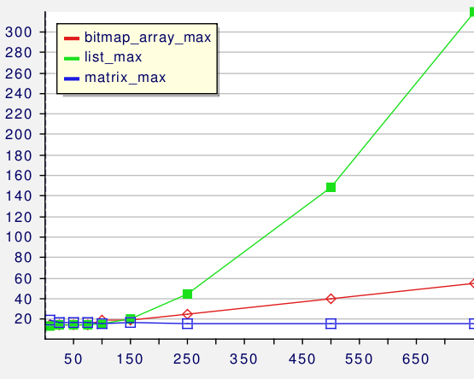
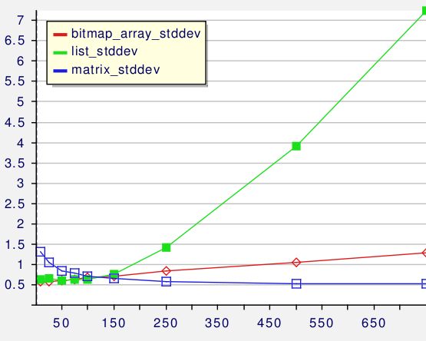
Results
scheduler overhead
break-even point
Maximum duration(μs) for increasing
number of processes
Standard deviation for increasing
number of processes
Notes:
On the right we conducted an experiment measuring the maximum scheduler overhead in msec when the number of the processes in the system is increasing
We can see that for less than 150 processes there is no point in using the matrix plugin as it would not result in better performance
On the left we have the standard deviation in function of increasing number of processes
We can see that the algorithm with the matrix plugin runs in constant time independent of the number of processes inthe system

Slide 14
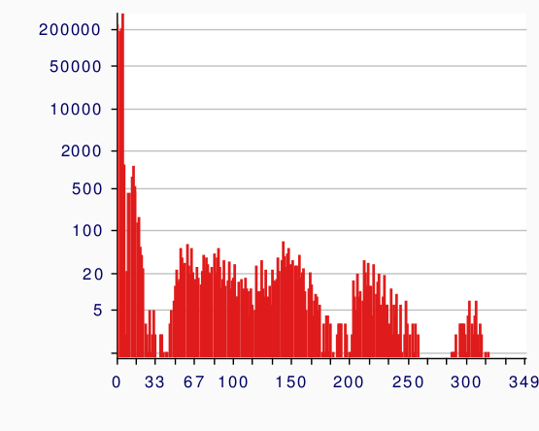
Results
scheduler overhead (list)
20 scheduler
runs had 100μs
duration
scheduler execution variance
Notes:
We next have a histogram showing the variance of scheduler overhead times.
On the x axis we have the time in microseconds and on the y axis the number of scheduler invocations that took a certain amount of time.
For example 20 scheduler runs had each an execution time of 100 microsec.
As can be seen, the scheduler execution variance spans from very low to around 300 microsecs when using the list plugin

Slide 15
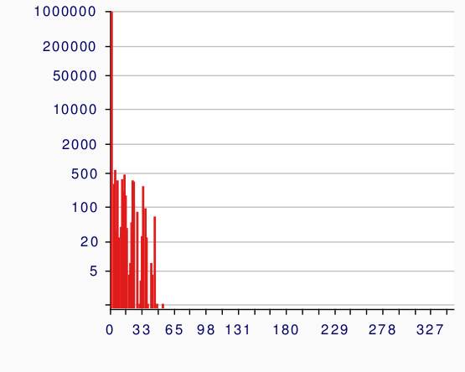
Results
scheduler overhead (array)
Notes:
With the array plugin the variance is reduced to around 60

Slide 16
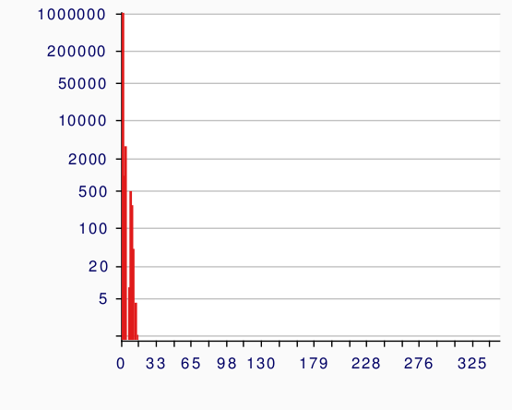
Results
scheduler overhead (matrix)
Notes:
And with the matrix we have very low variance

Slide 17
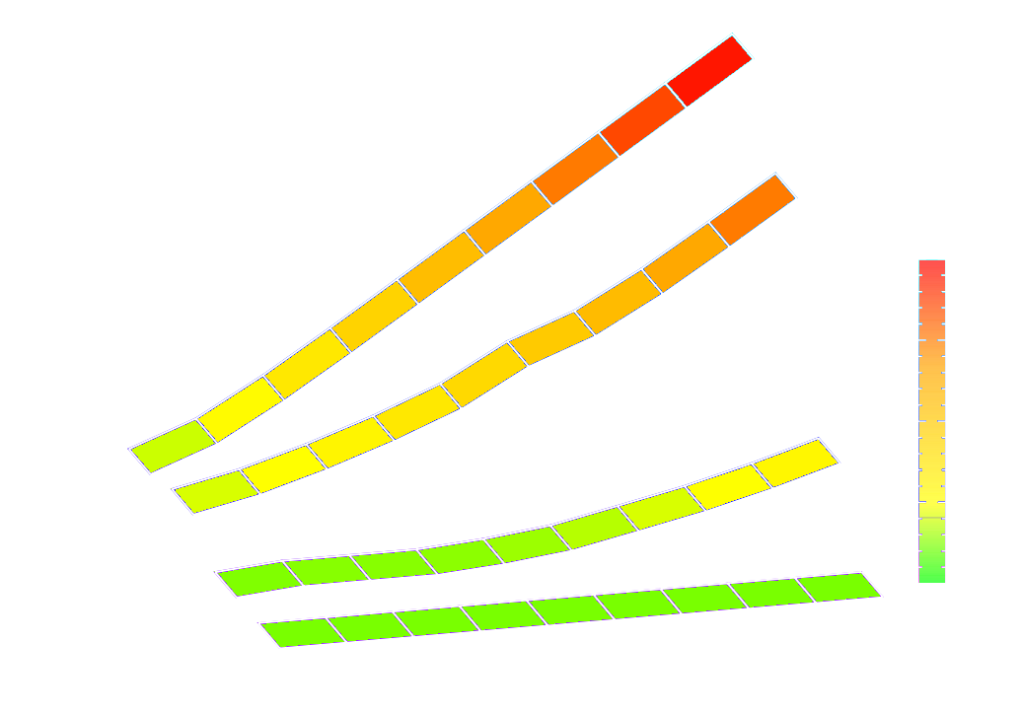
Results
space complexity
750 processes
Notes:
The different time complexities come with an increase in space overhead. The results shown are for 750 processes.
On the x-axis we have the number of different periods that we can distinguish in the sytem, on the y-axis the different plugins and the z-axis is logarithmic and shows the space consumption.
For the list plugin we have very low space overhead, for the array it goes up a little but for the constant-time matrix plugin we see a very high space penalty of around 1GB. We implemented the tree plugin to reduce this overhead to around 100MB.
Space consumption by the tree plugin is significantly smaller than with the matrix plugin if the period resolution is higher than the number of servers

Slide 18
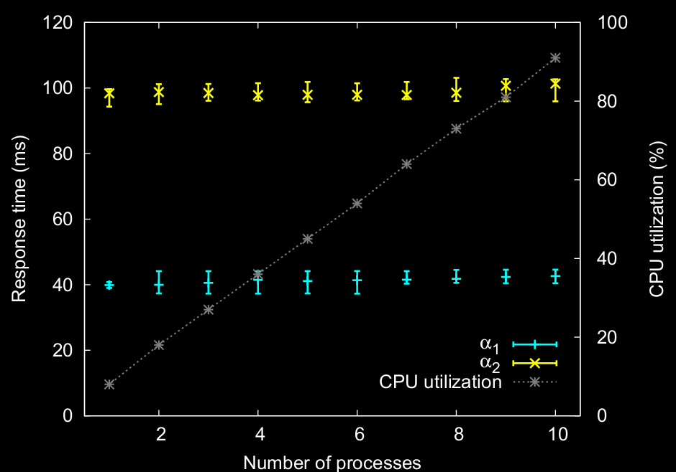
Results
bare-metal experiment
in theory response time jitter is
one period
in practice the jitter may be more
than one period but still bounded
scheduler
overhead accounting
Notes:
In order to show the temporal isolation properties of our scheduler we conducted a bare-metal experiment on an XScale 400MHzprocessor
with 64MB RAM. We run and measure the response time of a single process with two action first as a single process in the system and then we increase the number of concurrently running processes. We can see that the system utilization goes up to around 92% when the number of processes increases but the response tiem stays within some bounds shown here as max and min. In theory the respose time jitter should be one period but in reality it is mor because of factors like scheudler overhead. We are currently working on more exact bounds that accont also for the scheduler overhead.

Slide 19
Conclusion
VBS scheduling enables:
    temporal isolation
    trading off throughput and latency
    controlling the response-time jitter of individual process actions
    trading off space and time complexity of the scheduling overhead
Thank you!
http://tiptoe.cs.uni-salzburg.at/
Notes:
In conclusion ....

Slide 20

VBS
selected related work
CBS does not allow changing of the period and limit
RBED and VBS differ on the level of abstractions provided

Slide 21
Release strategy
late release
time
arrival
termination
response time under VBS
early release
time
arrival
termination
response time under VBS
Notes:
Scheduling of an action from arrival to completion

Slide 22
Logical response time jitter
actual termination
Process runnning on VBS
time
arrival
logical termination
jitter
2(π - 1)
Notes:
Scheduling of an action from arrival to completion

