Slide 1

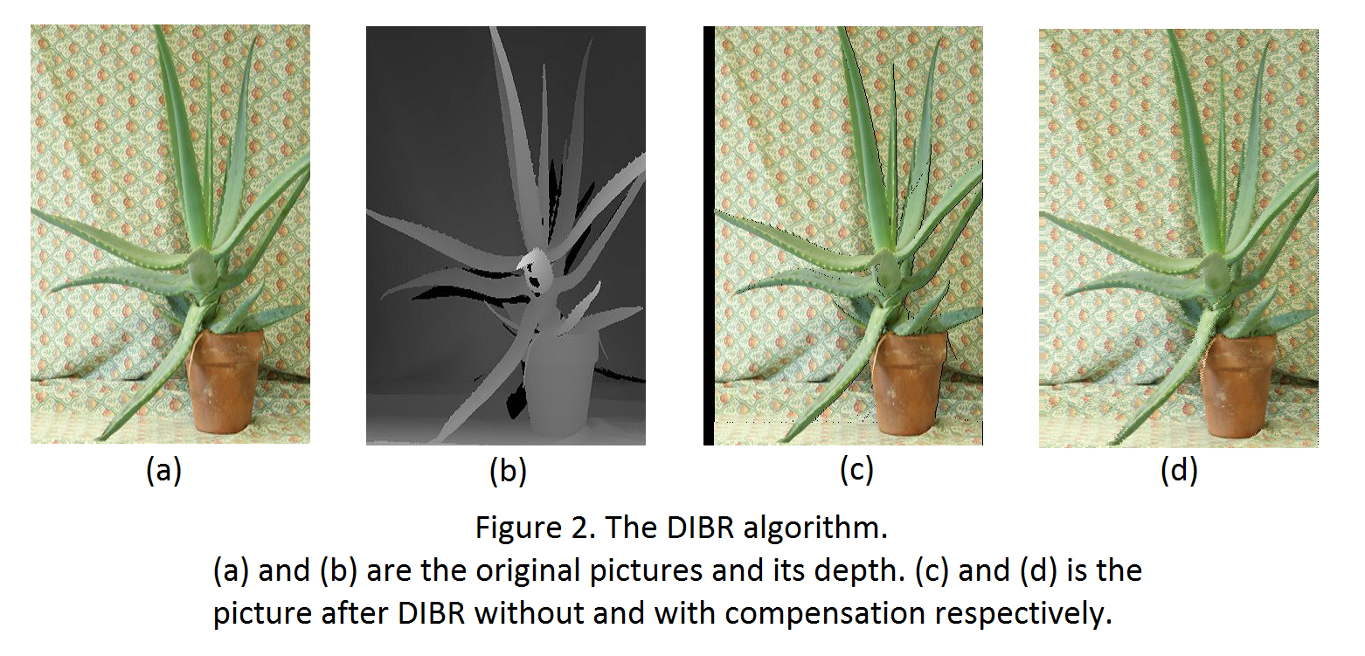
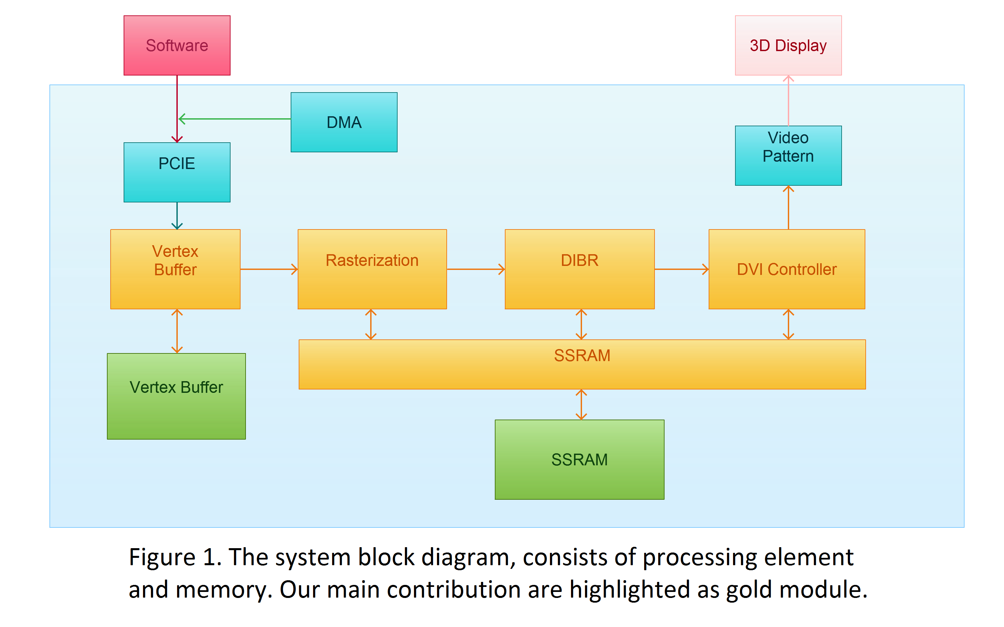
Simple PCI-e Graphics Card with 3D Display
Chi-Wen Cheng, Shih-Chieh Lin, and Hung-Yu Tseng
Advisor. Professor Shao-Yi Chien
Department of Electrical Engineering, National Taiwan University
Introduction
In this project, we model a simple PCI-e graphics card which supports 3D display. The reason why it’s simple is that the card is a fix-pipeline design and doesn’t support many modern GPU’s feature function such as texture mapping. However, the card can do simple rasterization and can interpolate the pixel when the vertices in 3D space are transformed onto a 2D frame. Furthermore, we implement the DIBR algorithm in hardware, which draws the right frame in 3D display with only the original left frame and depth map. In short, the simple graphics card receives transformed triangle vertices data from software through PCI-e bus as its input. Then, the hardware rasterize and do the DIBR processing, and directly write the frame to DVI output from the hardware.
Design Methodology
As a hardware-software co-design, we decide to do the transformation(, including model, view, projection) in the software because if we do this in the prototype hardware, it would cost a lot of resources to compute many mathematic operation such as sine or cosine. As the hardware part, get a quick look at Figure 1 first. The transformed vertices data are stored in an internal memory first. After all the data loaded to the memory, the rasterization engine starts interpolating the color and depth, transforms the coordinates into screen space and creates and saves a simple frame in SSRAM. When rasterization completes its work, the DIBR engine would create another frame with the original frame and the depth map in order to support 3D display. The DIBR algorithm uses a simple common knowledge that the closer the object is, the more different our eyes see. Therefore, this is how DIBR compensates the right frame. Figure 2(a) shows the left frame, which is also the original picture and Figure 2(b) shows its depth map. Combined with these to pictures, DIBR creates a new right frame Figure 2(c). Furthermore, we compensate the hole and get Figure 2(d). We can see clearly that the created frame is slightly from Figure 2(a) and has no holes in Figure 2(c).
Contribution
Our first contribution is the hardware-software data flow control. In order to handle both the PCI-e bus protocol and DVI display output pattern, we must add the controller to handle the data. Our second contribution is that we realize the rasterization hardware engine, and can write and save a frame in SSRAM. Last but not least, the last contribution is the DIBR hardware engine and thus we supports the 3D display. In sum, our simple PCI-e graphics card supports basic 3D rendering and is very robust.

