Slide 1
Simple PCI-e Graphics Card with 3D Display Support
Chi-Wen Cheng, Shih-Chieh Lin, and Hung-Yu Tseng
Advisor. Professor Shao-Yi Chien

Slide 2
Hardware-Software Co-design
Software
Vertices are transformed
Floating point data are transformed into fix point data.
Hardware
Vertex buffer controller
Rasterization engine
DIBR engine
DVI controller

Slide 3
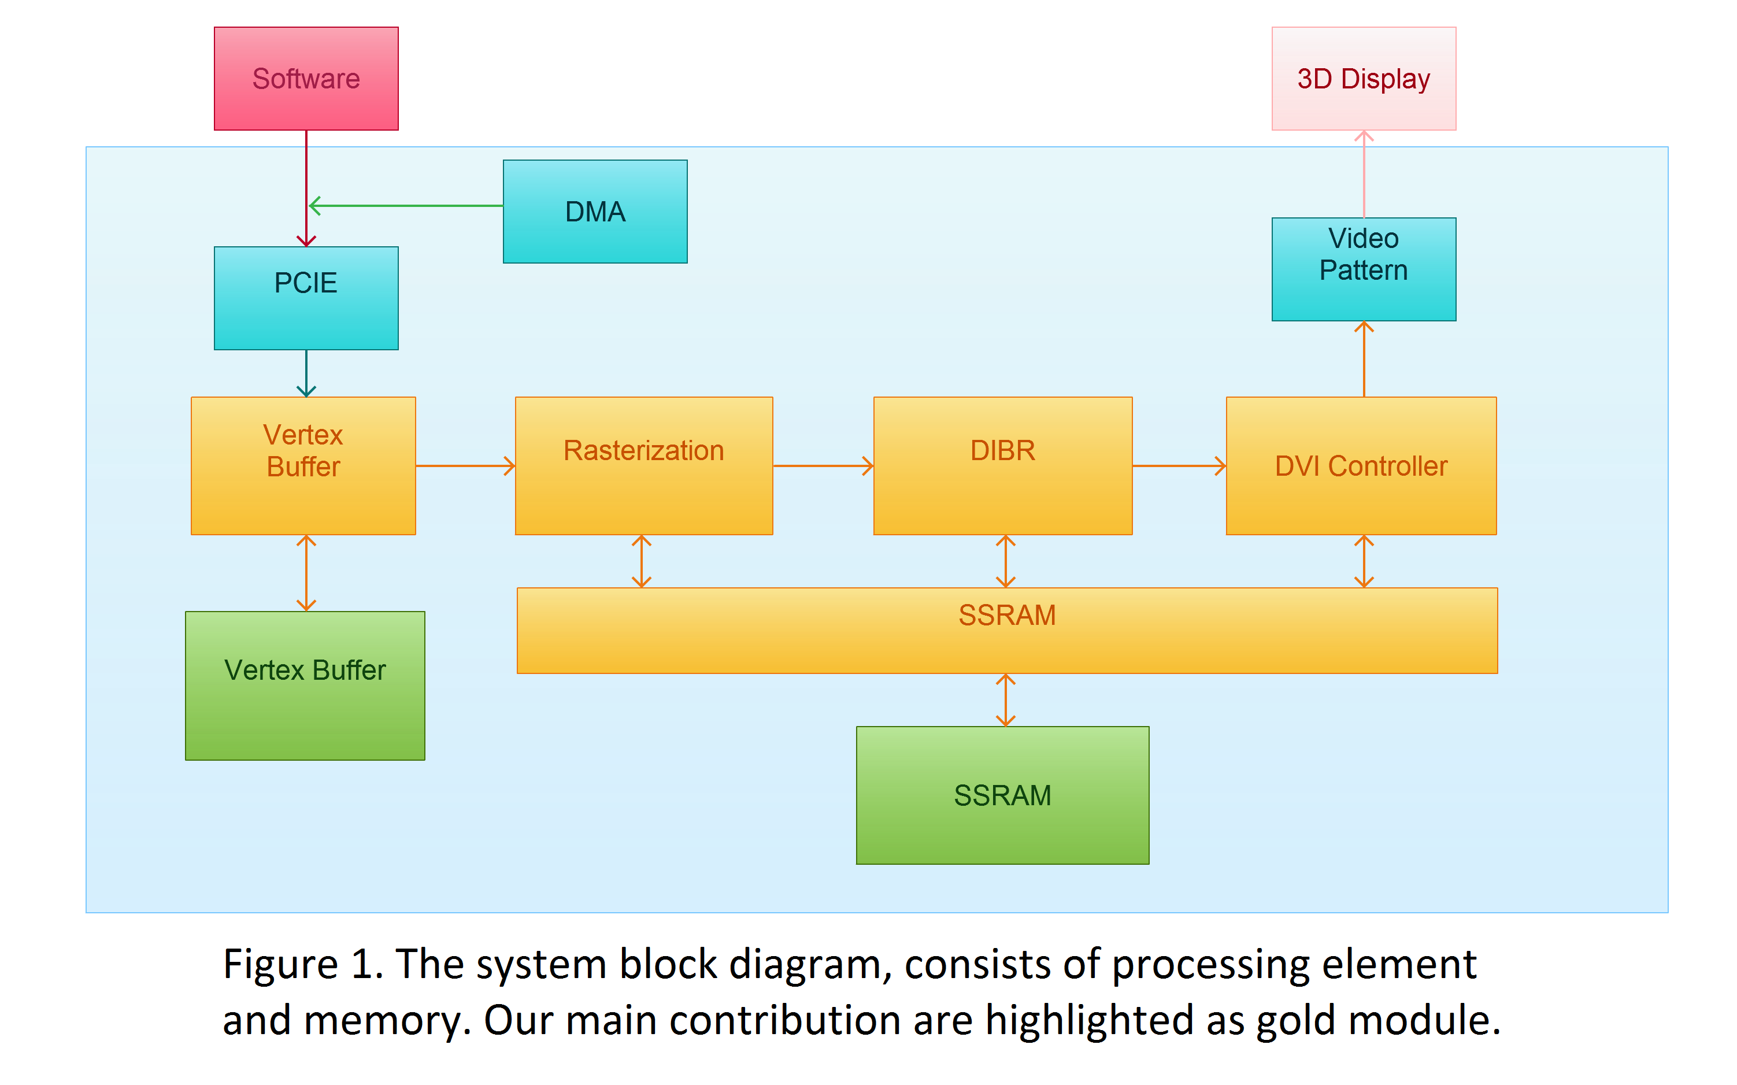
System Diagram

Slide 4
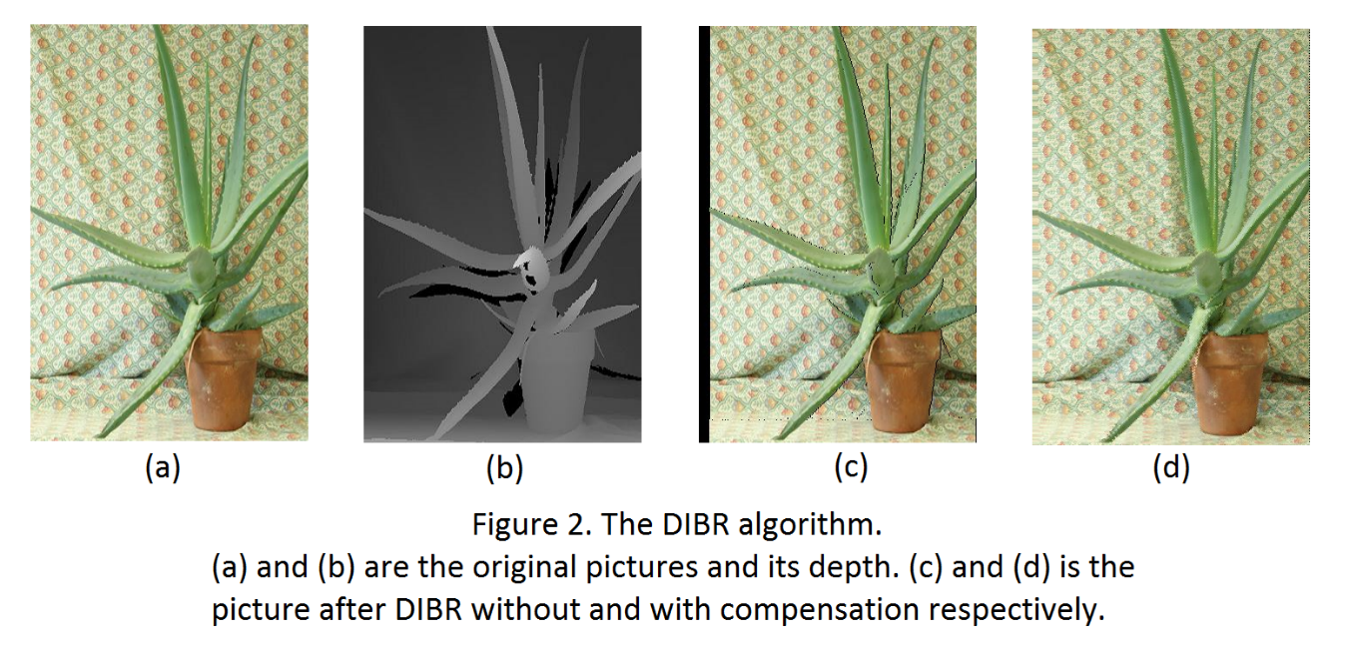
Feature
Rasterization
Can draw point, wire.
DIBR engine
Not only mapping to new point, but also compensate the holes

