Slide 1
CHAPTER 10
More Complex Business Rules

Slide 2
More Complex Business Rules
Entity objects can do more than just be representations of data. They can also encapsulate the business rules pertaining to the data they represent.
An entity object can:
  Enforce validation rules for attribute values
  Calculate default values for attributes
  Automatically calculate the values of transient attributes
  Automatically react to data changes

Slide 3
Overview of Entity Classes
Entity object definitions are handled by three classes in the ADF BC library. They are referred to as the base entity classes:
  oracle.jbo.server.EntityImpl Each instance represents one row in a database table. This class has all the methods needed to read, update, insert, delete, and lock rows.
  oracle.jbo.server.EntityDefImpl Instances of this class act as wrappers for the entity object definition XML files. The class contains methods allowing you to dynamically change the definition of the entity object itself – to add or remove entity attributes or to change the properties of these attributes.
  oracle.jbo.server.EntityCache An instance acts as an entity cache – a memory location holding instances of a particular entity object definition in use in a single transaction. Methods are provided that manipulate rows in the cache. You normally do not use these methods directly. They are for internal use.

Slide 4
Overview of Entity Classes
If you need further customization, you can generate custom entity classes that extends one or more of them. For example, for a particular entity object definition, Departments, you could generate any or all of the following:
  DepartmentsImpl
  An entity object class, which extends EntityImpl
  DepartmentsDefImpl
  An entity definition class, which extends EntityDefImpl
  DepartmentsCollImpl
  An entity collection class, which extends EntityCache
These classes may be customized for a particular application.

Slide 5
Entity Object Classes
An entity object class is a subclass of EntityImpl that a particular object definition can use to represent its instances. They have the same name as the entity object definition with an "Impl" suffix. The entity object definition "Departments“, for example, would have an implementation class called "DepartmentsImpl".

Slide 6
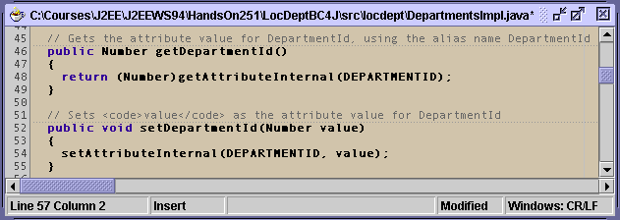
Entity Attribute Accessors
Entity object classes provide accessors (getters and setters) for each attribute. For example, DepartmentsImpl will by default contain the getDepartmentId() and setDepartmentId() methods.
EntityImpl contains the getAttribute() and setAttribute() methods
which also allow you to retrieve and change attribute values, but accessors
in the entity object class have two advantages.

Slide 7
Entity Attribute Accessors Are Typesafe
Entity attribute accessors are typesafe, they take fully typed objects as parameters and have fully typed return values.
For example, DepartmentsImpl will by default contain the method getDepartmentId(), which returns a Number, and the method setDepartmentId(), which returns void and takes a Number argument.
The following code causes compile-time errors.
String myDeptId = myDepartmentsImpl.getDepartmentId();
// because the return-type is not a Number
myDepartmentsImpl.setDepartmentId( “25” );
// because the parameter is not a Number
Number myDeptId = myDepartmentsImpl.getDeptId();
// because the attribute name is not correct

Slide 8
Entity Attribute Accessors Are Typesafe
EntityImpl's attributes can still be accessed directly using the following methods (although they are not typesafe):
  EntityImpl.getAttribute()
  Takes a String (attribute name) argument and returns a java.lang.Object
  EntityImpl.setAttribute()
  Takes a String (attribute name) and an Object as arguments
If you forget the Java type of your attributes you will not get a compile-time error, but the application will throw an exception at runtime (making things harder to debug).
Neither of these lines will cause a compile-time error, but they will throw exceptions at run-time:
String myDeptId = (String)myEntityImpl.getAttribute("DepartmentId");
myEntityImpl.getAttribute("DepartmentId“, “25”);

Slide 9
Entity Attribute Accessors Are Typesafe
Using entity attribute accessors can make it easier to debug typos in attribute names.
For example, the first line below will cause a compile-time error, and the second line below will throw an exception at run-time.
Number myDeptId = myDepartmentsImpl.getDepartmentId();
Number myDeptId = myEntityImpl.getAttribute("DepartmentId“);

Slide 10
Entity Object Classes Allow You to Write Custom Business Logic
The accessors in entity object classes can be edited if necessary. You can write code in accessors to perform actions such as:
    Restrict access to data
    Validate changes
    Trigger events when an attribute is changed
You must implement complex requirements in an entity object class.

Slide 11
Overriding Methods in EntityImpl
You can also override various methods in the EntityImpl class to implement other business logic. By overriding the EntityImpl.create() method, for example, you can implement defaulting logic or trigger events whenever a row is created.

Slide 12
Entity Definition Classes
Entity definition classes extend oracle.jbo.server.EntityDefImpl.
Unlike entity object classes, which are usually generated for most entity objects, there are only two reasons for creating an entity definition class are:
  To override the method EntityDefImpl.createDef(), which is called as soon as the entity object is loaded into memory. This allows you to dynamically change the definition of the entity object without writing code in every application that uses it.
  The need to provide a place to put a custom method that affects an entire table, as opposed to a single row (which should be in an entity object class) or all rows returned by a particular query (which should be in a view object class).

Slide 13
Entity Collection Classes
Suppose an application has just inserted a row into, or accessed a row from, the DEPARTMENTS table. When it did, an instance of the DepartmentImpl object was created. Usually the application will need to access the row again in the near future, so rather than destroying the object, ADF BC stores it in a cache called the entity cache.
When a row is changed, instead of making a time-consuming round trip to the database, ADF BC simply makes the change to the DepartmentImpl object in the entity cache until the transaction is committed or the change is manually posted.
Usually an entity cache is implemented by an object of the type oracle.jbo.server.EntityCache. You can also generate an entity collection class (extended from EntityCache) if you need to change the behavior of the entity cache. Entity collection classes have the same name as the entity object with a "CollImpl" suffix. For example, the "Departments" entity object would have the definition class called "DepartmentsCollImpl".

Slide 14
Manipulating Attribute Values
You can manipulate domains from the oracle.jbo.domain package. There are two options you can use.
1. Convert the domain to a standard java type. You can now use methods and
operators provided by Java. When finished, you can re-create the domain by passing
the standard Java type to the domain’s constructor. For example:
2. You can work directly with the domains using methods provided by domain classes.
Each option has its own advantages.
int salaryValue = salary.intValue();
salaryValue++; // manipulate the data
salary = new Number(salaryValue);

Slide 15
Manipulating Attribute Values
Conversion methods:
Domain Conversion Methods
Number int intValue(), long longValue(),
short shortValue(), float floatValue(),
double doubleValue(), byte byteValue(),
java.math.BigDecimal bigDecimalValue(),
java.math.BigInteger bigIntegerValue()
Date java.lang.Date toDate()
Array java.lang.Object[] getArray()
BFileDomain,
BlobDomain,
ClobDomain byte[] toByteArray()

Slide 16
Manipulating Attribute Values
Domains based on Oracle types have accessor methods to retrieve and change values.
For example, if the object myAddress is of AddressType (from Chapter 9), you can append “-1234” to myAddress’s PostalCode attribute as follows:
String myPostalCode = myAddress.getPostalCode();
myPostalCode = myPostalCode + “-1234”;
myAddress.setPostalCode( myPostalCode );

Slide 17
Manipulating Attribute Values
Conversion methods:
Domain Conversion Methods
Number add(), subtract(), multiply(), divide(), increment(), abs(),
exp(), sin(), cos(), tan(), compareTo()
Date addJulianDays(), addMonths(), round(), lastDayInMonth(),
diffInMonths(), getCurrentDate()
BFileDomain getInputStream(), getOutputStream, closeOutputStream()
BlobDomain getBinaryStream(),getBinaryOutputStream(),
closeOutputStream(), getBytes(), getLength()
ClobDomain getCharacterStream(),getCharacterOutputStream(),
getSubstring(), getLength()

Slide 18
Attribute-Level Validation
The simplest kind of business rule is one that needs to fire whenever an attribute is changed, to make sure the value passes some test.
You may want to implement a rule that email addresses must have a length of at most eight characters. Logic like this is called attribute-level validation because it is intended to check the value in a single attribute in a single row. ADF provides three ways to do this:
  Validation rules
  Validation domains
  Setter method validation

Slide 19
Validation Rules
Validation rules are Java classes that can be attached to entity attributes or entire entity object definitions using the Entity Object Editor.
A validation rule contains a method that throws an exception whenever a potential attribute value does not pass some test. The EntityImpl class will call this method whenever an application attempts to change the attribute value; the value is only changed if the exception is not thrown.

Slide 20
Validation Rules
For example, a validation rule called the CompareValidator has been added to the Salary entity attribute in the following:
<Attribute
Name="Salary"
IsNotNull="true"
Type="oracle.jbo.domain.Number"
...
TableName="EMPLOYEES" >
<CompareValidationBean
OnAttribute="Salary"
OperandType="LITERAL"
CompareType="GREATERTHAN"
CompareValue="1000" >
</CompareValidationBean>
</Attribute>
The CompareValidationBean element nested inside the Attribute element implements the CompareValidator rule.

Slide 21
Built-In Validation Rules
JD provides four built-in validation rules for attributes. Three of which can be used without writing code.
  CompareValidator
  ListValidator
  RangeValidator
  MethodValidator

Slide 22
The CompareValidator
A CompareValidator requires an attribute's value be in some relation to a specified value. The relations available are:
  Equals
  NotEquals
  LessThan
  GreaterThan
  LessOrEqualTo
  GreaterOrEqualTo

Slide 23
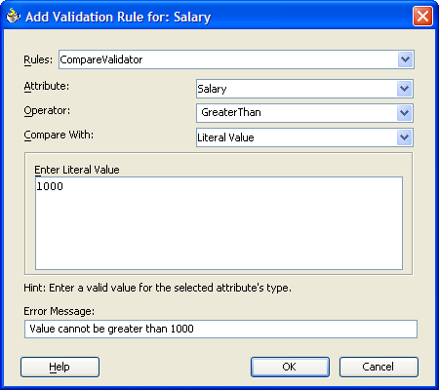
The CompareValidator
The simplest use is to require an attribute's value be in some relation to a particular literal value specified in the validation rule. Here the Salary attribute's value must be greater than 1000:

Slide 24
The CompareValidator
A CompareValidator can be used to enforce a relation to a column from a query or a transient attribute. Besides Literal Value, a Query Result or View Object Attribute can be selected from the Compare With dropdown.
With Query Result, the attribute is compared with the value in the first column of the first row in the result set returned by the SQL query entered. The query may also be created to return only one column and row.

Slide 25
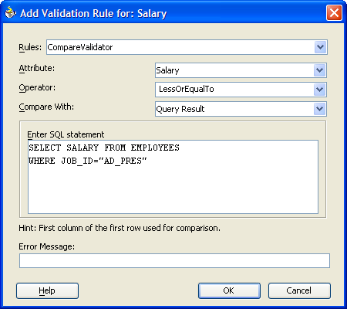
The CompareValidator
The screen shot below shows a single-row, single column query used to enforce the rule that nobody can have a higher salary than the company's president:

Slide 26
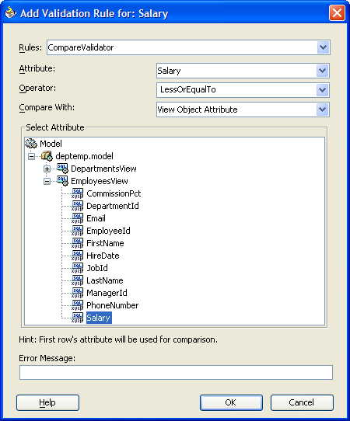
The CompareValidator
With the View Object Attribute, the value will be compared to the value of the selected view row attribute for the first view row.
The screen shot below shows how to require the first view row in EmployeesView to have the maximum salary for all the employees:
The problem with using default view objects is that there is very little control over which view row is first. Therefore, using the View Object Attribute is not very useful.

Slide 27
The ListValidator
The ListValidator requires an attribute's value either to be in a list of possible values, or not to be in a list of excluded values. The list of values can be created from:
  Literal values
  A query result
  A view attribute

Slide 28
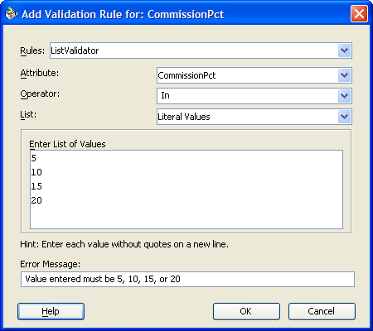
The ListValidator
The list of literal values can simply be keyed in as shown below:

Slide 29
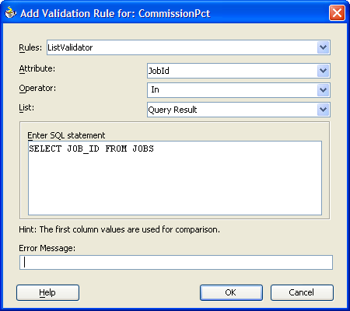
The ListValidator
With a SQL query, the values for the list come from the first column (as in the CompareValidator). Unlike the CompareValidator though, a ListValidator looks at all rows in the query result.
The example below uses a SQL statement to require the Employees JobId attribute match a JOB_ID in the JOBS table.

Slide 30
The ListValidator
The ListValidator works the same way with a view attribute. The list is formed from the value of the view attribute in every row the view object returns.
For example, you could select JobId from the JobsView to have the same effect as the SQL statement above (with the added advantages that the ADF BC framework would cache the query values for you and use any logic you added to the JobsView view object).

Slide 31
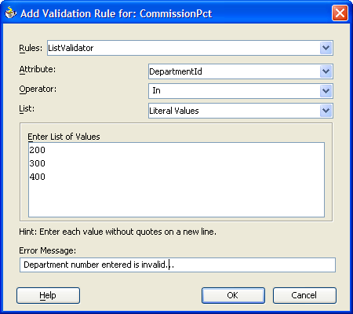
The ListValidator
Example ListValidator for DepartmentId
ListValidator screen:

Slide 32
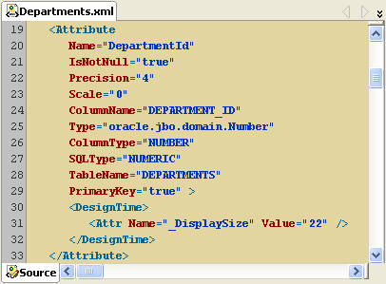
The ListValidator
Generated statements in the Departments.xml file:

Slide 33
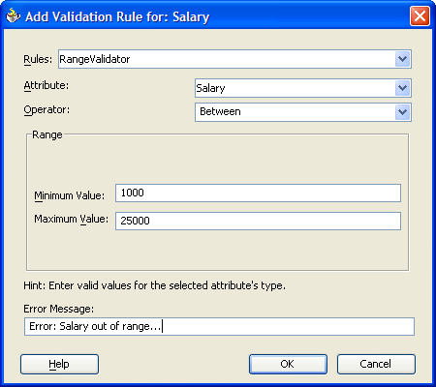
The RangeValidator
The RangeValidator requires the attribute's value to be either between two possible values or outside ("notBetween") a range of excluded values.
A RangeValidator cannot use a query or view object to calculate the endpoints of the range. The MUST be specified as literals, as show below:

Slide 34
The MethodValidator
If none of the other validators provide the attribute validation you want, you can use the MethodValidator to define it yourself.
MethodValidator calls a Java method in the entity object class. This method must take a single argument with the following requirements:
  Of the same type as the attribute
  It must be public
  It must return a boolean value

Slide 35
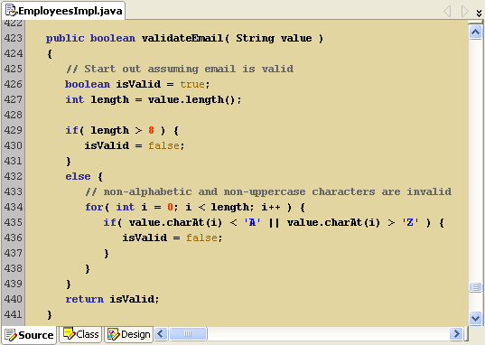
The MethodValidator
For example, the company in the HR schema requires that all email addresses (Email attribute of the Employees entity object) have eight or less uppercase alphabetic characters. A method, like the one below, can be coded to return true if the email address is valid or false if it is not.

Slide 36
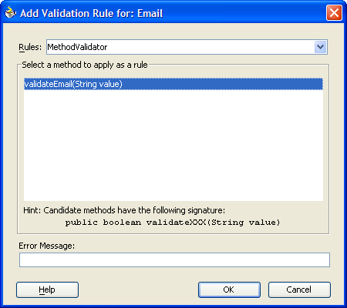
The MethodValidator
You can then apply the MethodValidator to call the method defined above as shown below:

Slide 37
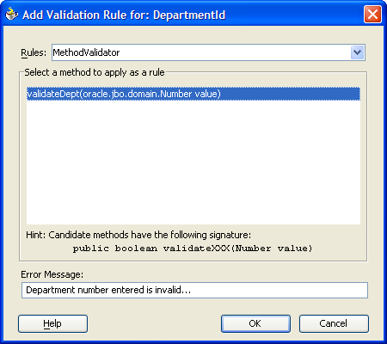
The MethodValidator
Example MethodValidator for DepartmentId
MethodValidator screen:

Slide 38
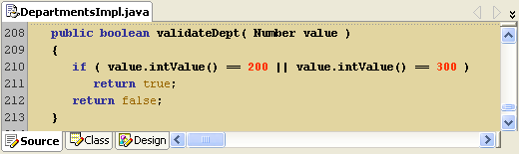
The MethodValidator
Code for the validateDept() method in the DepartmentsImpl.java file:

Slide 39
When Validation Fails
When a client tries to set a value for an attribute which violates a validation rule, two things happen:
  If the validation rule was a MethodValidator, the entity object class throws an oracle.jbo.ValidationException.
  If the validation rule was not a MethodValidator, the entity object class throws an oracle.jbo.AttrSetValException.
These exceptions can be caught in your client, and dealt with however you want. The exceptions contain error messages you can set when the validation rule is created.

Slide 40
Setter Method Validation
Validation rules are simple, declarative, and quick to use. But, for more complex business rules, programs need to use Java. Using the MethodValidator above on an attribute is one way of using Java, but business logic can be coded directly in the setter of an entity attribute.
JDeveloper creates simple setters that do nothing but call a single method (setAttributeInternal()) when it generates an entity object class.
public void setEmail(String value)
{
setAttributeInternal(EMAIL, value);
}

Slide 41
Setter Method Validation
The setAttributeInternal() method takes an int and an Object. The int corresponds to a particular entity attribute (in EmployeesImpl, the constant EMAIL equals the value 3).
protected static final int EMPLOYEEID = 0;
protected static final int FIRSTNAME = 1;
protected static final int LASTNAME = 2;
protected static final int EMAIL = 3;
protected static final int PHONENUMBER = 4;
The Object corresponds to a value to set the attribute to.

Slide 42
Setter Method Validation
The difference between setAttributeInternal() (takes an int to identify the attribute) and setAttribute() (takes a String to identify the attribute), is that the setAttribute() calls the setter method (if setters have been generated), but the setAttributeInternal() simply checks the XML for validation rules and then sets the attribute's value.
When you call EntityImpl.setAttribute() or an entity object's setter method, the first thing that happens is that the Java code in the setter will be executed. At some point the setter method should call setAttributeInternal() as shown above. When that method is called, it will check for validation rules, and if none are found, or all of them are passed, it will set the attribute's value.
public void setEmail( String value ) throws oracle.jbo.jboException {
if ( value.length <= 8 ) {
setAttributeInternal( EMAIL, value );
}
else {
throw new oracle.jbo.JboException (
“An email address must have at most 8 characters.” );
}
}

Slide 43
Stages of validation
View object layer calls setAttribute("EMAIL", "SKING")
setAttribute() calls setEmail("SKING")
setEmail() executes Java business logic
setEmail() calls setAttributeInternal("EMAIL", "SKING")
setAttributeInternal() invokes validation rules
Email attribute is set to "SKING"

Slide 44
The validateEntity() Method
All previous examples of validation have been examples of attribute-level validation, meaning rules that apply to a specific entity attribute, such as Salary or Email. Some validation logic does not apply to a single attribute, but to multiple attributes in the same row.

Slide 45
The validateEntity() Method
For example, you might want to require that no manager (job title "MAN") can have a salary of less then $10,000 and that no other employee can have a salary of $10,000 or greater. This logic cannot be applied in setter methods for the following reasons:
  For Salary alone, because it has to be applied when the users enter or change an employee's JobId.
  For JobId alone, because it has to be applied when users enter or change an employee's Salary.
  In both setter methods, because it will be impossible to promote an employee to manager. If you try to promote the employee first, setJobId() will throw an exception because the salary is too low, and if you try to give the employee a raise first, setSalary() will throw an exception because the employee is not yet a manager.

Slide 46
The validateEntity() Method
This kind of rule requires entity-level validation - a rule that applies to an entire row, rather than to a single attribute.
Entity-level validation is implemented by overriding the method EntityImpl.validateEntity(). This method is called whenever an instance of the entity object class loses currency (whenever the client is done looking at a particular row). If validateEntity() throws an exception, the entity object will be prevented from losing currency. The Business Component Browser, or any other client, will meet an exception when it tries to scroll off the row.
The validateEntity() method is also called when a client attempts to commit a transaction.

Slide 47
The validateEntity() Method
This will generate code like the following in the entity object's Java file:
The call to super.validateEntity() should always be kept, so that the entity object class will continue to exhibit EntityImpl's default behavior in addition to any modifications made.
protected void validateEntity()
{
super.validateEntity();
}

Slide 48
The validateEntity() Method
Put any business logic after that call. For example, the code below in EmployeeImpl would implement the manager-minimum-salary rule:
Just like the validate() method in validation domains, validateEntity() needs to do something (throw an exception) if the validation fails.
protected void validateEntity() throws oracle.jbo.JboException {
super.validateEntity();
if (getJobId().endswith("MAN") {
if (getSalary().intValue() < 10000) {
throw new oracle.jbo.JboException(
"Managers must have a salary of at least 10000.");
}
}
else {
if (getSalary.intValue() > 9999) {
throw new oracle.jbo.Exception(
"Non-managers cannot have a salary more than 9999.");
}
}
}

Slide 49
Hands-on Practice:
Add Validation to the HR Business Domain Components
Pages 303 to 314

Slide 50
Adding Default Values to Entity Attributes
The previous examples of business logic where triggered when an entity object is set, its instance loses currency, or when a transaction is committed. You might also want to write business logic for new rows in the database (new entity objects) as soon as they are created.
The most common case is defaulting, which means giving an entity object a default value as soon as the row is created. There are two ways to implement default logic:
  In XML
  In Java code for cases too complex to handle in the XML
These two methods are distinguished by the following:
  Static default values (value specified at design time and always applies to the attribute) can be done in XML.
  Dynamically calculated values (attribute can have different initial value in different rows) must be added to Java code.

Slide 51
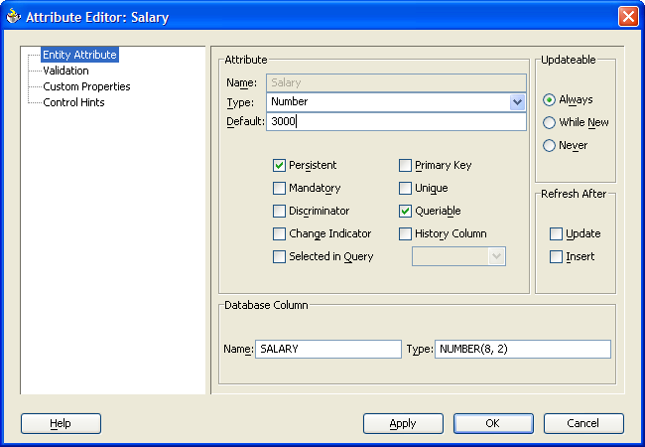
Static Default Values
The ADF BC framework stores static default values as XML attributes, which can be set using the Default field in the Attribute Editor as shown below:

Slide 52
Static Default Values
The ADF BC framework stores static default values as XML attributes, which can be set using the Default field in the Attribute Editor as shown below:
This method can be used to set default values for any class with a String representation: String, Number, Date, Boolean, and so on, or any validation domain based on one of these classes.

Slide 53
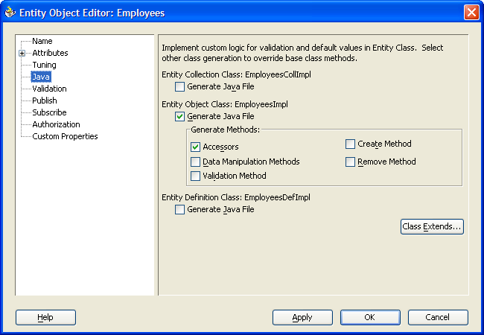
Dynamically Calculated Default Values
Some attributes should be automatically set, but not to the same value every time. To dynamically assign default values, Java code must be used. This is done by overriding the method EntityImpl.create(), which is called whenever a new entity object instance is created.
You can generate a stub to override the create() method by selecting the Create Method checkbox on the Java page of the Entity Object Wizard shown below.

Slide 54
Dynamically Calculated Default Values
The create() stub begins with a call to super.create(), which you should keep. After this call, add any logic necessary to calculate and set defaults.
For example, the following causes an employee's hire date to default to the date they where added to the database:
protected void create( AttributeList attributeList )
{
super.create( attributeList );
Date currDate = new Date( Date.getCurrentDate() );
setHireDate( currDate );
}
Do not delete this call. It must be first

Slide 55
The SequenceImpl Class and the DBSequence Domain
A common reason to dynamically calculate a default value is to populate attributes in successive rows with a series of sequential numbers. The BC4J framework contains the oracle.jbo.server.SequenceImpl class that wraps Oracle database sequences for use in the Java world.
Its constructor requires two arguments:
  The name of the sequence
  A database transaction (so ADF BC knows where the sequence is)
The EntityImpl class provides a method called getDBTransaction() that returns the current transaction. After calling getDBTransaction(), you can increment the sequence and extract the next value into a Number using the getSequenceNumber() method.

Slide 56
The SequenceImpl Class and the DBSequence Domain
Instead of dynamically obtaining the attribute in Java, you can put a trigger in the database to update the attribute's table column. The attribute should be of the type DBSequence if this is done. DBSequence maintains a temporary unique value in ADF BC cache until the data is posted.
The advantage of DBSequence over coding with SequenceImpl is that it does not waste sequence numbers in transactions that are rolled back before they are posted.
But, DBSequence only works if the database has a trigger to populate the attribute. SequenceImpl populates the attribute at the Java level. .

Slide 57
Calculated Transient Attributes
Business rules can also be used to calculate values form transient attributes. Transient attributes exist only in the entity object, and do not correspond to any database column. Their most common use is to hold values calculated from other attributes.
The attribute must be calculated, the first time, in its getter method. Your code should make sure the attribute is not null (it has already been calculated), and, if it is null, calculate it. It should both set the attribute to the calculated value and return that value.
Usually when the value of a calculated attribute is set, you should do so by using the method EntityImpl.populateAttribute(). This method works like the setAttributeInternal() method, with two exceptions:
  It bypasses all validation, including XML validation rules.
  It does not mark the entity object instance as changed (important for calculated values).

Slide 58
Calculated Transient Attributes
Why use populateAttribute()?
The setAttributeInternal() method marks the entity object instance changed. When data is later posted to the database, BC4J will only attempt to post the rows marked as changed (posting the other rows wastes time). If the setAttribute() or setAttributeInternal() methods are used to calculate transient attributes, every entity instance with a calculated attribute will be marked as changed, and therefore posted to the database.
However, if the only change you have made to an instance is to calculate a transient attribute, there is generally no posting to be done. An application will save network and database resources by using populateAttribute() so that the row is NOT posted.
You need to make sure the calculation stays up to date. Do this by putting code that sets the transient attribute to null in the setter method of any attribute this attribute depends on. For example, if the calculation depends on JobId, add code to setJobId() to set the calculated attribute to null every time JobId is changed. The next time the transient attribute is requested, it will be recalculated (because it is null).

Slide 59
Using Associations in Business Rules
Sometimes business rules do not apply to a specific attribute, but to relationships between entities. These relationships were covered in Chapter 9, and are implemented by associations. Using associations allows implementation of cross-entity business rules.
The creation of an association creates accessors in the entity object classes at each end. Using these accessors from a particular entity object instance allows you to access the related entity object instances at the other end.

Slide 60
Hands-on Practice:
Add More Business Rules to the HR Business Domain Components
Pages 322 to 328

