Slide 1

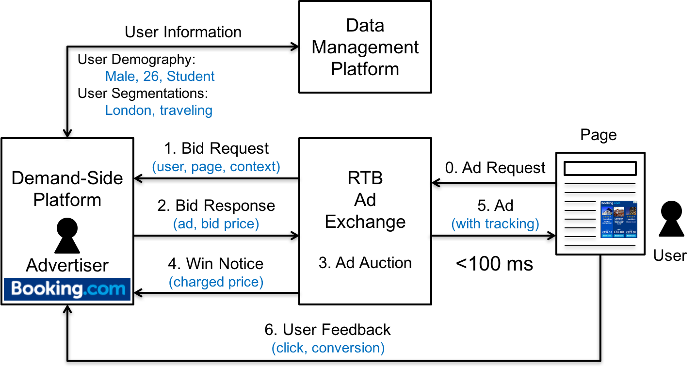
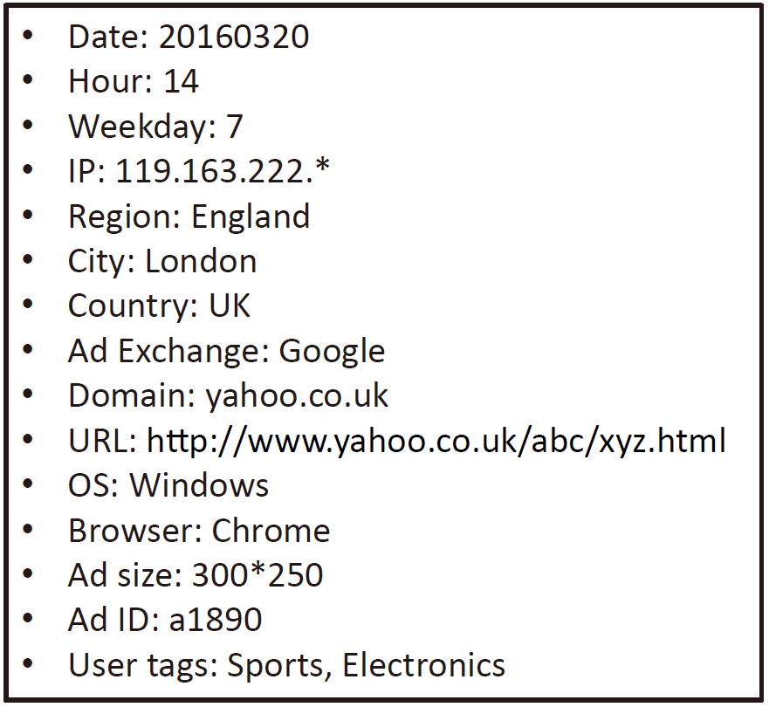
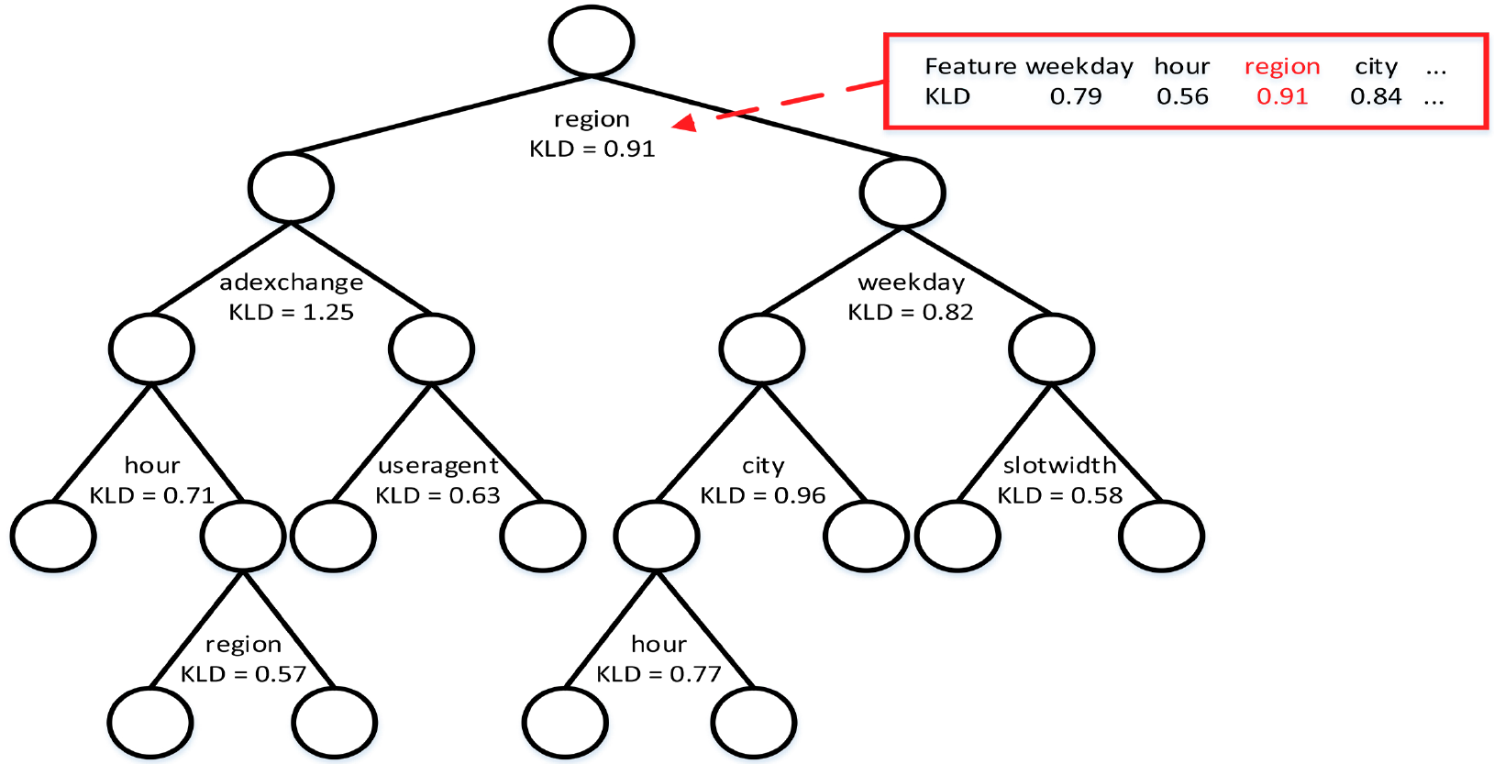
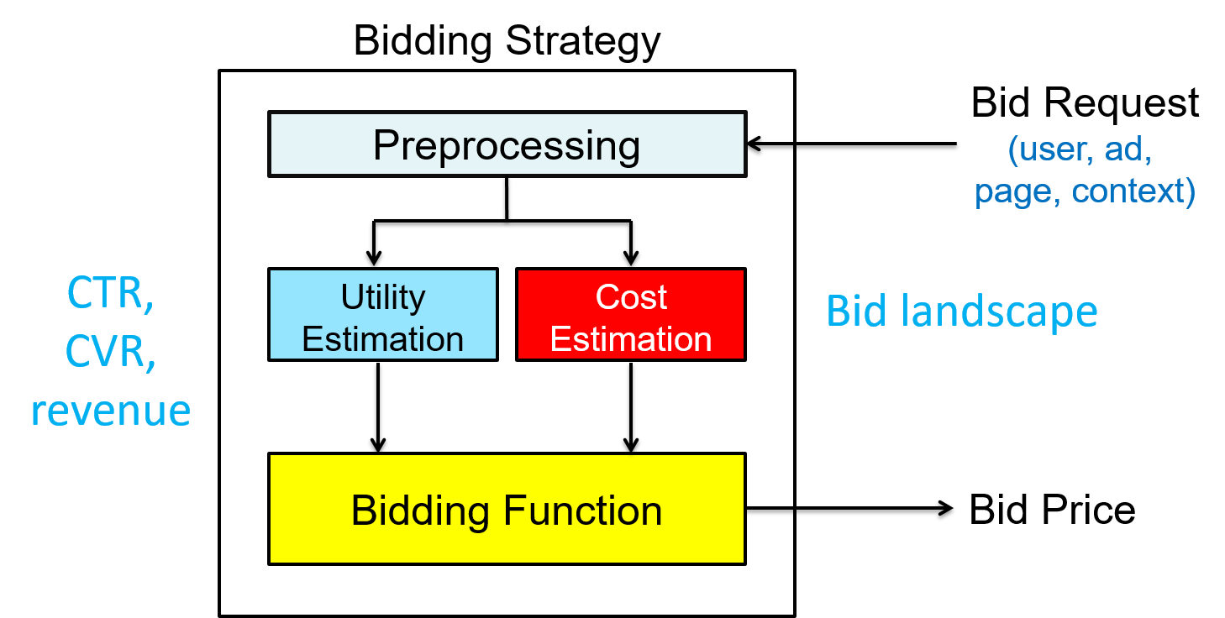
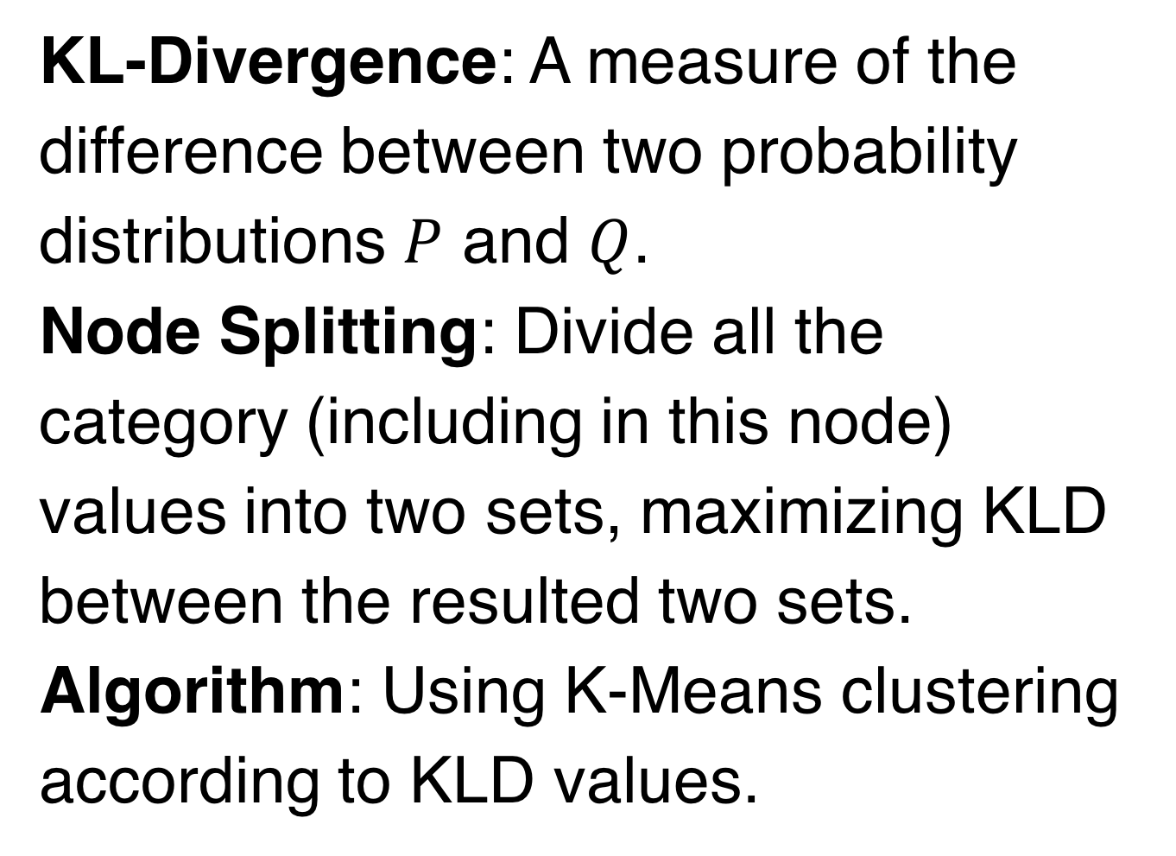
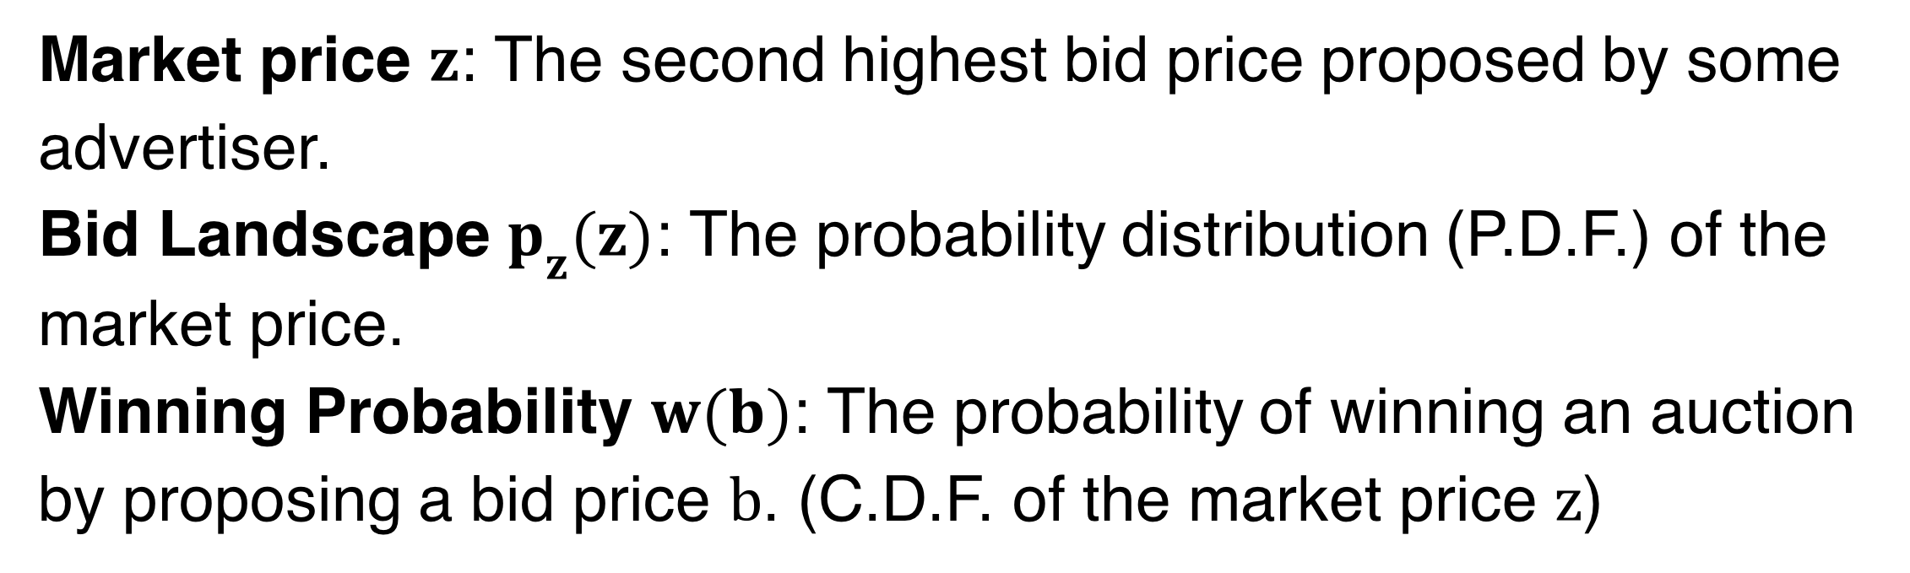
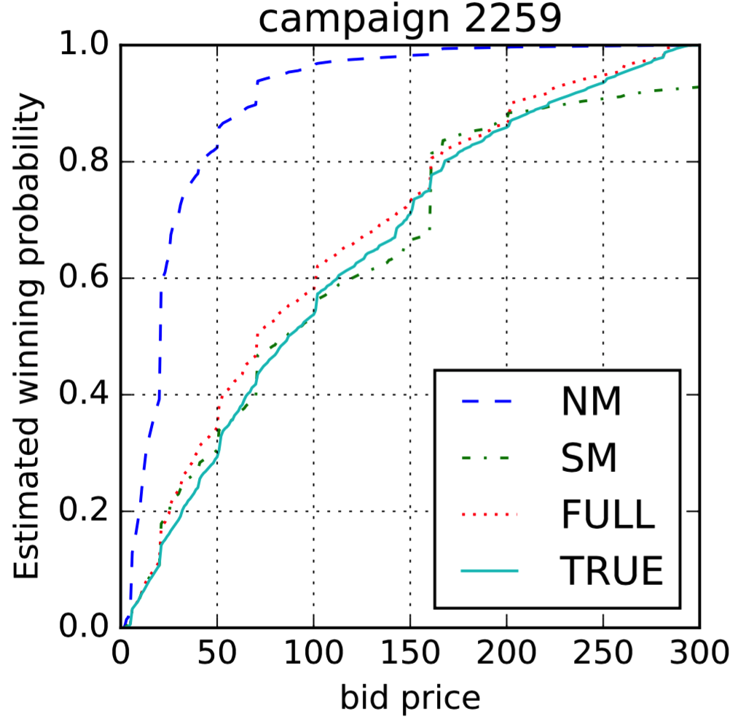
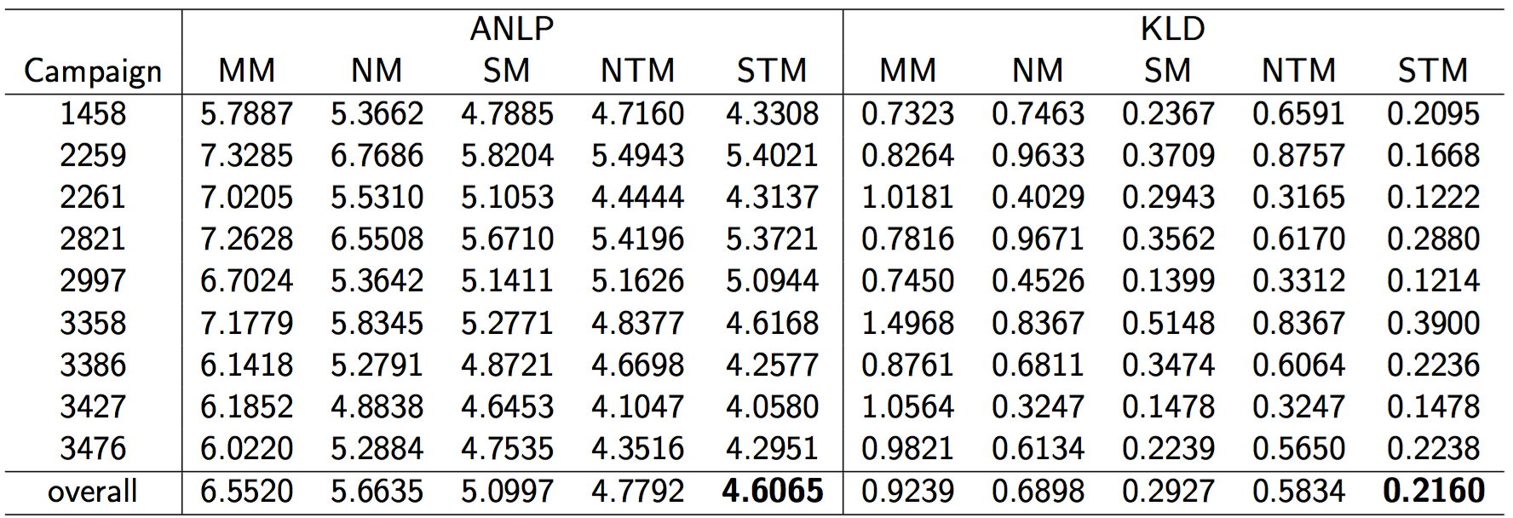
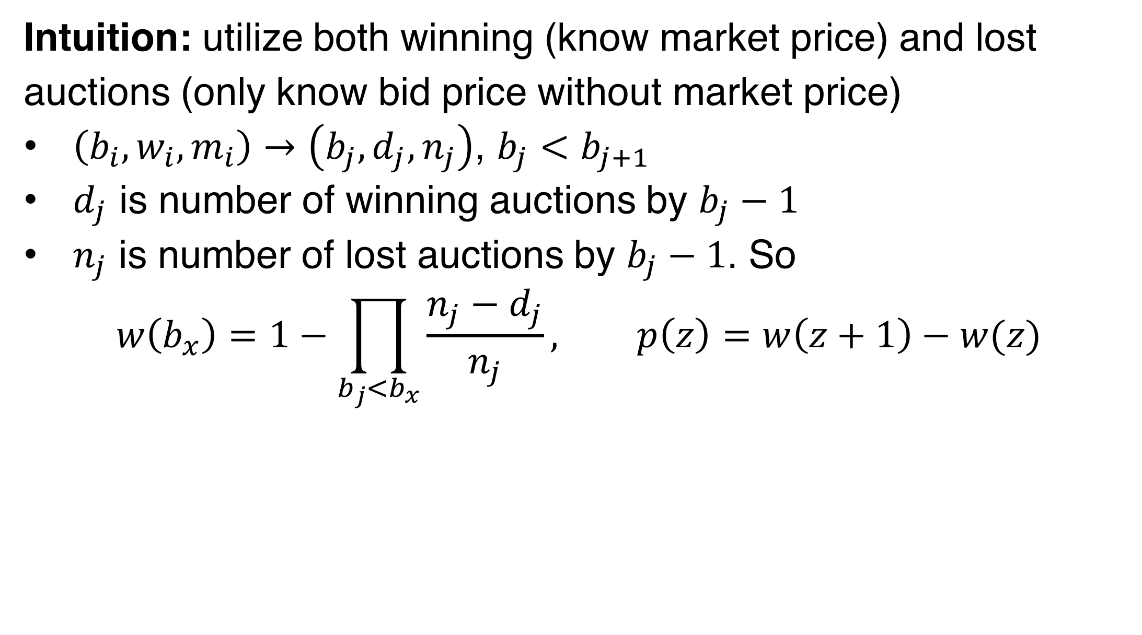
Why Detectors Fail on Unseen Generators
Anonymous Author | AI-Generated Image Detection Project
Background
Our Approach
Introduction
Main Results: Detection Accuracy (%)
Key Findings
Node Splitting
Method Backbone Strategy GLIDE BigGAN ADM VQDM
─────────────────────────────────────────────────────────────────
Baseline ResNet-18 Full FT 98.2 99.3 56.2 53.0
Ablation ViT-Small Full FT 98.7 97.8 54.9 52.1
Ablation ResNet-18 Linear Probe 92.0 91.9 59.4 54.7
Ablation CLIP-ViT Linear Probe 99.3 98.3 61.3 55.6
Ojha-style CLIP-ViT KNN (k=1) 85.4 81.7 64.9 64.7
Patch ResNet-18 3×3 Vote 61.5 54.0 60.8 61.8
GLIDE: in-distribution; others: zero-shot cross-generator
City
New York
Honolulu
…
Los Angeles
…
Indianapolis
New Orleans
Philadephia
Weekday
…
Monday
…
Friday
…
Tuesday
Saturday
Sunday
Thursday
Dataset
MoE Framework (Future Work)
AI-generated images from GANs, diffusion models, and autoregressive
architectures are increasingly photorealistic, creating urgent demand
for robust detectors.
Core challenge: cross-generator generalisation
A detector trained on one generator typically fails on a different
generator because each model leaves distinct low-level artifacts.
Two strategies:
(1) Data diversity: train on many generators
(2) Representation universality: use frozen pretrained features
No single method generalises robustly across all generator families.
Intuition: utilize both winning (know market price) and lost auctions (only know bid price without market price)
$\left(b_{i},w_{i},m_{i}\right)→\left(b_{j},d_{j},n_{j}\right)$, $b_{j}<b_{j+1}$
$d_{j}$ is number of winning auctions by $b_{j}−1$
$n_{j}$ is number of lost auctions by $b_{j}−1$. So
$$w\left(b_{x}\right)=1−\prod_{b_{j}<b_{x}}{\frac{n_{j}−d_{j}}{n_{j}}}, p\left(z\right)=w\left(z+1\right)−w(z)$$
Task
Auction Feature
Bid Landscape
Clustering Evidence
Setup
Forecasting
Unsupervised K-Means (k=4) on 800 fake images:
Feature Space Purity NMI
──────────────────────────────────────
Pretrained ViT-Small 0.278 0.003
Fine-tuned ViT-Small 0.559 0.378
Cluster breakdown (fine-tuned):
Cluster 0: GLIDE (192/318)
Cluster 1+3: ADM/VQDM (154/312)
Cluster 2: BigGAN (97/178)
Key insight: detection-oriented supervision
implicitly structures feature space by
generator family, enabling MoE routing.
Proposed MoE architecture:
(1) GAN expert — CNN for frequency artifacts
(2) Diffusion expert — DIRE/FIRE detector
(3) Universal router — routes by generator family
GenImage subset: GLIDE (train), BigGAN/ADM/VQDM (test)
Backbones: ResNet-18, ViT-Small, CLIP-ViT-B/32
Strategies: Full FT, Linear Probe, KNN
5 Key Findings
1. Full FT dominates: 98–99% on GLIDE
2. Diffusion collapse: ADM/VQDM 52–65%
3. CLIP KNN best: 64.9% ADM, 64.7% VQDM
4. Patch errors systematic: 90% consistency
5. Features encode generators: Purity=0.559
Demand-Side Platform
Advertiser
RTB
Ad
Exchange
Results
Bid Response
(bid price)
Largest
Lose
Win
Do nothing, only know market price is larger
Deliver ads, record the market price
Apex Data & Knowledge Management Lab
http://apex.sjtu.edu.cn

