Slide 1
Coordinates

Slide 2
P
Width
x = evt.getx()
y = evt.gety()
Offset.x
Local 0,0
x,y
High
Offset.y
Panel
H
Réel: 0,0

Slide 3
Move

Slide 4
offset.x= 0
0,0
Before
Drag : -> 50
offset.x= x - dragStart.x
-100 = 50 – 150
Clic Pressed (x=150 for example)
dragStart.x = evt.getx() - offset.x
= 150 – 0 = 150

Slide 5
offset.x= -100
After
0,0

Slide 6
Enthalpie

Slide 7
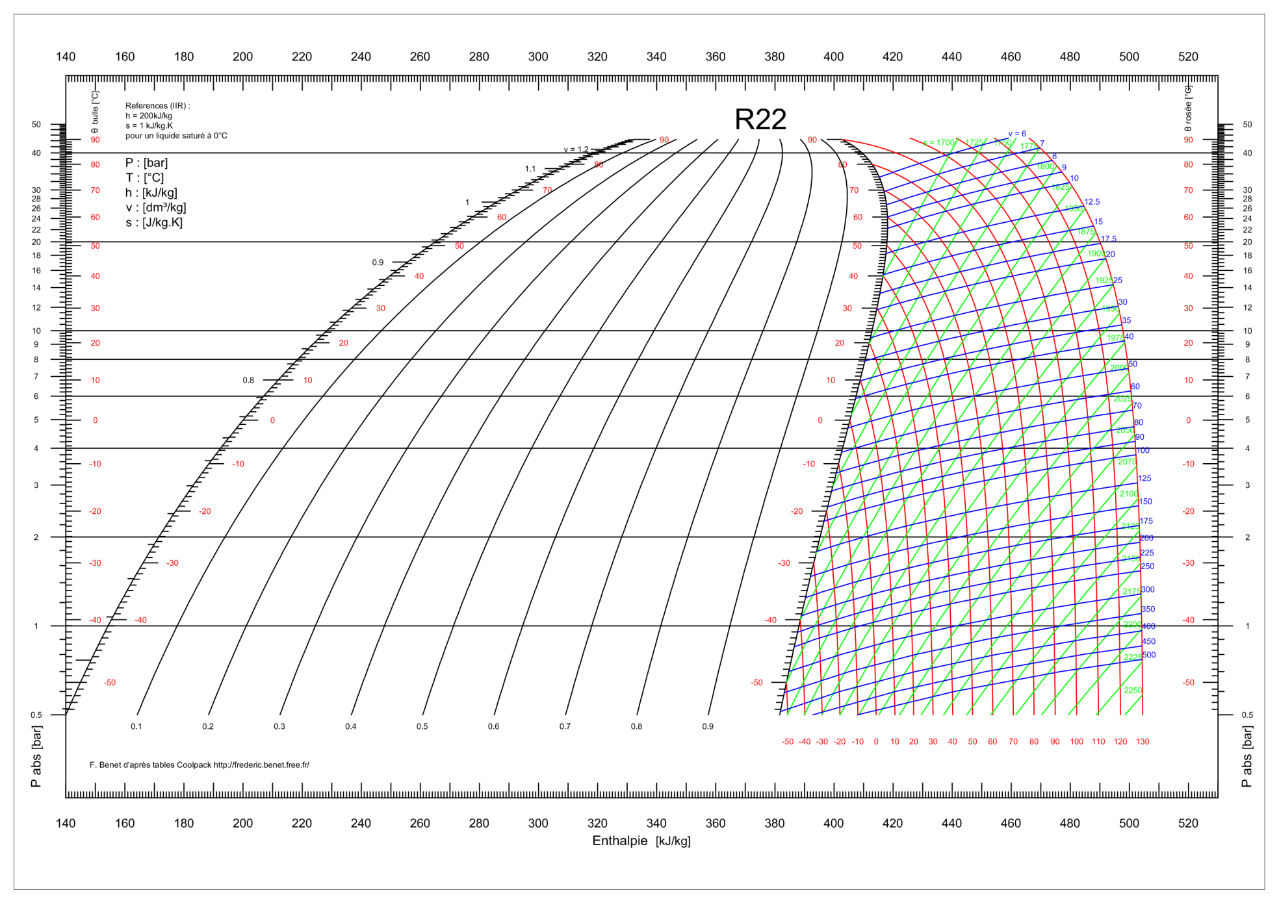

Slide 8
Width
x=0,y=0
xMargin
xMargin
xmin
xmax
0
x
0
H
HgMin
HgMax

Slide 9
H
HgMax
HgMin
xmin
xmax
0
x
H = (x - xmin – offset) (HgMax-HgMin) + HgMin
(xmax-xmin)
x = (H-HgMin) (xmax-xmin) + xmin + offset
(HgMax – HgMin)

Slide 10
P
LogP = Log(P)
100
2
PgMax
LogPMax
1
20
PgMin
10
LogPMin
0.5
0
y
ymin
ymax
LogP = (y-ymin) (LogPMax - LogPmin) + LogPmin
(ymax - ymin)

Slide 11
y
(+)
yMargin
ymax
height
ym
y
0 = -ym + height – yMargin - y
0
ymin
yMargin
ym
Avec Offset:
y = -ym + height – yMargin + offset
LogP = (y-ymin) (LogPMax - LogPmin) + LogPmin
(ymax - ymin)
Y = (LogP – LogPMin) (ymax – ymin)
(LogPMax-LogPMin)

