Slide 1
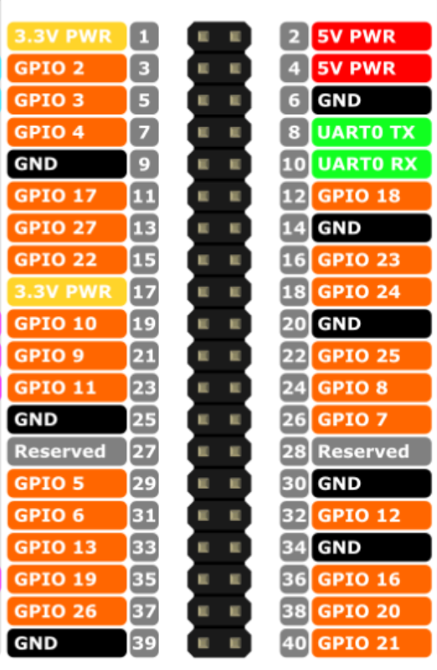
Led Power
Led Pay
Back
Play/Pause

