Slide 1
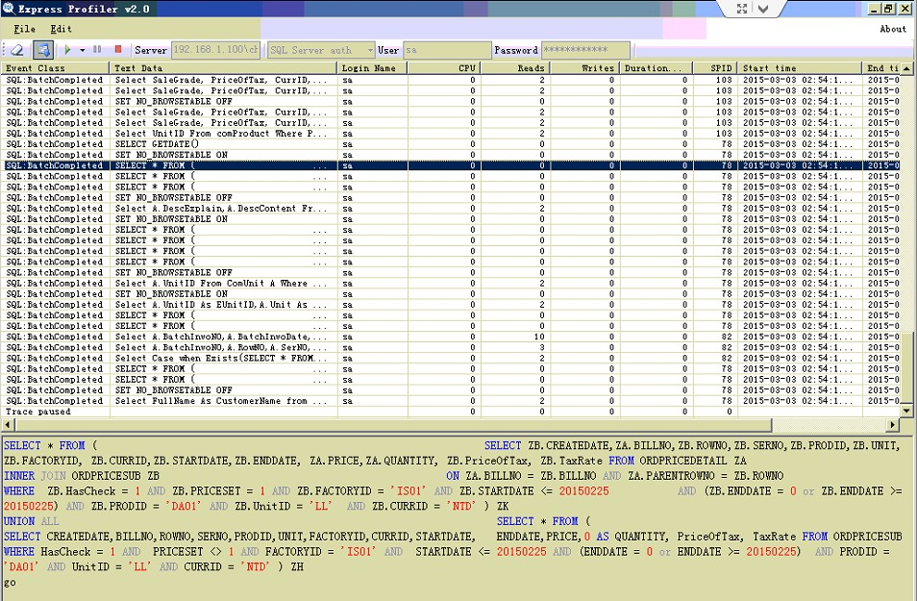
SQL Profiler 監聽

Slide 2



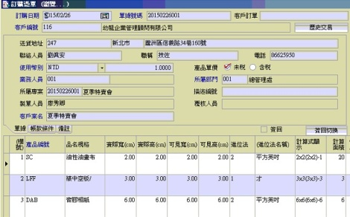
運作方式
正航外掛系統網站
轉換相對應正航
SQL1、SQL2…
寫入正航DB
正航 App 再把
資料讀出

Slide 3
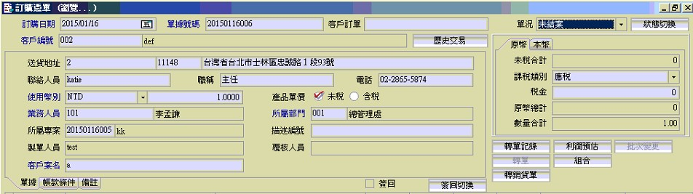
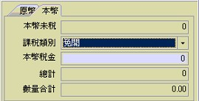
訂單主檔 CHIComp02.dbo.OrdBillMain
BillStatus(0~2)
BillDate
BillNo
CustBillNo
CustomerID
ZipCode
CustAddress
AddressID
SumBTaxAmt
LinkMan
LinkManProf
LinkTelephone
TaxType (0~4)
CurrID
ExchRate
PriceOfTax (1~0)
SumTax
SalesMan
SumAmtATax
DepartID
SumQty
ProjectID
Detail
Maker
Permitter
CProjectName
SignBack
LocalTotal
LocalTax

Slide 4
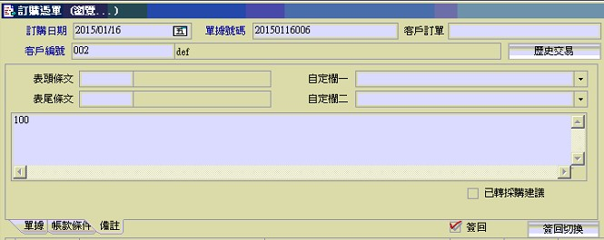
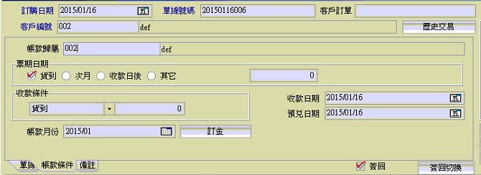
訂單主檔 CHIComp02.dbo.OrdBillMain
HeaderID
UserDef1
FooterID
UserDef2
Remark
IsTrans
DueTo
CheckStyle 0~3
CheckDelay
GatherStyle
GatherDelay
PrepayDay
EncashDay
AccMonth

Slide 5
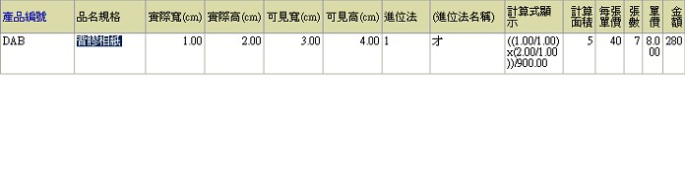
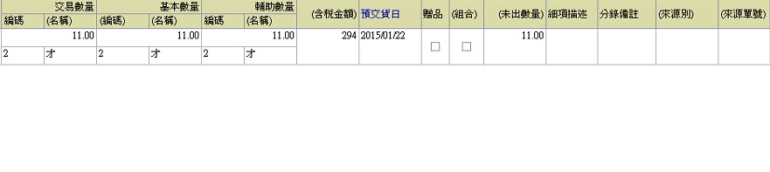
訂單品項 OrdBillSub
ProdID
ProdName
width
heigh
vwidth
vheigh
InCrementID
1:才
2:平方英吋
3:平方米
CalcDisp
計算面積CalcArea
每張單價PaperPrice
張數PaperCount
單價
sPrice
金額
amount
squantity
quantity
EQuantity
ItemRemark
FromNO
QtyRemain
Detail
sUnitID
EUnitID
金額
Amount * 1.05
PreInDate
贈品:
IsGift

