Slide 1
Analysis of severity of traffic accidents
Coursera Applied Data Science Capstone
October 25, 2020

Slide 2
Introduction
Driving is an day-to-day activity for a lot of people
Helpful to identify some risk factors that may make traffic accidents relatively more severe
The risk factors can be served as early warning signals
Help the community as a whole to reduce the traffic accidents and the severity of losses

Slide 3
Data
Collisions data published by the City of Seattle
Data set covers all types of collisions from 2004 until now

Slide 4
Exploratory analysis
Target variable: severity of the traffic accidents
Severitycode “1” means property damage only; Severitycode “2” means bodily injuries

Slide 5
Exploratory analysis
A few features are used to predict the target variable, including
Location of traffic accidents
Whether it was due to inattention
Whether the driver was under the influence of drugs or alcohol
Whether the pedestrian right of way was not granted
Whether speeding was a factor
The light conditions

Slide 6
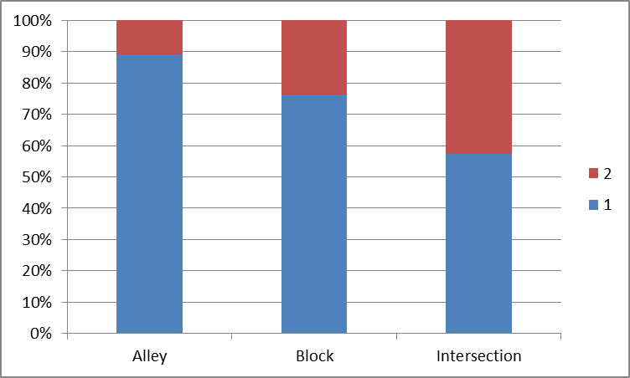
Exploratory analysis
The severity of accidents varies quite a bit for different accident locations
The accidents at the intersection is relatively more severe

Slide 7
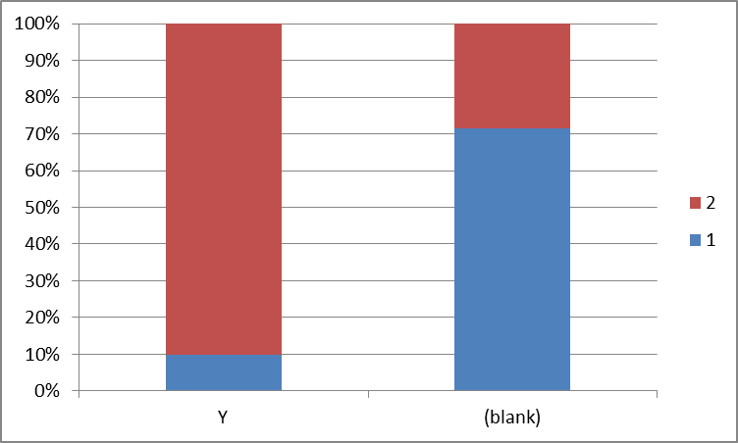
Exploratory analysis
The severity of accidents varies significantly whether the pedestrian right of way was not granted
If it was not granted, the accidents is a lot more likely to be more severe

Slide 8
Data prepreation
Data cleaning is essential
One-hot encoding for categorical variables
Split of training data and testing data in 75%/25% ratio for model testing

Slide 9
Machine Learning
Classification problem
Models used for testing includes
Logistic regression
Decision tree
Random forest
Support Vector Machines (SVM)

Slide 10
Model evaluation
Logistic regression and SVM give relatively better results for prediction

Slide 11
Conclusion
Machine learning models can be applied to use several features to predict the severity of traffic accidents
The models can be further enhanced with more data collected and more fine-tuning of parameters

