Slide 1

Coursera IBM Data Science Capstone Project
KM Fong
Dec 2019

Slide 2

When East meets West…
Canada is one of the most popular places for immigration for Hong Kong citizens. The Chinese Canadian population has been growing since 1960s due to the changes in immigration law and political issues in Hong Kong. The Chinese has established many shops and restaurants to cater their population. As the capital of the province of Ontario, many immigrants favor Toronto as their port of entry. In this project, we would be finding the neighborhood with the best Chinese restaurants in Toronto. This would be valuable for newcomers joining the community who prefer Chinese food.

Slide 3

Data collection
Toronto city data that contains list Boroughs, Neighborhoods along with their latitude and longitude.
Data source : http://cocl.us/Geospatial_data, https://en.wikipedia.org/wiki/List_of_postal_codes_of_Canada:_M
Description : The Wikipedia page includes the postode, borough, and neighbourhood. And geocodes will be obtained from the geospatial_data. After combination, we will use this data set to explore various neighborhoods of Toronto city. Chinese resturants in each neighborhood of Toronto.

Slide 4
Data collection
Foursquare API
By using this API we will get all the venues in each neighborhood. We can filter these venues to get only Chinese restaurants.
City of Toronto Neighborhood Shapes for mapping
Data source : https://www.google.com/maps/d/u/0/viewer?msa=0&mid=1uclm6-D3MSanesned1rQCnzJtws&ll=43.71277641798449%2C-79.49240235858218&z=10
Description : By using this data we will get the Toronto neighbourhood boundaries that will help us visualize choropleth map. (KML converted to geojson file)

Slide 5
Approach
Collect the Toronto data from http://cocl.us/Geospatial_data
Using FourSquare API we will find all venues for each neighborhood.
Filter out all venues that are Chinese Restaurants.
Find rating , tips and like count for each Chinese Resturants using FourSquare API.
Using rating for each restaurant , we will sort that data.
Visualize the Ranking of neighborhoods using folium library(python)

Slide 6
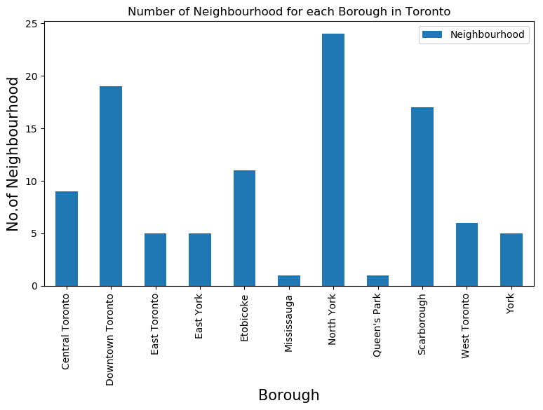
Analysis of the city
We see that North York has highest number of neighborhoods

Slide 7
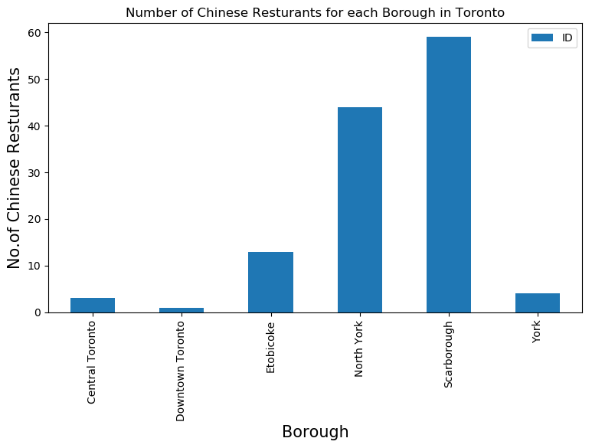
Chinese restaurants in the City
Scarborough is the borough with the largest number of Chinese restaurants in Toronto

Slide 8
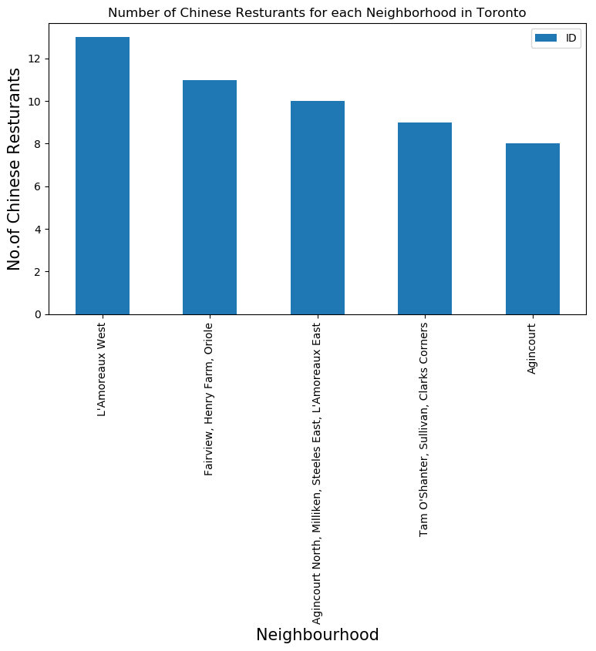
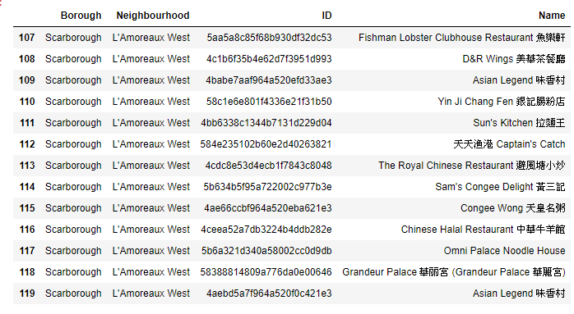
L'Amoreaux West is the neighborhood with the largest number of Chinese restaurants of 13.

Slide 9
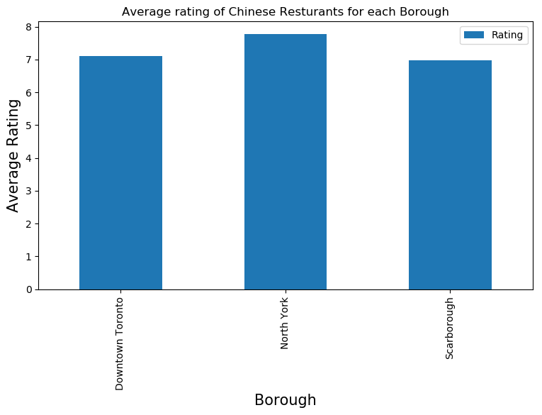
Average rating of Chinese restaurants
North York has the highest average rating of Chinese resturants

Slide 10
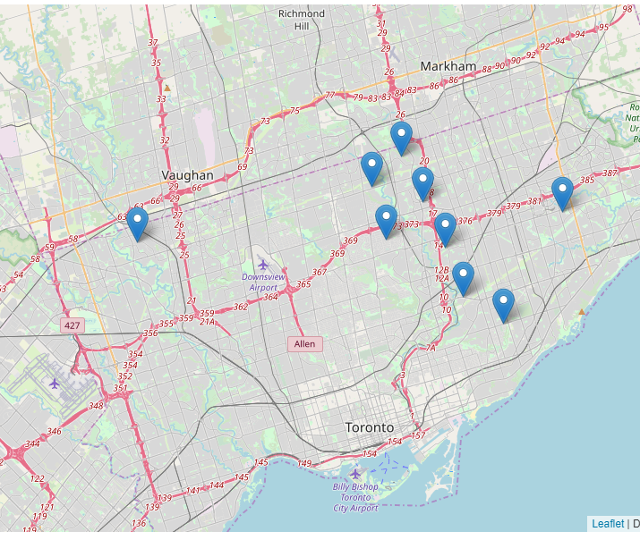
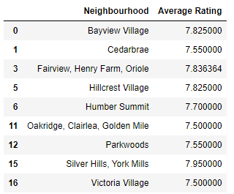
Neighborhoods
With Chinese restaurants average rating greater than 7.5

Slide 11
Discussion
Toronto is a city with plenty of Chinese restaurants available.
Most of the restaurants are in Scarborough with average rating > 7.5.
Scarborough is the third largest borough in terms of neighborhood.
Bayview village is the neighborhood with the highest average rating of Chinese restaurants.
I would recommend people who enjoy Chinese food to visit Bayview village

Slide 12
Conclusion
This study summarizes the location and rating of Chinese restaurants in Toronto.
It is recommended to visit Bayview village for people who enjoy Chinese food.

