Slide 1
Never work again – Tools for financial freedom
Lars von Fromberg & Cornelius Koller
Notes:
1

Slide 2

Introduction
Source of image: Stux from pixabay.
Notes:
2

Slide 3
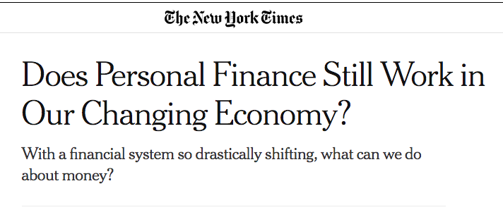
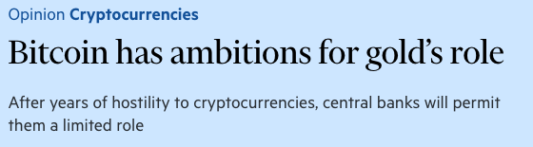
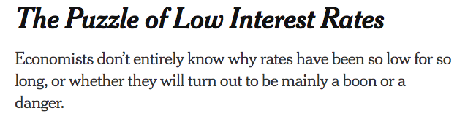
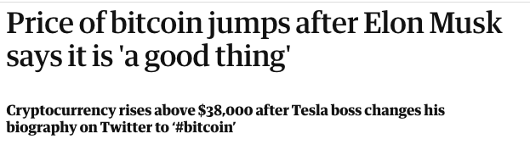
Transformation of the Financial world, and…
https://www.ft.com/content/625fbd5a-d90c-434f-998d-5e0eeb4c0f71
https://www.nytimes.com/2020/01/23/smarter-living/does-personal-finance-still-work-in-our-changing-economy.html
https://www.nytimes.com/2020/12/04/business/low-interest-rates-puzzle.html
https://www.theguardian.com/technology/2021/feb/01/price-of-bitcoin-jumps-after-elon-musk-says-it-is-a-good-thing
Source of content: New York Times, Guardian, Financial Times
Notes:
Whole Financial World is changing. New investment opportunities (e.g. bitcoin) are emerging, while conservative investment strategies get under pressure (e.g. through low interest rates). How trustworthy are these new opportunities?
Source of content: Own thoughts
3

Slide 4
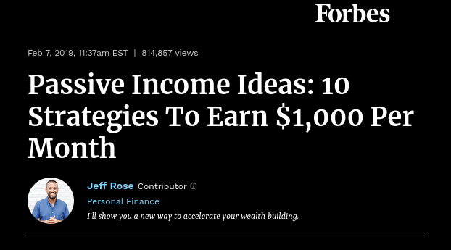
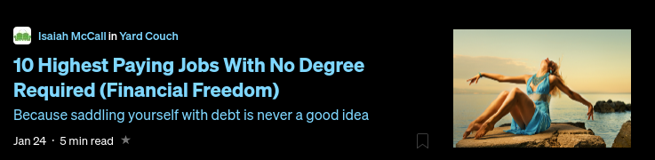
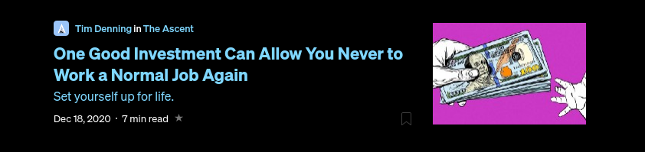

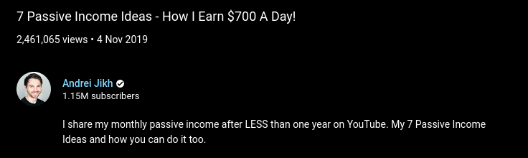
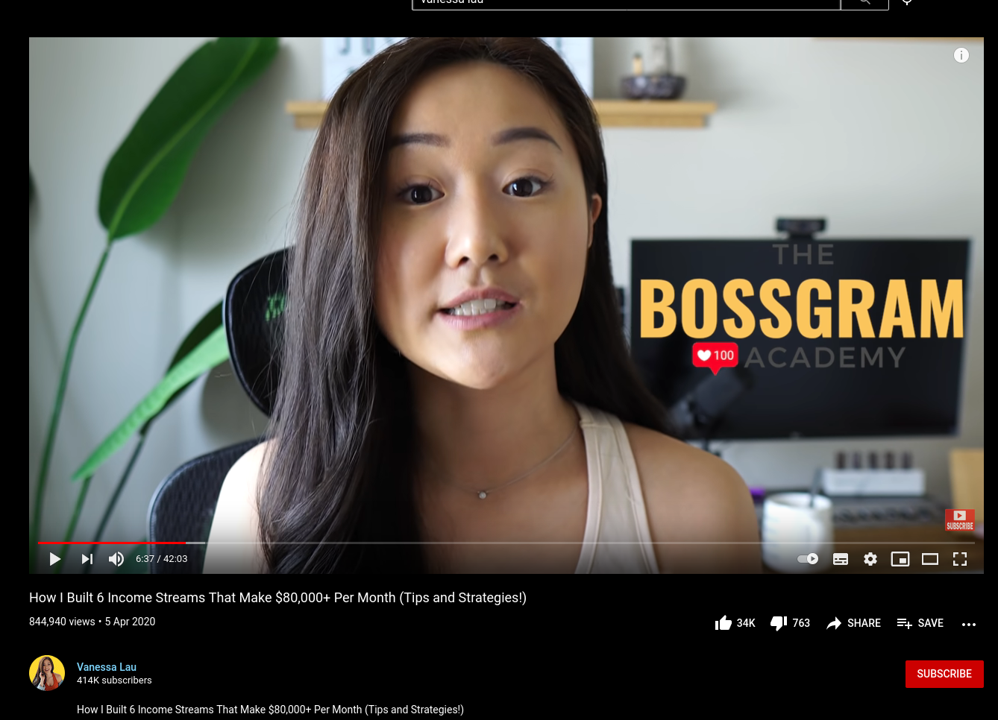
apparently, everybody wants (you) to get rich
https://bit.ly/2LiFhcx
https://www.forbes.com/sites/jrose/2019/02/07/ passive-income-ideas-2019/
https://bit.ly/2YI89xN
https://bit.ly/2LhhHwG
https://www.youtube.com/watch?v=D0oB4aZsz6c
https://www.youtube.com/watch?v=rfb3gpNsy-4
Source of content: medium.com, forbes.com, youtube.com, businessinsider.de
Notes:
The internet is full of more or less competent advice on how to get rich one way or another. The screenshots here are from relatively serious publications like forbes, business insider or medium. But also from YouTube.
This spawn
Source of content: Own thoughts
4

Slide 5
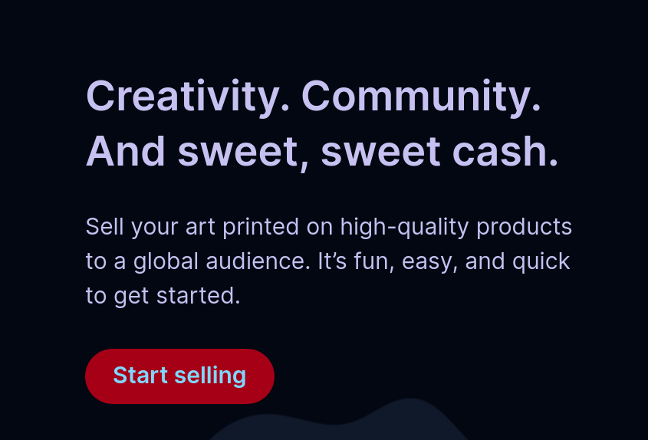
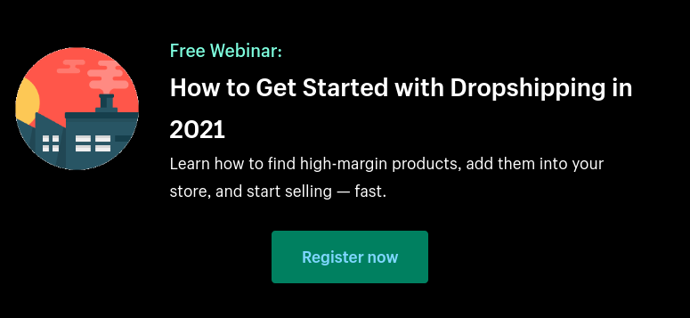
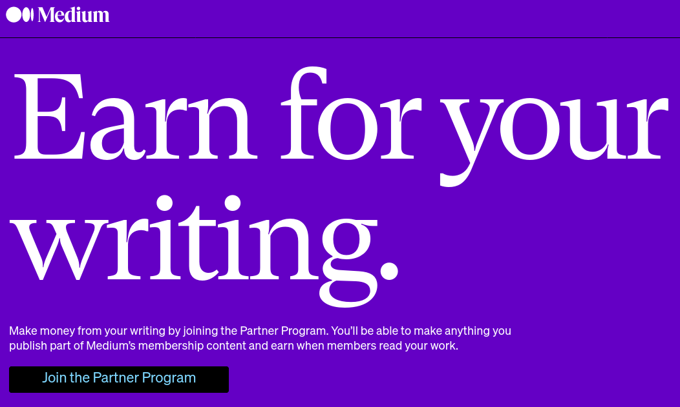
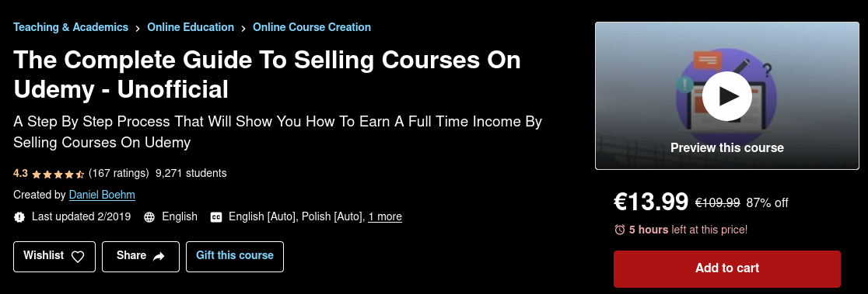
You could invest your time...
Or both, see next slide
Source of content: medium.com/earn, www.redbubble.com/about/selling, www.shopify.com/blog/dropshipping-niches, www.udemy.com/course
Notes:
There exist several to “earn money on the internet”. These mostly include blogging / writing, selling digital products like courses or niche physical products. The latter include print-on-demand shops,
art-related things or dropshipping.
Source of content: Own thoughts
5

Slide 6


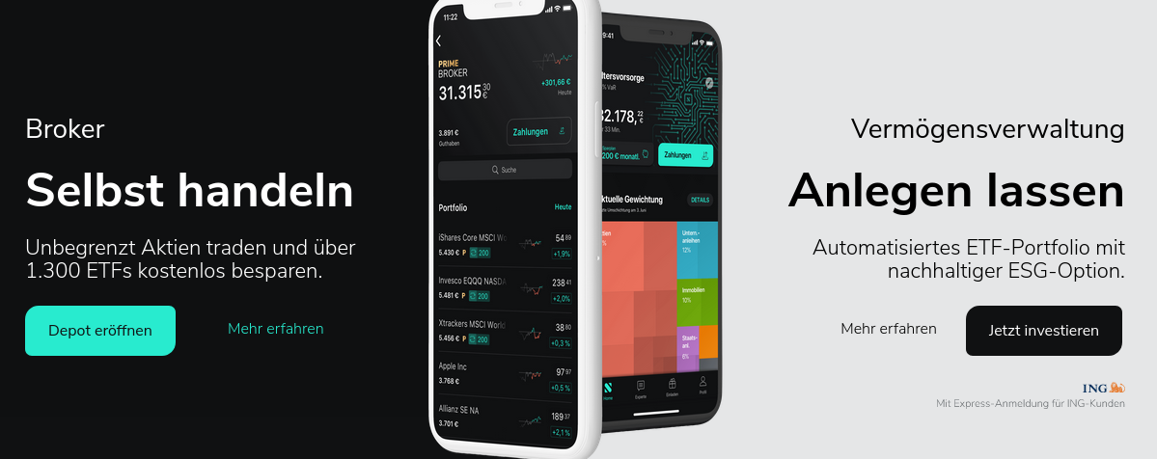
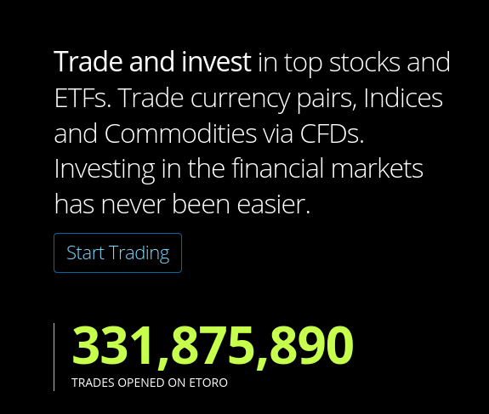
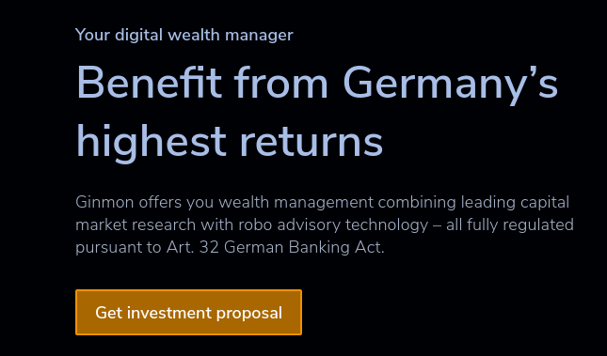

... or your money
Source of content: robinhood.com, wealthfront.com, https://de.scalable.capital, etoro.com, ginmon.de, deutsche-bank.de
Notes:
An astonishing amount of different offerings regarding personal wealth management by robo-advisory and online brokers appeared on the market in the last few years. These screenshots show a small excerpt.
6

Slide 7
Initial clustering of Fintech Services
StashAways
Robinhood
Automated AirBnb**
ginmon
eToro
Coinbase*
Kraken*
Etsy
Redbubble
Betterment
Public.com
Scalable Capital
Dropshipping**
Trade Republic
E-Trade
Yieldstreet
Online Ads**
Medium
Estimize
WealthFront
growney
Fidelity
Ameritrade
Collectable
Doorvest
Portfolio Management
Market Access
e.g. Brokers
Non-stock exchange Passive Income
* Crypto currency broker **Technique, not a company name;
Source of content: Own thoughts and memory, General internet search
Notes:
In my opinion, education is changing. While, for example, in the past, and in some cases even today, degrees are still essential, in the future, credentials will become more important than degrees. Specifically, personal recommendations can be more valuable in telling whether someone is suitable for a job than degrees obtained at a university.
Source of content: Own thoughts
7

Slide 8
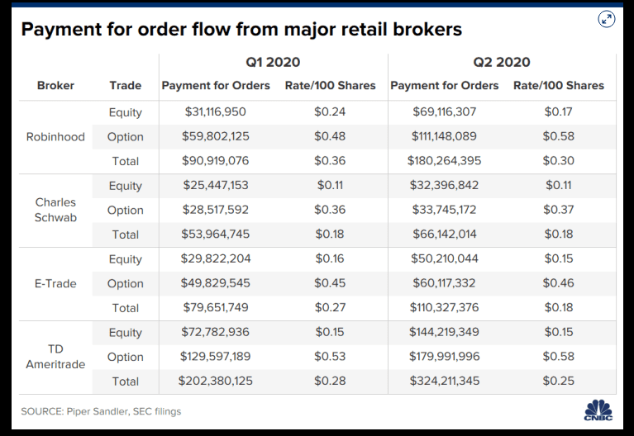
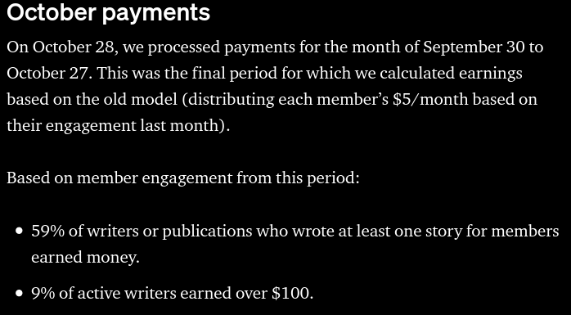
No Free Lunch
‘No direct commission’ does not mean ‘free’.
‘earning money’ does not mean ‘living wage’.
Source of content: https://www.cnbc.com/2020/08/13/how-robinhood-makes-money-on-customer-trades-despite-making-it-free.html https://blog.medium.com/october-update-from-the-partner-program-f6cf8216a6d8
Notes:
However, there are several caveats to all of this.
For example, most “commission-free” brokers earn a majority of their income through order-routing, receiving a commission from the order recipient. Therefore, the broker has a hidden incentive to promote products with hire routing commissions and the user probably pays for the service via increased quote prices.
In the “invest your time”-sphere of passive income, there is a huge leap between earning a bit of cash on the side and actually living off of it. Opportunity cost may to taken into account.
8

Slide 9
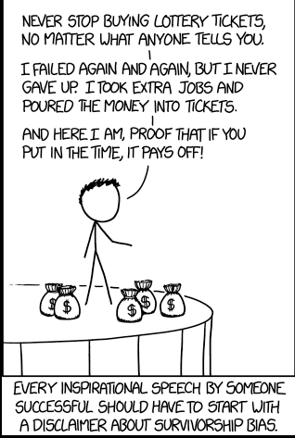
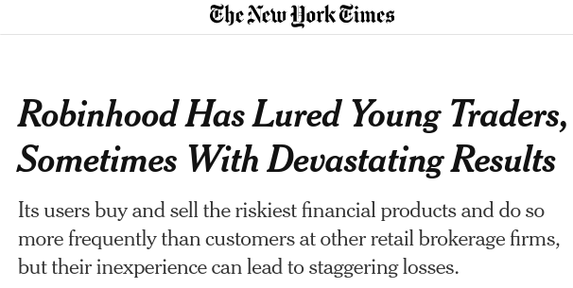
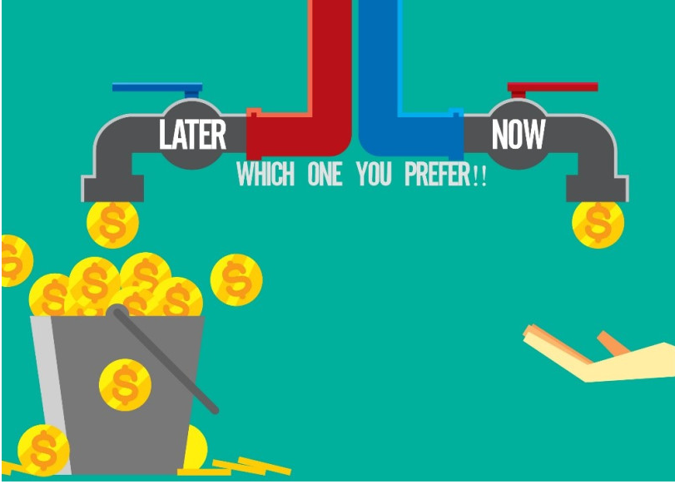
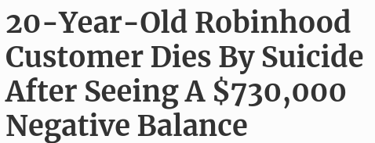
New tech, old biases
Survivorship Bias
Deferred Gratification
Media Coverage of unfortunate events related to Robinhood trading
Retail Investors usually lose money in day-trading (Malinova et. Al 2013)
A study on day traders in Taiwan found that less than 1% of traders actually can reap abnormal returns in a predictive and reliable manner (Barber et al. 2014)
Source of content: https://xkcd.com/1827/, https://idyahive.com/2017/07/14/delayed-gratification-path-to-riches/, https://www.nytimes.com/2020/07/08/technology/robinhood-risky-trading.html, https://www.forbes.com/sites/sergeiklebnikov/2020/06/17/20-year-old-robinhood-customer-dies-by-suicide-after-seeing-a-730000-negative-balance/ Malinova, K., Park, A. & Riordan, R. (2013) Shiftings Sands: High Frequency, Retail and Institutional Trading Profits over Time Barber. B.M., Lee, Y., Liu, Y., & Odean, T. The cross-section of speculator skill: Evidence from day trading

Slide 10
<Influencer marketing, Youtube channel etc. downsides here>

Slide 11
Hypotheses
Source of image: Stux from pixabay.
Notes:
11

Slide 12
Hierarchy of Hypotheses
Users over-trade, racking up fees
Users under-diversify, racking up risk
Users choose inappropriate strategies for their specific situation
Users overestimate their understanding of markets
Users do not choose efficient-frontier portfolios
Users waste resources on ultimately unsuccessful efforts
Users do not pick the right option for themselves
Source of content: Own thoughts; Source of graphic: Own graphic
Notes:
In my opinion, education is changing. While, for example, in the past, and in some cases even today, degrees are still essential, in the future, credentials will become more important than degrees. Specifically, personal recommendations can be more valuable in telling whether someone is suitable for a job than degrees obtained at a university.
Source of content: Own thoughts
12

Slide 13
Tool & Bias Navigator
Source of image: Stux from pixabay.
Notes:
13

Slide 14
The right tool for the job
Acquire Information
Generally explain cognitive biases
Weight & match biases according to user information
Recommend Tools / Techniques for a given user
Examples:
Examples:
Examples:
Examples:
Investment
Knowledge
Confirmation Bias → Are you looking for stock info that supports your guess?
”I want to get rich asap”
→ Deferred Gratification
Impatient people get no-interaction robo advisors, that force them to keep their hands off
Current Lifestyle
“I have no idea of stocks” → Dunning-Kruger effect
Current Wealth
Sunk Cost Fallacy → Are you investing further because the stock “can only go up from here”?
“Celebrity XY is so successful” → Survivorship Bias
Extremely risk-averse are recommended an ETF portfolio in order to achieve low-risk yields
“I don’t need retirement planning” → Plan continuation fallacy
Dependents
“My investment strategy doesn’t need an update” → Hot-hand fallacy
Time Horizon
Hyperbolic Discounting →Do you value cash at hand more than future opportunities?
Experienced traders may be recommended a low-fee brokerage service
Individual Goals
“I always hold” →Disposition effect
Source of content: Bias examples: own thoughts; Own illustration; Biases taken from https://en.wikipedia.org/wiki/List_of_cognitive_biases
Notes:
In my opinion, education is changing. While, for example, in the past, and in some cases even today, degrees are still essential, in the future, credentials will become more important than degrees. Specifically, personal recommendations can be more valuable in telling whether someone is suitable for a job than degrees obtained at a university.
Source of content: Own thoughts
14

Slide 15
The Antithesis
Source of image: Stux from pixabay.
Notes:
15

Slide 16
Explain Bias Exploitation
To emphasize the impact of (potential) biases, we build an inverse Tool selector which depicts the answer to “how to best exploit this user?”.
Acquire User Information
Infer potential biases
Weight potential biases
Determine the “worst” tool
Users are different, therefore it’s important to gauge which biases they may be impacted by
→ I am young, energetic and willing to take risks
User information may point to certain biases which then may point to certain investment behaviours like seeking leverage
→ I am impatient, I seek leverage to speed things up
Different biases “hit harder” depending on the business model behind an offering
→ If I profit off selling options, I have an interest to sell to people who seek leverage.
Contrary to the best tool,
There is potentially also a worst tool, that perfectly exploits the users biases
→ An impatient person may generate the most revenue if lead to very frequent trading
The core idea is to emphasize the “No Free Lunch Theorem”. Everyone offering something has their own agenda, which may infer with a given users goals.
Source of content: Own thoughts; Own illustration
Notes:
In my opinion, education is changing. While, for example, in the past, and in some cases even today, degrees are still essential, in the future, credentials will become more important than degrees. Specifically, personal recommendations can be more valuable in telling whether someone is suitable for a job than degrees obtained at a university.
Source of content: Own thoughts
16

Slide 17
Summary
Pro-user interpretation
Sharpen user’s understanding
Individual User
Individual Biases
Anti-user interpretation
By highlighting both sides of the coin, we can enhance the user’s understanding in a way that classic sales-oriented tool recommenders by design can not.

Slide 18
Checklist
Source of image: Stux from pixabay.
Notes:
18

Slide 19
Please check the following bullet points before presenting
Does every slide utilize the font type Arial?
Do I stick to the guidelines concerning font size etc. (see slide 2)?
If I use another background color (e.g. black, green, etc.), which we encourage, have I used an element on the slide for this and not changed the background in the master?
Is all information in the footer removed (e.g., date, page number, session, presenter)?
Does every slide contain information on both image and content source (i.e., each slide must name at least one source – possibly “own illustration”)?
Are all sources added to the comment section as well?
Does each slide contain several concise sentences on what you would say when explaining this slide in the comment section, i.e. the “soundtrack” of each slide?
Are all my slides visually attractive, cool and creative?
Notes:
19

